Slide 1
Nurture Joy
Group Members
Kamamo Lesley – 8984971
Abdullahi Mohamed - 9082466
Albright Maduka - 9053136
Andrew Silveria - 5077086

Slide 2
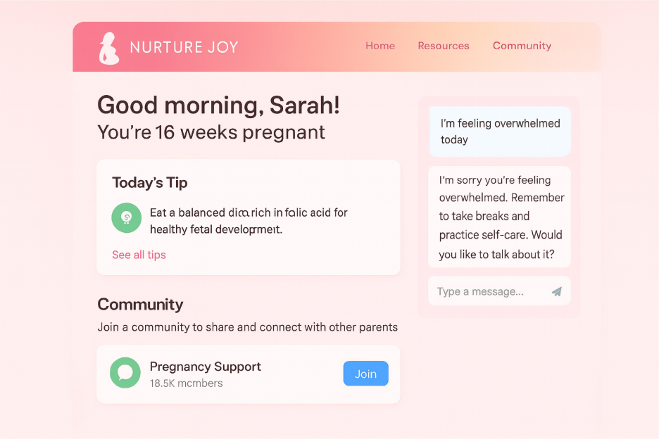
Introduction
AI-Enabled Emotional & Pregnancy Support Platform

Slide 3
Vision
Every mother receives individualized, knowledgeable, caring support—anytime, anywhere.
Mission
A safe digital platform using Machine Learning to support expectant mothers and clinicians (non-diagnostic).

Slide 4
Purpose
NurtureJoy aims to bridge gaps in emotional support, early risk awareness, and safe community access for expectant mothers using ethical, non-diagnostic artificial intelligence

Slide 5
Problem Statement
Lack of timely emotional support, insights, and safe communities for pregnant women.

Slide 6
Strategy
Create an emotional well-being chatbot for pregnant users, leveraging NLP to categorize free-text reflections into emotional sentiments and provide supportive, non-clinical feedback.

Slide 7
Tactics
Define emotional sentiment categories relevant to pregnancy (e.g., positive, neutral, stressed, anxious, overwhelmed)
Identify and prepare publicly available mental-health or emotion-labeled text datasets
Clean and preprocess text data (tokenization, stop-word removal, TF-IDF vectorization)
Train supervised NLP models (Naive Bayes, Logistic Regression) for sentiment classification
Evaluate model performance using accuracy, precision, recall, and confusion matrices
Design non-clinical, supportive chatbot responses mapped to sentiment categories
Expose the NLP model via a REST API using Python (Flask or FastAPI)
Integrate chatbot functionality into the application UI
Add safety disclaimers and escalation messaging for high-distress categories

Slide 8
1.
NLP-based Emotional Well-being Chatbot with sentiment-aware responses.
Use
Cases
2.
Non-diagnostic Machine Learning Pregnancy Risk Prediction using user-reported health data.
3.
Moderated Community forum with ML-assisted sentiment and safety insights.

Slide 9
Use Case | People | Industry | Economy | Culture
Emotional Well-Being Chatbot | Improves emotional support and mental well-being for pregnant women | Advances AI-driven digital health solutions | Reduces pressure on healthcare systems through early support | Encourages stigma-free emotional expression
Pregnancy Risk Prediction (Non-Diagnostic) | Raises awareness of potential risks and promotes proactive care | Supports data-driven maternal health innovation | Enables early intervention, reducing costly complications | Respects culturally sensitive health decisions
Moderated Community Forum | Provides a safe, supportive peer community | Enhances scalable community moderation using ML | Low-cost support channel for maternal health | Builds inclusive, supportive pregnancy communities

Slide 10
Justification for Use Cases
Emotional Well-Being Chatbot High impact and low risk; technically feasible within a semester using NLP models while delivering immediate emotional support.
Pregnancy Risk Prediction Ethically constrained as non-diagnostic; feasible using structured health data and supports early clinical engagement.
Community Forum Scalable and safe; leverages sentiment analysis to improve community trust while minimizing moderation overhead.

Slide 11

Literature Review
1. Emotional Well-Being Chatbot
Title: AI-Driven Chatbot for Mental Health Support Using Sentiment Analysis
PDF Source Link: https://www.scitepress.org/Papers/2025/138817/138817.pdf
Relevance to the Project:
The researchers developed a sentiment-aware chatbot capable of real-time emotional classification and response generation, designed to assist users who may not have immediate access to mental health professionals.

Slide 12
2. Pregnancy Risk Prediction
Title: Prediction of High-Risk Pregnancy Based on Machine Learning Algorithms
PDF / Source Link:https://www.nature.com/articles/s41598-025-00450-3.pdf
Relevance to the Project:
This research by demonstrates the feasibility of using machine learning to predict pregnancy risks using user-reported health data, aligning with Nurture Joy’s personalized risk awareness feature.

Slide 13
3. Community Forum Support
Title: Text Classification for Assisting Moderators in Online Health Communities
PDF / Source Link: https://pmc.ncbi.nlm.nih.gov/articles/PMC3874858/
Relevance to the Project:
This research shows that machine learning and sentiment analysis can help moderate and prioritize posts in online health communities.

Slide 14
Conclusion
Nurture Joy combines AI, empathy, and safety to enhance maternal well-being.
We will focus on implementing Use Case 1 as the main foundation for the project.

