Slide 1
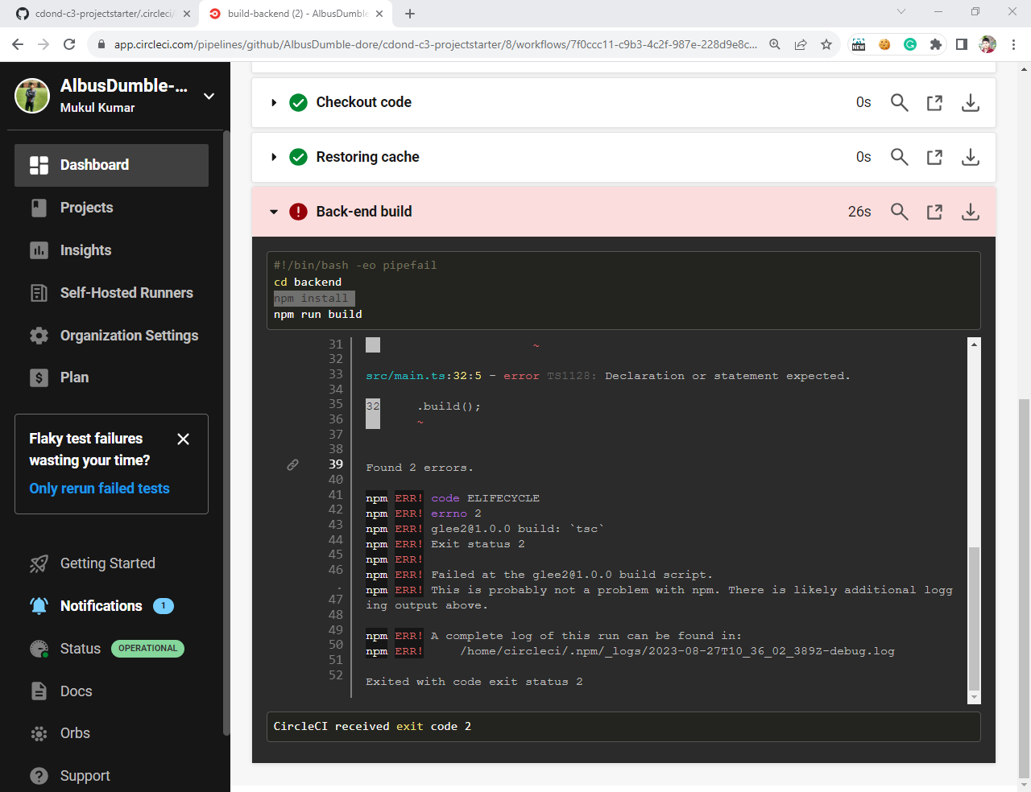
Job failed because of compile errors. [SCREENSHOT01]

Slide 2
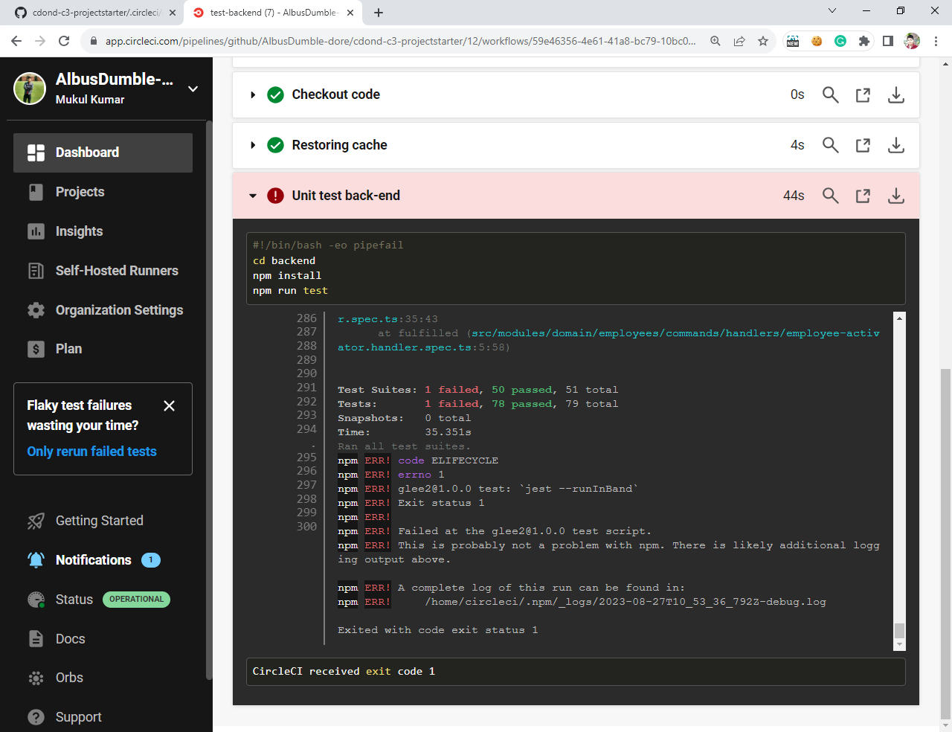
Job failed because of unit tests. [SCREENSHOT02]

Slide 3
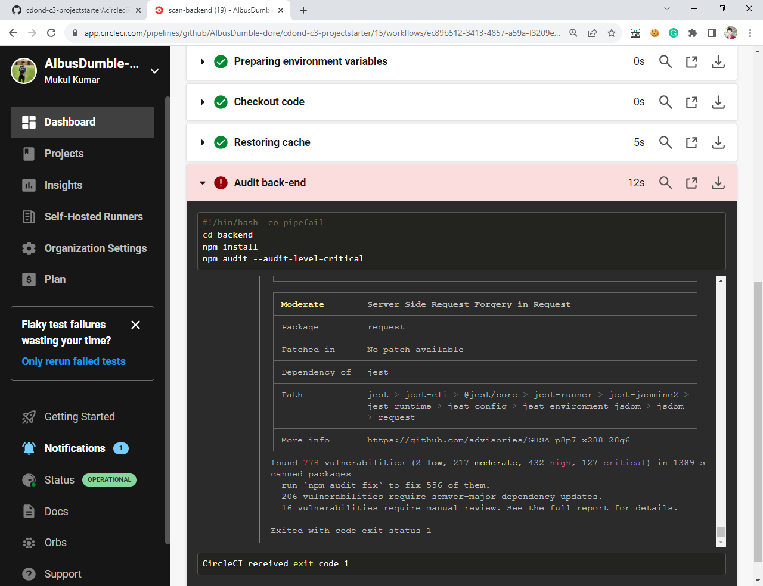
Job that failed because of vulnerable packages. [SCREENSHOT03]

Slide 4
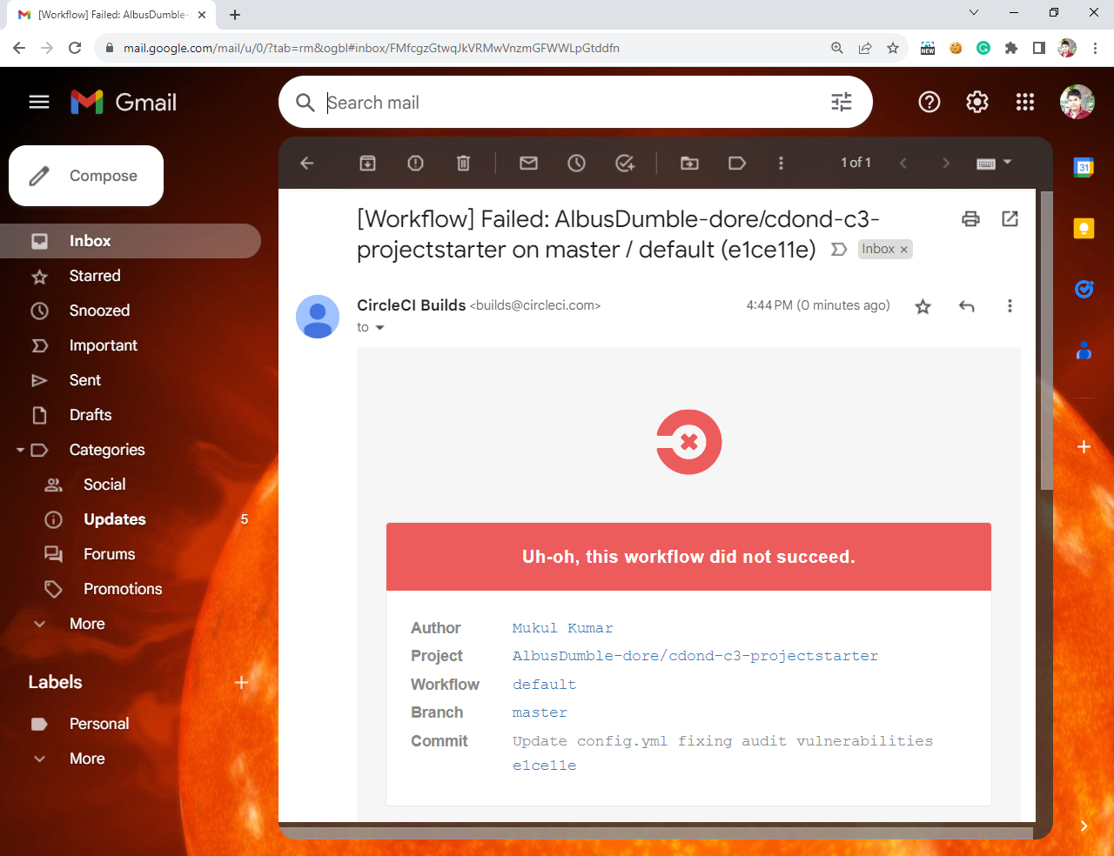
An alert from one of your failed builds. [SCREENSHOT04]

Slide 5
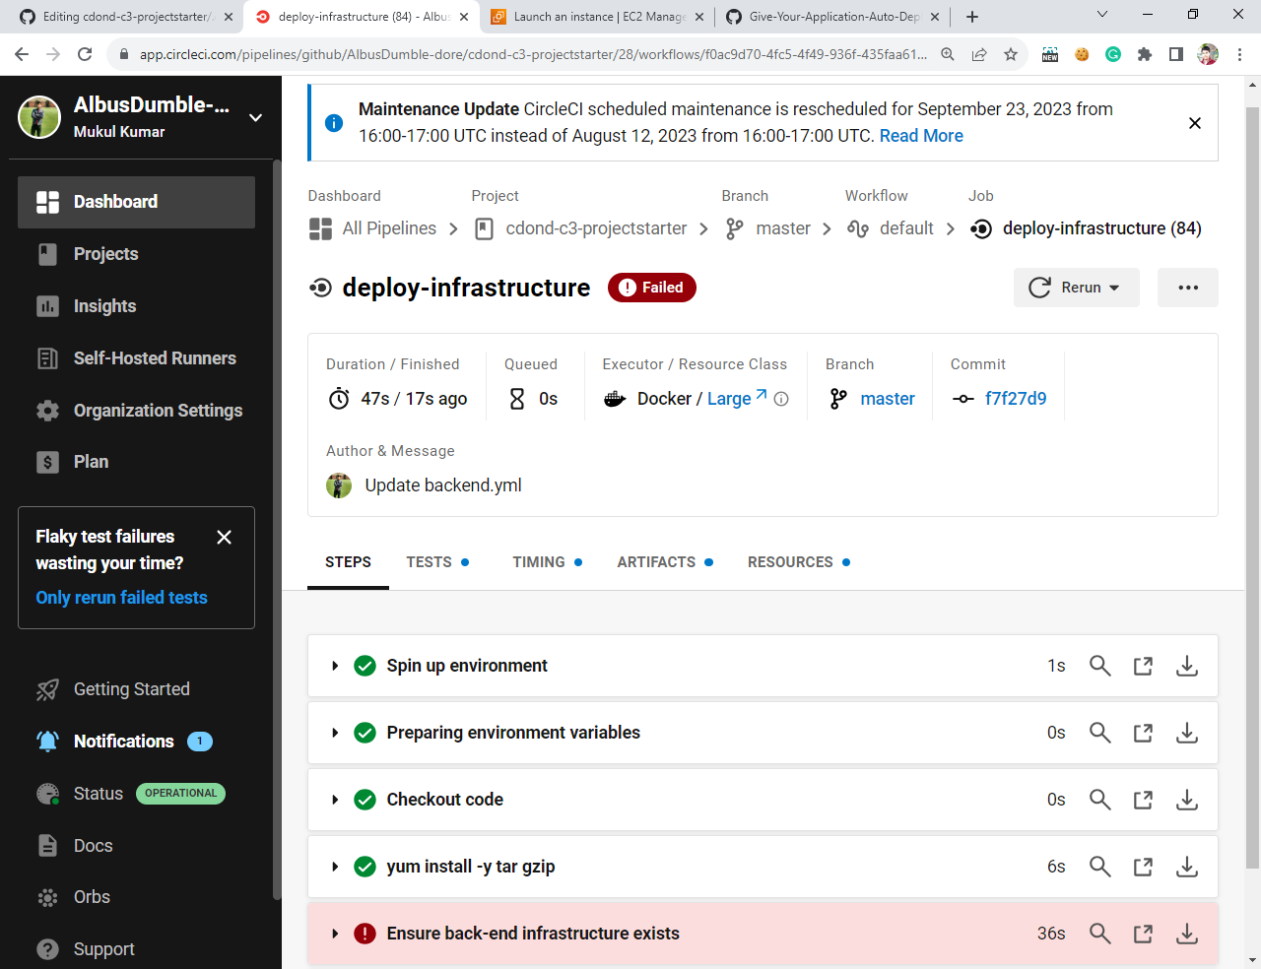
Appropriate job failure for infrastructure creation. [SCREENSHOT05]

Slide 6
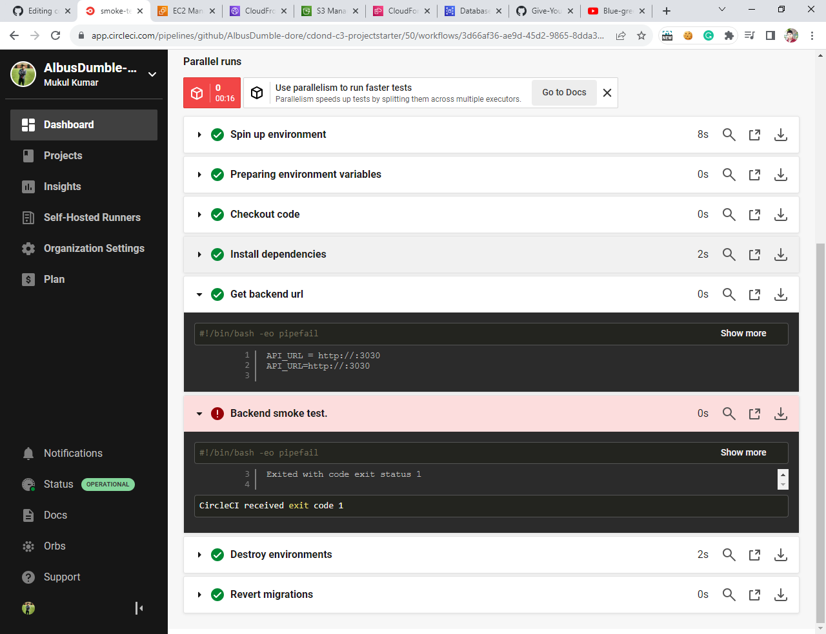
Appropriate job failure for the smoke test job. [SCREENSHOT06]

Slide 7
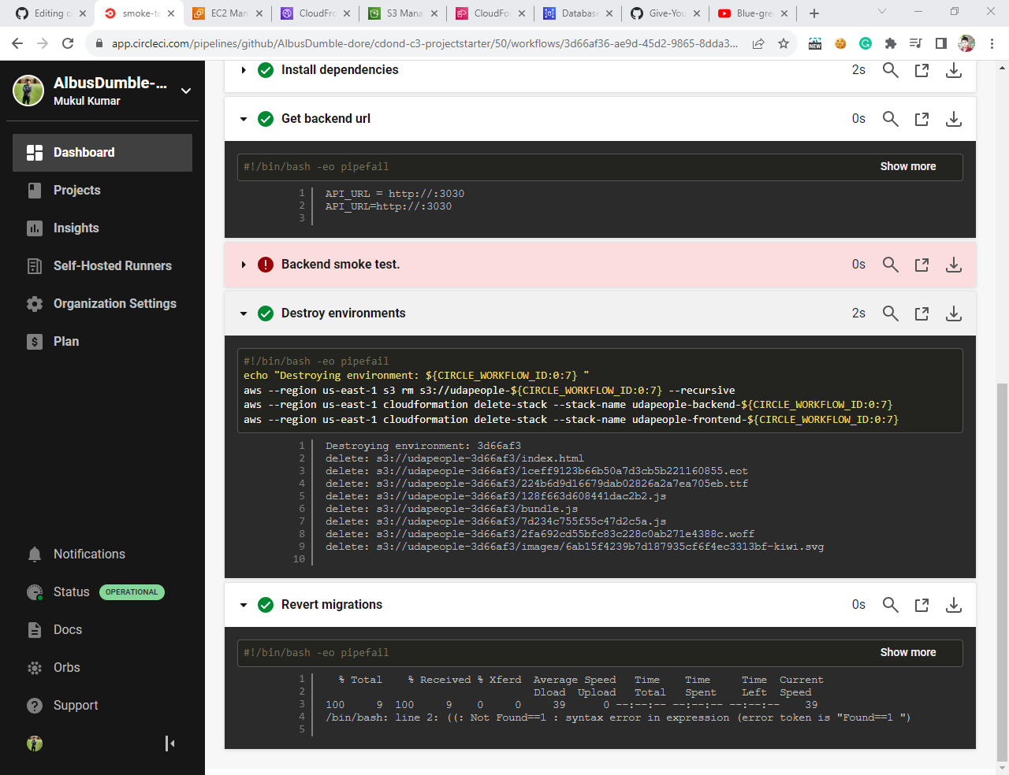
Successful rollback after a failed smoke test. [SCREENSHOT07]

Slide 8
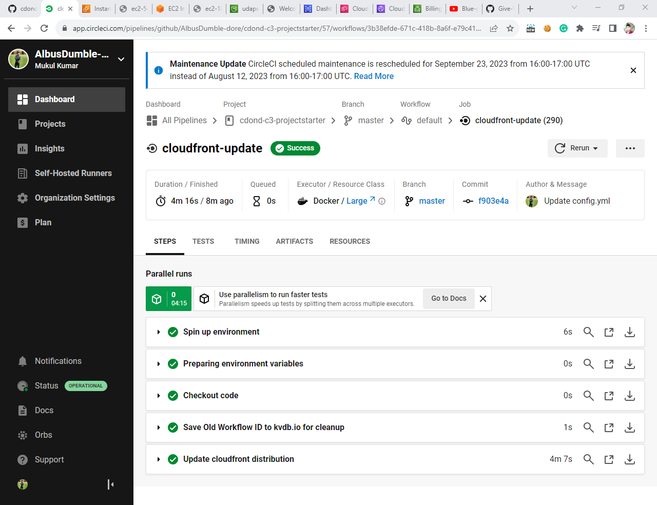
Successful promotion job. [SCREENSHOT08]

Slide 9
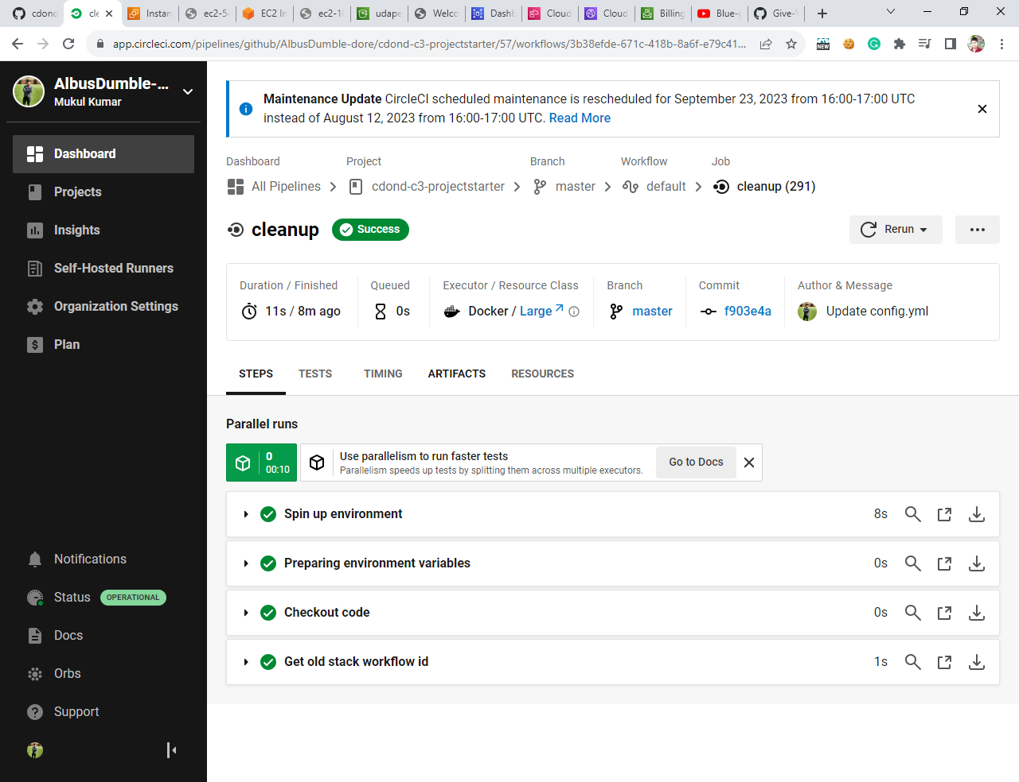
Successful cleanup job. [SCREENSHOT09]

Slide 10
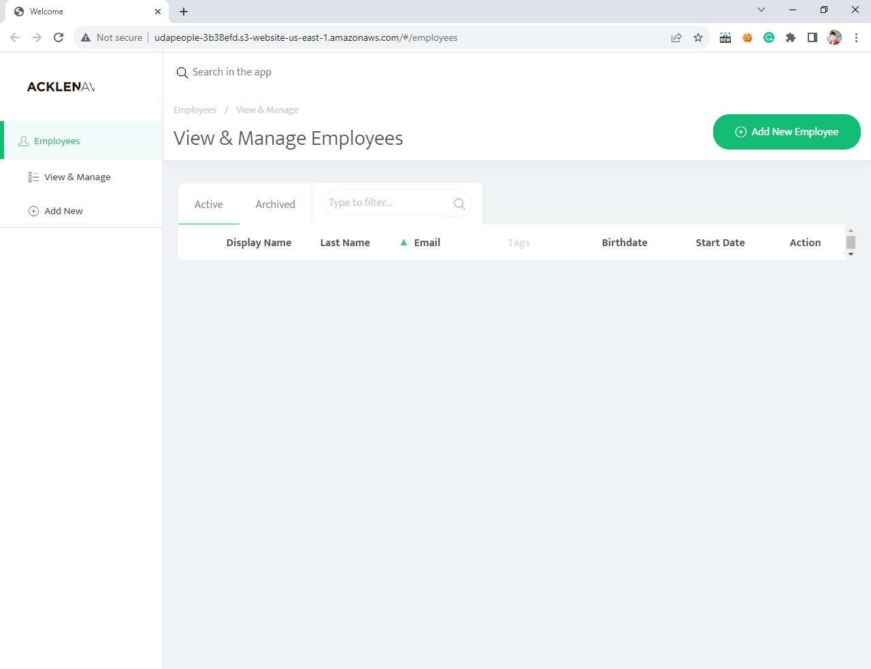

Slide 11
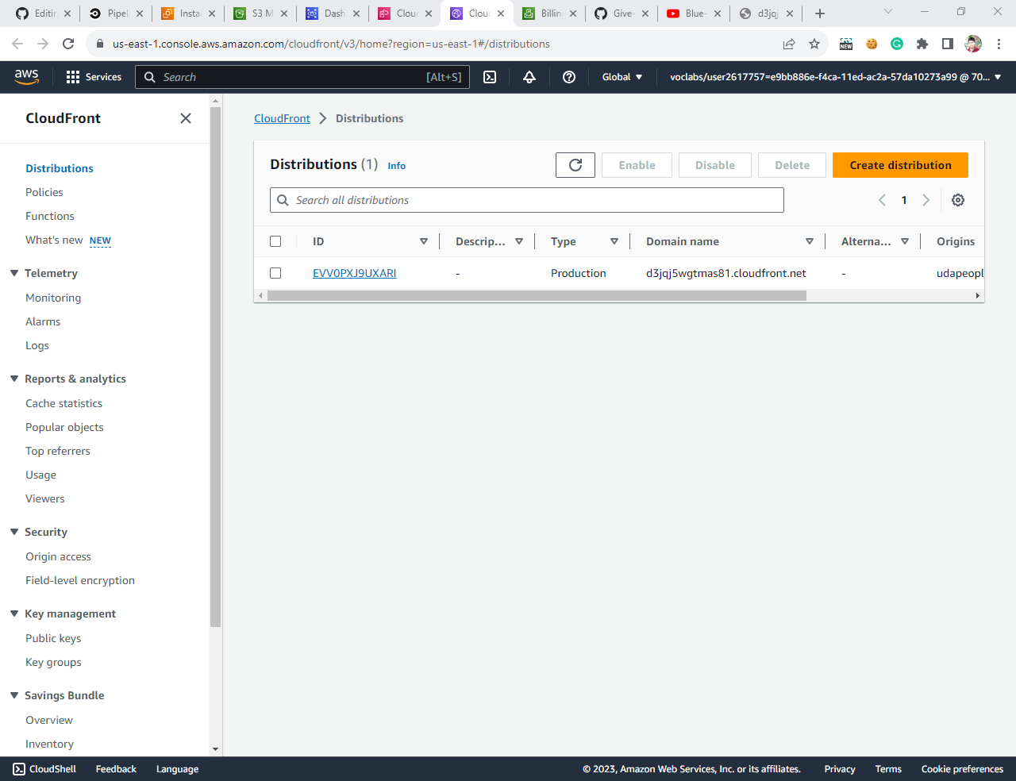
Provide a screenshot showing the evidence of deployed and functioning front-end application in CloudFront (aka, your production front-end). [URL03_SCREENSHOT]

Slide 12
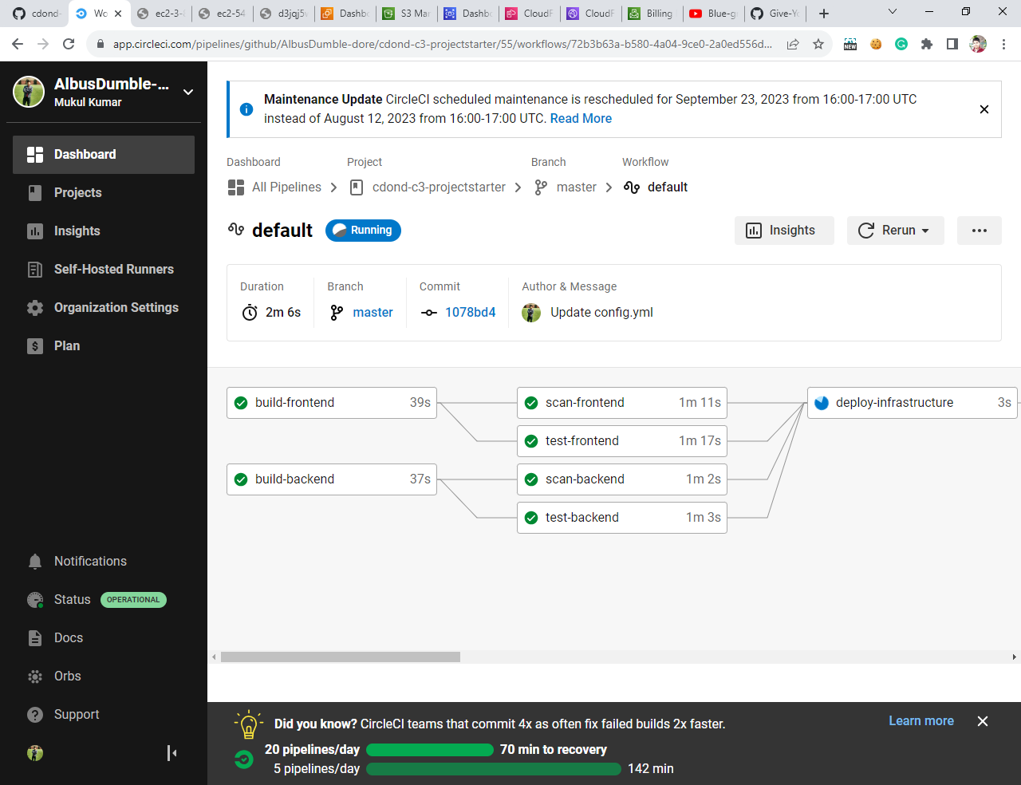
Only deploy on pushed to master branch. [SCREENSHOT10]

Slide 13
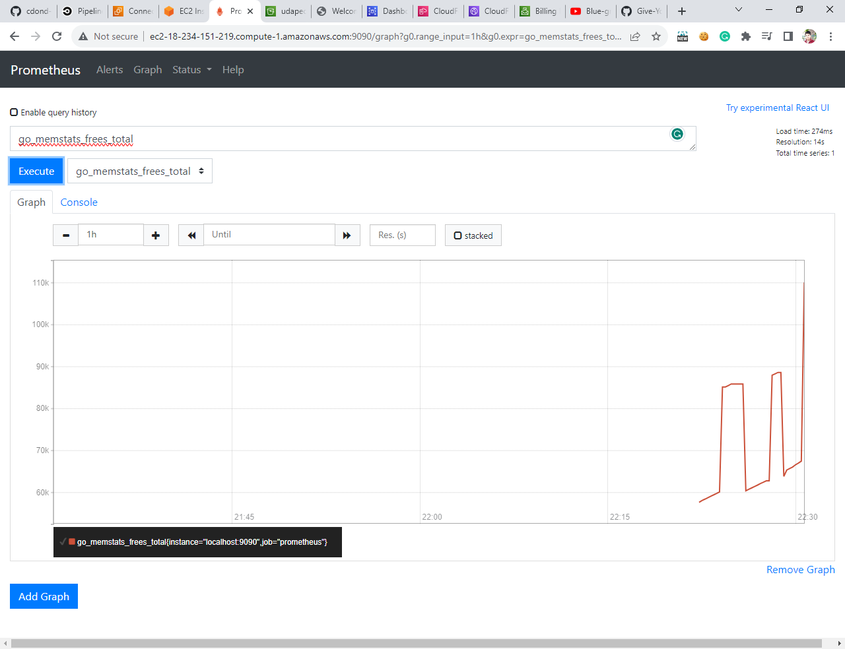
Provide a screenshot of a graph of your EC2 instance including available memory, available disk space, and CPU usage. [SCREENSHOT11]

Slide 14
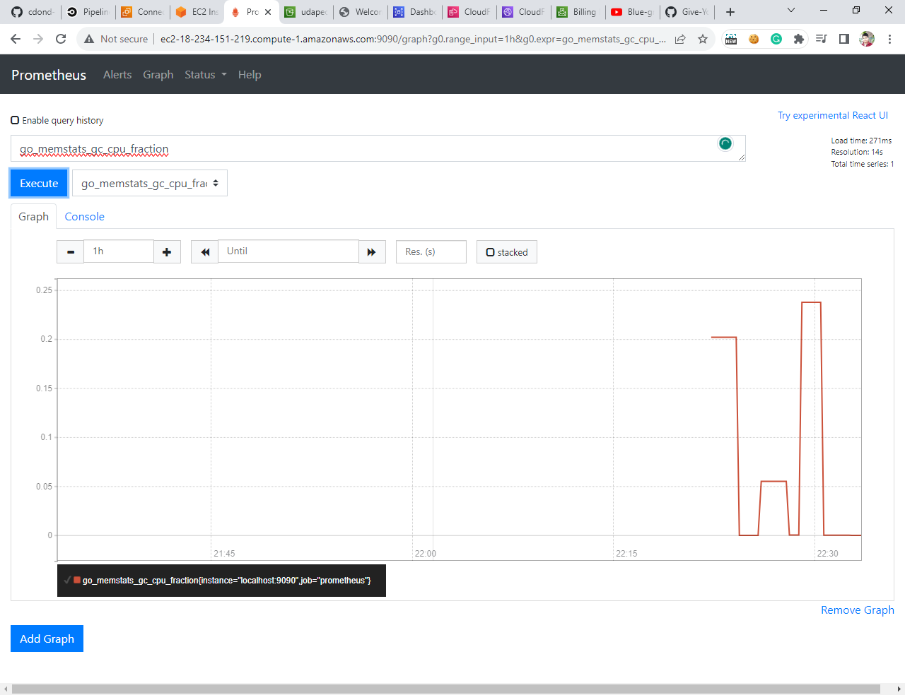

Slide 15
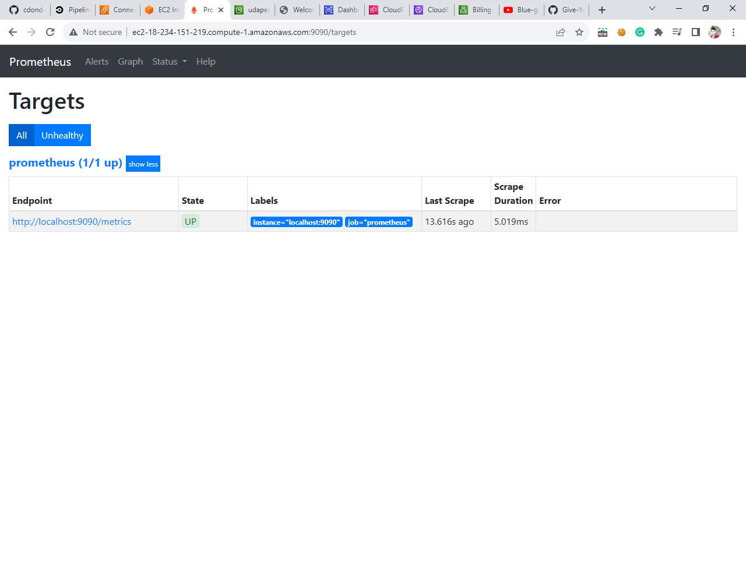
Provide a screenshot of your Prometheus server showing UP state [URL05_SCREENSHOT]

Slide 16
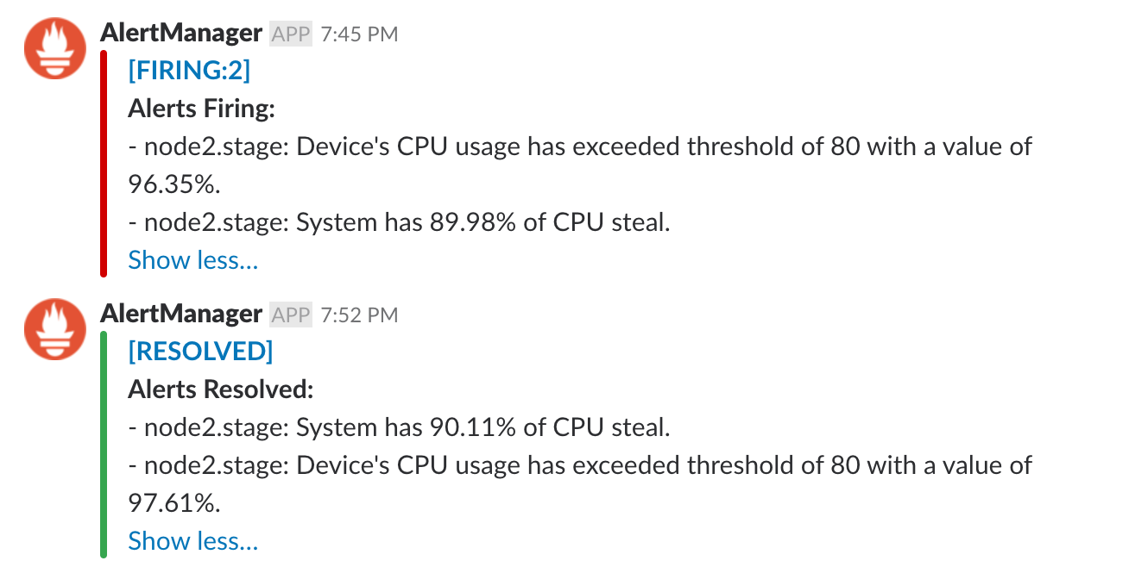
Provide a screenshot of an alert that was sent by Prometheus. [SCREENSHOT12]

