Slide 1

Project Title - Seasonal Agriculture Performance Analysis
Student Name – Ankur Majumder
College Name - University Institute of Technology, BU
AICTE STU ID : STU6a5f6a81933631784638081

Slide 2

PROBLEM STATEMENT
Agricultural activities are influenced by seasonal variations in environmental conditions, farming practices, resource availability and market conditions. As a result, agricultural performance may differ from one season to another.
However, raw agricultural data does not clearly explain how agricultural performance changes across seasons or what patterns can be observed in different seasonal conditions.
The problem is to analyze the given agricultural dataset and investigate seasonal differences in agricultural performance by identifying meaningful patterns, trends, relationships and variations within the available data.

Slide 3
Project Description
This project analyzes an agricultural dataset to investigate how farming performance changes across seasons. By exploring data related to farming practices, environmental conditions, crop production, resource usage, and economic performance, this analysis identifies meaningful patterns, trends, and variations. The primary objective is to evaluate these seasonal differences using data preparation, statistical analysis, and visualization techniques to develop evidence-based insights for agricultural planning.

Slide 4

WHO ARE THE END USERS?
Farmers & Agriculturists: To optimize crop selection based on seasonal yield patterns.
Government & Policymakers: To allocate resources, subsidies, and infrastructure effectively.
Supply Chain Managers: To forecast market supply and manage inventory.
Agronomists & Researchers: To study the impact of climate and seasonal variations on agricultural efficiency.

Slide 5

Technology Used
Google Colab: Cloud-based IDE for executing Python code.
Python: Core programming language.
Pandas: For data loading, manipulation, and cleaning.
NumPy: For high-performance numerical and statistical calculations.
Matplotlib: For creating static, insightful data visualizations.

Slide 6
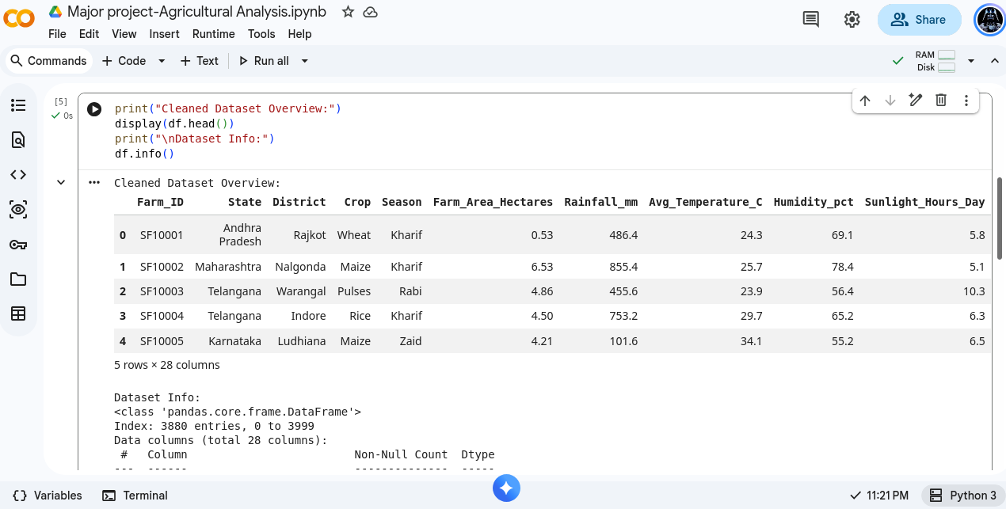
RESULTS
Initializing the analysis………
Cleaned dateset

Slide 7
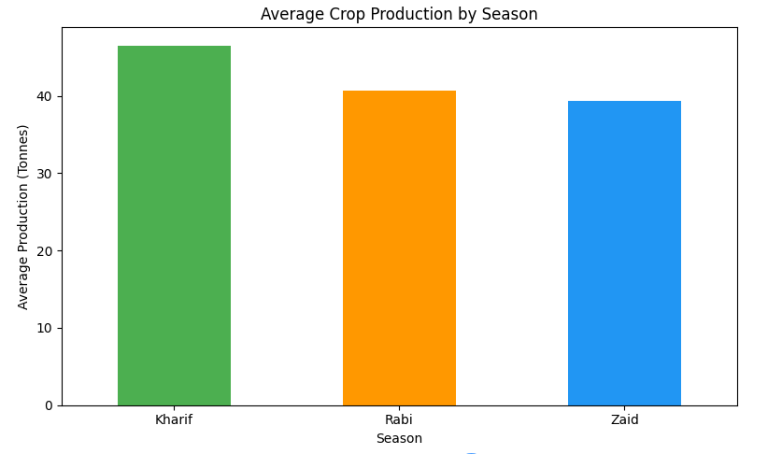
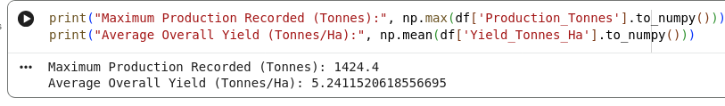
RESULTS
Bar Graph of Average Crop Production
Maximum Production Recorded

Slide 8
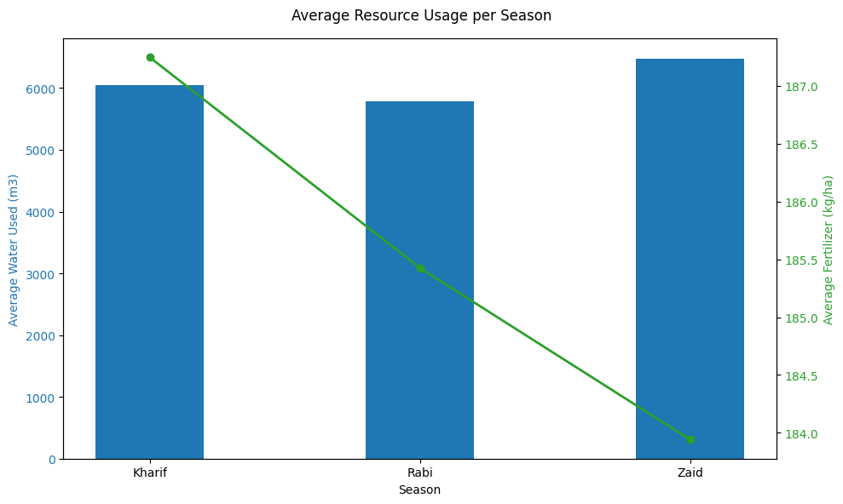
RESULTS
Graph of Average Resource Usage

Slide 9
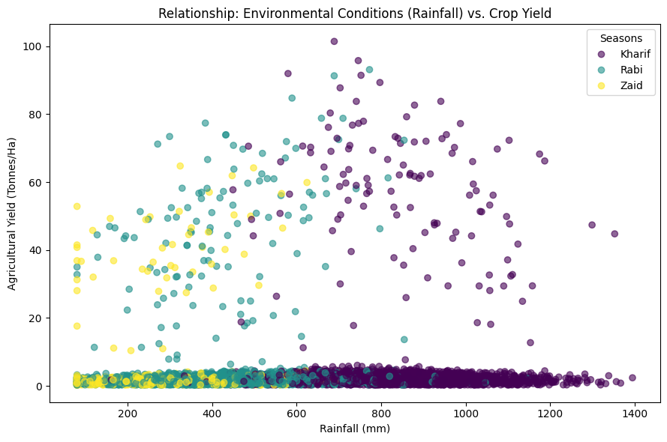
RESULTS
Scattered Graph of Relationship between Rainfall and Crop Yield

Slide 10
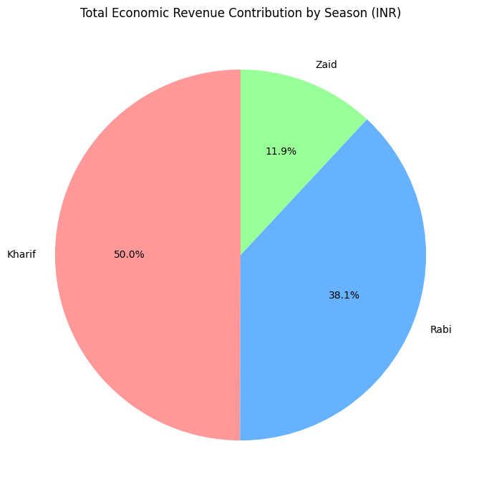
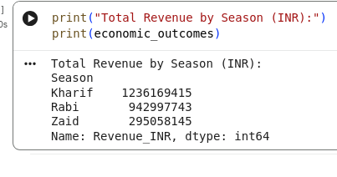
RESULTS
Total Revenue by Season
Pie chart of Total Economic Revenue Contribution

Slide 11
Future scope
Machine Learning Integration: Implementing predictive models to forecast future crop yields based on historical seasonal data.
Weather API Integration: Combining historical agricultural data with real-time climate data for deeper environmental insights.
Interactive Dashboards: Transitioning static Matplotlib charts into interactive web dashboards using libraries like Streamlit or Plotly.

Slide 12
GitHub Link
My github Repository: https://github.com/AlbusKnyght/Seasonal-Agriculture-Performance-Analysis

Slide 13

VOIS Course completion certificate -
Course name- Data Visualization

Slide 14
Thank you
.
.

