Slide 1

The Polarization of Latent Skills in the AI Labor Market
A Computational Social Research Approach
Mergoni Alberto VR542261

Slide 2

Introduction: The Fragmented 'Data Scientist'
The traditional role of the "Data Scientist" is undergoing profound structural fragmentation due to the explosion AI.
What was once a monolithic profession is dividing into hyper-specialized sub-fields.
Research Objective: Uncover and categorize latent professional profiles within the AI labor market based on actual skills demanded by employers using a bottom-up, data-driven approach.
▹
Move beyond a priori occupational classifications (bureaucratic lag).
▹
Analyze socioeconomic nuances
▹
Contribute to sociological discourse on the future of work and high-cognitive labor polarization.

Slide 3


Theoretical Framework
Skill-Biased Technological Change
The Network Society Divide
Building on Acemoglu & Autor (2011), this study posits that technological progress does not disrupt labor uniformly.
Following Castells (2010), the transition creates a sharp divide:
▹
Technocratic Elite: Govern technological infrastructure.
It disproportionately rewards workers with frontier analytical skills while penalizing routine tasks, generating a structural polarization of cognitive labor.
▹
Data Proletariat: Execute ordinary data manipulation (bound to descriptive reporting).

Slide 4
The Problem of Data Validity
Evaluating data validity when using secondary datasets is critical. This study contrasts two distinct sources
 | Dataset A: LinkedIn Data Jobs Dataset | Dataset B: AI Jobs Dataset 2026
 | Empirical sample of ~1,050 unique job postings. | Massive sample size of >50,000 generated observations.
 | Scraped Jan-Apr 2026 (captures temporal volatility). | Fiscal year 2026.
 | Represents the chaotic, unstructured nature of human recruitment. | Highly structured, forward-looking map of the market.

Slide 5






Methodology: Computational Pipeline
1. Data Cleaning
2. TF-IDF Vectorization
3. K-Means Clustering
Standard NLP techniques applied to raw job description texts (tokenization, stop-word removal, lemmatization) to reduce noise.
Operationalizing qualitative text. Weighs the sociological importance of terms (e.g., "data" = low weight; "MLOps" = high weight).
Unsupervised machine learning to discover latent skill groupings without a priori coding bias, determining optimal (k) via Elbow Method.

Slide 6
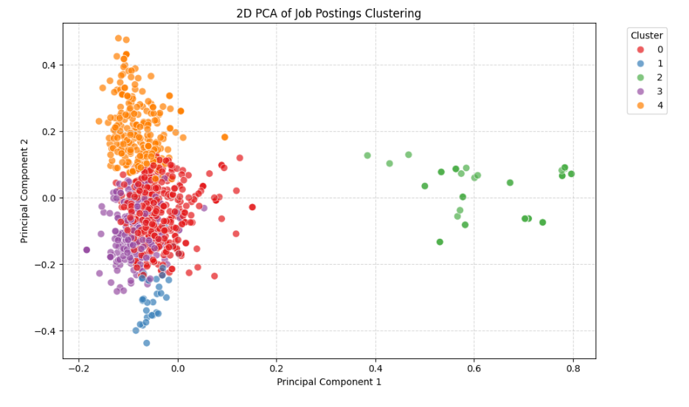
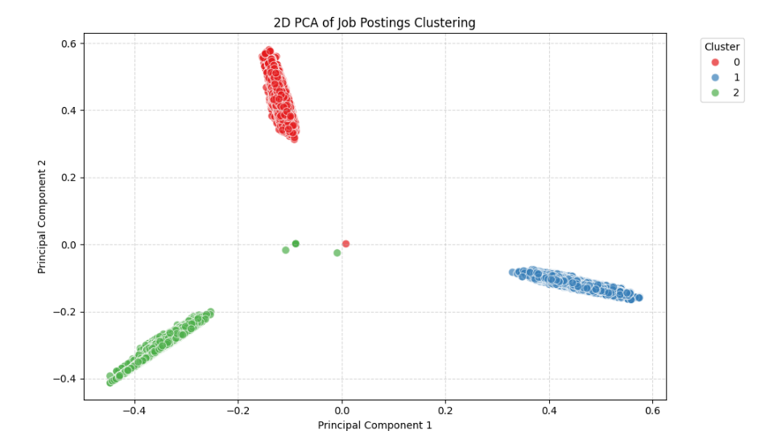
Methodological Critique via PCA
Dataset A: Organic
Dataset B: Synthetic
Exposing Synthetic Data
Principal Component Analysis (PCA) was used to geometrically validate cluster separation and expose artificial structures.
Definitive Empirical Proof
"Dataset B is a synthetically generated LLM simulation, not an organic market reflection."
PCA reveals fluid, overlapping boundaries in organic data vs. rigid, highly artificial boundaries in synthetic data.
Fluid & Amorphous
Revealed overlapping clusters consistent with fluid human language and natural professional role overlap (e.g., Data Analyst vs. Data Engineer).
Perfect & Rigid
Produced geometrically perfect, parallel clusters ("perfect cigars"). Human language never produces such zero-variance artificial boundaries.

Slide 7




Findings: The Organic Fragmentation
Dataset A segmented into five distinct sociological archetypes, reflecting the authentic complexity of tech recruitment.
Cluster 4: MLOps / AI Architect
Cluster 3: BI Analyst
The market frontier. Focuses on 'scale pipelines', 'cloud', 'deployment'. High demand for engineering production infrastructure, not just building models.
The traditional data core. Anchored to 'dashboards', 'SQL'. Legacy roles focused on descriptive business intelligence over predictive engineering.
Cluster 1: Applied Researcher
Clusters 0 & 2: "Big Tech" Corporate
A hybrid profile bridging academic research and business strategy with cutting-edge tools.
Characterized by specific corporate jargon and massive scale requirements (e.g., FAANG). Profiles defined by organizational culture.

Slide 8
The Synthetic Simplification
When applied to dataset B, the clusters collapsed to just three rigid categories:
Idealized & Sanitized Market
The LLM-generated dataset represents an idealized, sanitized version of the future market.
While predicting technical shifts, it ignores the messy reality where advanced AI architects coexist with traditional analysts in organic structures.
MLOps
Software Engineering
Applied Research
The Sociological Failure
It completely failed to capture legacy BI roles and corporate-specific archetypes found in the real world.

Slide 9
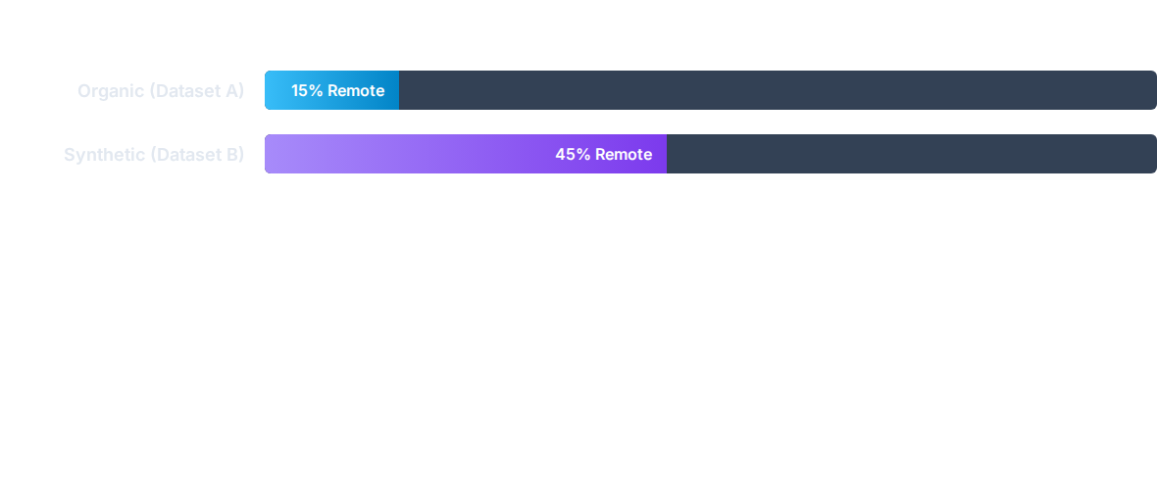
Geographic Reality vs. Remote Utopia
Spatial operationalization revealed a profound divergence in geopolitical labor organization.
Organic Reality
Synthetic Fantasy
Heavily anchored to physical clusters (US, UK, Germany). Real-world AI deployment is bound to corporate headquarters and regional hubs.
Projects a frictionless utopia decoupling cognitive labor from geography, masking persistent technocratic centralization.

Slide 10


Discussion
Inequality of High-Cognitive Labor
Digital literacy is no longer a monolithic metric for social mobility. The market aggressively rewards the technocratic elite (MLOps) while marginalizing traditional, descriptive analytics roles facing automation.
Epistemological Crisis in Digital Sociology
Synthetic datasets construct a double illusion: wage flattening and borderless workforce. Uncritical reliance on massive open-source repositories risks theorizing about computational simulations rather than actual human behavior.

Slide 11
Conclusion
alt_route
Structural Fracture
The market is shifting away from the monolithic "Data Scientist" to fracture into hyper-specialized archetypes, contrasting advanced AI architects against a data proletariat.
architecture
Architecture as Status
Digital literacy alone no longer guarantees social mobility. A worker's socio-economic positioning is now dictated by the specific technological architecture they master.
grain
Organic Frictions
To fully comprehend AI's impact, social science must resist the allure of sanitized datasets and actively investigate the messy, localized, and unequal realities of the workforce.

Slide 12
Bibliography
Dataset A
Social Research LinkedIn Market Analysis Repository
Mergoni, A. (2026). Kaggle Code.
URL:https://www.kaggle.com/code/albertomergoni/social-research-mergoni
Dataset B
Social Research 2026 Standardized Forecast Repository
Mergoni, A. (2026). Kaggle Code.
URL:https://www.kaggle.com/code/albertomergoni/social-research-mergoni-std

