Slide 1
Branch Coverage: Squeezing more out of LLVM Source-based Code Coverage
Alan Phipps, Texas Instruments
2020 LLVM Developers’ Meeting

Slide 2
What is Source-based Code Coverage?
A measurement for how thoroughly code has been executed during testing
Ideally all sections of code have an associated test
Un-executed code may be at higher risk of having lurking bugs
Supported Coverage criteria (in increasing level of granularity)
Function
Percentage of code functions executed at least once
Line
Percentage of code lines executed at least once
Region
Percentage of code statements executed at least once
Notes:
LLVM is “Source-based”, meaning it is tied directly to the source code through Abstract Syntax Trees.
A customer could easily run into a defect in code that isn’t tested. It’s has happened that functions could be left out of test coverage only to blow up in user code.

Slide 3
Basic Phases (High Level)
Counter Allocation and Counter-to-Source
Region Mapping (clang)
Counter Instrumentation
in LLVM IR (clang)
Test Execution
Data Visualization
(llvm-profdata & llvm-cov)

Slide 4
Counter Region Mapping and Instrumentation
Counters are inserted into basic blocks of generated code mapped to source
Counter1 instrumented to track
Region (9:24 → 10:23)
Function (line 9 – foo())
Line (line 10)
Statement: if-stmt
Counter2 instrumented to track
Region (10:18 → 10:25)
Statement (y > 0)
Counter3 instrumented to track
Region (11:0 → 11:12)
Line coverage (line 11)
(Counter1 – Counter3) tracks
Region (12:0 → 14:0)
Line coverage (line 13)
line 9: bool foo(int x, int y) {
line 10: if ((x > 0) && (y > 0))
line 11: return true;
line 12:
line 13: return false;
line 14: }
Counter1++
^Counter2++
Counter3++
Notes:
To track line function and line coverage, counters are inserted:
After execution, instrumented data is fed to a visualization tool
Display file-level view of coverage criteria
Display overall coverage statistics according to measured coverage criteria

Slide 5
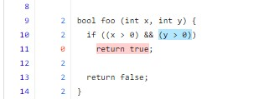
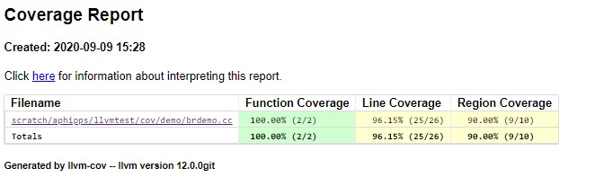
LLVM Coverage Visualization
LLVM Coverage Utility (llvm-cov)
Text (llvm-cov)
8| |
9| 2|bool foo (int x, int y) {
10| 2| if ((x > 0) && (y > 0))
^1
11| 0| return true;
12| 2|
13| 2| return false;
14| 2|}

Slide 6
Why is branch Coverage Important?
Line | Cnt |
9| |bool foo(int x, int y) {
10| 4| if ((x > 0) && (y > 0))
^1
11| 1| return true;
12| |
13| 3| return false;
14| 3|}
There are two conditions on line 10 that form a decision: (x > 0), (y > 0)
Line 11 shows that “return true” was executed once
What was the execution path through the control flow that facilitated this?
What was the execution path through the control flow around this?
If we don’t know, we can’t be sure we are executing all paths!
Branch Coverage tells us this!
How many times is each condition taken (True) or not taken (False)?
Line | Cnt |
9| |bool foo(int x, int y)
10| 4|{
11| 4| return ((x > 0) && (y > 0));
^1
12| 4|}
Notes:
It’s a more granular measure of code execution than line or statement coverage
Are we really measuring all paths through our code?
If we AREN’T, condition code might be wrong, and it could be caught by some other user or customer (lurking defects)
If each condition is shown as being taken and not-taken at least once, we know we are testing all paths.
It can ensure more maintainable code
Is it easy to write tests that test all paths through our code?
Is the code simple enough to understand?
Required by Functional Safety standards
Used in Industrial and Automotive markets

Slide 7
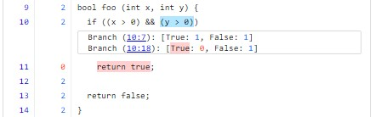
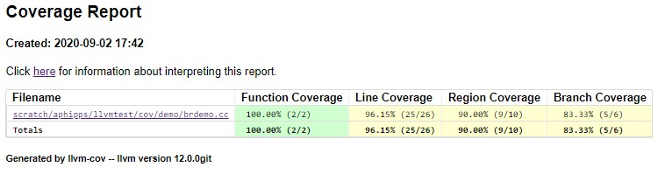
LLVM Coverage Visualization + Branch Coverage
LLVM Coverage Utility (llvm-cov)
Text (llvm-cov)
9| 2|bool foo (int x, int y) {
10| 2| if ((x > 0) && (y > 0))
------------------
| Branch (10:7): [True: 1, False: 1]
| Branch (10:18): [True: 0, False: 1]
------------------
11| 0| return true;
12| 2|
13| 2| return false;
14| 2|}

Slide 8
Goal: Ensure 100% Branch Coverage
C short-circuit semantics on logical operators
Testing all individual conditions also tests corresponding decisions
foo(1, 0): (x > 0) = true
(y > 0) = false
(x > 0) && (y > 0) = false
bool foo(int x, int y) {
if ((x > 0) && (y > 0))
return true;
return false;
}
foo(0, 1): (x > 0) = false
(y > 0) = … not executed!
(x > 0) && (y > 0) = false
foo(1, 1): (x > 0) = true
(y > 0) = true
(x > 0) && (y > 0) = true

Slide 9
How is Branch Coverage implemented?

Slide 10
Clang Source Region Creation
Counter-to-Source
Region Mapping (clang)
Regions created based on AST walk
Counter Instrumentation
in LLVM IR (clang)
Test Execution
Data Visualization

Slide 11
CounterMappingRegion
struct CounterMappingRegion {
enum RegionKind {
/// A CodeRegion associates some code with a counter.
CodeRegion,
/// An ExpansionRegion represents a file expansion region that associates
/// a source range with the expansion of a virtual source file, such as
/// for a macro instantiation or #include file.
ExpansionRegion,
/// A SkippedRegion represents a source range with code that was skipped
/// by a preprocessor or similar means.
SkippedRegion,
/// A GapRegion is like a CodeRegion, but its count is only set as the
/// line execution count when its the only region in the line.
GapRegion,
/// A BranchRegion represents leaf-level boolean expressions and is
/// associated with two counters, each representing the number of times the
/// expression evaluates to true or false.
BranchRegion
};
/// Primary Counter that is also used for Branch Regions (TrueCount).
Counter Count;
/// Secondary Counter used for Branch Regions (FalseCount).
Counter FalseCount;
unsigned FileID, ExpandedFileID;
unsigned LineStart, ColumnStart, LineEnd, ColumnEnd;
CounterMappingRegion associates a source range with a counter. It uses RegionKind to identify how to interpret its data.
1.) Extend RegionKind to include a new BranchRegion kind to represent branch-generating conditions
2.) Use existing Counter to represent “True” BranchRegion counts
3.) Add a second Counter to represent “False” BranchRegion counts
Notes:
The BranchRegion kind tracks two Counters along with Source
True count and False count
Tied to a single condition in the source code
The two Counters are encoded along with other MappingRegions
Distinguished based on region kind
All other CounterMappingRegion kinds ignore the second Counter
Nothing changes in how they’re encoded (backward compatible)

Slide 12
Counter Region Mapping (clang)
Instrumentation profile Counters are already created for statement regions
We can trivially reuse them to calculate Branch condition counts!
A Counter can also refer to an arithmetic expression between two counters
Counter1++
Counter1 maps to “Parent” region
Counter2 maps to If-Stmt “Then” region
For BranchRegion(C)
C.TrueCounter = Counter2
C.FalseCounter = Counter1 – Counter2
if ( C ) {
…
}
Counter2++
This is true for all control-flow statements: if, for, while, switch, ternary ?:

Slide 13
Clang Counter Instrumentation
Counter-to-Source
Region Mapping (clang)
ASTs lowered to LLVM IR
Since we reuse counters, no special instrumentation needed! … except …
Counter Instrumentation
in LLVM IR (clang)
Test Execution
Data Visualization

Slide 14
Counter Instrumentation for Logical Operators
Counter1 maps to “Parent” region
Counter2 maps to “C2”, the right-hand-side, representing C2 execution count
C short-circuit semantics on logical operators
Counter2 increments only when C1 is false
For BranchRegion(C1)
C1.FalseCounter = Counter2
C1.TrueCounter = Counter1 – Counter2
For BranchRegion(C2)
C2.FalseCounter = ?
C2.TrueCounter = ?
New
Counter1++
bool X = C1 || C2;
|| Counter3++
^ Counter2++
For BranchRegion(C2)
C2.FalseCounter = Counter3
C2.TrueCounter = Counter2 – Counter3
I have to instrument a new counter (Counter3) to track C2’s counts
Notes:
Short-circuit semantics is key to how this works!
The new Counter (Counter3) increments based on the same short-circuit behavior that Counter2++ increments. For logical OR, it only increments if C2 evaluates to false.

Slide 15
Data Visualization
Counter-to-Source
Region Mapping (clang)
Counter Instrumentation
in LLVM IR (clang)
Data Decoded and Statistics Calculated
Test Execution
Data Visualization
(llvm-cov)
Notes:
Llvm-cov extended to understand new CounterMappingRegion structure.
Filter CounterMappingRegion objects according to File, Function, or Macro Expansion
Distinguished based on a FileID
I sort BranchRegions into their own list
All other code regions formed into CoverageSegments
These are then visualized on top of the source-code as a View (or SubView)

Slide 16
Visualization (llvm-cov)
Decode mapping regions and filter based on Function and Macro Expansion
Function (foo)
CodeRegion1 (9:24-10:23)
CodeRegion2 (11:0-11:12)
CodeRegion3 (12:0-14:0)
BranchRegions:
BranchRegion1 (10:5-10:11)
BranchRegion2 (10:16-10:22)
line 9: bool foo(int x, int y) {
line 10: if ((x > 0) && (y > 0))
line 11: return true;
line 12:
line 13: return false;
line 14: }
Expansion (MAX)
CodeRegion1 (18:18-18:40)
BranchRegions:
BranchRegion1 (18:19-18:24)
line 18: #define MAX(x,y) ((x) > (y) ? (x) : (y))
line 19: bool bar(int x, int y) {
line 20: return MAX(x,y);
line 24: }
Function (bar)
CodeRegion1 (19:24-24:0)
ExpansionRegion1 (20:10-20:13)
Notes:
Filter CounterMappingRegion objects according to File, Function, or Macro Expansion
Distinguished based on a FileID
I sort BranchRegions into their own list
All other code regions formed into CoverageSegments
These are then visualized on top of the source-code as a View (or SubView)
Expansions are tied

Slide 17
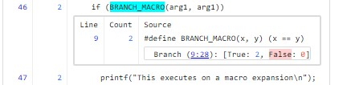
Visualization (llvm-cov) SubViews
Extend notion of region SubView to include branches
SubViews are demarcated nested views in the source-code
Branches on the same line are grouped into the same SubView
SubViews are also used to demarcate macro expansions
Macro expansions can be recursive
Macro expansions can contain conditions
Extend summary reports to include Branch Coverage
Add BranchCoverageInfo class
BranchCoverageInfo
Total # of Branches (2 per region)
# Branches executed at least once

Slide 18
Branch Coverage Future Optimizations
Better counter reuse for logical operators
Nested conditions: bool myval = (C1 && C2 && (C3 || C4));
Enable HTML ToolTip “hover” capability on source conditions
Hovering will reveal actual True/False Branch Counts
Similar to how region coverage counts show up today
Better identification of special branch regions
Identify an implicit default Case in a switch statement
Identify the sense of constant-folded conditions: always True or never True

Slide 19
What’s Next: MC/DC
Ultimate Goal: Modified Condition/Decision Coverage (MC/DC)
Percentage of all condition outcomes that independently affect a decision outcome
Built on top of branch-coverage
Usually involves emitting a truth table to confirm all possibilities

Slide 20
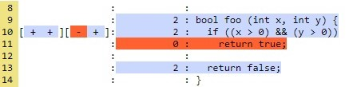
Observations on GCC Branch Coverage
GCC HTML (LCOV)
GCC Text (GCOV)
True/False Branch Data shown
“+” → Executed at least once
“-” → Not Executed (i.e. “0”)
Hover to see counts
Difficult to tie branches to source
Which branch goes with which condition?
Which branch represents taken vs not taken?
In other contexts…
May see additional branches that aren’t visible in source code
Some branches may be removed
GCC advises against using optimization with code coverage
function _Z3fooii called 2 returned 100% blocks executed 80%
2: 9:bool foo (int x, int y) {
2: 10: if ((x > 0) && (y > 0))
branch 0 taken 1 (fallthrough)
branch 1 taken 1
branch 2 taken 0 (fallthrough)
branch 3 taken 1
#####: 11: return true;
-: 12:
2: 13: return false;
-: 14:}

Slide 21
GCC vs. LLVM
GCC HTML (LCOV)
GCC Text (GCOV)
LLVM HTML
LLVM Text
function _Z3fooii called 2 returned 100% blocks executed 80%
2: 9:bool foo (int x, int y) {
2: 10: if ((x > 0) && (y > 0))
branch 0 taken 1 (fallthrough)
branch 1 taken 1
branch 2 taken 0 (fallthrough)
branch 3 taken 1
#####: 11: return true;
-: 12:
2: 13: return false;
-: 14:}
9| 2|bool foo (int x, int y) {
10| 2| if ((x > 0) && (y > 0))
------------------
| Branch (10:7): [True: 1, False: 1]
| Branch (10:18): [True: 0, False: 1]
------------------
11| 0| return true;
12| 2|
13| 2| return false;
14| 2|}
Notes:
LLVM Source-based Code Coverage is tied to Abstract Syntax Trees
It can give us a much more precise representation of branch execution!
Branch measurements can truly be source-based
LLVM Code Coverage isn’t negatively impacted by optimization!

Slide 22
Current State of LLVM Branch Coverage
Implementation is complete -- in the process of upstreaming the work!
Phabricator Review https://reviews.llvm.org/D84467
Should be included with stock LLVM Source-based Code Coverage
A lot of ways to improve branch coverage! Want to be involved?
Contact me! a-phipps@ti.com

Slide 23
Thank you!
Acknowledgements
Vedant Kumar, Apple
Cody Addison, Nvidia
Alan Davis, Texas Instruments

