Slide 1

The Present and Future
of Interprocedural
Optimization in LLVM
Stefanos Baziotis stefanos.baziotis@gmail.com
Kuter Dinel
kuterdinel@gmail.com
Shinji Okumura okuraofvegetable@gmail.com
Luofan Chen
clfbbn@gmail.com
Hideto Ueno uenoku.tokotoko@gmail.com
Johannes Doerfert
johannesdoerfert@gmail.com

Slide 2
The Present

Slide 3
Kinds of IPO passes
Inliner
AlwaysInliner, Inliner, InlineAdvisor, ...
Propagation between caller and callee
Attributor^{[1]}, IP-SCCP, InferFunctionAttrs, ArgumentPromotion, DeadArgumentElimination, ...
Linkage and Globals
GlobalDCE, GlobalOpt, GlobalSplit, ConstantMerge, ...
Others
MergeFunction, OpenMPOpt^{[2]}, HotColdSplitting^{[3]}, Devirtualization^{[4]}...
Checkout the IPO tutorial^{[5]} for details!

Slide 4
Current State of IPO in LLVM
301 total passes
20 module passes
5 cgscc passes
250 function passes
12 loop passes
14 immutable passes
Statistics
~ 84k lines of C
~ 260k lines of IR
sqlite3.c
-O3 -debug-pass=Details

Slide 5
Current State of IPO in LLVM
301 total passes
20 module passes
5 cgscc passes
250 function passes
12 loop passes
14 immutable passes
Statistics
~ 84k lines of C
~ 260k lines of IR
sqlite3.c
-O3 -debug-pass=Details
>90% of passes are intraprocedural

Slide 6
Current State of IPO in LLVM
~ 84k lines of C
~ 260k lines of IR
sqlite3.c
-O3
-O3 -fno-inline
~24s wall clock time
~22s pass execution
~3.4s (~16%) X86 InstSelect
~1.2s (~ 6%) Inlining
~692k bytes .text
-54%
-61%
-65%
-47%
Statistics
~11s wall clock time
~8.5s pass execution
~1.2s (~16%) X86 InstSelect
~367k bytes .text
Statistics
>50% time & bytes spend as a consequence of inlining

Slide 7
Inlining - Benefits: Code specialization
static void foo(int x, bool c) {
if (c) y = 1; else y = 2;
use(x, y);
}
void caller1(int x) {
foo(x, true);
}
void caller2(int x) {
foo(x, false);
}
void caller1(int x) {
use(x, 1);
}
void caller2(int x) {
use(x, 2);
}

Slide 8
Inlining - Drawbacks: Code Duplication
static void foo(int x, bool c) {
if (c) y = 1; else y = 2;
use(x, y);
/* more stuff */
}
void caller1(int x) {
foo(x, true);
}
void caller2(int x) {
foo(x, false);
}
void caller1(int x) {
use(x, 1);
/* more stuff */
}
void caller2(int x) {
use(x, 2);
/* more stuff */
}

Slide 9
Inlining - Drawbacks: Code Duplication
static void foo(int x, bool c) {
if (c) y = 1; else y = 2;
use(x, y);
/* more stuff */
}
void caller1(int x) {
foo(x, true);
}
void caller2(int x) {
foo(x, false);
}
void caller3(int x) {
foo(x, false);
}
void caller1(int x) {
use(x, 1);
/* more stuff */
}
void caller2(int x) {
use(x, 2);
/* more stuff */
}
void caller3(int x) {
use(x, 2);
/* more stuff */
}

Slide 10
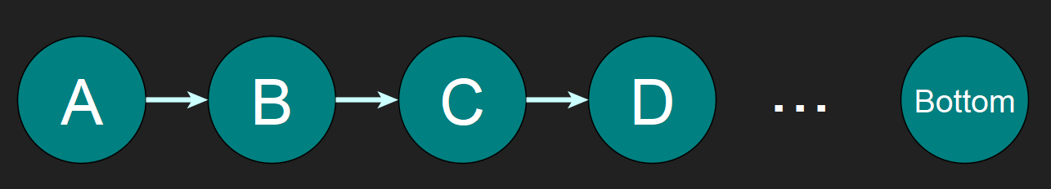
Inlining - Drawbacks: Inline Order
Info at the top, e.g. constant arguments
Complex Functions (starting without context)

Slide 11
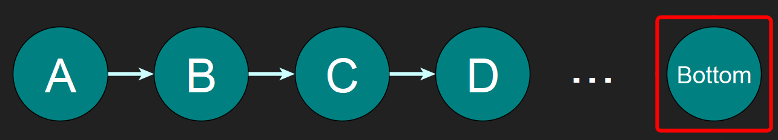
Inlining - Drawbacks: Inline Order
Info at the top, e.g. constant arguments

Slide 12
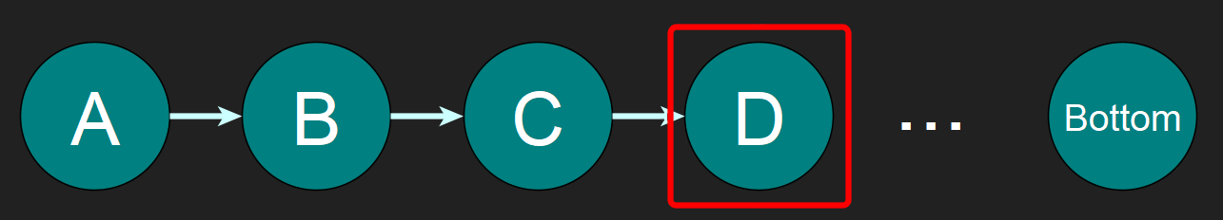
Inlining - Drawbacks: Inline Order
Info at the top, e.g. constant arguments

Slide 13
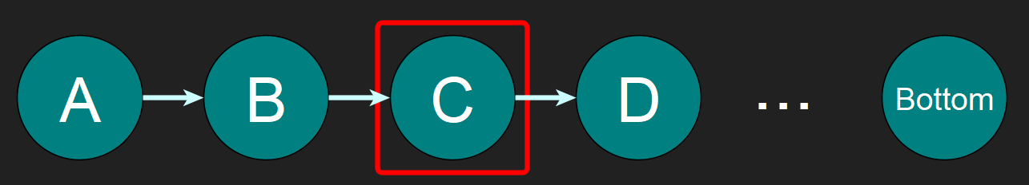
Inlining - Drawbacks: Inline Order
Info at the top, e.g. constant arguments
Maybe the inliner stops here
Notes:
Can be the other way around if we’d do top-down

Slide 14
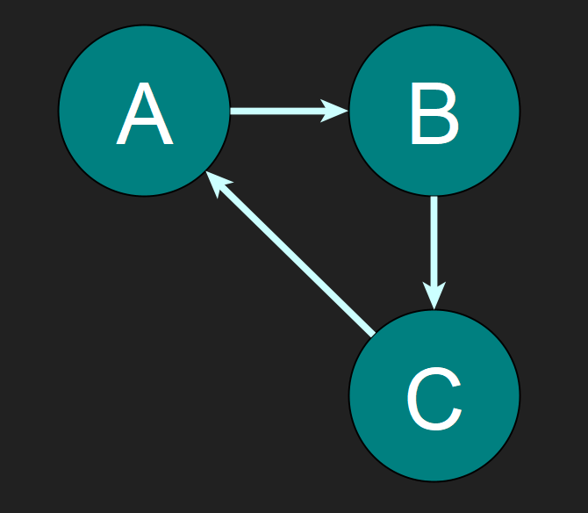
Inlining - Drawbacks: Inline Order
Strongly Connected Components (SCCs) have no top-down/bottom-up order

Slide 15
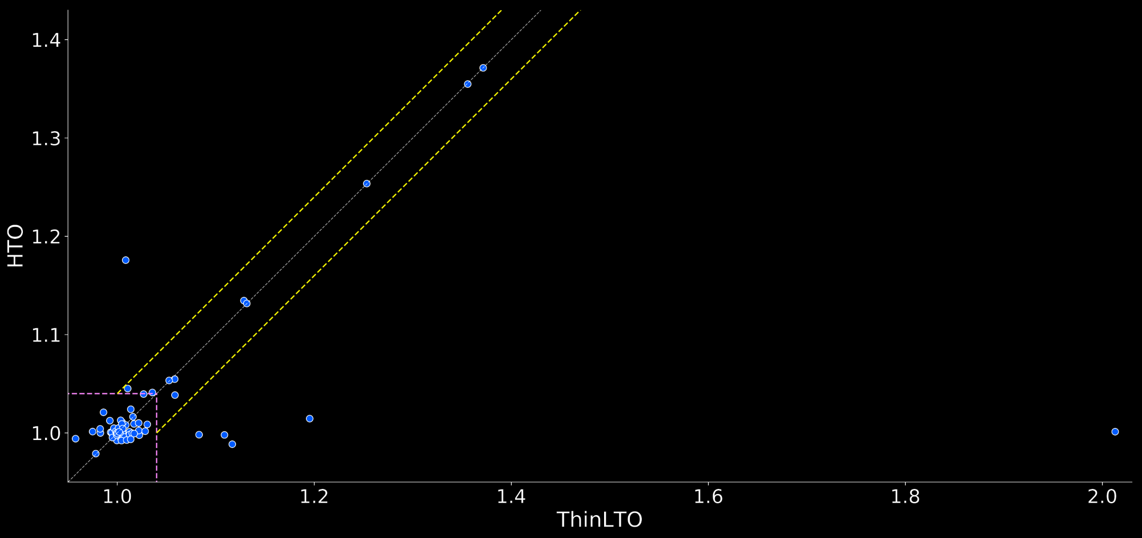
Inlining - Alternatives: thin-LTO^{[7]} vs HTO^{[8]}
inter-translation unit “LLVM-IR” attributes can match thin-LTO speedups
so far, not all

Slide 16
Design Space
Inlining
Interprocedural Optimization
Function Specialization

Slide 17
Design Space
Inlining
Present Default
Interprocedural Optimization
Function Specialization
Notes:
We do some sort of function specialization when we do outlining, though it’s a stretch

Slide 18
Design Space
Inlining
Present Options
Present Default
Interprocedural Optimization
Function Specialization

Slide 19
Design Space
Inlining
Present Options
Present Default
Future Default
Interprocedural Optimization
Function Specialization

Slide 20
Design Space
Inlining
Present Options
Present Default
Future Options
Future Default
Interprocedural Optimization
Function Specialization

Slide 21
Design Space
✔
Inlining
Present Options
Present Default
Future Options
Future Default
Interprocedural Optimization
Function Specialization

Slide 22

Design Space
✔
Inlining
Present Options
Present Default
Future Options
Future Default
Interprocedural Optimization
Function Specialization
Attributor

Slide 23
Pass Ordering
Interprocedural Sparse Conditional Constant Propagation Pass
void unknown(int &x);
static void check_n_rec(int n, int &x, int &y) {
if (x) unknown(x);
if (n) check_n_rec(n-1, y, x);
}
int test(int n) {
int x = 0, y = 0;
check_n_rec(n, x, y);
return x + y;
}
Function Attribute Pass
Promote Arguments
Function Passes
Inliner
Notes:
The example will not be optimized to return 0 in one O3 run. A second O3 run will do that though.

Slide 24
The Future

Slide 25
Attributor
The Attributor^{[1,9]} is an interprocedural fixpoint iteration framework;
with lots of built-in features.

Slide 26
Attributor covers many IPO passes
infers almost all LLVM-IR attributes ✔ (Reverse)Post Order Function Attribute Pass
simplifies arguments, branches, return values and ... ✔ IP-SCCP*, Called Value Propagation
rewrites function signatures ✔ Argument Promotion, Dead Argument Elimination

Slide 27
Pass Ordering
Interprocedural Sparse Conditional Constant Propagation Pass
void unknown(int &x);
static void check_n_inc(int n, int &x, int &y) {
if (x) unknown(x);
if (n) check_n_inc(n-1, y, x);
}
int test(int n) {
int x = 0, y = 0;
check_n_inc(n, x, y);
return x + y;
}
Function Attribute Pass
Promote Arguments
Function Passes
Inliner
Notes:
[context] the code on the right is not optimized by llvm to return 0 no matter how often you run the O3 pipeline.

Slide 28
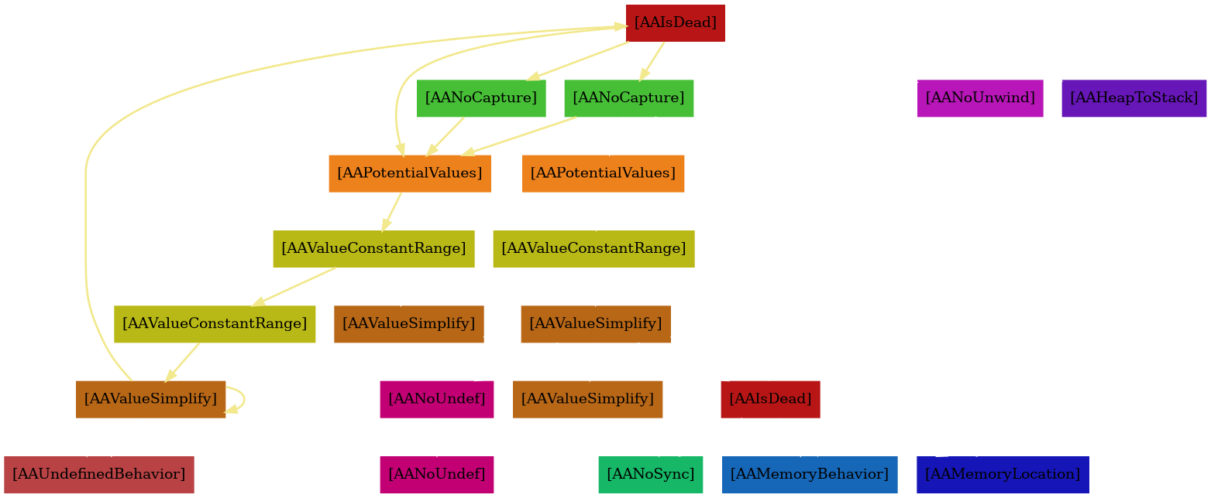
Dataflow Iterations
void unknown(int &x);
static void check_n_inc(int n, int &x, int &y) {
if (x) unknown(x);
if (n) check_n_inc(n-1, y, x);
}
int test(int n) {
int x = 0, y = 0;
check_n_inc(n, x, y);
return x + y;
}

Slide 29
Function Specialization
__attribute__((linkonce_odr))
void foo(int x, bool c) {
if (c) y = 1; else y = 2;
use(x, y);
}
void caller1(int x) {
foo(x, false);
}
void caller2(int x) {
foo(x, false);
}
void caller3(int x) {
foo(x, true);
}
__attribute__((linkonce_odr))
void foo(int x, bool c) {
if (c) y = 1; else y = 2;
use(x, y);
}
static void foo.internal(int x, bool c) {
if (c) y = 1; else y = 2;
use(x, y);
}
void caller1(int x) {
foo.internal.false(x);
}
void caller2(int x) {
foo.internal.false(x);
}
void caller3(int x) {
foo.internal.true(x);
}

Slide 30
Function Specialization
__attribute__((linkonce_odr))
void foo(int x, bool c) {
if (c) y = 1; else y = 2;
use(x, y);
}
void caller1(int x) {
foo(x, false);
}
void caller2(int x) {
foo(x, false);
}
void caller3(int x) {
foo(x, true);
}
__attribute__((linkonce_odr))
void foo(int x, bool c) {
if (c) y = 1; else y = 2;
use(x, y);
}
static void foo.internal.false(int x) {
use(x, 2);
}
static void foo.internal.true(int x) {
use(x, 1);
}
void caller1(int x) {
foo.internal.false(x);
}
void caller2(int x) {
foo.internal.false(x);
}
void caller3(int x) {
foo.internal.true(x);
}
Notes:
Similar input as on the previous slide but

Slide 31
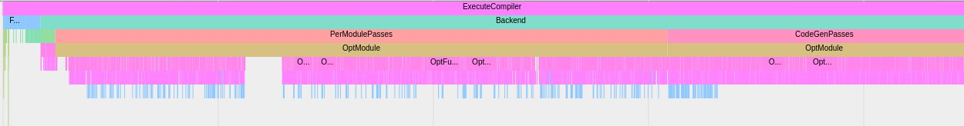
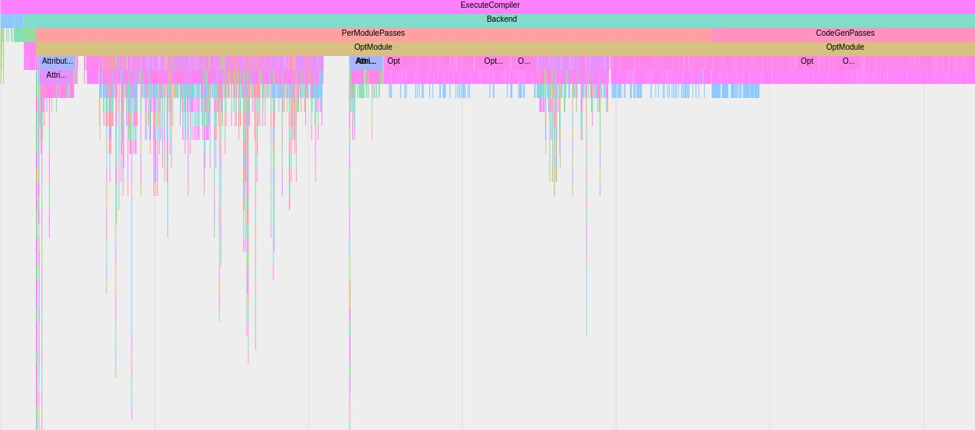
Time Traces

Slide 32
How To Get There

Slide 33
Intrinsic & Library Functions
State
Most intrinsics & library functions have some attributes
Notes:
[Context] IPO is to a large degree based on summary information. The summaries can easily be really bad if any intrinsic or library function isn’t properly annotated

Slide 34
Intrinsic & Library Functions
State
Most intrinsics & library functions have some attributes
Most intrinsics & library functions miss a lot of attributes

Slide 35
Intrinsic & Library Functions
State
Most intrinsics & library functions have some attributes
Most intrinsics & library functions miss a lot of attributes
Solutions (in progress)
Default attributes for intrinsics, you need to opt-out
Revisit library functions and add attributes systematically

Slide 36
Intrinsic & Library Functions
llvm-test-suite/SingleSource/Benchmarks/BenchmarkGame/fannkuch.c
[Heap2Stack] Bad user: call void @llvm.memcpy.p0i8.p0i8.i64(...) may-free the allocation
[Heap2Stack] Bad user: call void @llvm.memcpy.p0i8.p0i8.i64(...) may-free the allocation
[Heap2Stack]: Removing calloc call: %call = call noalias dereferenceable_or_null(44)
i8* @calloc(i64 noundef 11, i64 noundef 4)
3x heap to stack + follow up transformations:
~5% speedup
Notes:
Clearly memcpy doesn’t free an allocation. These kind of problems pop up all over the place. strcpy doesn’t capture pointers, ...

Slide 37
Introduce & Utilize New Attributes
Frontend:
generic LLVM-IR attributes^{[8]}
“access” (like GCC^{[10]})

Slide 38
Introduce & Utilize New Attributes
Frontend:
generic LLVM-IR attributes^{[8]}, i.a., __attribute__((fn_arg(“willreturn”)))
“access” (like GCC^{[10]}), i.a., __attribute__ ((access (read_only, 1))) int puts (const char*)
Notes:
Generic llvm attributes allow to put any LLVM-IR attribute into C/C++ as ``

Slide 39
Introduce & Utilize New Attributes
Frontend:
generic LLVM-IR attributes^{[8]}, i.a., __attribute__((fn_arg(“willreturn”)))
“access” (like GCC^{[10]}), i.a., __attribute__ ((access (read_only, 1))) int puts (const char*)
LLVM-IR:
fine-grained memory effects:
writes(@errno,...)
2^{inaccessible,argument,global,...}
potential values
value(null, arg(0), @global, ...)

Slide 40
Attributor - Testing
State
reasonable unit test coverage
no regular (=CI) builds
Solutions
Try it out, report and track down bugs
Setup buildbot(s) that enable the Attributor (anyone?)

Slide 41
Attributor - Memory Overhead
State
Way better than in the last release
Mostly an issue for the module-wide pass, not the call graph pass
Solutions (in progress)
Drop Attributor state that is not useful anymore eagerly
Minimize the number of Abstract Attributes created

Slide 42
Attributor - Compile Time Overhead
State
Improved compared to the last release
Issue for both the module-wide pass and the call graph pass
Solutions (in progress)
Improve the schedule order (less updates, better locality, …)
Avoid costly deductions or perform them conditionally
Minimize the number of Abstract Attributes created

Slide 43
Attributor - Selective Investment
Focus on hot code; look at otherwise cold code only as a consequence

Slide 44
Attributor - Selective Investment
Focus on hot code; look at otherwise cold code only as a consequence
static void foo() { ... }
static int* bar() { ...; return ...; }
static void baz(int *) { ... }
extern void __attribute__((cold)) sink();
void hotcold(int cond) {
int *p = ...;
if (cond) {
p = bar();
sink();
foo();
}
baz(p);
}

Slide 45
Attributor - Selective Investment
Focus on hot code; look at otherwise cold code only as a consequence
static void foo() { ... }
static int* bar() { ...; return ...; }
static void baz(int *) { ... }
extern void __attribute__((cold)) sink();
void hotcold(int cond) {
int *p = ...;
if (cond) {
p = bar();
sink();
foo();
}
baz(p);
}

Slide 46
Attributor - Selective Investment
Focus on hot code; look at otherwise cold code only as a consequence
static void foo() { ... }
static int* bar() { ...; return ...; }
static void baz(int *) { ... }
extern void __attribute__((cold)) sink();
void hotcold(int cond) {
int *p = ...;
if (cond) {
p = bar();
sink();
foo();
}
baz(p);
}

Slide 47
Attributor - Selective Investment
Focus on hot code; look at otherwise cold code only as a consequence
static void foo() { ... }
static int* bar() { ...; return ...; }
static void baz(int *) { ... }
extern void __attribute__((cold)) sink();
void hotcold(int cond) {
int *p = ...;
if (cond) {
p = bar();
sink();
foo();
}
baz(p);
}

Slide 48
Attributor - Selective Investment
Focus on hot code; look at otherwise cold code only as a consequence
static void foo() { ... }
static int* bar() { ...; return ...; }
static void baz(int *) { ... }
extern void __attribute__((cold)) sink();
void hotcold(int cond) {
int *p = ...;
if (cond) {
p = bar();
sink();
foo();
}
baz(p);
}

Slide 49
Attributor - Selective Investment
Focus on hot code; look at otherwise cold code only as a consequence
static void foo() { ... }
static int* bar() { ...; return ...; }
static void baz(int *) { ... }
extern void __attribute__((cold)) sink();
void hotcold(int cond) {
int *p = ...;
if (cond) {
p = bar();
sink();
foo();
}
baz(p);
}

Slide 50
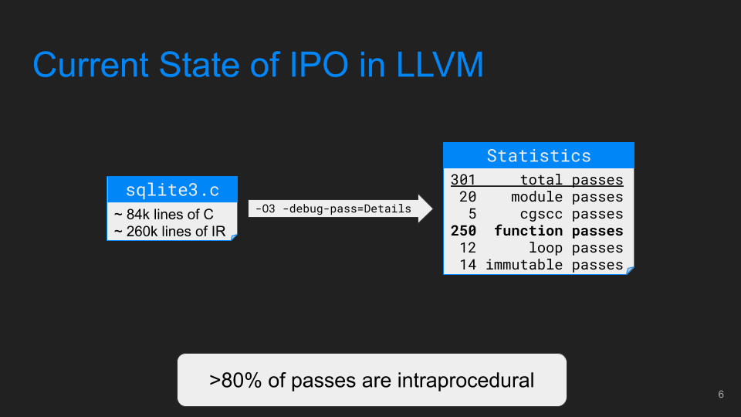
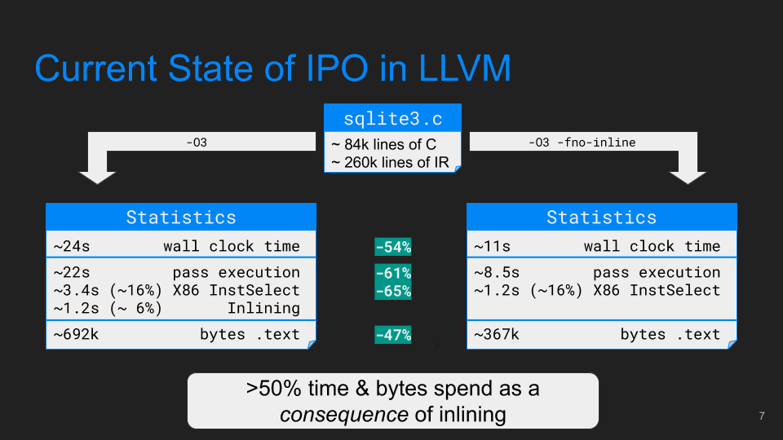
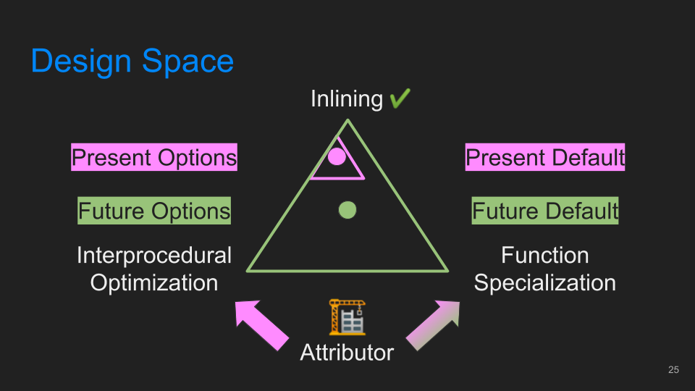
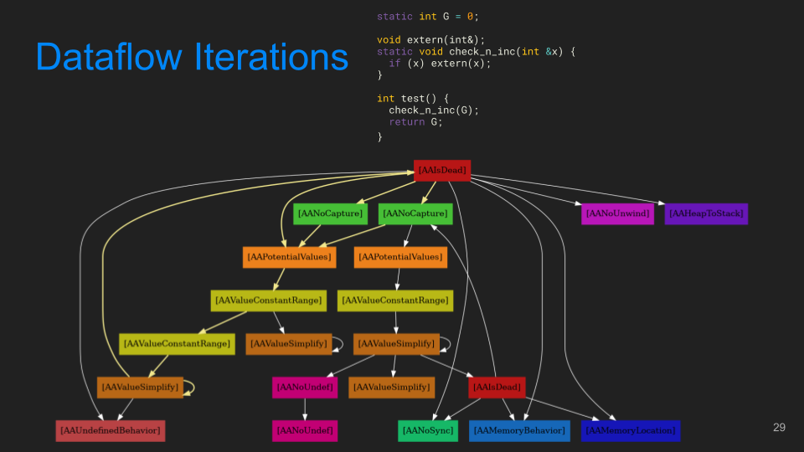
Conclusions

Slide 51
References
Tech talk: The Attributor: A Versatile Inter-procedural Fixpoint, J. Doerfert, S. Stipanovic, H. Ueno, LLVM Developers’ Meeting 2019
(OpenMP) Parallelism Aware Optimizations, LLVM Developers’ Meeting 2020
Hot Cold Splitting Optimization Pass In LLVM, A. Kumar, LLVM Developers’ Meeting 2019
Devirtualization in LLVM, P. Padlewski, LLVM Developers’ Meeting 2016
A Deep Dive into the Interprocedural Optimization Infrastructure, LLVM Developers’ Meeting 2020
The Attributor: A Versatile Inter-procedural Fixpoint, J. Doerfert, S. Stipanovic, H. Ueno, LLVM Developers’ Meeting 2019
ThinLTO: Scalable and Incremental Link-Time Optimization, Teresa Johnson, CppCon 2017
Cross-Translation Unit Optimization via Annotated Headers, W. Moses, J. Doerfert, LLVM Developers’ Meeting 2019
Tutorial: The Attributor: A Versatile Inter-procedural Fixpoint, J. Doerfert, S. Stipanovic, H. Ueno, LLVM Developers’ Meeting 2019
GCC common function attributes

Slide 52
Backup

Slide 53
Pass Ordering
Interprocedural Sparse Conditional Constant Propagation Pass
static int G = 0;
void extern(int&);
static void check_n_inc(int &x) {
if (x) extern(x);
}
int test() {
check_n_inc(G);
return G;
}
Function Attribute Pass
Promote Arguments
Function Passes
Inliner
Notes:
The example will not be optimized to return 0 in any number of O3 runs. This is a shortcoming in IP-SCCP.

Slide 54
Attributor
int NDim;
HANDLE *RandTree(int n, int seed, int node, int level) {
future_cell_int f_left, f_right;
HANDLE *h = NULL;
if (n < 1) return h;
int newnode;
if (level < NDim)
newnode = node + (1 << (NDim - level - 1));
else
newnode = node;
seed = random(seed);
int next_val = seed % RANGE;
h = NewNode(next_val);
h->left = RandTree((n / 2), seed, newnode, level + 1);
h->right = RandTree((n / 2), skiprand(seed, (n) + 1), node, level + 1);
return h;
}
llvm-test-suite/MultiSource/Benchmarks/Olden/bisort/bitonic.c

Slide 55
Attributor
int NDim;
HANDLE *RandTree(int n, int seed, int node, int level) {
future_cell_int f_left, f_right;
HANDLE *h = NULL;
if (n < 1) return h;
seed = random(seed);
int next_val = seed % RANGE;
h = NewNode(next_val);
h->left = RandTree((n / 2), seed, 0, 0);
h->right = RandTree((n / 2), skiprand(seed, (n) + 1), 0, 0);
return h;
}
llvm-test-suite/MultiSource/Benchmarks/Olden/bisort/bitonic.c

Slide 56

Attributor
Feature: -attributor-dump-dep-graph
int NDim;
HANDLE *RandTree(int n, int seed, int node, int level) {
future_cell_int f_left, f_right;
HANDLE *h = NULL;
if (n < 1) return h;
seed = random(seed);
int next_val = seed % RANGE;
h = NewNode(next_val);
h->left = RandTree((n / 2), seed, 0, 0);
h->right = RandTree((n / 2), skiprand(seed, (n) + 1), 0, 0);
return h;
}
llvm-test-suite/MultiSource/Benchmarks/Olden/bisort/bitonic.c

Slide 57
Current State of IPO in LLVM
Focused on inlining… But there are other passes:
Interprocedural Sparse Conditional Constant Propagation (IPSCCP)
OpenMPOpt
Optimize OpenMP directives.
Hot-Cold Splitting¹
Split cold regions to improve locality.
Whole Program Devirtualization²
Optimize Virtual Calls
GlobalDCE / GlobalOpt / GlobalSplit
Eliminates dead globals and transforms globals that never have their address taken etc.
...
¹ Hot Cold Splitting Optimization Pass In LLVM, A. Kumar, LLVM Developers’ Meeting 2019
² Devirtualization in LLVM, P. Padlewski, LLVM Developers’ Meeting 2016

Slide 58
Current State of IPO in LLVM (cont’d)
Focused on inlining… But there are other passes:
SampleProfile
Annotates IR given profile data (e.g. perf)
Attributor³
A fix-point interprocedural analysis framework that deduces and/or propagates attributes.
...
More passes, almost all of them live under /llvm/lib/Transforms/IPO
³ The Attributor: A Versatile Inter-procedural Fixpoint, J. Doerfert, S. Stipanovic, H. Ueno, LLVM Developers’ Meeting 2019

Slide 59
Inlining in LLVM - Corner Cases
Bottom-up inlining is the preferred method in LLVM
Possible reasoning: Sinks are the most easy to reason about, so start with them -> provide up-to-date info going upwards.

Slide 60
Inlining in LLVM - Corner Cases
However, bottom-up inlining may fail hard in some cases
Example: When information comes from the top

Slide 61
Current State of IPO in LLVM
Johannes Doerfert
johannesdoerfert@gmail.com
Argonne National Lab
ArgumentPromotionPass
PostOrderFunctionAttrsPass
AttributorCGSCCPass
InlinerPass
OpenMPOptPass
CoroSplitPass

Slide 62
[Sidenote] A Word about GCC’s inliner
GCC had tried bottom-up inlining early on
At this point, GCC’s IPO was not advanced, people were not very happy with it⁴.
⁴ GCC Cauldron 2013 - Status of IPO in GCC, Jan Hubicka

Slide 63
[Sidenote] A Word about GCC’s inliner
GCC had tried bottom-up inlining early on
At this point, GCC’s IPO was not advanced, people were not very happy with it⁴.
Then, it tried top-down inlining⁴
It was supposed to minimize compile-time / memory consumption.
It didn’t have good results.
⁴ GCC Cauldron 2013 - Status of IPO in GCC, Jan Hubicka

Slide 64
[Sidenote] A Word about GCC’s inliner
GCC had tried bottom-up inlining early on
At this point, GCC’s IPO was not advanced, people were not very happy with it⁴.
Then, it tried top-down inlining⁴
It was supposed to minimize compile-time / memory consumption.
It didn’t have good results.
Now, it uses a priority-based approach^{5,6}
⁴ GCC Cauldron 2013 - Status of IPO in GCC, Jan Hubicka
⁶ Aggressive Inlining, Ayers, Andrew and Schooler, Richard and Gottlieb, Robert, ACM SIGPLAN 1999
⁵ GCC Summit 2004, The GCC call graph module, Jan Hubicka

Slide 65
Inlining - Drawbacks: Inline Order
Info at the top, e.g. constant arguments
Maybe the inliner stops here
We stopped before we reach the top, at which point we could have way more info / context

Slide 66
Inlining - Drawbacks: Inline Order
Info at the top, e.g. constant arguments
Maybe the inliner stops here

Slide 67
Info at the top, e.g. constant arguments
Maybe the inliner stops here
We stopped before we reach the top, at which point we could have way more info / context
That can create huge bloat, without benefit. It could also be avoided

Slide 68
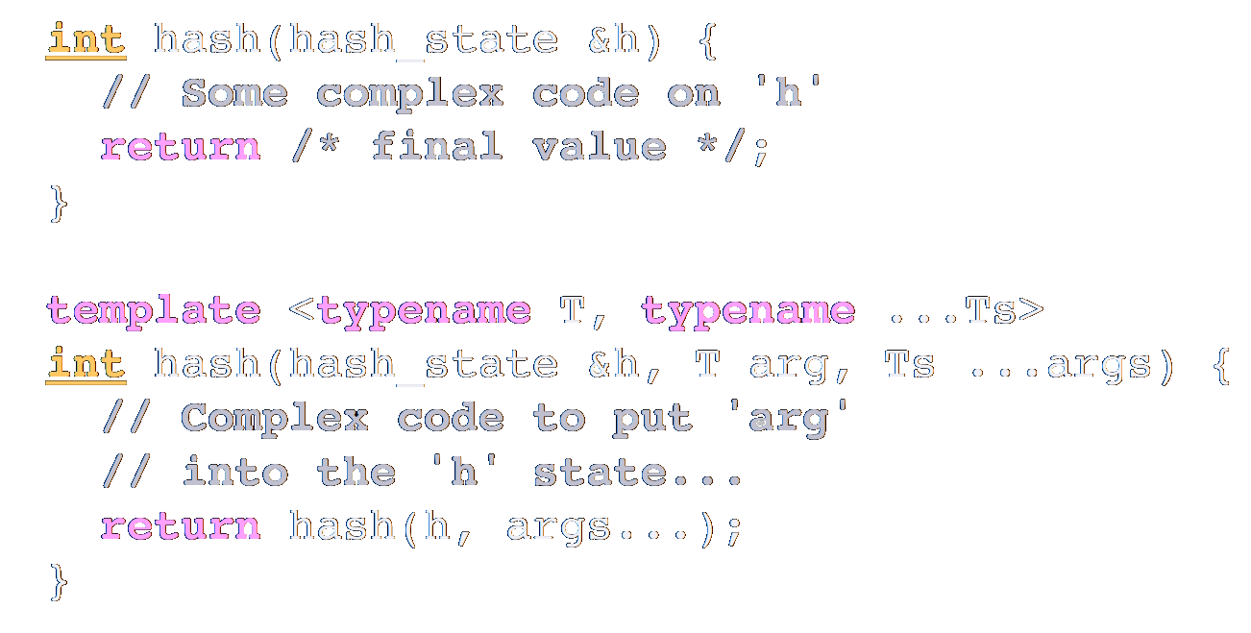
Example: Bottom-up Inlining Fails
This is not an uncommon case and can happen e.g. in variadic function templates.
From Chandler Carruth’s talk: Understanding Compiler Optimization, code::dive 2016
Godbolt Snippet

Slide 69
Example: Bottom-up Inlining Fails
void foo() {
for (int i = 0; i < N; ++i)
A[i] = i;
bar();
}
void bar() {
for (int i = 0; i < N; ++i)
B[i] += A[i];
complex1();
complex2();
complex3();
}

Slide 70
Inlining - Benfits/Drawbacks: Heuristics
Heuristics

Slide 71
Inlining in LLVM - Stuff I Did Not Cover
Heuristics
Deferred Inlining
In A -> B -> C, inlining B into A might be more profitable than inlining C to B.

Slide 72
Inlining in LLVM - Stuff I Did Not Cover
Heuristics
Deferred Inlining
In A -> B -> C, inlining B into A might be more profitable than inlining C to B.
Partial Inlining^{7,8}
Inlining only part of a function, the hot part, outline the rest.
⁷ R. Muth, S. Debray, “Partial Inlining”, 1999
⁸ J. Lee, J. Kim, S. Moon and S. Kim, "Aggressive Function Splitting for Partial Inlining,"

Slide 73
Inlining in LLVM - Stuff I Did Not Cover
Heuristics
Deferred Inlining
In A -> B -> C, inlining B into A might be more profitable than inlining C to B.
Partial Inlining^{7,8}
Inlining only part of a function, the hot part, outline the rest.
Link-Time Optimization⁹ and Cross-Module Inlining
⁷ R. Muth, S. Debray, “Partial Inlining”, 1999
⁹ Teresa Johnson, “ThinLTO: Scalable and Incremental Link-Time Optimization”, CppCon 2017
⁸ J. Lee, J. Kim, S. Moon and S. Kim, "Aggressive Function Splitting for Partial Inlining,"

Slide 74
Attributor - Capabilities
Deduction of 19 LLVM-IR attributes*
Various “internal” properties:
fine-grained memory locations: internal & external global, argument memory, …
potential set of constant values, constant value range, …
Improved control and insight
time traces, dependence graph dumps, …
selective abstract attribute seeding, ...
*Deduced LLVM-IR attribtues: nounwind, nosync, norecurse, willreturn, noreturn, returned, nonnull, noalias, dereferenceable, align, nocapture, nofree, readnone, readonly, writeonly, inaccessiblememonly, argmemonly, inaccessiblemem_or_argmemonly, noundef

Slide 75
inlining vs internalization [luofan]
slide 1: What is internalization (short example), why *linkage*
slide 2: Inlining specializes a function *per call site*,
internalization has *variable granularity*:
deep wrapper as we have it is one specialization for the module
show an example for one specialization per set of call sites, e.g.
void foo(bool b, bool c) {
if (b) { …} else { if (c) { …} else { /* huge */ } }
}
static void foo.false.true() { }

Slide 76
Function internalization
Make copies of functions to allow IPO on non-exact functions.
define linkonce_odr i32 @inner1(i32 %a, i32 %b) { entry: %c = add i32 %a, %b ret i32 %c } define i32 @outer1(i32 %a, i32 %b) { entry: %ret1 = call i32 @inner1(i32 1, i32 2) ret i32 %ret1 }
define linkonce_odr i32 @inner1(i32 %a, i32 %b) { entry: %c = add i32 %a, %b ret i32 %c } define private i32 @inner1.internalized(i32 %a, i32 %b) { %c = add i32 %a, %b ret i32 %c } define i32 @outer1(i32 %a, i32 %b) { %ret1 = call i32 @inner1.internalized(i32 %a, i32 %b) ret i32 %ret1 }

Slide 77
Function Specialization
__attribute__((linkonce_odr))
void foo(int x, bool c) {
if (c) y = 1; else y = 2;
use(x, y);
}
void caller1(int x) {
foo(x, false);
}
void caller2(int x) {
foo(x, false);
}
void caller3(int x) {
foo(x, false);
}
__attribute__((linkonce_odr))
void foo(int x, bool c) {
if (c) y = 1; else y = 2;
use(x, y);
}
__attribute__((private))
static void foo.internal(int x, bool c) {
if (c) y = 1; else y = 2;
use(x, y);
}
void caller1(int x) {
foo.internal(x, false);
}
void caller2(int x) {
foo.internal(x, false);
}
void caller3(int x) {
foo.internal(x, false);
}

Slide 78
Function Specialization
__attribute__((linkonce_odr))
void foo(int x, bool c) {
if (c) y = 1; else y = 2;
use(x, y);
}
void caller1(int x) {
foo(x, false);
}
void caller2(int x) {
foo(x, false);
}
void caller3(int x) {
foo(x, false);
}
__attribute__((linkonce_odr))
void foo(int x, bool c) {
if (c) y = 1; else y = 2;
use(x, y);
}
__attribute__((private))
static void foo.internal(int x) {
use(x, 2);
}
void caller1(int x) {
foo.internal(x);
}
void caller2(int x) {
foo.internal(x);
}
void caller3(int x) {
foo.internal(x);
}

Slide 79
Inlining - Drawbacks: Code Duplication
static void foo(int x, bool c) {
if (c) y = 1; else y = 2;
use(x, y);
/* more stuff */
}
void caller1(int x) {
foo(x, true);
}
void caller2(int x) {
foo(x, false);
}
void caller3(int x) {
foo(x, false);
}
void caller1(int x) {
use(x, 1);
/* more stuff */
}
void caller2(int x) {
use(x, 2);
/* more stuff */
}
void caller2(int x) {
use(x, 2);
/* more stuff */
}

Slide 80
Function Specalization
static void foo(int x, bool c) {
if (c) y = 1; else y = 2;
use(x, y);
/* more stuff */
}
void caller1(int x) {
foo(x, true);
}
void caller2(int x) {
foo(x, false);
}
void caller3(int x) {
foo(x, false);
}

Slide 81
Function Specalization
static void foo(int x, bool c) {
if (c) y = 1; else y = 2;
use(x, y);
/* more stuff */
}
void caller1(int x) {
foo(x, true);
}
void caller2(int x) {
foo(x, false);
}
void caller3(int x) {
foo(x, false);
}
static void foo.2true(int x) {
use(x, 1);
/* more stuff */
}
static void foo.2false(int x) {
use(x, 2);
/* more stuff */
}

Slide 82
Function Specalization
static void foo(int x, bool c) {
if (c) y = 1; else y = 2;
use(x, y);
/* more stuff */
}
void caller1(int x) {
foo(x, true);
}
void caller2(int x) {
foo(x, false);
}
void caller3(int x) {
foo(x, false);
}
static void foo.2true(int x) {
use(x, 1);
/* more stuff */
}
static void foo.2false(int x) {
use(x, 2);
/* more stuff */
}
void caller1(int x) {
foo.2true(x);
}
void caller2(int x) {
foo.2false(x);
}
void caller2(int x) {
foo.2false(x);
}

Slide 83
Attributor - Selective Investment
Focus on hot code; look at cold code only as a consequence
sink() call-site post-dominates bar() dominates foo() call-sites
static void foo() { ... }
static int* bar() { ... }
static void baz(int *) { ... }
extern void __attribute__((cold)) sink();
void hotcold(int cond) {
int *p = ...;
if (cond) {
p = bar();
sink();
foo();
}
baz(p);
}

Slide 84
Attributor - Selective Investment
Focus on hot code; look at cold code only as a consequence
sink() call-site post-dominates bar() dominates foo() call-sites
Consequently, foo() and bar() are cold! Don’t seed them
static void foo() { ... }
static int* bar() { ... }
static void baz(int *) { ... }
extern void __attribute__((cold)) sink();
void hotcold(int cond) {
int *p = ...;
if (cond) {
p = bar();
sink();
foo();
}
baz(p);
}

Slide 85
Attributor - Selective Investment
Focus on hot code; look at cold code only as a consequence
sink() call-site post-dominates bar() dominates foo() call-sites
Consequently, foo() and bar() are cold! Don’t seed them
hotcold() is only partly cold
static void foo() { ... }
static int* bar() { ... }
static void baz(int *) { ... }
extern void __attribute__((cold)) sink();
void hotcold(int cond) {
int *p = ...;
if (cond) {
p = bar();
sink();
foo();
}
baz(p);
}

