Slide 1

Using the Clang Static Analyzer
Vince Bridgers

Slide 2
About this tutorial
“Soup to nuts” – Small amount of theory to a practical example
Why Static Analysis?
Static Analysis in Continuous Integration
What is Cross Translation Unit Analysis, and how Z3 can help
Using Clang Static Analysis on an Open Source Project

Slide 3
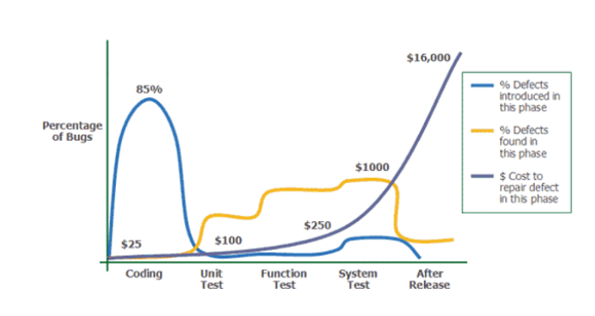
Why tools like Static Analysis? : Cost of bugs
Notice most bugs are introduced early in the development process, and are coding and design problems.
Most bugs are found during unit test, where the cost is higher
The cost of fixing bugs grow exponentially after release
Conclusion: The earlier the bugs found, and more bugs found earlier in the development process translates to less cost
Source: Applied Software Measurement, Caspers Jones, 1996

Slide 4
Finding Flaws in Source Code
Compiler diagnostics
Code reviews
“Linting” checks, like Clang-tidy
Static Analysis using Symbolic Execution
Analysis Performed executing the code symbolically through simulation
Dynamic Analysis – Examples include UBSAN, TSAN, and ASAN
Analysis performed by instrumenting and running the code on a real target
Difficult to test the entire program, and all paths – dependent upon test cases

Slide 5
Four Pillars of Program Analysis
Examples
False positives
Inner Workings
Compile and Runtime affects
Compiler
diagnostics
Linters, style
checkers
Static Analysis
Dynamic Analysis
Clang, gcc, cl
Lint, clang-tidy,
Clang-format,
indent, sparse
Cppcheck, gcc 10+, clang
Valgrind, gcc and clang
No
Yes
Yes
Not likely, but possible
Programmatic
checks
Text/AST
matching
Symbolic Execution
Injection of runtime
checks, library
None
Extra compile step
Extra compile step
Extra compile step,
extended run times
Notes:
5
5
5
5
Static Analysis

Slide 6


Typical CI Loop with Automated Analysis
Code Change
Automated
Program Analysis
Manual Code Review
Test
Ready to commit
Report coding errors
Quick Feedback
Syntax, Semantic, and Analysis Checks: Can analyze properties of code that cannot be tested (coding style)!
Automates and offloads portions of manual code review
Tightens up CI loop for many issues

Slide 7
Finding bugs with the Compiler
1: #include <stdio.h>
2: int main(void) {
3: printf("%s%lb%d", "unix", 10, 20);
4: return 0;
5: }
$ clang t.c
t.c:3:17: warning: invalid conversion specifier 'b' [-Wformat-invalid-specifier]
printf("%s%lb%d", "unix", 10, 20);
~~^
t.c:3:35: warning: data argument not used by format string [-Wformat-extra-args]
printf("%s%lb%d", "unix", 10, 20);
~~~~~~~~~ ^
2 warnings generated.
Static analysis can find deeper bugs through program analysis techniques – like memory leaks, buffer overruns, logic errors.

Slide 8
Finding bugs with the Analyzer
1:int function(int b) {
2: int a, c;
3: switch (b) {
4: case 1: a = b / 0; break;
5: case 4: c = b - 4;
6: a = b/c; break;
7: }
8: return a;
9:}
This example compiles fine – but there are errors here.
Static analysis can find deeper bugs through program analysis techniques
This one is simple, but imagine a large project – thousands of files, millions of lines of code

Slide 9

Program Analysis vs Testing
“Ad hoc” Testing usually tests a subset of paths in the program.
Usually “happy paths”
May miss errors
It’s fast, but real coverage can be sparse
Same is true for other testing methods such as Sanitizers
All used together – a useful combination
1
2
3
4

Slide 10
Program Analysis vs Testing
Program analysis can exhaustively explore all execution paths
Reports errors as traces, or “chains of reasoning”
Downside – doesn’t scale well – path explosion
Path Explosion mitigation techniques …
Bounded model checking – breadth-first search approach
Depth-first search for symbolic execution
1
7
5
2
8
3
12
6
4

Slide 11
Clang Static Analyzer (CSA)
The CSA performs context-sensitive, inter-procedural analysis
Designed to be fast to detect common mistakes
Speed comes at the expense of some precision
Normally, clang static analysis works in the boundary of a single translation unit.
With additional steps and configuration, static analysis can use multiple translation units.

Slide 12
Clang Static Analyzer – Symbolic Execution
Finds bugs without running the code
Path sensitive analysis
CFGs used to create exploded graphs of simulated control flows
switch(b)
b: $b
default
case 4
case 1
b: $b
b: $b
b: $b
$b=[1,1]
$b=[4,4]
Return
Garbage value
c=b-4
Compiler warns here
int function(int b) {
int a, c;
switch (b) {
case 1: a = b / 0; break;
case 4: c = b – 4;
a = b/c; break;
}
return a;
}
b: $b
c: 0
a=b/0
$b=[4,4]
b: $b
a=b/c
Divide by 0
b: $b
c: 0
Divide by 0
Source: Clang Static Analysis - Gabor Horvath - Meeting C++ 2016

Slide 13
Using the Clang Static Analyzer – Example 1
Basic example ….
$ clang --analyze div0.c
Runs the analyzer, outputs text report
$ clang --analyze -Xclang -analyzer-output=html -o <output-dir> div0.c
Runs the analyzer on div0.c, outputs an HTML formatted “chain of reasoning” to the output directory.
cd to <output-dir>, firefox report* &

Slide 14
Using the Clang Static Analyzer – Example 2
Basic example ….
$ scan-build -V clang -c div0.c
Runs the analyzer on div0.c, brings up an HTML report

Slide 15
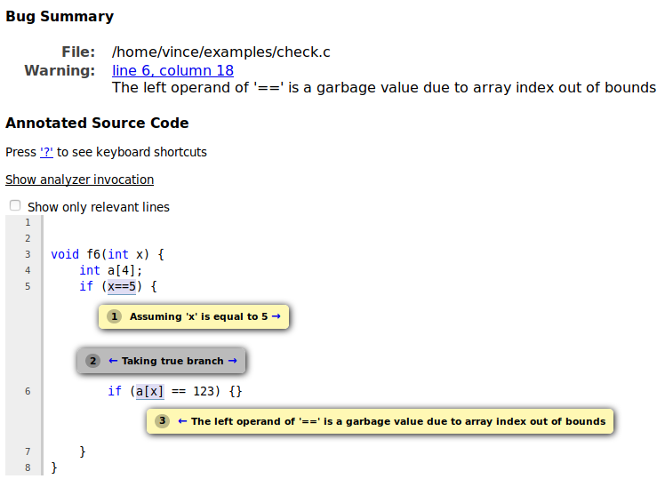
Clang Static Analyzer – Example 1
void f6(int x) {
int a[4];
if (x==5) {
if (a[x] == 123) {}
}
}
Intra procedural
Array index out of bounds.
$ clang --analyze -Xclang -analyzer-output=html -o somedir check.c
check.c:6:18: warning: The left operand of '==' is a garbage value due to array index out of bounds [core.UndefinedBinaryOperatorResult]
if (a[x] == 123) {}
~~~~ ^
1 warning generated.

Slide 16
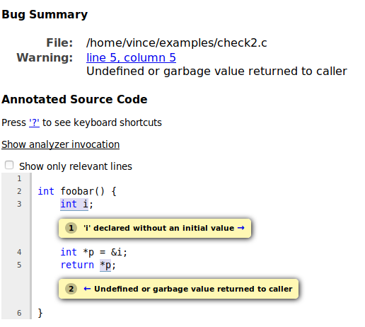
Clang Static Analyzer – Example 2
1:
2: int foobar() {
3: int i;
4: int *p = &i;
5: return *p;
6: }
Intra procedural
‘i’ declared without an initial value
‘*p’, undefined or garbage value

Slide 17
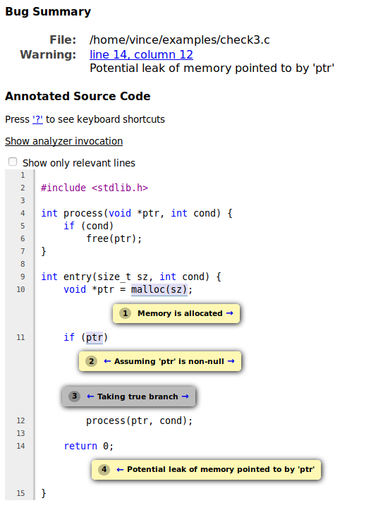
Clang Static Analyzer – Example 3
1:
2: #include <stdlib.h>
3:
4: int process(void *ptr, int cond) {
5: if (cond)
6: free(ptr);
7: }
8:
9: int entry(size_t sz, int cond) {
10: void *ptr = malloc(sz);
11: if (ptr)
12: process(ptr, cond);
13:
14: return 0;
15: }
Analysis spans functions – said to be “inter-procedural”
A Memory leak!

Slide 18
What about analyzing calls to external functions?
These examples were single translation unit only.
In other words, in the same, single source file – “inter-procedural”, or inside of a single translation unit
What if a function calls another function outside of it’s translation unit?
Referred to as “Cross translation Unit”
Examples …

Slide 19
Cross Translation Unit Analysis
Main.cpp
Foo.cpp
int foo();
int main() {
return 3/foo();
}
int foo() {
return 0;
}
foo() is not known to be 0 without CTU
CTU gives the analyzer a view across translation units
Avoids false positives caused by lack of information
Helps the analyzer constrain variables during analysis

Slide 20
How does CTU work?
Call
Graph
Pass 2
Pass 1
CTU
Build
Function index
Analyzer
Analysis results
AST Dumps
Source code and JSON Compilation Database
compile_commands.json

Slide 21
Manual CTU – compile_commands.json
[
{
"directory": “<root>/examples/ctu",
"command": "clang++ -c foo.cpp -o foo.o",
"file": "foo.cpp"
},
{
"directory": “<root>/examples/ctu",
"command": "clang++ -c main.cpp -o main.o",
"file": "main.cpp"
}
]
Mappings implicitly use the compile_commands.json file
Analysis phase uses compile_command.json to locate the source files.
Source: https://clang.llvm.org/docs/analyzer/user-docs/CrossTranslationUnit.html

Slide 22
Manual CTU - Demo
# Generate the AST (or the PCH)
clang++ -emit-ast -o foo.cpp.ast foo.cpp
# Generate the CTU Index file, holds external defs info
clang-extdef-mapping -p . foo.cpp > externalDefMap.txt
# Fixup for cpp -> ast, use relative paths
sed -i -e "s/.cpp/.cpp.ast/g" externalDefMap.txt
sed -i -e "s|$(pwd)/||g" externalDefMap.txt
# Do the analysis
clang++ --analyze \
-Xclang -analyzer-config -Xclang experimental-enable-naive-ctu-analysis=true \
-Xclang -analyzer-config -Xclang ctu-dir=. \
-Xclang -analyzer-output=plist-multi-file \
main.cpp

Slide 23
Using Cross Translation Unit Analysis
scan-build.py within Clang can be used to drive Static Analysis on projects, scan-build is not actively maintained for Cross Translation Unit Analysis.
Ericsson’s Open Source CodeChecker tool supports CTU flows
Let’s see an example …

Slide 24
CodeChecker automates this process
# Create a compile.json
CodeChecker log –b “clang main.cpp foo.cpp” –o compile.json
# First, try without CTU
CodeChecker analyze –e default –clean compile.json –o result
CodeChecker parse result
# Add CTU
CodeChecker analyze –e default –ctu –clean compile.json –o result
CodeChecker parse result
# try with scan build
scan-build clang main.cpp foo.cpp

Slide 25
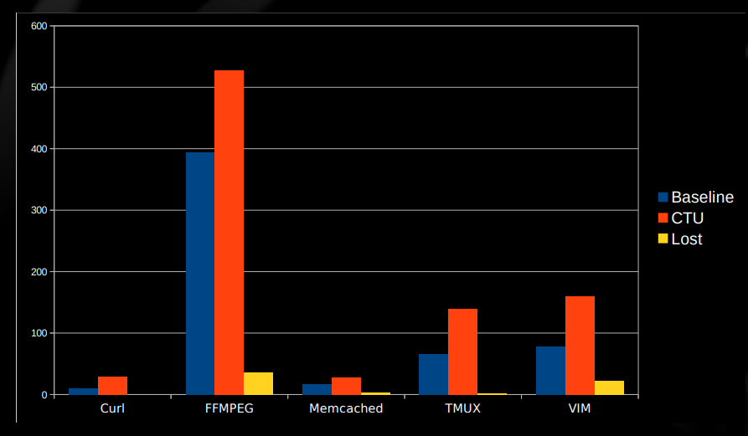
Benefits of CTU
2.4x Average
2.1x median
5x peak
Note there are some lost defects when using CTU
See https://llvm.org/devmtg/2017-03//assets/slides/cross_translation_unit_analysis_in_clang_static_analyzer.pdf , https://www.youtube.com/watch?v=7AWgaqvFsgs

Slide 26
CSA Modeling Weaknesses
CSA does a good job modeling program execution, but does have some weaknesses.
CSA is built for speed, and common cases. The constraint solver gives up on some complex expressions when they appear with symbolic values.
An example …

Slide 27
Example of unhandled bitwise operations
1: unsigned int func(unsigned int a) {
2: unsigned int *z = 0;
3: if ((a & 1) && ((a & 1) ^1))
4: return *z; // unreachable
5: return 0;
6: }
This program is safe, albeit brittle
$ clang --analyze test.cpp
test.cpp:5:16: warning: Dereference of null pointer (loaded from variable 'z') [core.NullDereference]
return *z;
^~
1 warning generated.
$ clang --analyze -Xclang -analyzer-config -Xclang crosscheck-with-z3=true test.cpp
$ clang --analyze -Xclang -analyzer-constraints=z3 func.c
Z3 Refutation, preferred
Z3 constraint manager, slower
Source: Refuting false bugs in the clang static analyzer, Gadelha… https://www.youtube.com/watch?v=SO84AmbWiLA

Slide 28

Refuting False Positives with Z3
CSA sometimes detects false positives because of limitations in the CSA constraint manager.
Speed comes at the expense of precision -- symbolic analysis does not handle some arithmetic and bitwise operations. Z3 can compensate for some of these shortcoming.
CodeChecker enables Z3 by default, if found.
See https://github.com/Z3Prover/z3. Clang can be compiled to use Z3.

Slide 29
Why not just replace the CSA solver?
First SMT backend solver (Z3) implemented in late 2017. It aimed to replace the CSA constraint solver.
This solver was 20 times slower than the built in solver.
A refutation approach gives us best of both worlds
Clang Static Analyzer’s Speed for common cases
A chance for a Z3 solver to refute bugs
So, this is the approach for now

Slide 30
Putting it all together …
How do we use everything we’ve learned to find some real bugs?
Using LLVM/Clang “tip of tree”, compiled with Z3 “tip of tree”
Let’s look at the “bitcoin curve” library https://github.com/bitcoin-core/secp256k1.git.
It’s small enough to demonstrate, and does have some bugs CSA can find
I’ll demonstrate how to run Static Analysis on this code, and the differences in analysis results using Z3 and Cross Translation Unit Analysis
I’ll also demonstrate using Clang Static Analyzer on a well developed project, gzip

Slide 31
Results & Conclusion
We found some real bugs in the “bit coin curve” library.
Demonstrated how more bugs can be found, or refuted, using CTU and Z3
Shown you how to make use of Clang tools to find real bugs

Slide 32
References
Using scan-build https://clang-analyzer.llvm.org/scan-build.html
Cross Translation Unit Analysis https://clang.llvm.org/docs/analyzer/user-docs/CrossTranslationUnit.html
CodeChecker https://github.com/Ericsson/codechecker
Z3 Refutation in Clang - https://arxiv.org/pdf/1810.12041.pdf
Implementation of CTU in Clang - https://dl.acm.org/doi/pdf/10.1145/3183440.3195041
https://llvm.org/devmtg/2017-03//assets/slides/cross_translation_unit_analysis_in_clang_static_analyzer.pdf
SMT based refutation of spurious bug reports in CSA - https://www.youtube.com/watch?v=WxzC_kprgP0
“Bit coin curve” library - https://github.com/bitcoin-core/secp256k1.git
Compile command JSON Specification https://clang.llvm.org/docs/JSONCompilationDatabase.html
Z3 https://github.com/Z3Prover/z3
Tutorial Source - https://github.com/vabridgers/LLVM-Virtual-Tutorial-2020.git

Slide 33
Thank you for attending!

Slide 34
Demo notes
git clone https://github.com/Z3Prover/z3.git
cd z3; mkdir build; cd build
cmake -G Ninja ../ ; ninja ; sudo ninja install # assumes installed at /usr/local/lib/libz3.so
CodeChecker pulled/installed from https://github.com/Ericsson/CodeChecker.git
Be sure to set “CC_ANALYZERS_FROM_PATH=1”, set PATH to your clang
Bit coin curve library git clone https://github.com/bitcoin-core/secp256k1.git
Gzip https://git.savannah.gnu.org/git/gzip.git
Run scan-build -> “scan-build make”
CodeChecker command notes …
CodeChecker log –b “make” –o compile_commands.json
CodeChecker analyze –e default –clean –j 16 compile_commands.json –o outputdir
CodeChecker analyze –e default –ctu –clean –j 16 compile_commands.json –o outputdir
CodeChecker analyze –e default –ctu –z3-refutation off –clean –j 16 compile_commands.json –o outputdir
CodeChecker parse –e html –o html-output-dir outputdir

