Slide 1
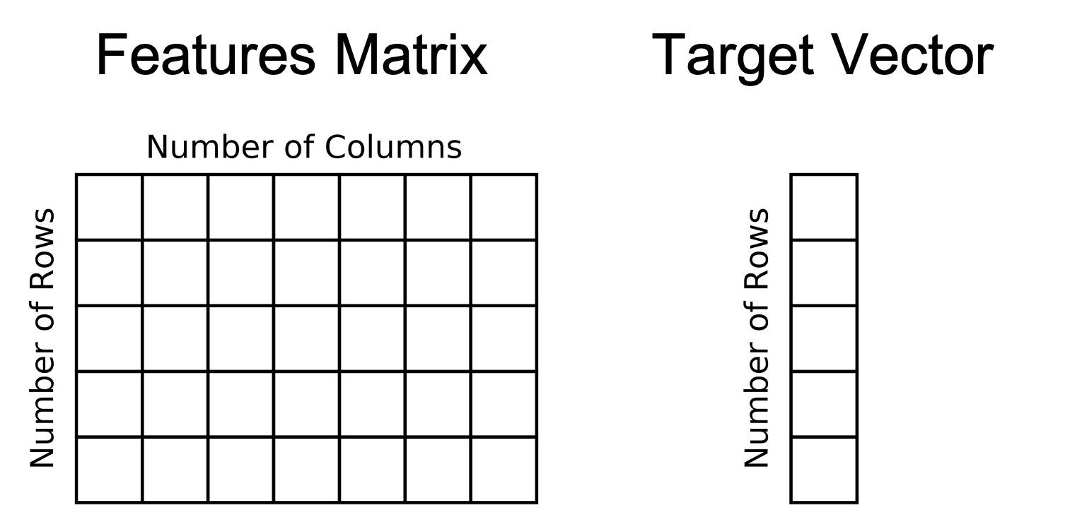
Supervised Learning
Unsupervised Learning

