Slide 1
Concluding thoughts
Notes:
logistic regression: https://towardsdatascience.com/logistic-regression-using-python-sklearn-numpy-mnist-handwriting-recognition-matplotlib-a6b31e2b166a
PCA (dimensionality reduction using Python): https://towardsdatascience.com/pca-using-python-scikit-learn-e653f8989e60

Slide 2
Disadvantages of Scikit-Learn
Scikit-learn models don’t parallelize as well as other libraries/frameworks/languages.
Scikit-learn is not widely used for deep learning.
Notes:
Programming machine learning algorithms from scratch is no easy task.
Scikit-learn provides a large amount of well programmed algorithms. Most models in scikit-learn also have reasonable default values for hyperparameters. This means that a machine learning algorithm might work well with little tuning.
Syntax allows you to try multiple algorithms quickly
Library works well with other python libraries like NumPy, pandas, and matplotlib
Library is popular. There are always more scikit-learn tutorials being written. This means that you can get your questions answered more easily.

Slide 3
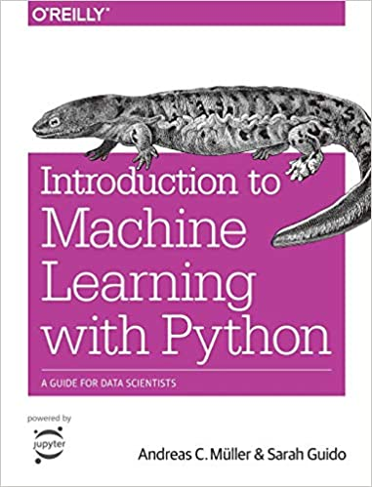
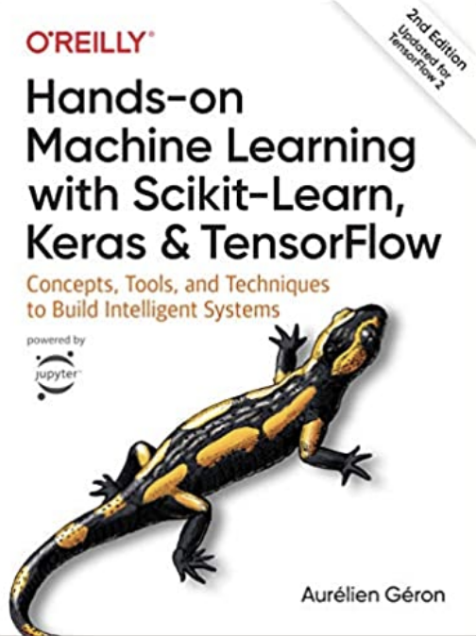
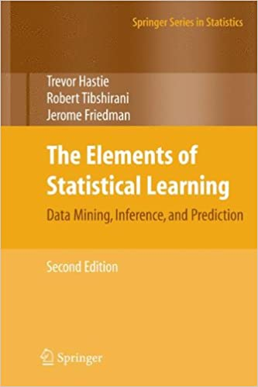
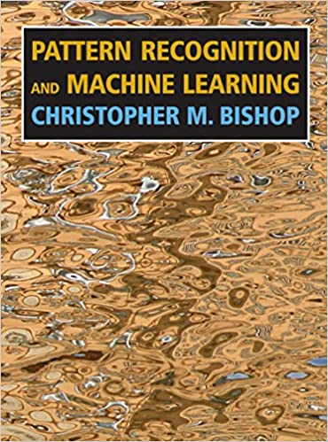
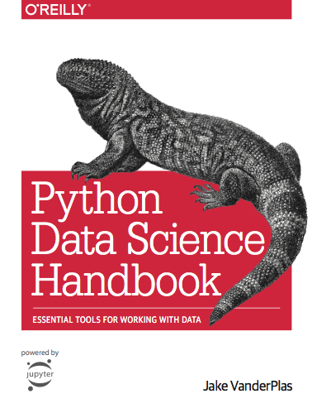
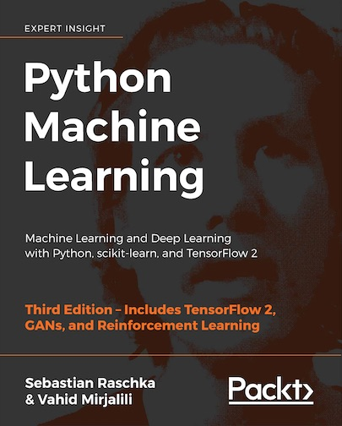
Where to Learn Machine Learning (Books)
Getting familiar with machine learning can take multiple courses and books
So here is my advice for learning more
Python in a Jupyter Notebook
Notes:
They are non-parametric (i.e. will outperform linear models if the relationship between features and response is highly non-linear).
Common practice is to assign the negative class as the absence of something (ie absence of a tumor), but it doesn’t really matter what you assign what.
positive class typically is the presence of something we are looking for.
This example is just with two classes. Later on, with our digits example, we will talk about multiclass classification problems as well. in that case our variable y can take on multiple values {0, 1, 2, 3, 4, 5, 6, 7, 8, 9}

Slide 4
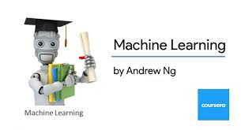


Where to Learn Machine Learning (Courses)
Coursera Machine Learning
Great Theory, MATLAB based (don’t recommend MATLAB assignments)
Free if you audit
Machine Learning A-Z: Hands-On Python & R in Data Science
Great concepts and theory.
Updated often and great way to learn for interviews.
Coursera Deep Learning Specialization
Great Theory, Mostly TensorFlow based
Free if you audit
Fast AI Course
Free learn by doing, Fastai based
Python in a Jupyter Notebook
Notes:
They are non-parametric (i.e. will outperform linear models if the relationship between features and response is highly non-linear).
Common practice is to assign the negative class as the absence of something (ie absence of a tumor), but it doesn’t really matter what you assign what.
positive class typically is the presence of something we are looking for.
This example is just with two classes. Later on, with our digits example, we will talk about multiclass classification problems as well. in that case our variable y can take on multiple values {0, 1, 2, 3, 4, 5, 6, 7, 8, 9}

Slide 5
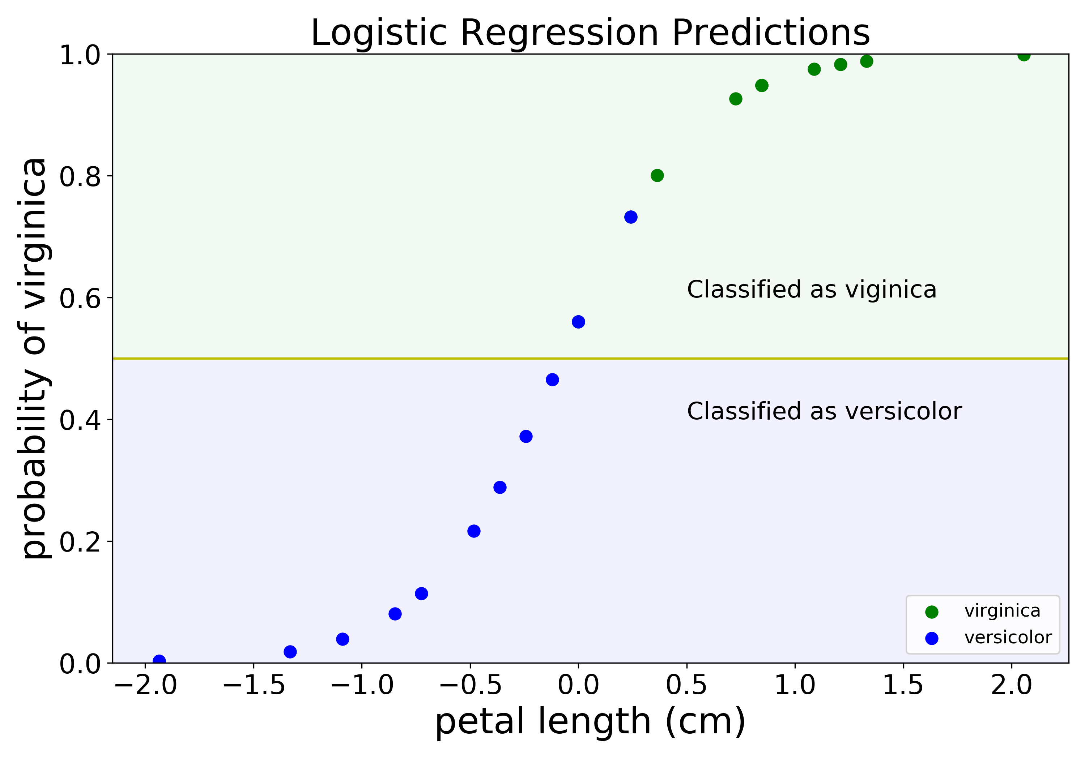
Concluding Thoughts
Hope you enjoyed this talk
Talk should be posted on YouTube eventually
Stay in touch! Feel free to connect with me on LinkedIn or Twitter (@GalarnykMichael)
Logistic regression predictions
Python in a Jupyter Notebook
Notes:
They are non-parametric (i.e. will outperform linear models if the relationship between features and response is highly non-linear).
Common practice is to assign the negative class as the absence of something (ie absence of a tumor), but it doesn’t really matter what you assign what.
positive class typically is the presence of something we are looking for.
This example is just with two classes. Later on, with our digits example, we will talk about multiclass classification problems as well. in that case our variable y can take on multiple values {0, 1, 2, 3, 4, 5, 6, 7, 8, 9}

