Slide 1
Machine Learning with Scikit-Learn
Notes:
logistic regression: https://towardsdatascience.com/logistic-regression-using-python-sklearn-numpy-mnist-handwriting-recognition-matplotlib-a6b31e2b166a
PCA (dimensionality reduction using Python): https://towardsdatascience.com/pca-using-python-scikit-learn-e653f8989e60

Slide 2



About Me
Senior Data Scientist at Coding Dojo
What I have done:
Understanding Fitbit Data
Machine Learning with Python Instructor
LinkedIn Learning Instructor
Notes:
Fitbit data

Slide 3
What you should know for this talk
Python strings
Integers and floats
Conditionals and booleans-if, else, and elif
For loops
Lists, tuples
Dictionaries
Notes:
I have posted supplementary material on Canvas for this

Slide 4
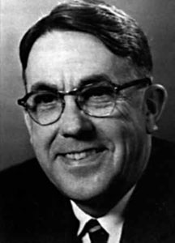
What is Machine Learning?
“field of study that gives computers the ability to learn from data without being explicitly programmed”
- Arthur Samuel

Slide 5

What is Machine Learning?
“‘Learning’ enters when we give these models tunable parameters that can be adapted to observed data; in this way the program can be considered to be ‘learning’ from the data."
- Jake Vanderplas

Slide 6
What is Machine Learning?
“Once models have been fit to previously seen data, they can be used to predict and understand aspects of newly observed data”
- Jake Vanderplas

Slide 7
Two Basic Types of Machine Learning
Supervised learning
Modeling the relationship between measured features of data and some target (label/value). When target is a label, it is classification. When target is a continuous value, it is regression.
Unsupervised learning
Modeling the measured features of data without some target (label/value)

Slide 8
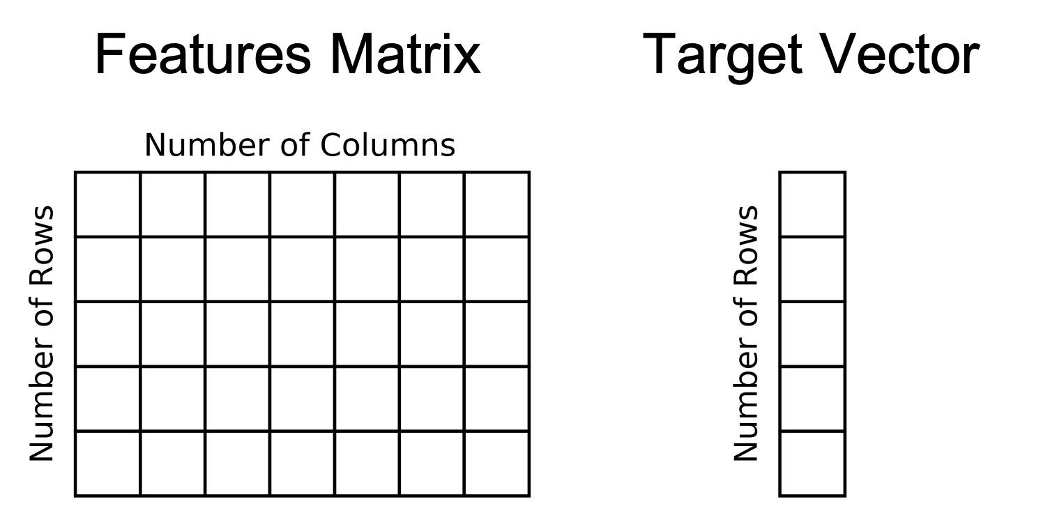
Supervised learning

Slide 9
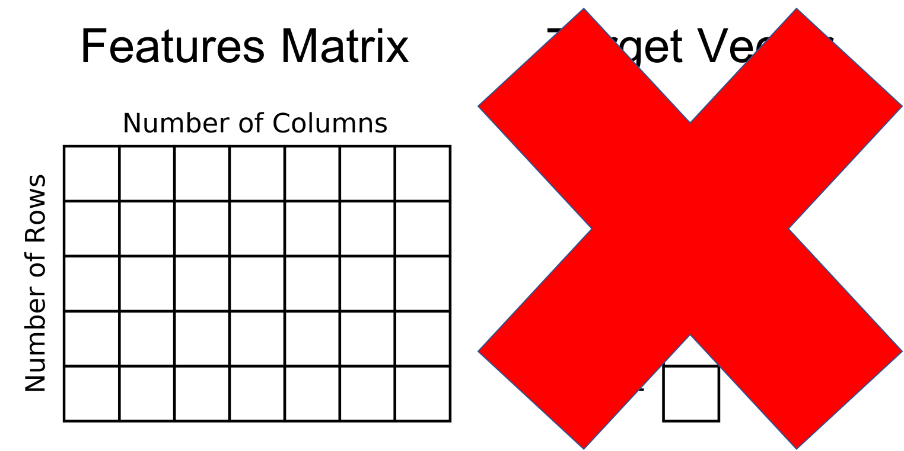
Unsupervised learning

Slide 10
Why use Scikit-Learn for Machine Learning?
Programming machine learning algorithms from scratch is no easy task.
Scikit-learn provides a large amount of well programmed algorithms
Syntax allows you to try multiple algorithms quickly
Library works well with other python libraries like NumPy, pandas, and matplotlib
Library is popular. There are always more scikit-learn tutorials being written. This means that you can get your questions answered more easily.
Notes:
Programming machine learning algorithms from scratch is no easy task.
Scikit-learn provides a large amount of well programmed algorithms. Most models in scikit-learn also have reasonable default values for hyperparameters. This means that a machine learning algorithm might work well with little tuning.
Syntax allows you to try multiple algorithms quickly
Library works well with other python libraries like NumPy, pandas, and matplotlib
Library is popular. There are always more scikit-learn tutorials being written. This means that you can get your questions answered more easily.

Slide 11
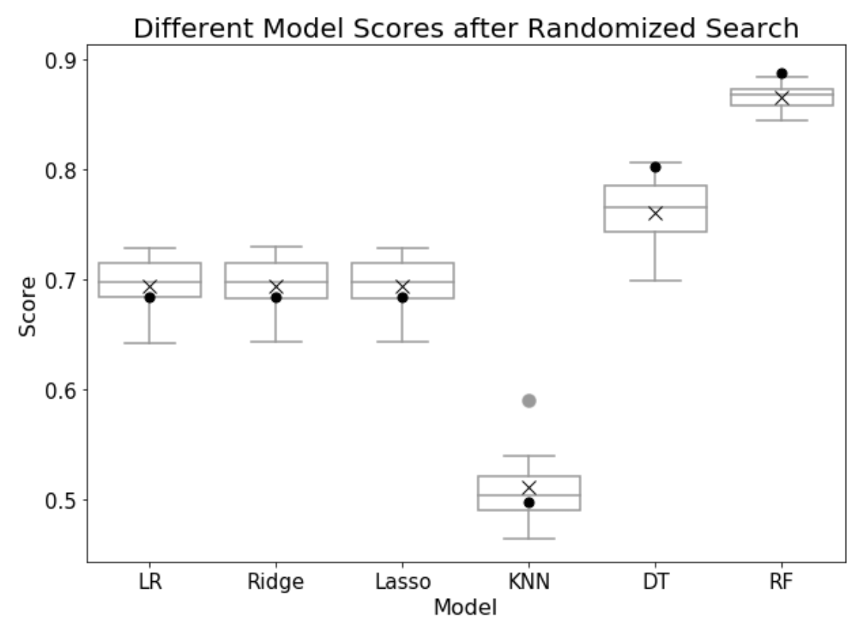
Why is this talk using Scikit-Learn?
The goal of this talk is to try out multiple machine learning algorithms quickly and learn each algorithms strengths and weaknesses.
In the process, learn concepts such as bias, variance, overfitting, and underfitting
Notes:
Programming machine learning algorithms from scratch is no easy task.
Scikit-learn provides a large amount of well programmed algorithms. Most models in scikit-learn also have reasonable default values for hyperparameters. This means that a machine learning algorithm might work well with little tuning.
Syntax allows you to try multiple algorithms quickly
Library works well with other python libraries like NumPy, pandas, and matplotlib
Library is popular. There are always more scikit-learn tutorials being written. This means that you can get your questions answered more easily.

