Slide 1
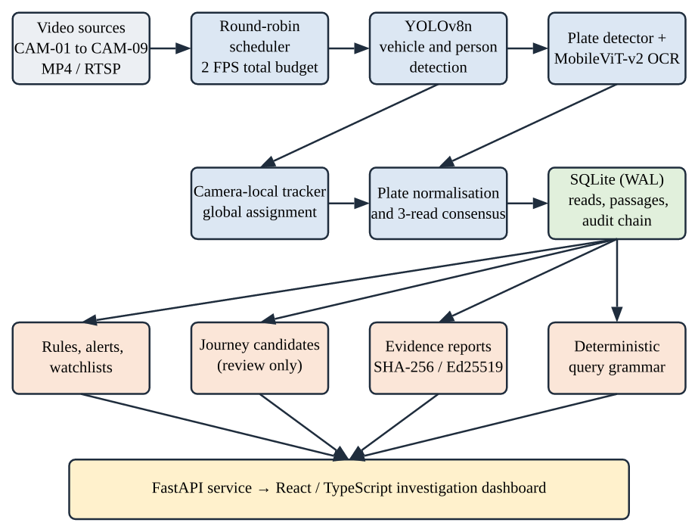
CSE311 ARTIFICIAL INTELLIGENCE | MINI PROJECT
SAKSHI
Multi-Camera Vehicle Analytics and Evidence Review
Vehicle detection, licence-plate review and auditable observations
A S Sri Dathan (2024BCS0091)
Akshay V.S (2024BCD0015)
Bharadwaj B Chand (2024BCS0059)
Shivansh Neekhra (2024BCS0023)
Srimoneyshankar Ajith (2024BCS0055)
Guide: Dr. Sreeja M U | Department of CSE, IIIT Kottayam | Third Year | 2026–2027
Notes:
SAKSHI turns multi-camera traffic video into reviewable, auditable vehicle and plate observations. Pretrained models do the perception; our contribution is the pipeline that keeps uncertainty visible.

Slide 2
The Problem: Too Much Video, Too Little Trust
Hours of CCTV from many cameras
Candidate vehicles and plate reads
Reviewed, auditable evidence
OCR can be wrong
Replay ≠ capture time
Wrong ID is costly
Small, blurred plates get misread
A file timestamp is not when it happened
So uncertain reads must abstain
Example: a reviewer asks which cameras saw a blue truck last night. SAKSHI returns a short list of candidate frames with raw evidence and an uncertainty label, instead of a confident but unsupported plate.
SAKSHI | CSE311 Artificial Intelligence | IIIT Kottayam
2
Notes:
Problem: reviewing video by hand does not scale, and a naive ALPR demo can implicate the wrong vehicle. We use AI for detection and OCR because fixed rules fail on varied scenes, and we wrap it in review controls.

Slide 3
Objectives
Shared sampling
Detect vehicles
Read plates
One processor, global 2 FPS budget
Pretrained YOLOv8n; people for masking
Detector + OCR; keep raw and ambiguous reads
Track per camera
Persist evidence
Review dashboard
Motion + box cost, ambiguity abstention
SQLite, model hashes, audit chain
Queries, rules, signed reports
Plus: reproducible evaluation tools that state what is and is not measured.
SAKSHI | CSE311 Artificial Intelligence | IIIT Kottayam
3
Notes:
Six objectives map to the six pipeline stages. The last line matters: we say clearly what we did not measure.

Slide 4
Existing Work and Literature
Work | Idea | Role in SAKSHI
YOLO [Redmon 2016], YOLOv8 | Single-stage real-time detection | Pretrained vehicle and person detector
SORT / DeepSORT | Motion + Hungarian assignment; learned appearance | Inspires global-assignment tracker; no appearance model
YOLO-based ALPR [Laroca 2018] | Detect plate, then read characters | Two-stage plate detector + OCR structure
MobileViT / v2 [Mehta 2022] | Convolution + separable self-attention for mobile | Backbone of the plate OCR model
Integer quantisation [Jacob 2018] | Lower precision for speed and size | INT8 detector comparison
Gap addressed: an integrated review workflow around uncertain predictions (provenance, audit, abstention), not a new detector.
SAKSHI | CSE311 Artificial Intelligence | IIIT Kottayam
4
Notes:
We combine established methods. Five or more works inform detection, tracking, plate OCR, efficient inference and evaluation. The report covers all of them in section 3.

Slide 5
Proposed System: Architecture
1 processor
Viewers read cached output; no extra workers
MP4 / RTSP
Input sources, 9 cameras in the demo
Signed reports
SHA-256 hashes, optional Ed25519
SAKSHI | CSE311 Artificial Intelligence | IIIT Kottayam
5
Notes:
Walk the figure left to right: sources, scheduler, detector, plate branch, tracker and gate, database, then rules, journeys, reports and queries behind one API and dashboard.

Slide 6
Dataset and Input
9
45
21
0
cameras: 6 bundled, 3 managed originals
prediction-blind review frames
plate crops reviewed by a person
labelled held-out samples
• CAM-01 to CAM-06: bundled clips for replay and detector calibration. CAM-07 to CAM-09: higher-resolution originals for plate review.
• Models are pretrained, so no training set was collected; there is no labelled test set, so no accuracy is claimed.
• Privacy mode pixelates people and plates before output is shared.
SAKSHI | CSE311 Artificial Intelligence | IIIT Kottayam
6
Notes:
Be explicit that the data supports runtime measurement and a small review, not an accuracy claim. Input sources: MP4 or RTSP. Output: observations, alerts, signed reports.

Slide 7
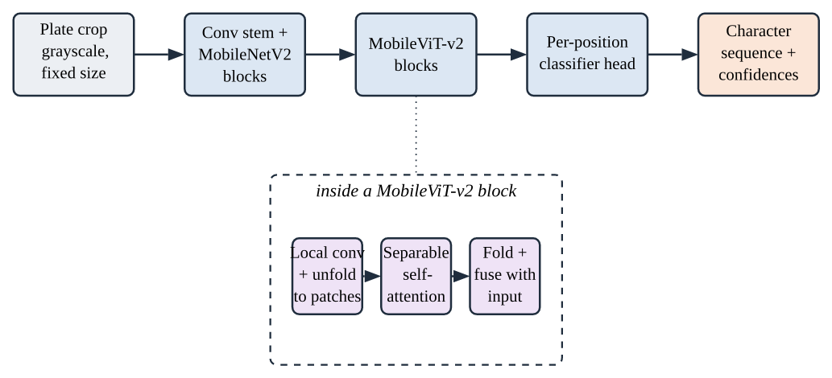
AI Technique: Transformer-Style Plate OCR
• MobileViT-v2 mixes convolution (local detail) with separable self-attention (global layout) at linear cost, so it runs on CPU.
• Plate detector: YOLOv9-tiny at 384 × 384; OCR model: global-plates-mobile-vit-v2; both via ONNX Runtime.
SAKSHI | CSE311 Artificial Intelligence | IIIT Kottayam
7
Notes:
Why this model: small, CPU-capable, available pretrained. Separable self-attention avoids quadratic cost over patches. We did not train it; its accuracy on Indian plates is unmeasured.

Slide 8
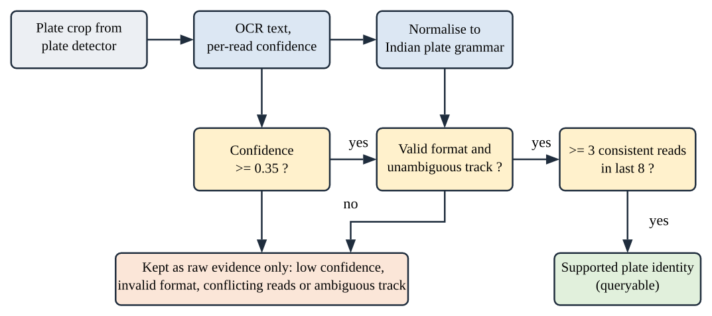
Plate Reading: Abstain Unless Evidence Agrees
≥ 0.35
3 of last 8
Else: raw only
OCR confidence threshold
reads must agree on one string
kept for review, never an identity
SAKSHI | CSE311 Artificial Intelligence | IIIT Kottayam
8
Notes:
This is the core safety idea. A wrong plate is worse than no plate, so a plate becomes queryable only after passing confidence, format, track and consensus checks.

Slide 9
Camera-Local Tracking
Association cost between a track and a detection
distance 0.75
1 − IoU 0.20
area change 0.05
• Minimum-cost assignment per frame; near-equal competing matches are marked ambiguous and those tracks are retired.
• Track IDs are local to one camera: no appearance model, so no cross-camera identity is claimed.
SAKSHI | CSE311 Artificial Intelligence | IIIT Kottayam
9
Notes:
Weights are from backend/tracking.py. Costs are heuristic scores, not probabilities.

Slide 10
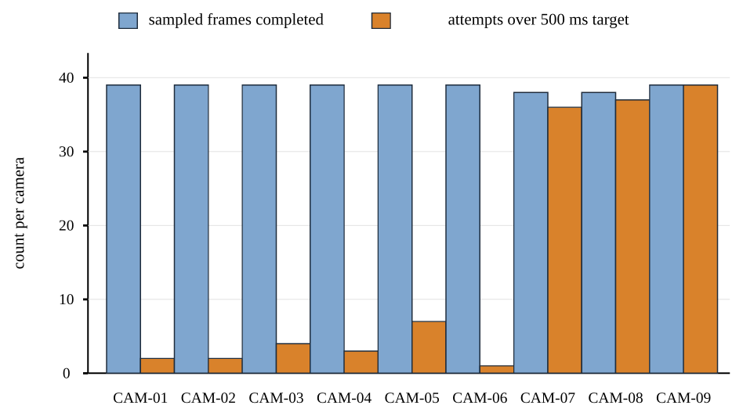
Results: Nine-Camera Replay
1.17 FPS
349 frames in 298 s (target 2.0)
0 failures
no failed inference attempts
830 MiB
median memory; 163% median CPU
Almost every 500 ms overrun comes from CAM-07 to CAM-09: full-resolution plate inference is the bottleneck.
SAKSHI | CSE311 Artificial Intelligence | IIIT Kottayam
10
Notes:
Stable, no failures, but below the 2 FPS budget on a single 12-thread laptop CPU. These are execution measurements, not accuracy.

Slide 11
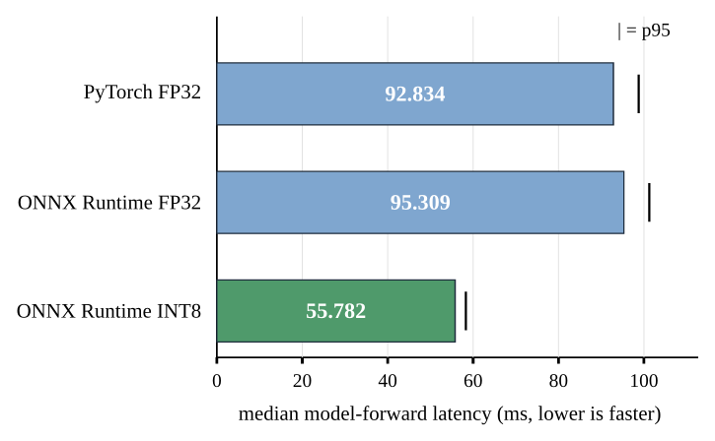
Results: INT8 Quantisation Speed-Up
55.8 vs 92.8 ms
INT8 ONNX vs PyTorch FP32 median
3.6 MB
INT8 model vs 12.8 MB FP32 ONNX
15 of 16
detections matched FP32 (unlabelled)
Detector-only, 10 runs after 2 warm-ups. Agreement with FP32 is not accuracy. INT8 is not yet in live inference.
SAKSHI | CSE311 Artificial Intelligence | IIIT Kottayam
11
Notes:
About 41 percent faster than FP32 ONNX. Quantisation is a promising speed lever pending held-out validation.

Slide 12
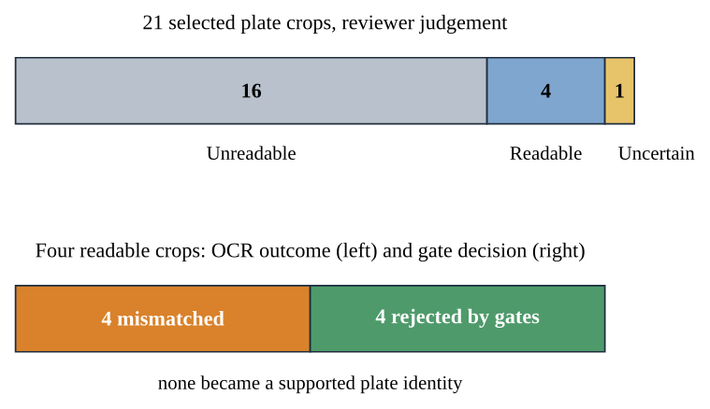
Results: Plate Gates on Real Crops
• 21 selected crops: 16 unreadable, 4 readable, 1 uncertain.
• All 4 readable crops were misread, and all 4 were rejected by the gates.
• None became a supported plate identity.
• Offline probe: 68 crop variants, 1 exact match, 5 passed gates.
Selected sample, not representative: shows abstention behaviour, not OCR accuracy.
SAKSHI | CSE311 Artificial Intelligence | IIIT Kottayam
12
Notes:
The honest takeaway: the system declined to name a plate rather than name a wrong one. We do not claim an accuracy or false-accept rate.

Slide 13
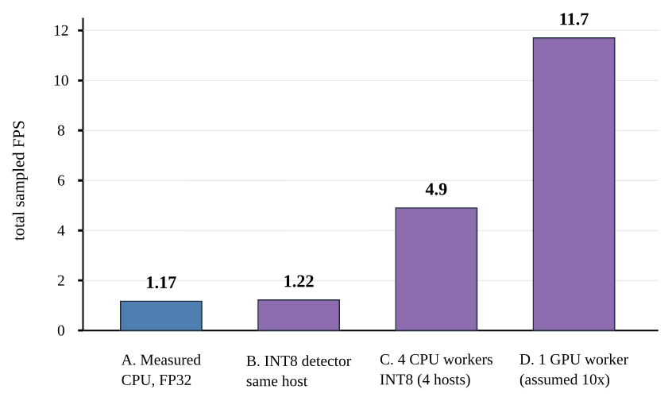
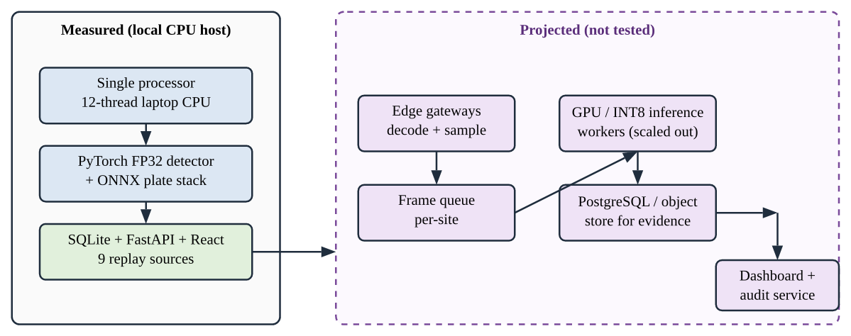
Projection: Scaling the Architecture (Estimate)
• Not tested: full hardware and budget were unavailable. B is derived from measured INT8 latency; C assumes linear scaling by camera; D assumes 10× (illustrative).
SAKSHI | CSE311 Artificial Intelligence | IIIT Kottayam
13
Notes:
Proof of concept framing: decode, inference and storage are separate, so they can be scaled independently. All projected numbers are labelled estimates.

Slide 14
Conclusion and Future Scope
What we built
Next
• End-to-end AI pipeline: detect, read, track, store, review.
• Zero failures over a nine-camera replay.
• Uncertainty controls that abstain instead of guessing.
• Honest scope: runtime measured, accuracy not claimed.
• Authorised labelled dataset and held-out evaluation.
• Fine-tune OCR on regional plates.
• GPU and edge profiling; INT8 in live inference.
• Verified clocks and locations for cross-camera journeys.
• Privacy, legal and security review.
SAKSHI | CSE311 Artificial Intelligence | IIIT Kottayam
14
Notes:
Limitations: no held-out labels, single host, replay timestamps. Questions to expect are in Appendix A of the report.

Slide 15
References and Demo
• J. Redmon et al., You Only Look Once, CVPR 2016.
• A. Bewley et al., SORT, ICIP 2016; N. Wojke et al., DeepSORT, ICIP 2017.
• R. Laroca et al., Robust Real-Time ALPR Based on YOLO, IJCNN 2018.
• S. Mehta, M. Rastegari, MobileViT, ICLR 2022; Separable Self-Attention, TMLR 2023.
• B. Jacob et al., Integer-Arithmetic-Only Inference, CVPR 2018.
• Ultralytics YOLOv8, Fast-ALPR, FastPlateOCR, Open Image Models documentation.
Demo: uv run run.py, then open http://localhost:5174
SAKSHI | CSE311 Artificial Intelligence | IIIT Kottayam
15
Notes:
Full reference list is in the report.

