Slide 1
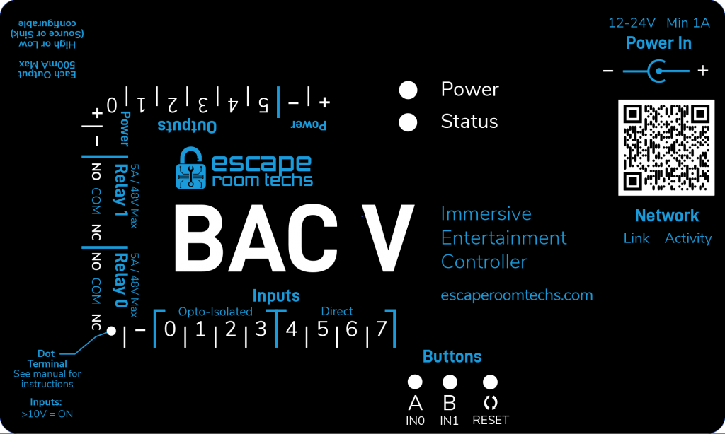
BAC Wiring (No extenders up to one meter)
Use middle i2c header
And ensure VCCIO jumper is set to pins 2-3 (3.3V)
FX45
Alchemy Escape
3D Hall Sensor
Alchemy Escape
3D Hall Sensor
Alchemy Escape
3D Hall Sensor
Alchemy Escape
3D Hall Sensor
I2C

Slide 2
BAC Wiring (With extenders)
Use hi drive i2c header
And ensure VCCIO jumper is set to pins 1-2 (5V)
FX14-mini
Alchemy Escape
3D Hall Sensor
FX14-mini
FX14-mini
Alchemy Escape
3D Hall Sensor
FX45
I2C
Diagram incomplete, need hi drive -> ethernet wiring from ERT
Short JST cable
Long ethernet cable
JST Cable
Ethernet

Slide 3
Microcontroller Wiring (No extenders up to one meter)
2.2K pullup resistor on SCL and SDA
Cable pinout:
Pin 1: SCL
Pin 2: SDA
Pin 3: 3.3V+
Pin 4: Ground
Microcontroller
SCL
Pin 1 is square pad on hall sensor
SDA
3.3V+
GND
Alchemy Escape
3D Hall Sensor
Alchemy Escape
3D Hall Sensor
Alchemy Escape
3D Hall Sensor
Alchemy Escape
3D Hall Sensor

Slide 4
Microcontroller Wiring (With extenders)
2.2K pullup resistor on SCL and SDA
Cable pinout:
Pin 1: SCL
Pin 2: SDA
Pin 3: 3.3V+
Pin 4: Ground
Microcontroller
SCL
Pin 1 is square pad on hall sensor
SDA
3.3V+
GND
FX14-mini
FX14-mini
Alchemy Escape
3D Hall Sensor
FX14-mini
FX14-mini
Alchemy Escape
3D Hall Sensor
Long ethernet cable
Short JST cable
JST Cable
Ethernet

