Slide 1
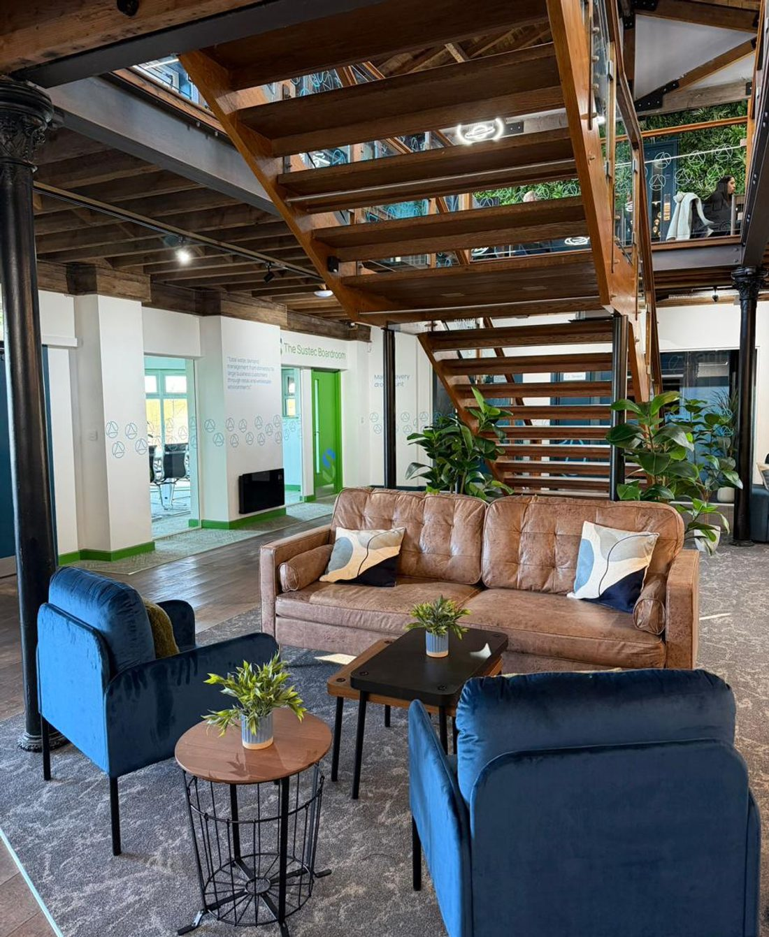


PART OF
Life at Aqualogic.
A business growing across the UK, doing work that matters, with the kind of culture you only get when people genuinely look out for each other.
INTERNAL ENGAGEMENT TEMPLATE

Slide 2
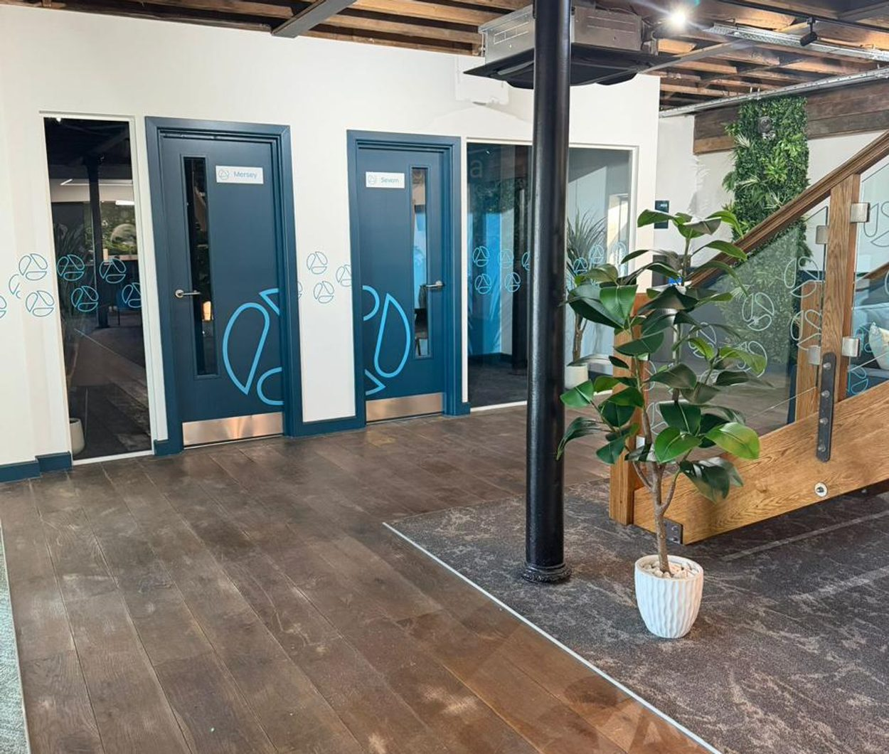

TEAM PRESENTATION
Contents
01
Who we are
02
Our purpose
03
Our values
04
Life here
05
Growing with us
06
Be part of it
02

Slide 3
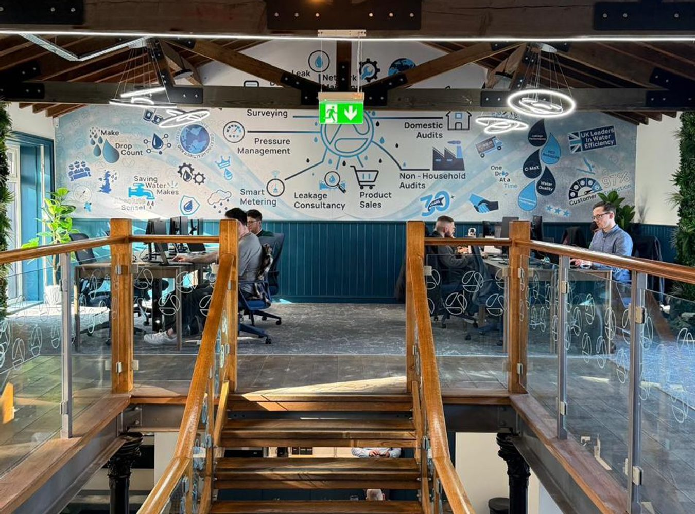
01 · WHO WE ARE
One team, one focus
Aqualogic is its people.
We are a skilled, mixed team, from apprentices taking their first steps to experienced engineers, consultants, plumbers, auditors and technical specialists, brought together by one shared aim: using water more intelligently.
We began as Flow Control in 1979 with one simple focus: reducing waste and saving water. What has stayed constant is the underlying logic: practical intervention, intelligent use of expertise and measurable outcomes. Today, as part of the Sustec group, we are building on that foundation, not leaving it behind.
03

Slide 4
02 · OUR PURPOSE
Why our work matters
To help protect water as a vital resource by reducing waste, improving efficiency and delivering practical solutions that create lasting value for customers, communities and the environment.
04

Slide 5
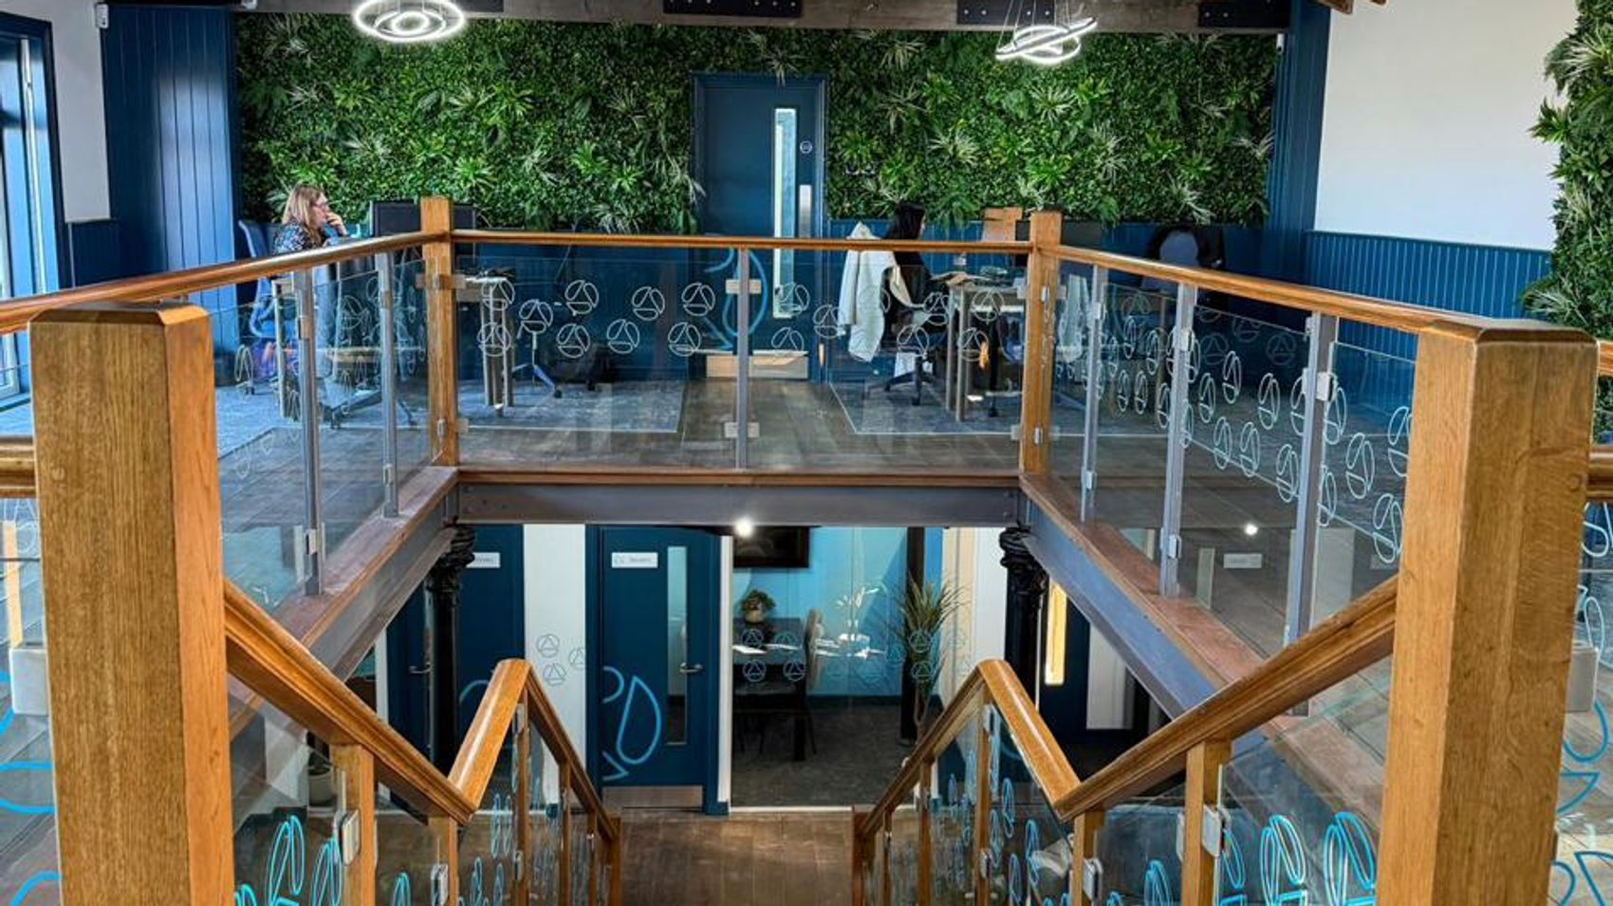
03
Our values
What we stand for, and how we work together.
05

Slide 6





03 · OUR VALUES
Our values
Trust
We build confidence through transparency, reliability and doing what we say we will do.
Ingenuity
We think practically, adapt intelligently and solve problems in ways that create better outcomes.
Excellence
We set high standards, take pride in our work and deliver with consistency, care and quality.
Collaboration
We work openly, support one another and build strong relationships that make us better together.
Agility
We stay responsive, adaptable and ready to move, so we can deliver where it matters most.
06

Slide 7
03 · OUR VALUES
Values in action
Values land through behaviour, not labels. Here is what they look like day to day.
Trust
Ingenuity
Excellence
Collaboration
Agility
Transparency
Accountability
Honesty
Dependability
Curiosity
Adaptability
Problem-solving
Improvement
Quality
Consistency
Ownership
Attention to detail
Openness
Support
Teamwork
Respect
Knowledge-sharing
Responsiveness
Flexibility
Pace
Willingness to act
07

Slide 8
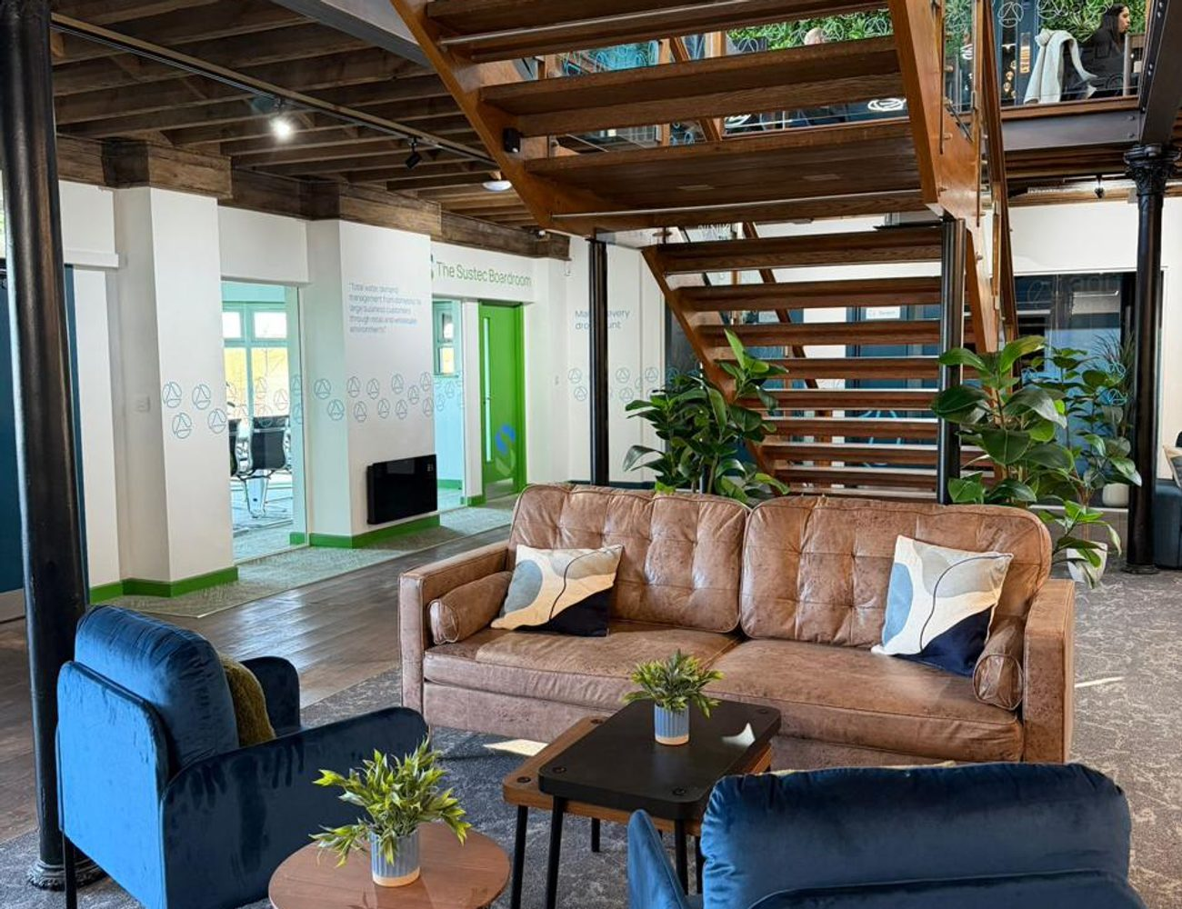
04 · LIFE HERE
Life at Aqualogic
The work here is practical and hands-on. Teams are close, the structure is flatter than you might expect, and people help each other out rather than standing on ceremony.
We would rather bring someone in and train them properly than hire bad habits, so the focus is on doing the job well and supporting each other to get there.
08

Slide 9
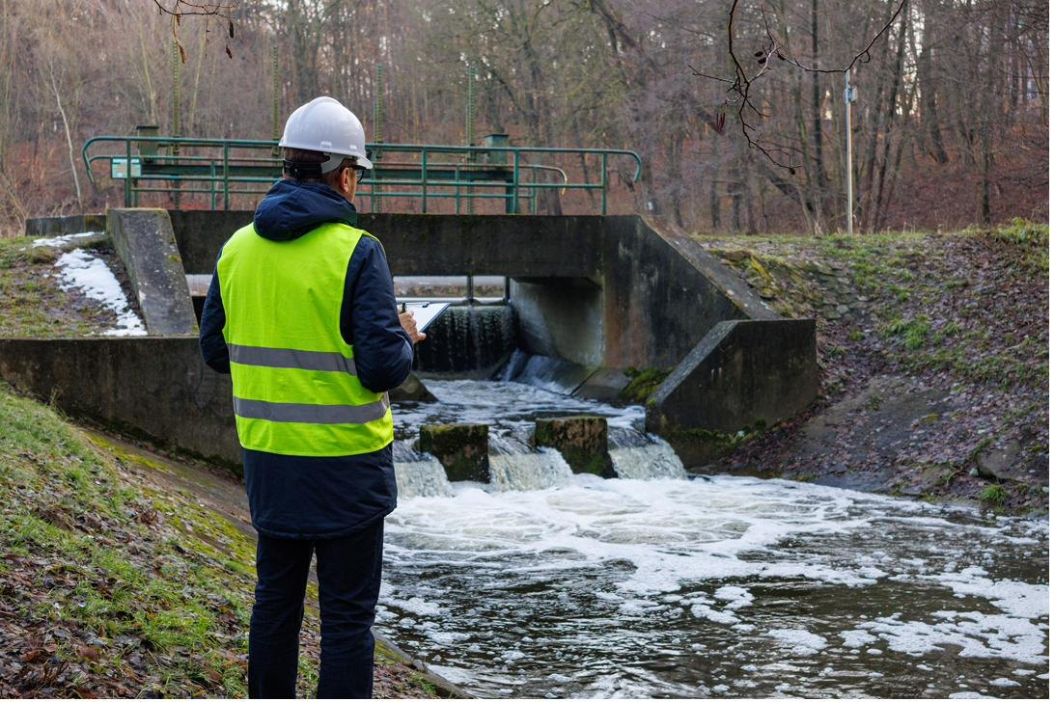
OUR CULTURE
Safe and Sound.
For more than 16 years we have worked to build a culture where every person, employee or partner, gets home safe each day.
09

Slide 10
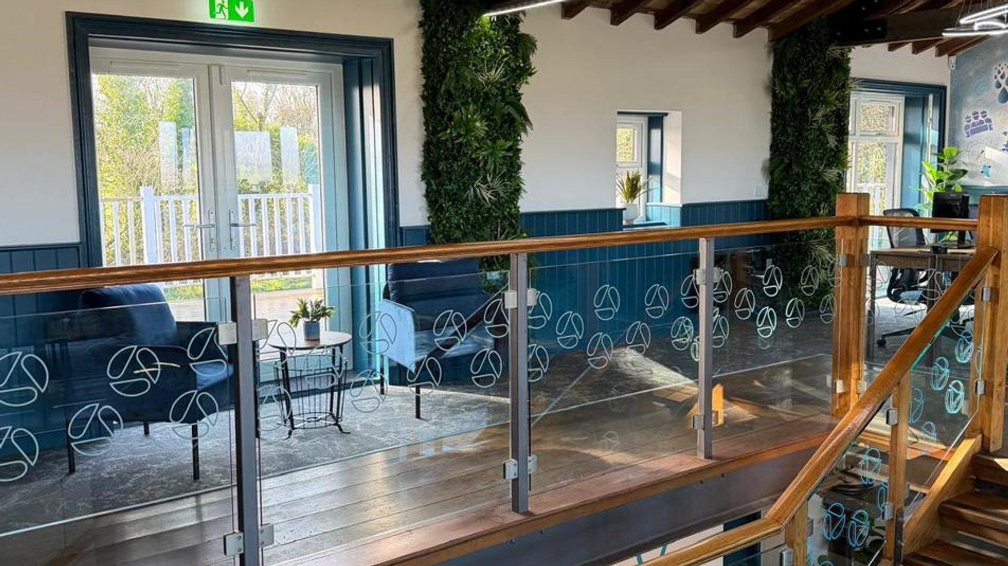
05
Growing with us
Real progression, strong training and room to build a long career.
10

Slide 11
05 · GROWING WITH US
Progression is real
A lot of our supervisors, project managers and senior people started in entry-level or field-based roles and worked their way up. If you are willing to learn and put the work in, there is a clear path forward.
1
›
2
›
3
›
4
Entry / field
Supervisor
Project manager
Senior / leadership
Where many begin
Lead a team
Run programmes
Shape the business
We promote from within: at supervisor level we develop our own people rather than advertising out.
11

Slide 12



05 · GROWING WITH US
We invest in people
Funded core training, the qualifications to do the job safely and well, and a clear route from learning the trade to leading on it.
Core training and tickets
Management development
Apprenticeships
Funded core training and the technical qualifications needed to do the job safely and well.
CMI-accredited management development for people moving up into supervisory and leadership roles.
We bring people in early, with a clear route from learning the trade to leading on it.
12

Slide 13

05 · GROWING WITH US
A growing business, national reach
This is a growing business with national reach. We deliver large-scale programmes for water companies right across the UK, which means real projects, real responsibility and room to grow with us.
South Wales
Operational centre
Two operational centres anchor the business. Wherever you are based, there are opportunities in the field, in our centres and across our programmes.
The Wirral
Operational centre
13

Slide 14

01 · WHO WE ARE
Meet the leadership
Ben Rice
Ashley Williams
CHIEF OPERATIONS OFFICER
CHIEF GROWTH OFFICER
Ben leads on operations and governance, helping Aqualogic deliver at pace and with confidence, with a focus on resilient operations and practical water conservation outcomes.
Ashley leads our growth, shaping how we expand our services across the water sector. He joined Aqualogic in 2011 and has built much of our market and partnership activity.
Jonathan Adler
Wayne Arscott
CLIENT SERVICES DIRECTOR
WATER SERVICES DIRECTOR
Jonathan leads Client Services, making sure customers get a consistent, high-quality experience from first contact through to ongoing support.
Wayne leads our Water Services Division, with senior experience across the UK water sector. He joined the board in 2025 and is known for leakage detection and frontline delivery.
14
Notes:
Leadership bios from the Our People copy. Drop in each leader's headshot in place of the placeholder avatar.

Slide 15
OUR PEOPLE
“
A genuine quote from someone on the team goes here, in their own words, on what it is like to work at Aqualogic.
[Name], [Role]
15
Notes:
Employee quote slot. Select from the engagement survey analysis once permissions are in place. Survey data stays internal; only chosen quotes are shared.

Slide 16

06 · BE PART OF IT
Be part of it
Live the values
Look out for each other
Grow with us
Bring trust, ingenuity, excellence, collaboration and agility into the everyday.
Close teams, a flatter structure and real support. We keep that human side as we grow.
Real progression and strong training. There is a clear path forward for people who put the work in.
16

Slide 17
PART OF
Thank you
Aqualogic is its people.
[Add your team contact, intranet link or next steps here]

