Slide 1
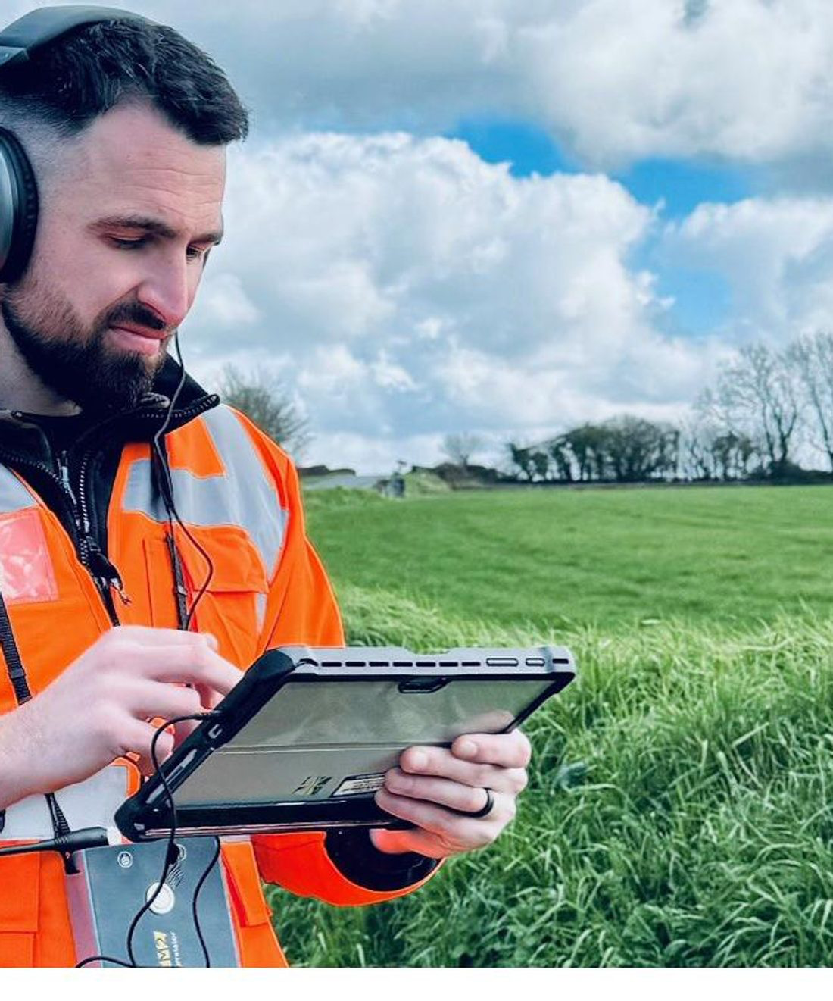


PART OF
PROPOSAL
[Programme or submission title]
Prepared for [Client name]
COMMERCIAL IN CONFIDENCE · [MONTH YEAR]

Slide 2
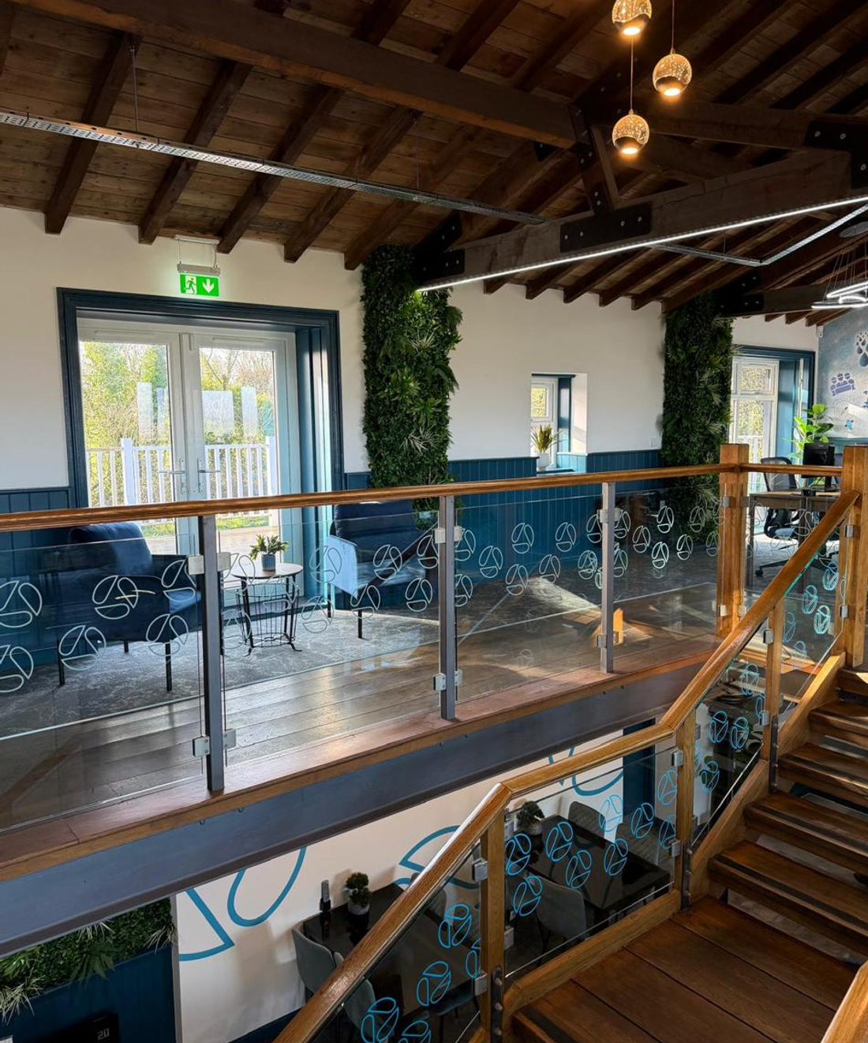

PROPOSAL
Agenda
01
The opportunity
02
About Aqualogic
03
Our approach and services
04
Methodology and proof
05
Programme and commercials
06
Our people and next steps
Aqualogic, a Sustec company
Commercial in confidence
02

Slide 3
PROPOSAL
Introductions
Your points of contact for this submission.
[CLIENT NAME]
AQUALOGIC
[Name]
Ashley Williams
[ROLE]
CHIEF GROWTH OFFICER
[email]
AshleyW@aqualogic-wc.com
[Name]
Jonathan Adler
[ROLE]
CLIENT SERVICES DIRECTOR
[email]
Aqualogic, a Sustec company
Commercial in confidence
03

Slide 4
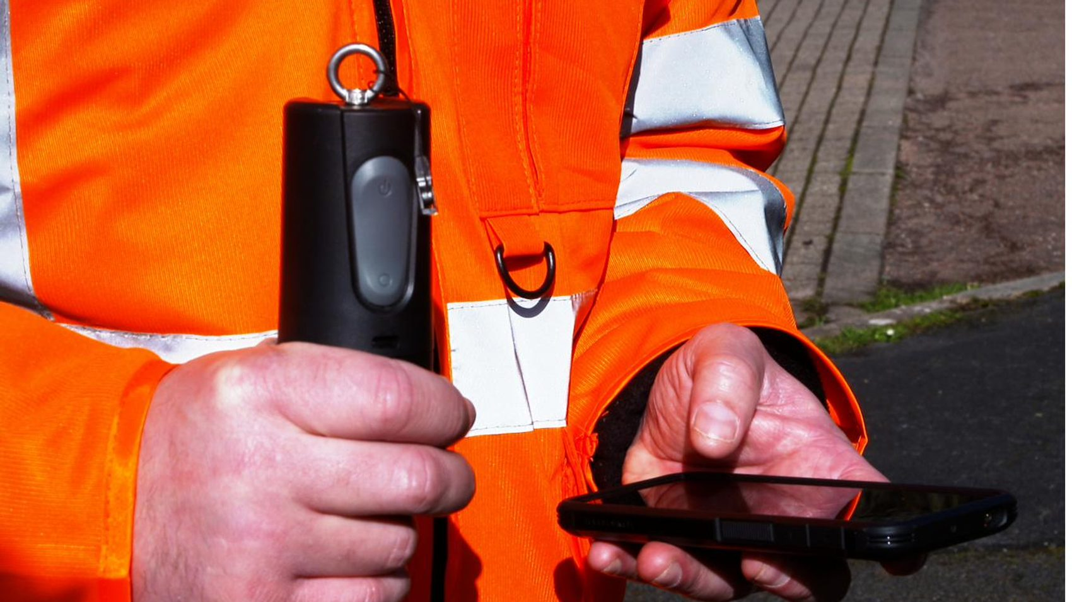
01
The opportunity
Understanding what you need and the outcome you are working towards.
Aqualogic, a Sustec company
Commercial in confidence
04

Slide 5
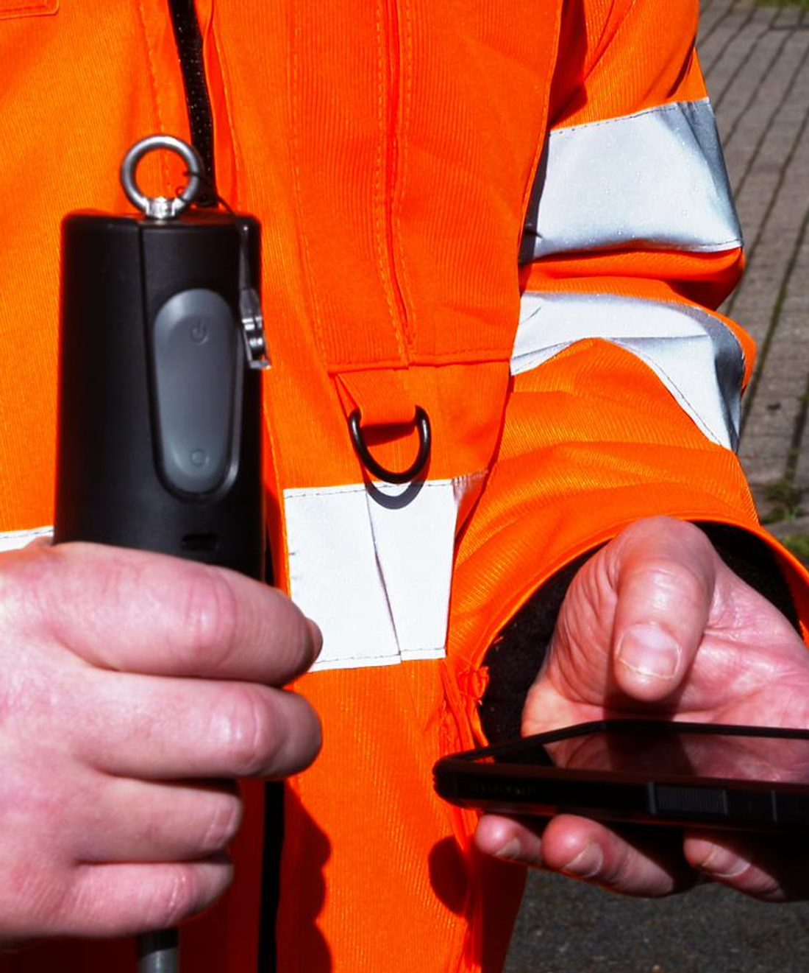
01 · THE OPPORTUNITY
About [Client name]
[Introduce the client in their own terms: who they are, the area or assets they manage, and the scale of their operation.]
[Summarise the drivers behind this opportunity, for example regulatory targets, performance commitments or operational pressures, and what success looks like for them.]
Aqualogic, a Sustec company
Commercial in confidence
05

Slide 6
01 · THE OPPORTUNITY
Understanding your requirements
The sector context
Water companies are under sustained pressure to reduce leakage, lower consumption and strengthen resilience, while proving measurable value and meeting tightening regulatory targets. Demand is rising, assets are ageing, and performance commitments leave little room for waste. [Tailor this to the client's specific position, targets and drivers.]
What we understand matters to you
[Reducing leakage and water loss]
[Lowering customer-side consumption]
[Meeting regulatory and performance targets]
[Strengthening long-term resilience]
[Demonstrating measurable value]
[Working with a partner who is easy to deal with]
Aqualogic, a Sustec company
Commercial in confidence
06

Slide 7
01 · THE OPPORTUNITY
The requirement
[Set out the scope of the opportunity. Replace the placeholders below with the detail for this submission.]
SCOPE
COMMENCEMENT
DURATION
[Workstreams or lots]
[Start date]
[Term and extensions]
RESOURCE
WORKING PATTERN
PARTNERS
[Team and roles]
[Hours and shifts]
[Delivery partners]
Aqualogic, a Sustec company
Commercial in confidence
07

Slide 8
01 · THE OPPORTUNITY
Why it matters
Every megalitre saved and every leak found sooner protects performance, cost and resilience. The opportunity is to deliver that at scale, with one partner accountable from source to tap.
Aqualogic, a Sustec company
Commercial in confidence
08

Slide 9
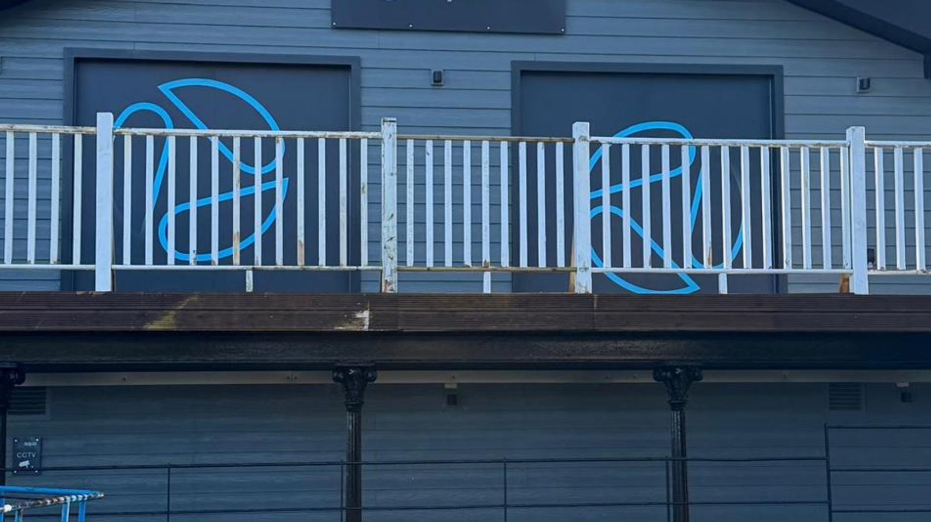
02
About Aqualogic
One joined-up company helping you manage water demand more intelligently.
Aqualogic, a Sustec company
Commercial in confidence
09

Slide 10

02 · ABOUT AQUALOGIC
Intelligent water conservation
Aqualogic is an integrated water conservation and demand management business.
We help water companies reduce waste, improve performance and strengthen long-term resilience, combining network expertise, customer-side delivery, data and practical field capability from source to tap.
We work as one joined-up partner, not a list of separate services. As a Sustec company, we have the platform to deliver at scale.
Aqualogic, a Sustec company
Commercial in confidence
10

Slide 11
02 · ABOUT AQUALOGIC
Heritage and expertise
Aqualogic began in 1979 as Flow Control Water Conservation and has traded as Aqualogic since 2004. Today we are part of the Sustec group, building on that foundation, not leaving it behind.
MILESTONES
1979
Founded as Flow Control Water Conservation
Our capability has been built over decades. It is established, not superficial, with deep sector knowledge and a consistent record of delivery.
2004
Became Aqualogic
Aqualogic is its people: a mixed team of apprentices, engineers, consultants, plumbers, auditors and technical specialists, working from two centres in South Wales and the Wirral.
Today
Part of the Sustec group
Aqualogic, a Sustec company
Commercial in confidence
11

Slide 12
02 · ABOUT AQUALOGIC
Why Aqualogic
01
Integrated water conservation
One joined-up company managing water demand intelligently, from source to tap, rather than a series of disconnected services.
02
Practical delivery that makes a measurable difference
Rooted in doing, not theorising. We reduce waste, improve performance and solve operational problems through real-world delivery.
03
Trusted expertise with real depth
Capability built over decades. Established, not superficial, with deep sector knowledge and consistent delivery.
04
Agile, responsive and easy to work with
Big enough to compete seriously, agile enough to react, support and move faster than larger corporates.
Aqualogic, a Sustec company
Commercial in confidence
12

Slide 13




02 · ABOUT AQUALOGIC
Aqualogic and the Sustec group
As a Sustec company, Aqualogic combines specialist focus with the strength of a larger group.
Specialist focus
Group strength
One accountable partner
Built to last
A dedicated water conservation and demand management business, not a side line.
Backed by the Sustec group, with the platform to deliver at scale.
Network, customer-side and field delivery under one roof, from source to tap.
Decades of capability, accredited systems and a consistent delivery record.
Aqualogic, a Sustec company
Commercial in confidence
13

Slide 14
02 · ABOUT AQUALOGIC
Our delivery model
Water Networks
Saving Water
Intelligence
▼
Integrated demand management
▼
Reduce waste
Improve performance
Strengthen resilience
Three angles on one job, joined up under one partner.
Aqualogic, a Sustec company
Commercial in confidence
14

Slide 15
03 · HOW WE WORK
Our approach
Four connected stages, so improvements are targeted, delivered and made to last.
01
02
03
04
Assess
Plan
Deliver
Optimise
Understand the network, the demand and the data to find where waste is happening.
Target the right action and agree a clear, practical plan with you.
Detection, repair and installation by skilled field teams on the ground.
Monitor, measure and refine so improvements hold over the long term.
Aqualogic, a Sustec company
Commercial in confidence
15

Slide 16


03 · HOW WE WORK
Our services
Three angles on one job: reduce waste, improve performance and strengthen resilience through integrated demand management.
Water Networks
Saving Water
Intelligence
Keeping more water in the network: leak detection, pressure management, metering, network services and consultancy.
Reducing demand where water is used: home visits, workplace assessments and water-saving products for homes and businesses.
Turning data into decisions: digital infrastructure, communications and AI-led analysis that show where to act first.
Aqualogic, a Sustec company
Commercial in confidence
16

Slide 17
03 · HOW WE WORK
Service areas in detail
Water Networks
Saving Water
Intelligence
Digital leak detection, with real-time visibility through Aquaint
Pressure management
Metering infrastructure
Network services
Consultancy, including IDM integrated demand management
Home water-efficiency visits
Workplace assessments
Water-saving products for homes and businesses
Digital infrastructure
Communications
AI-led analysis to show where to act first
Aqualogic, a Sustec company
Commercial in confidence
17

Slide 18




04 · METHODOLOGY AND PROOF
How we find and reduce loss
Survey
Detect
Analyse
Verify
Acoustic surveying across the network, collecting more than 250 data points per shift to find points of interest.
Acoustic logging deployed at pace, 50 to 60 noise loggers per shift covering around 1,000 properties.
Forensic analysis of the data, typically within 24 hours, progressed for strategic investigation.
Verification on the ground, then repair and optimisation to hold the saving.
Aqualogic, a Sustec company
Commercial in confidence
18

Slide 19
04 · METHODOLOGY AND PROOF
Survey and detection methodology
Acoustic surveying
Acoustic logging: lift and shift
Forensic investigation of the DMA through acoustic data collection. Technicians collate in excess of 250 data points per shift, with full verification of the area, including stop taps, boundary valves, customer meters, service pipes, fire hydrants and washouts. Analysis is completed within 24 hours and progressed for strategic investigation.
Reduced survey time using noise logger technology. A technician deploys 50 to 60 loggers per shift, covering around 1,000 properties. Loggers are left in underground chambers to record overnight, then collected and downloaded the following day for analysis.
Real-time network visibility is provided through our Aquaint system.
Aqualogic, a Sustec company
Commercial in confidence
19

Slide 20
04 · METHODOLOGY AND PROOF
Track record and proof
90+ Ml/d
130k+
200
4 ISO
leakage savings delivered in a single year
smart meters installed across the group
trained field personnel nationwide
accreditations: 9001 · 14001 · 45001 · 27001
Aqualogic, a Sustec company
Commercial in confidence
20
Notes:
Figures are point-in-time, drawn from recent programme material. Confirm and date before submission.

Slide 21
04 · METHODOLOGY AND PROOF
Case study: Wessex Water schools programme
A behaviour-led water efficiency programme across 100 schools, cutting water use by 20%.
CHALLENGE
Reduce consumption across a large schools estate, with lasting habit change rather than a one-off fix.
20%
100
water saving
schools visited
APPROACH
A behaviour-led programme delivered by a locally based project manager and trained water-efficiency engineers, with a mix of WC fittings.
21,496 m³
£81,040
WHAT IT PROVES
Practical delivery that makes a measurable difference. Pillar two in action.
saved per year
financial saving
Aqualogic, a Sustec company
Commercial in confidence
21

Slide 22
05 · PROGRAMME AND COMMERCIALS
Programme and delivery
Indicative programme. Replace the phases, activities and timings with the detail for this submission.
Phase | Activities | Outputs | Indicative timing
Mobilisation | [Set-up, data, access, safety] | [Plan and baseline] | [Weeks 1 to X]
Delivery | [Detection, repair, installation] | [Outputs and savings] | [Weeks X to Y]
Optimisation | [Monitor, measure, refine] | [Sustained performance] | [Ongoing]
Aqualogic, a Sustec company
Commercial in confidence
22

Slide 23
05 · PROGRAMME AND COMMERCIALS
Programme timeline
Indicative phasing. Adjust the bars and milestones to the submission.
Mobilisation
Set-up, data, access
Delivery
Detection, repair, installation
Optimisation
Monitor, measure, refine
[Start]
[Month X]
[Month Y]
[Ongoing]
Aqualogic, a Sustec company
Commercial in confidence
23

Slide 24
05 · PROGRAMME AND COMMERCIALS
Pricing
Indicative and for illustration only. Replace with the priced commercial summary for this submission.
Workstream | Basis | Indicative cost
[Workstream 1] | [Day rate / fixed / unit] | [£ ]
[Workstream 2] | [Day rate / fixed / unit] | [£ ]
[Workstream 3] | [Day rate / fixed / unit] | [£ ]
Total |  | [£ ]
Pricing basis, assumptions, exclusions and validity period to be set out in line with the client's requirements.
Aqualogic, a Sustec company
Commercial in confidence
24

Slide 25
06 · PEOPLE AND NEXT STEPS
Our people
Around 200 trained personnel nationwide, with a visible leadership team close to the work and a culture that promotes from within.
Ben Rice
Ashley Williams
CHIEF OPERATIONS OFFICER
CHIEF GROWTH OFFICER
Operations, delivery and safety across the business.
Growth, client relationships and new business.
Jonathan Adler
Wayne Arscott
CLIENT SERVICES DIRECTOR
WATER SERVICES DIRECTOR
Client services and account delivery.
Water services and technical delivery.
Aqualogic, a Sustec company
Commercial in confidence
25

Slide 26



06 · PEOPLE AND NEXT STEPS
The team we deploy
Field delivery
Technical and data
Management
Engineers, technicians, plumbers and auditors delivering detection, repair and installation on the ground.
Analysts and technical specialists turning survey and network data into targeted action.
Locally based project and contract management keeping delivery on track.
Aqualogic, a Sustec company
Commercial in confidence
26

Slide 27




06 · PEOPLE AND NEXT STEPS
Our commitment to people
A clear pathway
Fair reward
Tools and support
Progression
A pathway for future talent to excel in the industry.
Fair reward based on skills, knowledge and performance.
The tools, equipment, systems and support to do the job well.
Opportunity to progress and gain externally accredited qualifications.
Aqualogic, a Sustec company
Commercial in confidence
27

Slide 28
ASSURANCE
Health, safety, environment and quality
Health, safety and wellbeing are central to how we work. For more than 16 years we have built a Safe and Sound culture, where everyone, employee or partner, gets home safe each day.
ISO 9001
ISO 14001
Quality
Environment
Our Integrated Management System and recognised accreditations hold us to clear standards across quality, the environment, health and safety, and information security.
ISO 45001
ISO 27001
Health & safety
Information security
Aqualogic, a Sustec company
Commercial in confidence
28

Slide 29
06 · NEXT STEPS
Next steps
01
02
03
04
Review
Discuss
Refine
Mobilise
You review this submission and confirm any questions or clarifications.
We meet to walk through the approach, programme and commercials.
We refine the scope and pricing to match your requirements.
On award, we mobilise quickly with a clear plan and the right team.
Aqualogic, a Sustec company
Commercial in confidence
29

Slide 30
PART OF
Thank you
Intelligent water conservation.
Ashley Williams, Chief Growth Officer AshleyW@aqualogic-wc.com 0844 324 0844

