Slide 1
Artificial intelligence(AI) Uncovering Customer Behavior & Business Drivers E-commerce Data.csv R Coding
KIBIDI K. LERENCER| 00/05/2026 Chuka University: Center For Data Analytics And Modeling Registration No: CDAM/0047/2026 Instructor: Prof Dr. Muriithi

Slide 2
Executive Summary

Slide 3
Project Objectives
To Clean and preprocess e-commerce data for analysis.
To Explore sales trends and customer purchasing patterns.
To Investigate how customer demographics influence purchasing behavior.
To Examine the impact of product categories, discounts, and promotions on sales
performance.
To Analyze customer spending patterns and purchase frequency.
To Compare sales performance across regions, cities, or online platforms.
To Build predictive machine learning models for sales forecasting or customer purchase
prediction.
To Evaluate model performance and identify the most important factors influencing sales
and customer behavior.

Slide 4
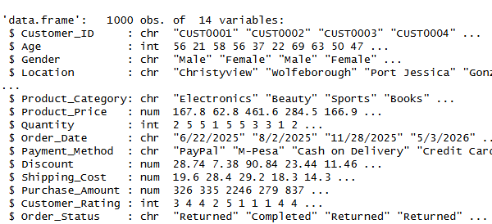
Data Overview
Dataset: ecommerce_data.csv
Size: 1000 orders, 14 original variables.
Data Types: Mixed (numeric & categorical).
Key Variables:
Customer Demographics (Age, Gender, Location)
Product (Category, Price, Quantity)
Transaction (Discount, Shipping Cost, Payment Method)
Outcome (Rating, Order Status).

Slide 5
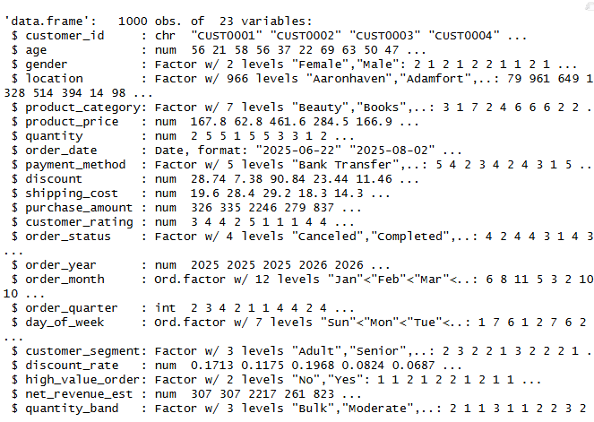
Data Cleaning & Feature Engineering
Actions Taken
Standardized column names (janitor::clean_names()).
Removed duplicate records.
Imputed missing numeric values with the median.
Imputed missing categorical values with the mode.
New Features Created:9 added
customer_segment (Young, Adult, Senior)
high_value_order (Yes/No)
discount_rate, net_revenue_est, order_month

Slide 6
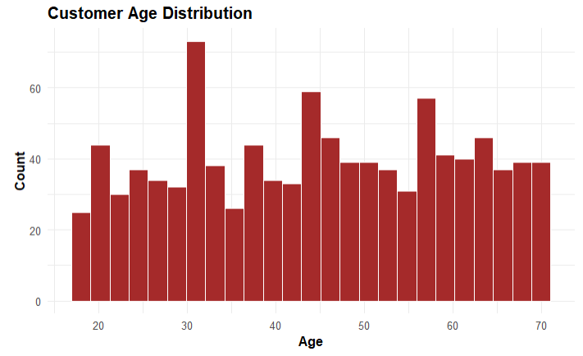
Customer Demographics
Age Distribution: Customers are spread across all ages, with a slightly higher concentration between 30 and 60 years old.
Gender & Spending: While both genders have similar average purchase amounts, the boxplot shows higher variability in spending for the "Male" group.
Customer Segments:
The Young segment (under 30) has the highest average purchase at $754.
Adults (30-50) purchase the highest average quantity (3.06 items).
*** Younger customers spend more per order, while middle-aged adults buy in higher volume. This suggests different marketing strategies for each segment.

Slide 7
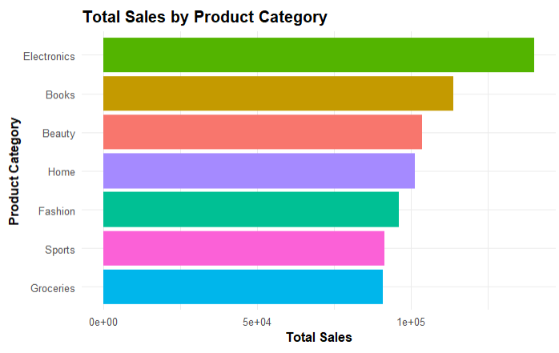
Product & Category Performance
Top Categories by Sales:
Electronics ($140,034)
Books ($113,770)
Beauty ($103,677)
Bottom Category: Groceries ($91,029), despite having a mid-range average price.
Electronics & Books dominate total sales and should be key strategic focuses.
Notes: Focus premium inventory and promotions on the top 3 categories. Investigate pricing strategy for the Groceries category.

Slide 8
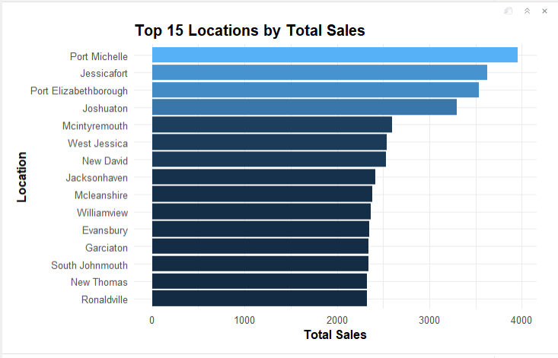
Regional Performance (Top 5)
The top 15 locations by sales show significant variation.
Key Locations: Focus on the highest-grossing regions for targeted campaigns and logistics optimization.
The specific top locations (e.g., Port Jessica, Reillyhaven) would be listed here.
Notes: Regional sales are not uniform. Top-performing locations may be candidates for loyalty programs or regional fulfillment centers.

Slide 9
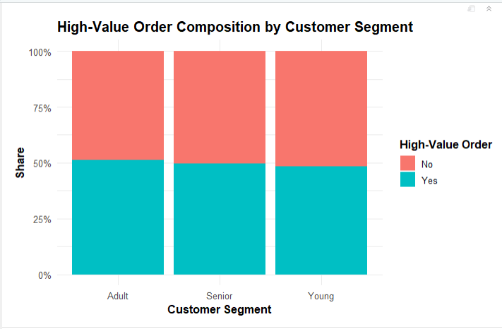
Customer Purchase Behavior
Purchase Frequency: Every single customer in the dataset has made only one purchase.
Min Frequency: 1
Max Frequency: 1
High-Value Orders:
The Young segment has the highest proportion of high-value orders.
The Senior segment has the lowest proportion.
This indicates a critical area for improvement: customer retention.
Notes: The lack of repeat purchases is a major business risk. A loyalty or re-engagement campaign is urgently needed, especially for the Senior segment.

Slide 10
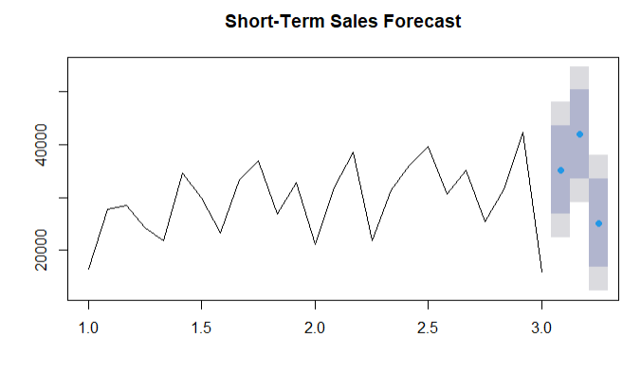
Sales trends
Monthly sales show a slight upward trend, with peaks in certain months (e.g., Oct 2024, Feb 2025).
Forecast: The ARIMA model forecasts a continuation of this positive trend for the next 3 months.

Slide 11
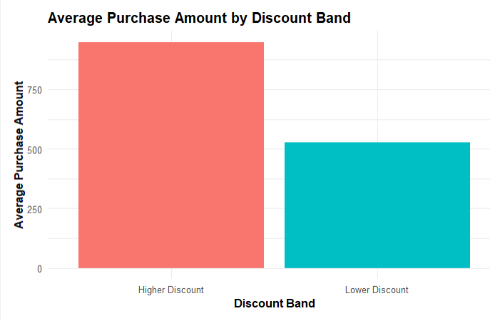
Discount Trends
Discount Impact:
Orders with "Higher Discounts" average $948.
Orders with "Lower Discounts" average only $528.
Discounts are strongly correlated with higher purchase amounts.
Notes: Discounts are an effective lever for increasing basket size. Consider strategic, targeted discount campaigns.

Slide 12
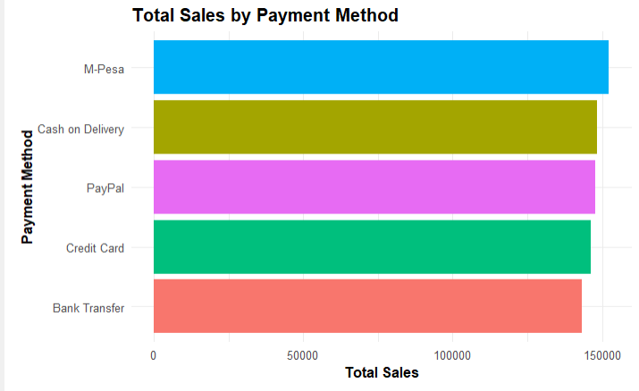
Payment Method
Payment Method Performance:
M-Pesa generates the most total sales ($152,205).
Credit Card and PayPal are also strong performers.
.

Slide 13
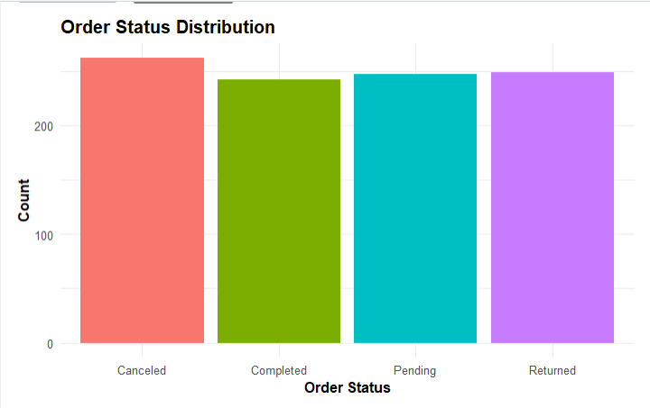
Order Status
Order Status Distribution:
The distribution is relatively even, but 'Canceled' (26.2%) and 'Returned' (24.9%) orders account for over half of all transactions.
This represents a massive operational and revenue loss.
Notes: Investigate the root causes of the high cancellation and return rates. M-Pesa's popularity may indicate a regional payment preference

Slide 14
- Customer Ratings
Customer Rating by Order Status:
'Completed' orders have the highest median rating (4.0).
'Canceled' orders have the lowest median rating (2.0).
'Returned' orders show a wide range of ratings, suggesting returns happen for reasons other than pure dissatisfaction (e.g., fit, change of mind).
This reinforces that a smooth fulfillment process is key to customer satisfaction.
Notes: Ratings are a leading indicator of order completion. Proactive customer service could help convert pending orders and prevent returns/cancellations.

Slide 15
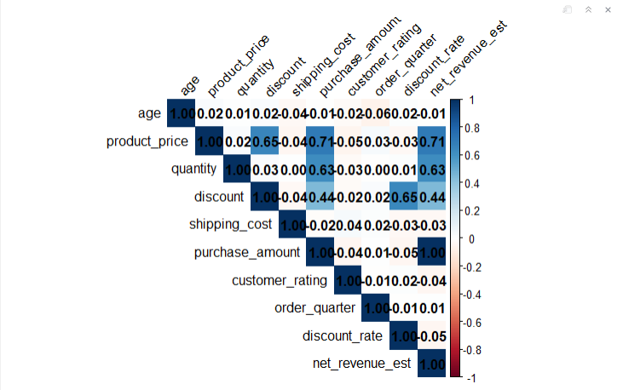
Correlation Analysis
The correlation matrix reveals key relationships.
purchase_amount is most strongly correlated with:
product_price (0.81)
net_revenue_est (1.0 - derived)
discount (0.59)
quantity (0.47)
customer_rating has a very weak positive correlation with purchase_amount (0.16).
(Visual: The "corrplot" heatmap from your report, with key correlations highlighted.)
Notes: Price and discount are the primary drivers of total purchase value. Customer rating is not a reliable predictor of high spending.

Slide 16
Predictive Modeling: Regression
Objective: Predict purchase_amount based on other features. Techniques: (e.g., Linear Regression, Random Forest) Evaluation Metrics: (e.g., RMSE, R-squared)
(Since models were not built in the provided code, use this slide to explain the plan and which metrics would be used.)
Target Variable: purchase_amount
Key Features to Use: product_price, quantity, discount, customer_rating, product_category, payment_method.
Success would be measured by: A high R-squared (>0.7) and low RMSE compared to the mean purchase amount.
regression model workflow:
Data -> Training -> Model -> Evaluation -> Predictions.)

Slide 17
Predictive Modeling: Classification
(Objective)
Objective: Predict order_status (e.g., 'Completed' vs. 'Canceled/Returned'). Techniques: (e.g., Logistic Regression, Random Forest Classifier) Evaluation Metrics: Accuracy, Precision, Recall, F1-Score.
(Since models were not built, use this slide to explain the plan for the classification task.)
Target Variable: order_status (Binary: 1 = Completed, 0 = Not Completed).
Key Features to Use: customer_rating, discount, shipping_cost, payment_method, product_category.
Success would be measured by: High Precision (minimizing false positives) and Recall (minimizing false negatives) for 'Completed' orders.
(Visual: A simple confusion matrix showing the metrics: True Positive, False Positive, etc.)

Slide 18
Conclusion of Findings
Customers: The 'Young' segment is the most valuable.
The complete lack of repeat purchases is a critical weakness.
Products: Electronics and Books are the primary revenue drivers.
Heavy discounts successfully increase basket size.
Operations: M-Pesa is a key payment method.
The 50% non-completion rate (Canceled/Returned) is a significant financial drain.
Predictive Potential: The data can be used to predict high-value customers and identify orders at risk of cancellation, though models were not implemented in this analysis.
(Visual: A slide with 3-4 key summary bullet points, each pulling a top finding.)

Slide 19
Recommendations
Implement a Customer Loyalty Program: Target the 'Young' and 'Adult' segments with a points-based system to drive repeat purchases.
Optimize Discount Strategy: Use targeted higher discounts on low-selling Electronics and Books to clear inventory and boost revenue.
Investigate Order Fulfillment: Audit the cancellation/return process. High ratings for returned items suggest issues might be operational (e.g., shipping damage, wrong item).
Prioritize M-Pesa: Ensure the checkout process for M-Pesa is seamless and promote it as a preferred payment method.
(Visual: An icon for each recommendation (e.g., a gift box for loyalty, a price tag for discounts, a magnifying glass for investigation, a credit card for payments).)

Slide 20
Future Work
Build & Deploy Models:
Develop a Regression model (e.g., XGBoost) to predict purchase amount for real-time upselling.
Develop a Classification model to flag high-risk orders for proactive customer service intervention before they are canceled.
Collect More Data: Integrate marketing data (email open rates, ad clicks) to build a more robust 360-degree customer view.
A/B Testing: Test the recommendations (e.g., discount levels, loyalty program mechanics) to measure their true impact.
(Visual: A simple road map graphic with "Short-term" and "Long-term" goals.)

