Slide 1
Advanced Databases Developing of a social network using CouchDB
Students: Aldar Saranov, Najim Essakali
Lecturer: Esteban Zimányi
Université libre de Bruxelles

Slide 2

Introduction
Technical requirements:
Security of personal data.
Fast response time.
Scalability.
Data consistency.
Simple modifying of functionality.

Slide 3
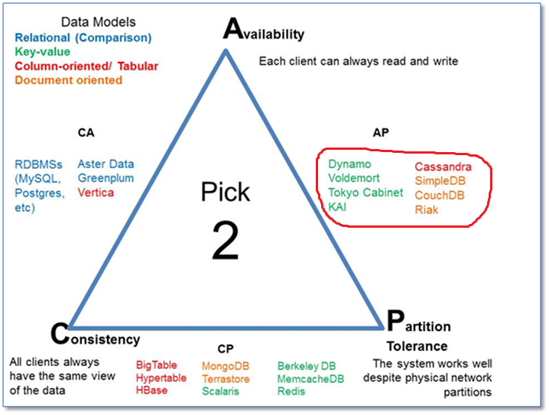
Why CouchDB? [1]
Availability and Partition Tolerance have higher priority
CAP theorem illustration.

Slide 4
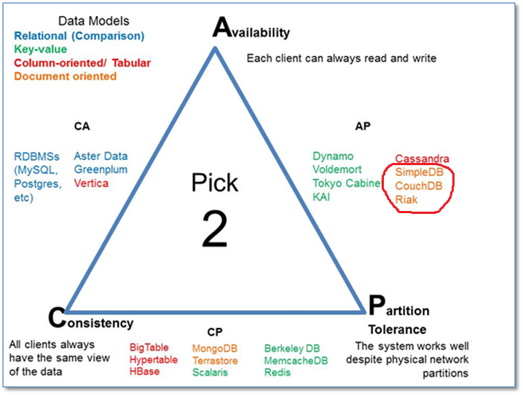
Why CouchDB? [2]
Flexibility over simplicity
CAP theorem illustration.

Slide 5
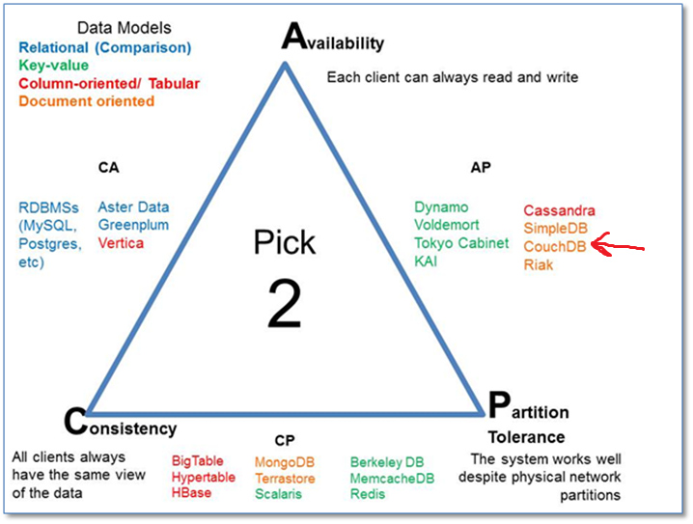
Why CouchDB? [3]
CouchDB vs. SimpleDB arguments:
REST
JSON
Direct indexing
CouchDB vs. Riak arguments:
Many more supporting OS.
CAP theorem illustration.

Slide 6
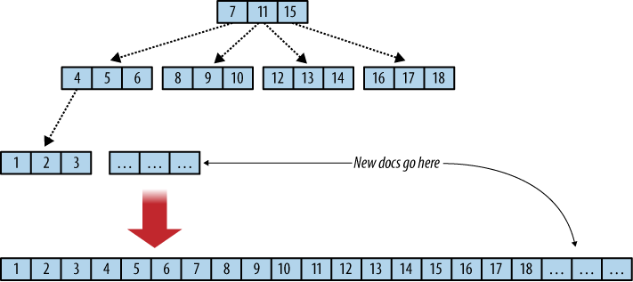
CouchDB B-tree
Append-only!

Slide 7
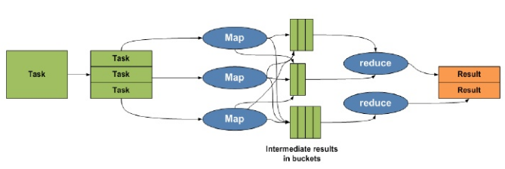
Map/reduce

Slide 8
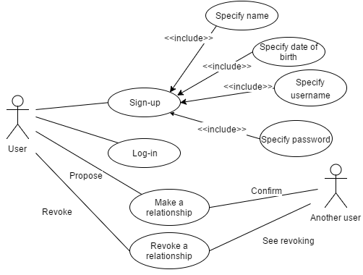
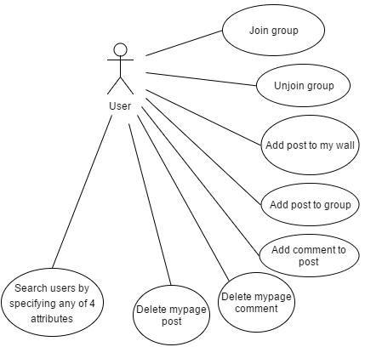
UML use case

Slide 9
ER-diagram

Slide 10
Object over document design
Post/comment merged document:
{
"_id": "dc3399efe88b8c4c9636ea…",
"_rev": "1-d0f2ac2de9a3855c2ca…",
"type": "post",
"username": "john",
"id_group": "192f2278f1902ed67…",
"date": "2016-09-02 12:00",
"text": "Quelqu'un a une imprimante?",
"comments":
{
"dc3399efe88b8c4…":
{
"username": "michelle",
"text": "Je l'ai ... mais la peinture est finie",
"date": "2016-09-02 12:10"
}
}
}
 | ER-entity | Document type
1. | User | User
2. | Relationship | Relationship
3. | Group | Group
4. | Group_participation | Group_participation
5. | Post | Post
6. | Comment | Post

Slide 11
Tuple key search
Ranged key request result

Slide 12
Index selection
Username is specified | FirstName is specified | SecondName is specified | Birthday is specified | Index
No | No | No | No | [Show all users]
No | No | No | Yes | user_by_bday_fname
No | No | Yes | No | user_by_sname_bday
No | No | Yes | Yes | user_by_sname_bday
No | Yes | No | No | user_by_fname_sname_bday
No | Yes | No | Yes | user_by_bday_fname
No | Yes | Yes | No | user_by_fname_sname_bday
No | Yes | Yes | Yes | user_by_fname_sname_bday
Yes | No | No | No | user_by_username
… | … | … | … | …

Slide 13
UML Deployment

Slide 14
UML Class

Slide 15
Thank you for attention!

