Slide 1
Advanced Databases Developing of a social network using CouchDB
Students: Aldar Saranov, Najim Essakali
Lecturer: Esteban Zimányi
Université libre de Bruxelles

Slide 2

Introduction
Technical requirements:
Security of personal data.
Fast response time.
Scalability.
Data consistency.
Simple modifying of functionality.

Slide 3
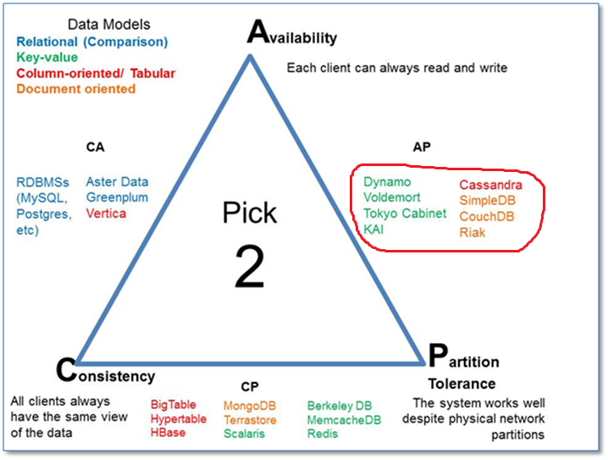
Why CouchDB? [1]
Availability and Partition Tolerance have higher priority
CAP theorem illustration.

Slide 4
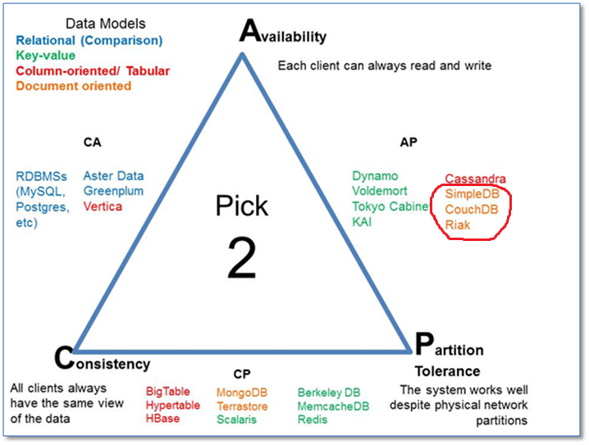
Why CouchDB? [2]
Flexibility over simplicity
CAP theorem illustration.

Slide 5
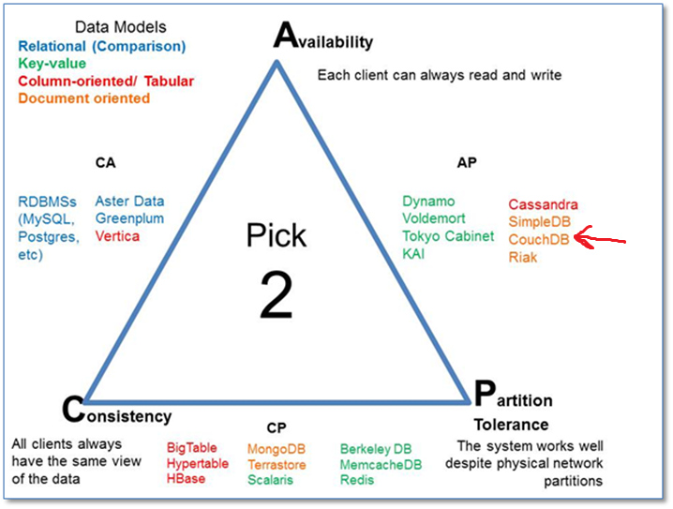
Why CouchDB? [3]
CouchDB vs. SimpleDB arguments:
REST
JSON
Direct indexing
CouchDB vs. Riak arguments:
Many more supporting OS.
CAP theorem illustration.

