Slide 1
Library System (Group 3)
AldarKHANGAI Chimed-Ochir
TAMIR GANBAT
JUne Andrew m rabin

Slide 2
agenda
Overview
Tools and Technologies
Class Diagram
Sequence Diagrams
Limitations
Demo

Slide 3
overview
Design and Build a Library System tool that can be used by a Librarian or an Administrator (or Both access) to add new books to the collection, create new Library Members and Edit Library Member information.
Librarian access has the ability to Check-out books
Administrator access is responsible to Add/Edit member's information and Add books to the collection
Librarian and Administrator access has the capability of doing all the tasks mentioned above for both Librarian and Admin

Slide 4
Overview (continuation)
Supports MVC (Model-View-Controller) model where project contains 3 different packages (UI Layer, Data Layer and Business Layer)
Uses JAVA Serialization
where an object can be represented as a sequence of bytes that includes the object's data as well as information about the object's type and the types of data stored in the object. (tutorialspoint.com).
User-Friendly User Interface

Slide 5
Tools and technologies
Eclipse
JAVA FX
FX CSS

Slide 6
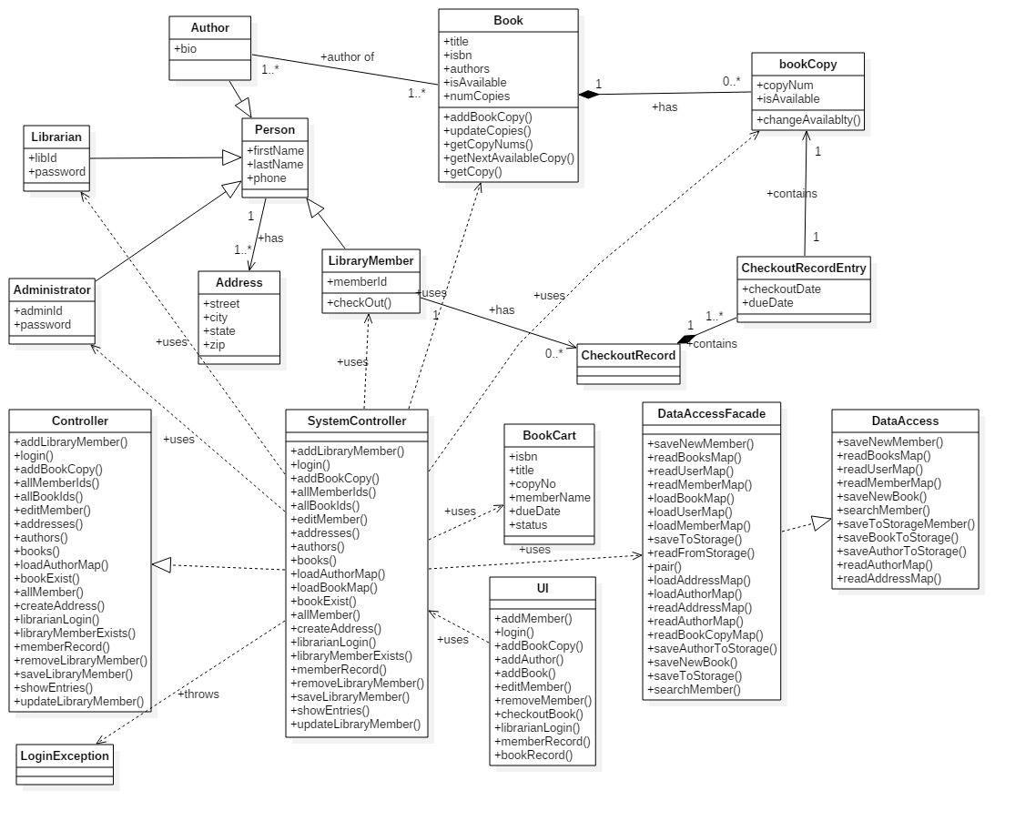
Class diagram

Slide 7
Sequence diagram
Login
Add new Library Member
Check-out Book
Add copy of Book to Library Collection
Add a book to Library Collection
Add an author to Library Collection
Print Checkout Record to Console
Display Book Status

Slide 8
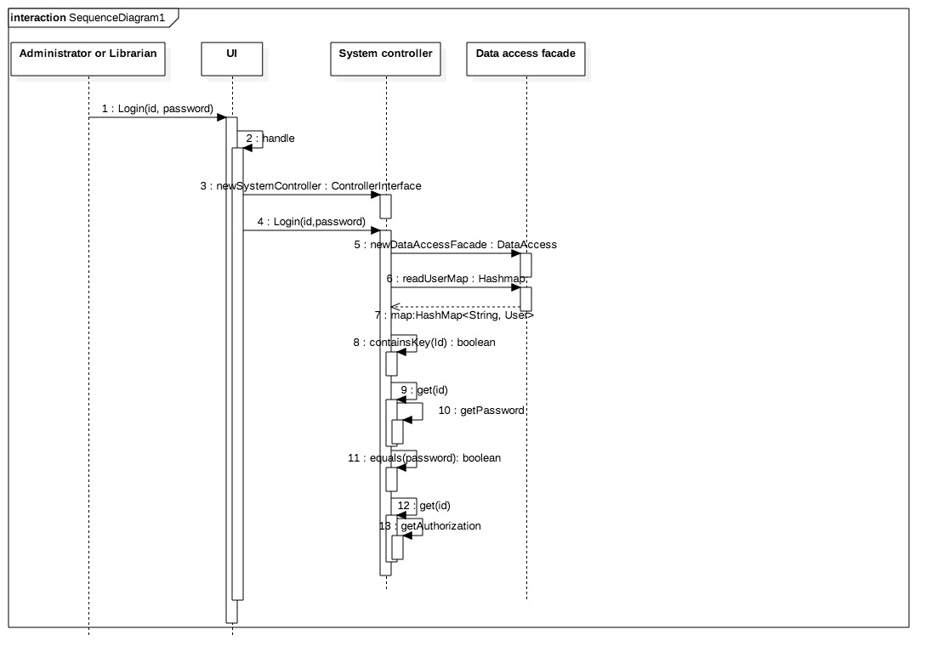
Login

Slide 9
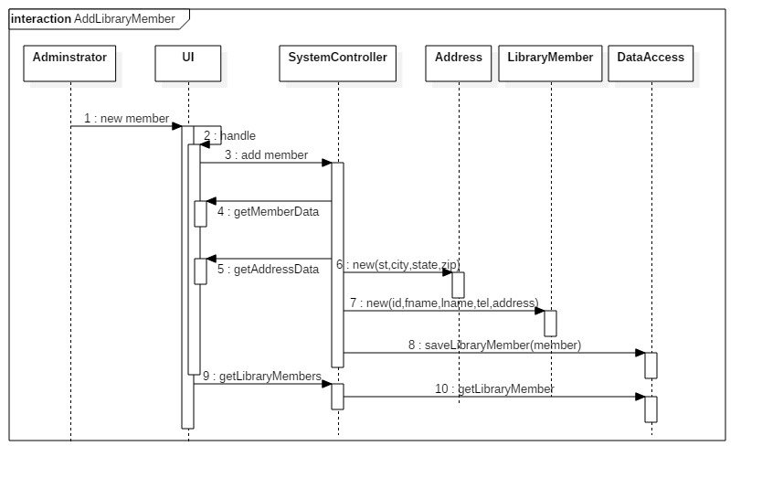
Add new library member

Slide 10
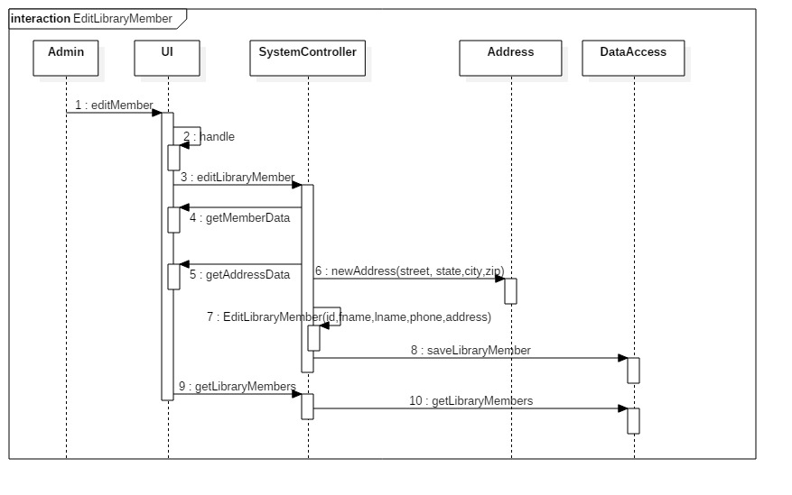
EDIt library member

Slide 11
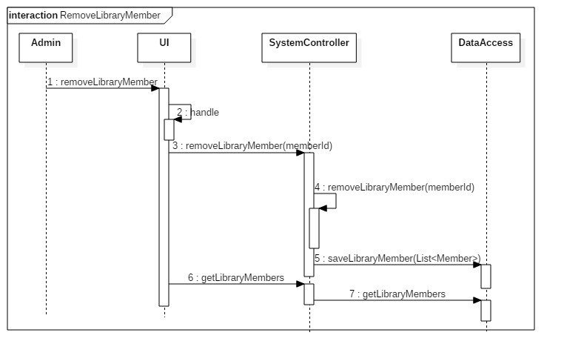
REMOVE library member

Slide 12
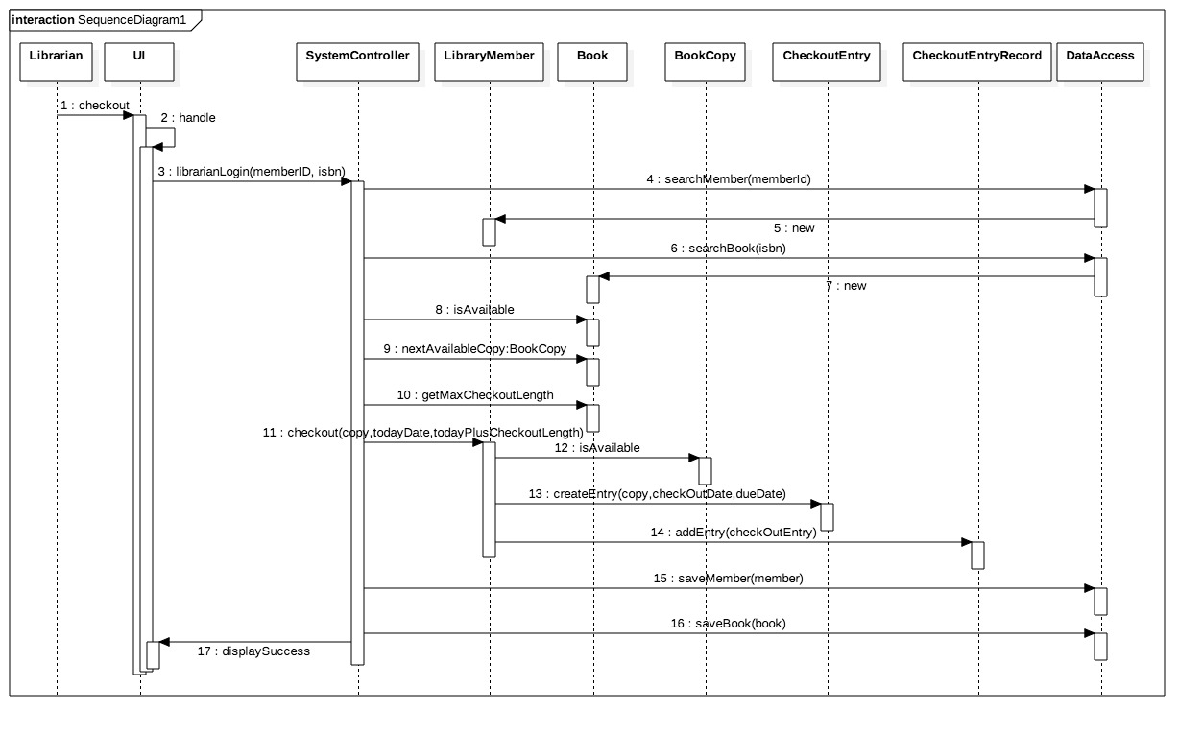
Check-out book

Slide 13
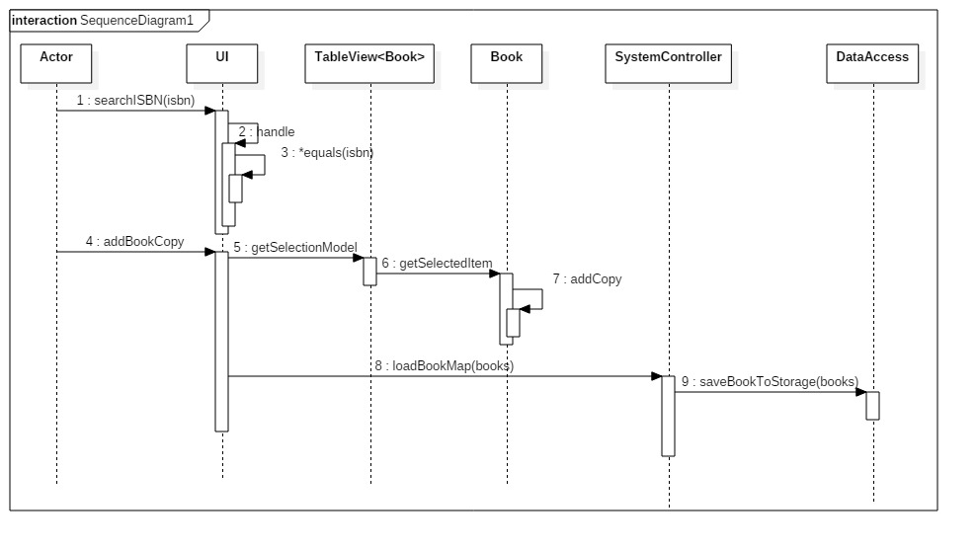
Add copy of existing book to collection

Slide 14
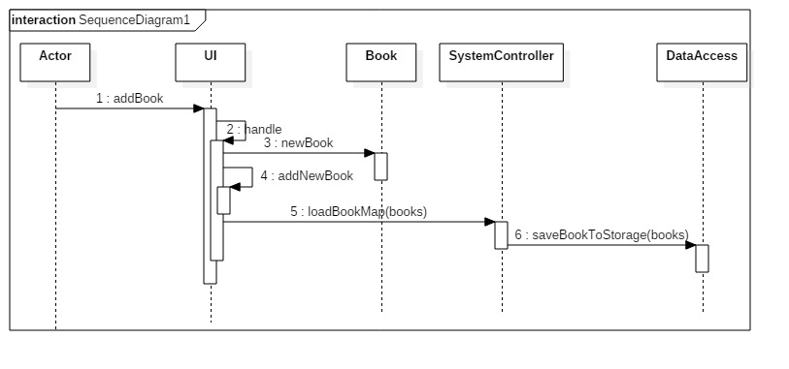
Add book to collection

Slide 15
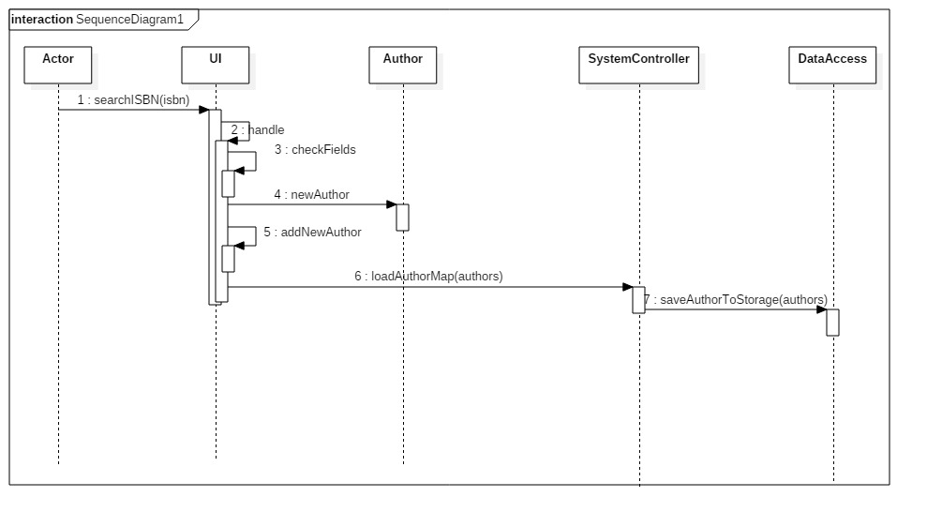
Add AUTHOR to collection

Slide 16
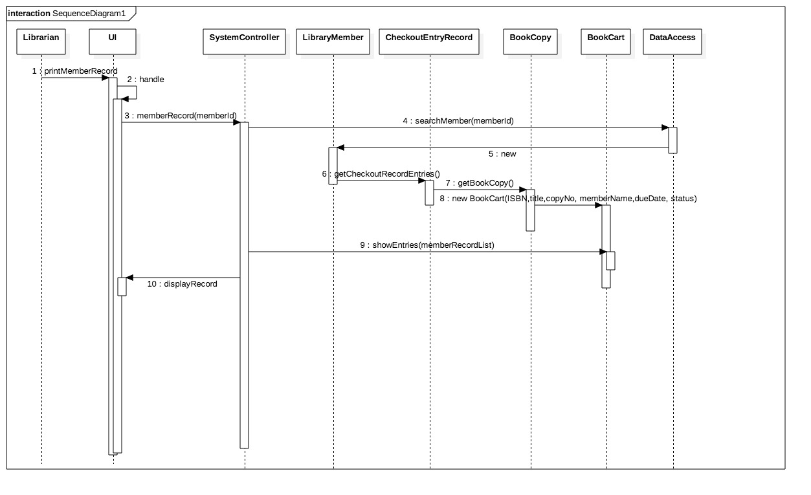
Print check-out record

Slide 17
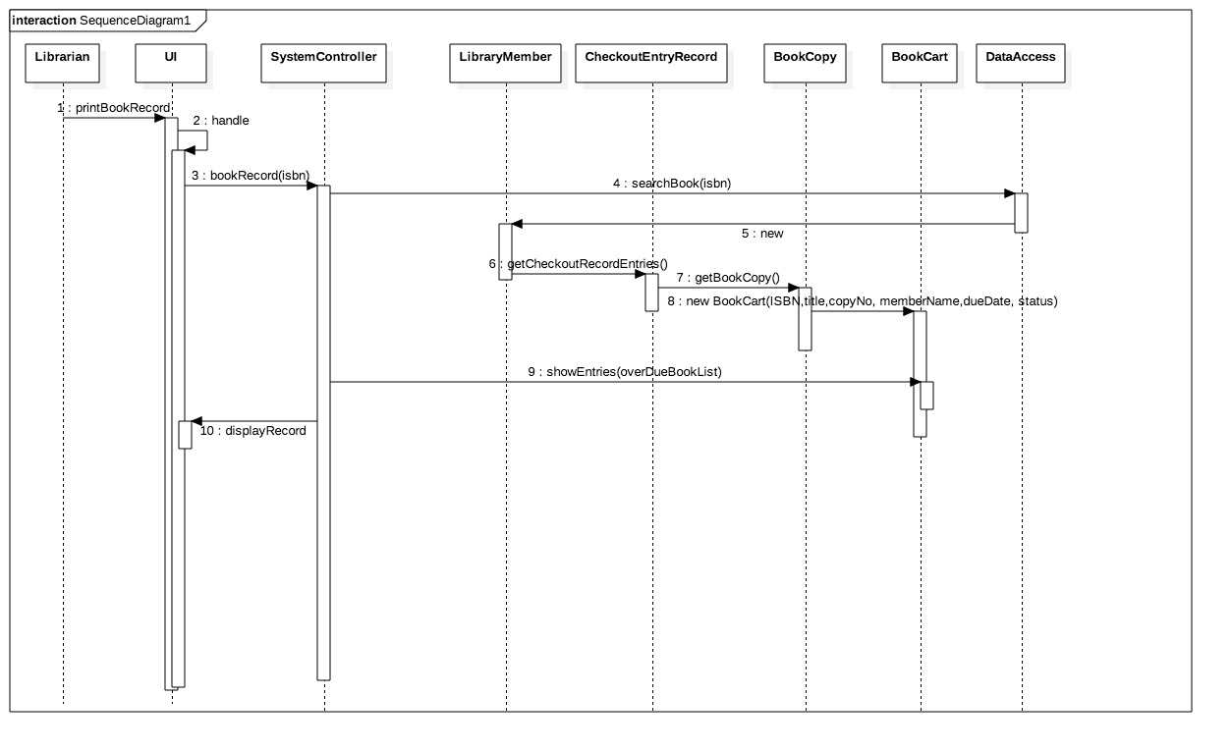
Display book availability

Slide 18
limitations
Since we are only using JAVA Serialization, it is assumed that we are only storing a couple of data for the purpose of showing the Library Management System Functionality, hence if we will be using this Application on a Large Scale environment, a Database setup will best fit as our option.

Slide 19
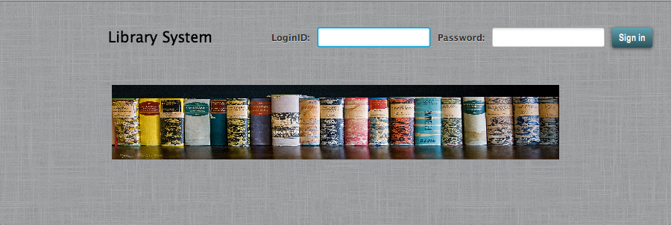
Application demonstration

Slide 20
Test cases
Logging-in to the System using 3 different Accounts (Librarian, Administrator or Both)
Adding a new library member to the System
Checking-out a book
Adding a copy of Existing Book to the Library Collection
Adding a Book to the Library Collection
Printing out the Check-out Record
Determine the Book Availability and as to who's Library Member has it in his/her possession.

