Slide 1
EnjoyTravel
Travel and enjoy, yes you can!

Slide 2
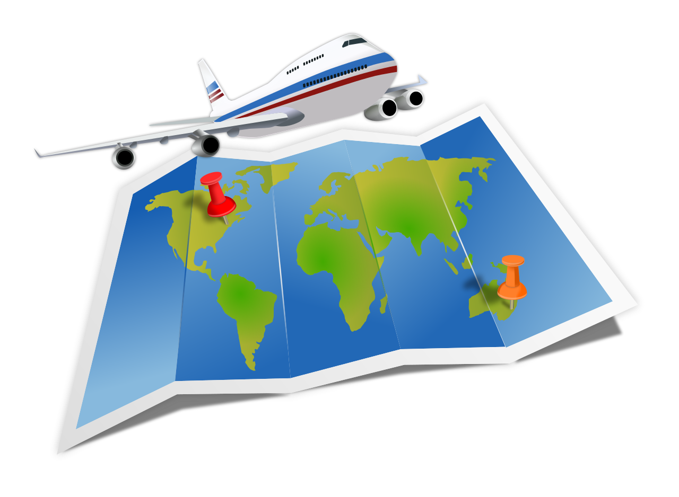


Slide 3
