Slide 1
Linear Programming

Slide 2
Topic: Linear Programming
Definition of Linear Programming
Objective Function
Decision Variables
Constraints
Graphical Solution Method
Feasible Region
Optimal Solution (Corner Point Method)

Slide 3
Learning Objectives
After the session, the students should be able to:
Define linear programming and its purpose
Identify the components of a linear programming problem
Formulate a linear programming problem from a word problem or scenario
Graph linear inequalities and identify the feasible region
Determine the optimal solution using the graphical method
Analyze the impact of constraints on feasible solutions
Solve two-variable LP problems using the corner-point method

Slide 4
Linear Programming
Linear Programming (LP) is a mathematical technique used to determine the best possible outcome in a given mathematical model. It is widely applied in fields like business, economics, engineering, and logistics. The goal is to maximize or minimize a linear objective function, subject to a set of linear constraints (inequalities or equalities).
Example: A factory wants to produce two types of products using limited labor and materials to maximize profit.

Slide 5
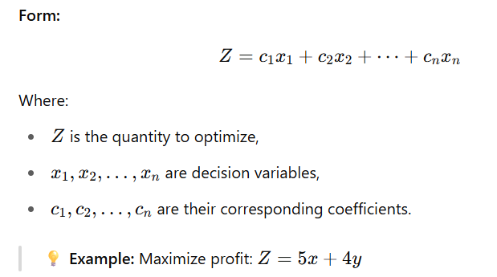
Objective Function
The objective function is the linear equation that defines what needs to be maximized or minimized, such as profit, cost, or time.

Slide 6
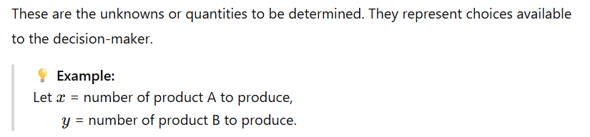
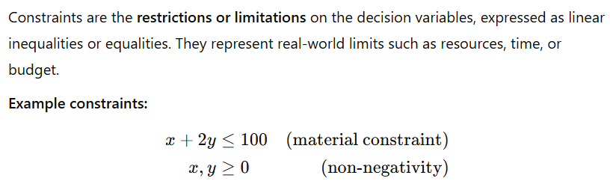
Decision Variables
Constraints

Slide 7
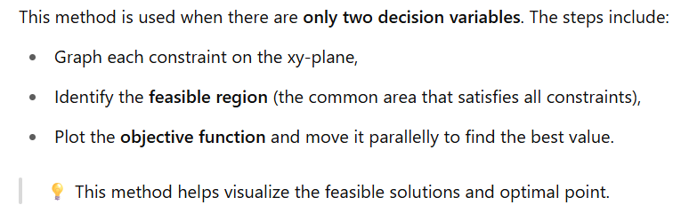
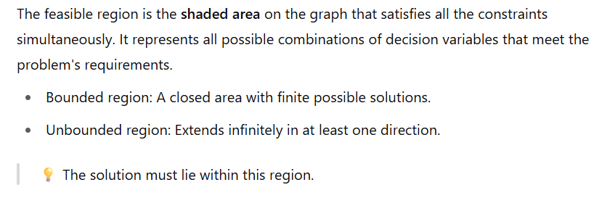
Graphical Solution Method
Feasible Region

Slide 8
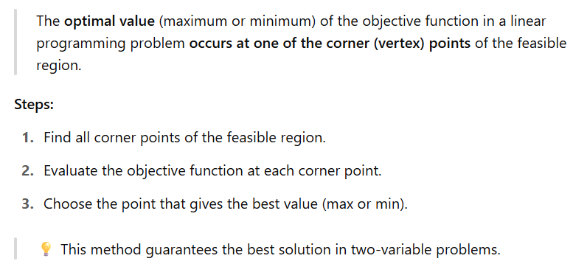
Optimal solution (corner point method)

Slide 9
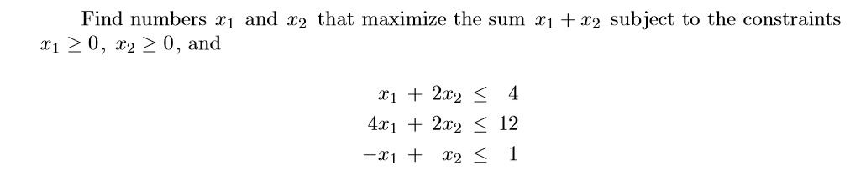
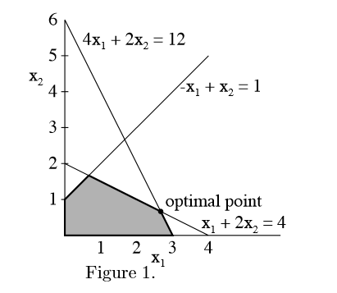
A linear programming problem may be defined as the problem of maximizing or minimizing a linear function subject to linear constraints. The constraints may be equalities or inequalities.
In this problem there are two unknowns,
and five constraints.

Slide 10
Terminology
Objective function
The function to be maximized or minimized
A vector, x for the standard maximum problem or y for the standard minimum problem, is said to be feasible if it satisﬁes the corresponding constraints. The set of feasible vectors is called the constraint set. A linear programming problem is said to be feasible if the constraint set is not empty; otherwise it is said to be infeasible. A feasible maximum (resp. minimum) problem is said to be unbounded if the objective function can assume arbitrarily large positive (resp. negative) values at feasible vectors; otherwise, it is said to be bounded. Thus there are three possibilities for a linear programming problem. It may be bounded feasible, it may be unbounded feasible, and it may be infeasible. The value of a bounded feasible maximum(resp, minimum) problem is the maximum (resp. minimum)value of the objective function as the variables range over the constraint set. A feasible vector at which the objective function achieves the value is called optimal.

Slide 11
Exercises
A. Consider the linear programming problem: Find y1 and y2 to minimize y1 + y2 subject to the constraints,
y1 +2 y2 ≥ 3
2y1 + y2 ≥ 5
y2 ≥ 0
y1 >=0
Graph the constraint set and solve.

Slide 12
Linear Programming (LP)
A mathematical technique designed to help operations managers plan and make decisions relative to the trade-offs necessary to allocate resources.

Slide 13
Examples of problems in which LP has been successfully applied in operations management
Scheduling school buses to minimize the total distance traveled when carrying students.
Allocating police patrol units to high crime areas to minimize response time to 911 calls.
Scheduling tellers at banks so that needs are met during each hour of the day while minimizing the total cost of labor.
Selecting the product mix in a factory to make best use of machine- and labor-hours available while maximizing the firm’s profit.

Slide 14
Examples of problems in which LP has been successfully applied in operations management
Picking blends of raw materials in feed mills to produce finished feed combinations at minimum cost.
Determining the distribution system that will minimize total shipping cost from several warehouses to various market locations.
Developing a production schedule that will satisfy future demands for a firm’s product and at the same time minimize total production and inventory costs.
Allocating space for a tenant mix in a new shopping mall so as to maximize revenues to the leasing company.

Slide 15
