Slide 1

Bird
Samir Hauser, Connor Charlton, Joel Alder

Slide 2

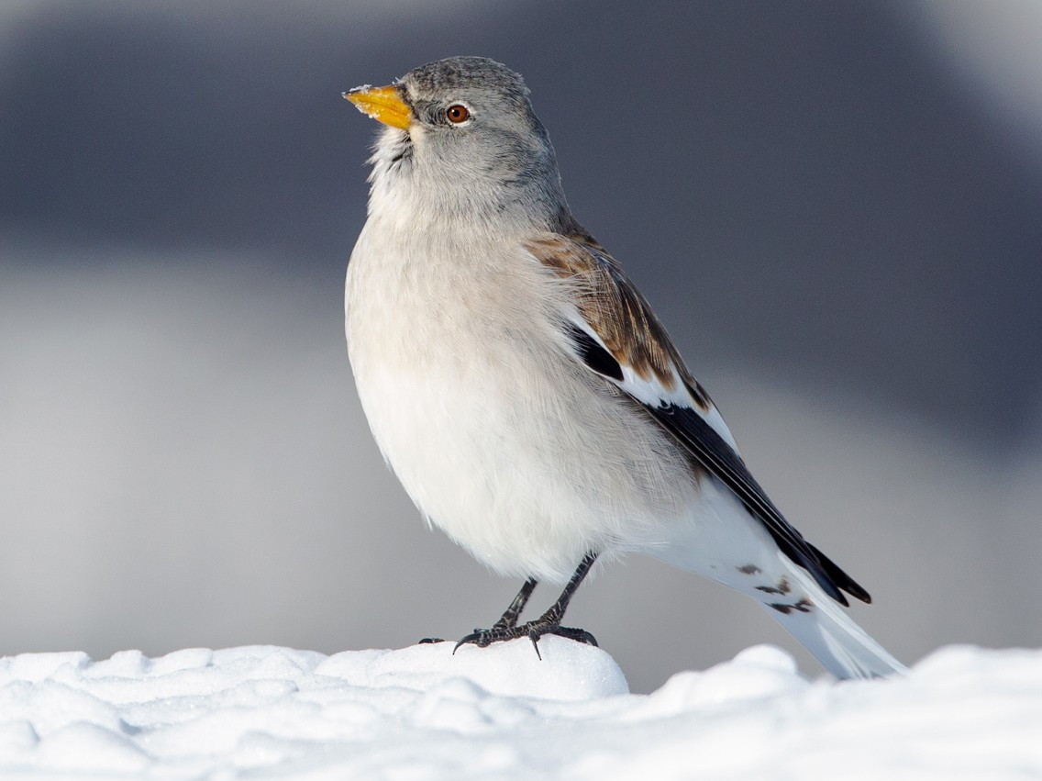
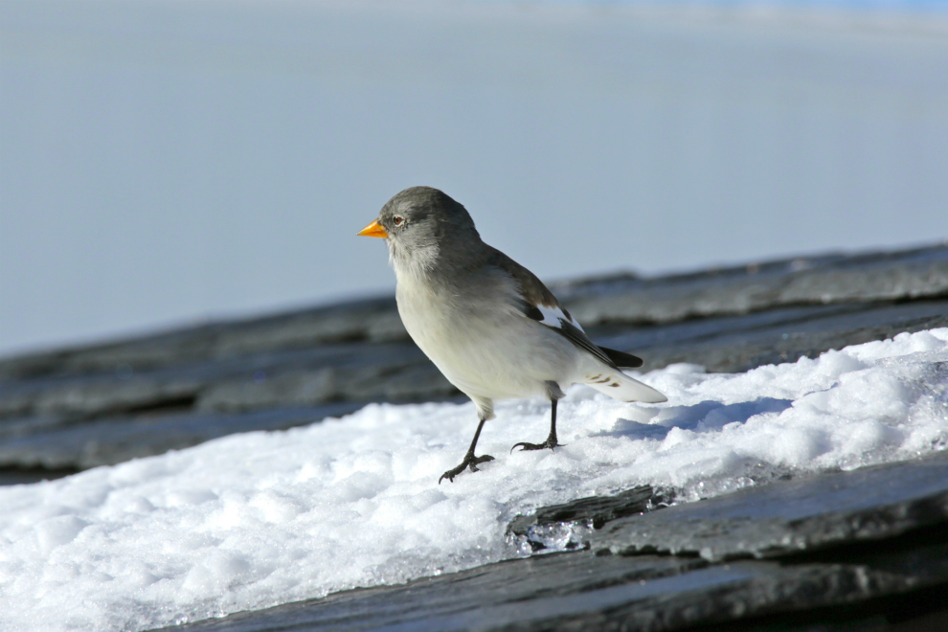
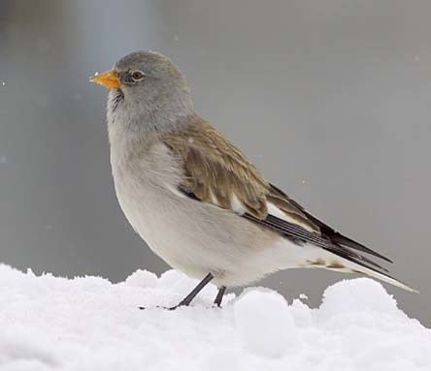
Do you remember?

Slide 3
Research Question
Develop a model that gives the probability for the sex via the morphological traits
Identify which measurements are important, that they know which one possibly to drop
Develop a model for the adult birds and one for the nestlings (too many NAs)

Slide 4
Data
Variable | Description
Age | 1 = nestling , >1 : adult bird
Wing | length in mm
P1 / P8 | feather length
Tarsus | leg length
Weight | in g (strongly varies with time of year)
Fat | (0 = lean, 6 = fat)
Muscle | (0 = hardly any muscle, 3 = a lot of muscle)
Bill length | In mm
Sex | Sex guess of the person who collected it
Ringer | Person which collected the data
Location | Place where the birds were collected
Time | When the data was collected
Sex_genetic | Sex determined via gene test

Slide 5
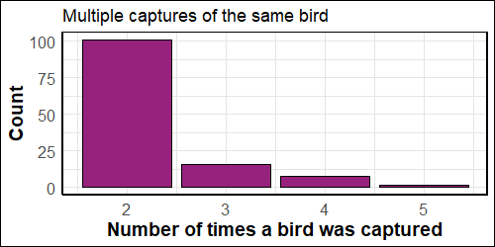
Data pre-processing
Remove duplicates: 140 observations
Roughly 13% of the studied birds have been captured multiples times
Keep the latest observation

Slide 6
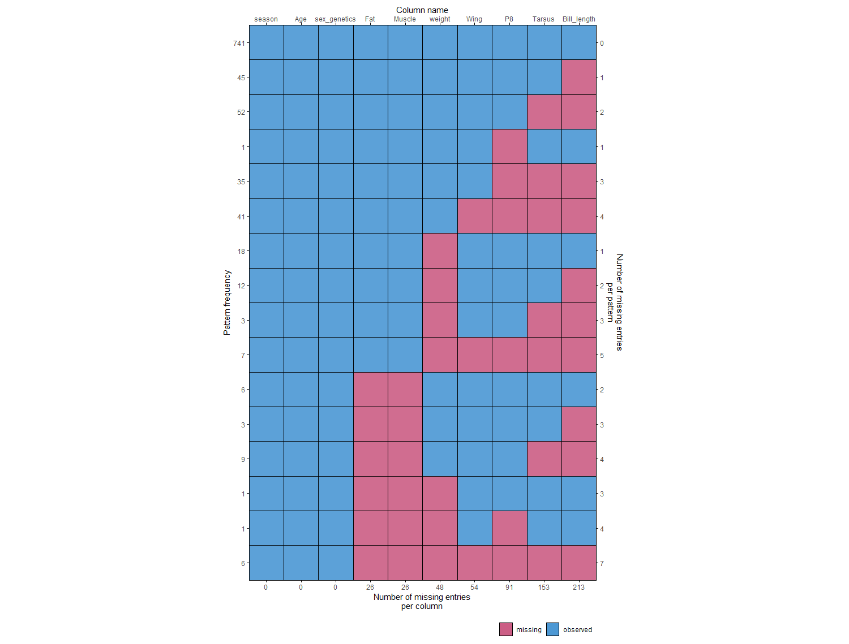
Overview:
Missing Values

Slide 7
Model 1: Decision Tree
Package: rpart
Can handle missing values
Accuracy: 84.7 %

Slide 8
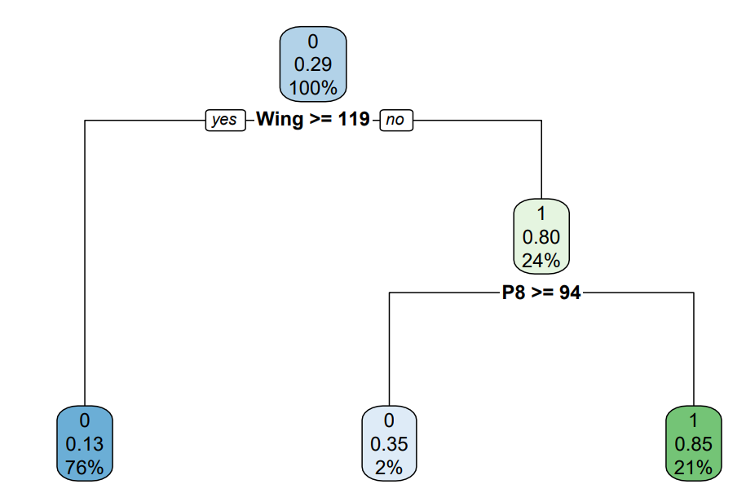
Tree

Slide 9
ModeL II: Random Forest
R package: randomForest
Can handle missing values
Accuracy: 84 %

Slide 10
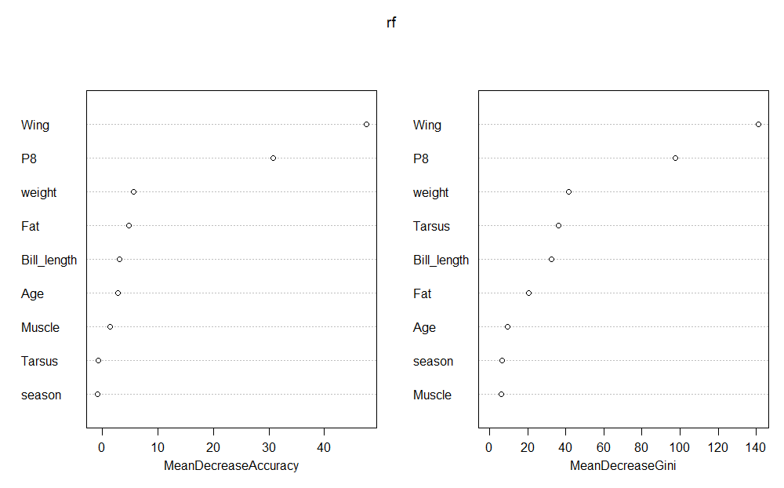
Importance of Variables

Slide 11
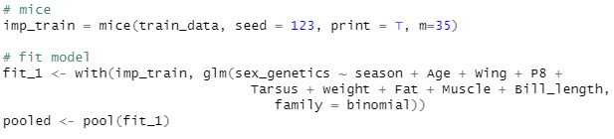
Model III: Logit Model
Imputed data with MICE
Trained glm on every imputed data set
Pooled estimates
Accuracy: 87.2 %
Number of multiple imputations
Pool the imputed data

Slide 12
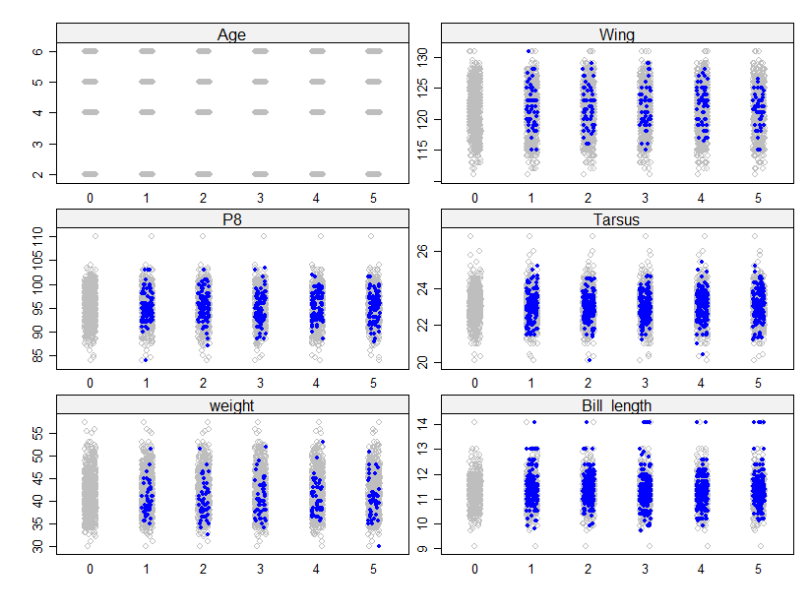
Stripplot of imputed data

Slide 13
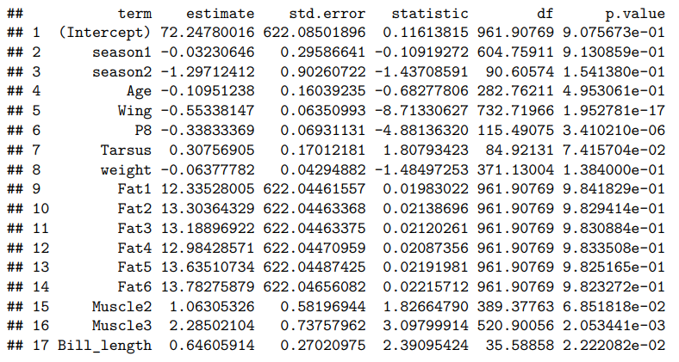
Estimates 1

Slide 14
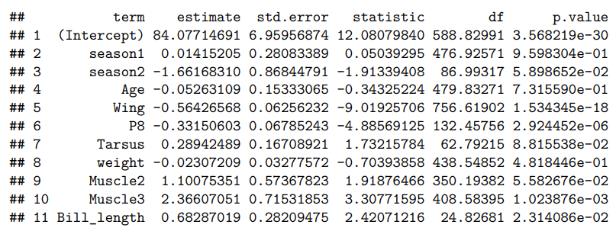
Estimates 2

Slide 15
Stats Method: MICE

Slide 16
To dos

Slide 17
Project review
Develop a systematic approach for cleaning and preparing data before processing
Take a closer look at the data before applying any modeling techniques
Conduct thorough research on Multiple Imputations by Chained Equations (MICE) before applying it
Do not apply the first ideas or finding!
Communicate early with the supervisor the methodology and progress

Slide 18
summary
Successfully cleaned and prepared the data for the client
Identify the most relevant morphological traits
Suggest a model that gives the probability for the sex via the morphological traits
Accuracy Decision Tree and Random Forest: ~84%
Accuracy Logit Model: 87.2 %
Critical assessment of our result
On a subsample of 415 observations the field expert got an accuracy of 93.2%

