Slide 1

Bird
Joel Alder, Connor Charlton, Samir Hauser

Slide 2

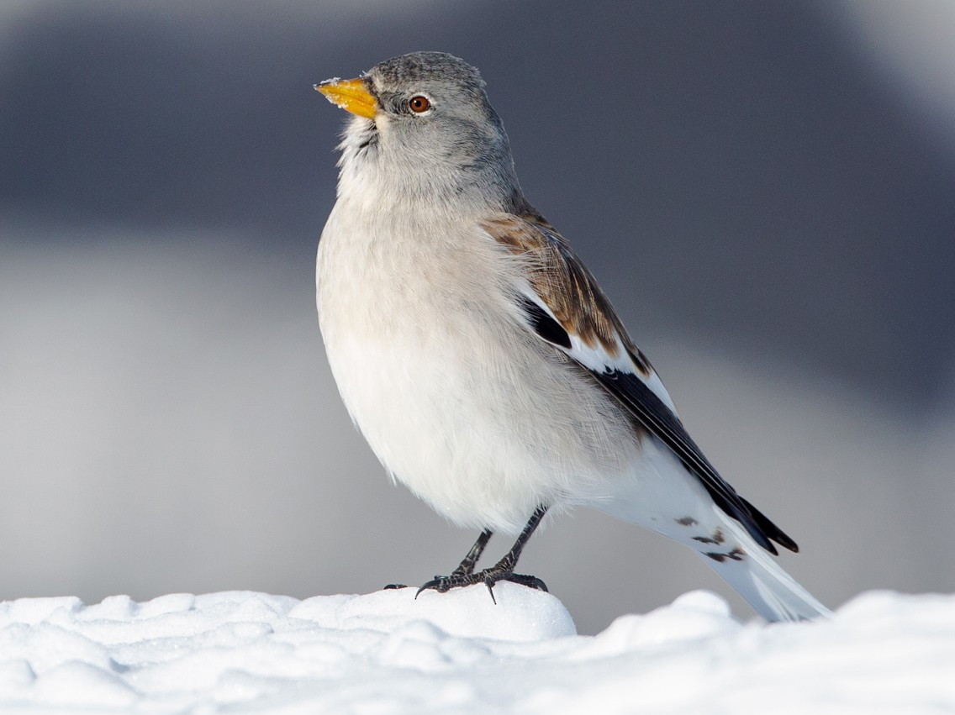
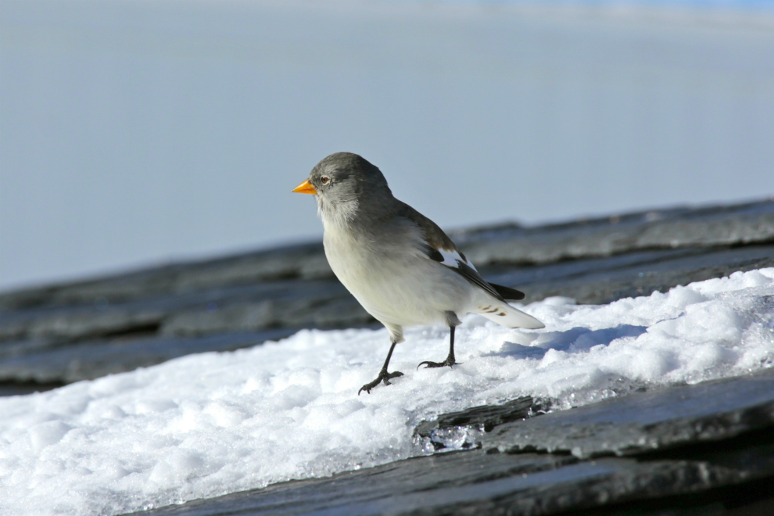
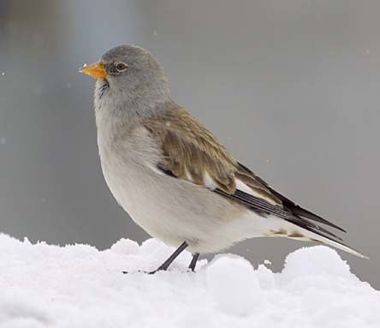
Do you remember?

Slide 3
Research Question
Develop a model that gives the probability for the sex via the morphological traits
Identify which measurements are important, that they know which one possibly to drop
Develop a model for the adult birds and one for the nestlings (too many NAs)

Slide 4
Data
Variable | Description
Age | 1 = nestling , >1 : adult bird
Wing | length in mm
P1 / P8 | feather length
Tarsus | leg length
Weight | in g (strongly varies with time of year)
Fat | (0 = lean, 6 = fat)
Muscle | (0 = hardly any muscle, 3 = a lot of muscle)
Bill length | In mm
Sex | Sex guess of the person who collected it
Ringer | Person which collected the data
Location | Place where the birds were collected
Time | When the data was collected
Sex_genetic | Sex determined via gene test

Slide 5

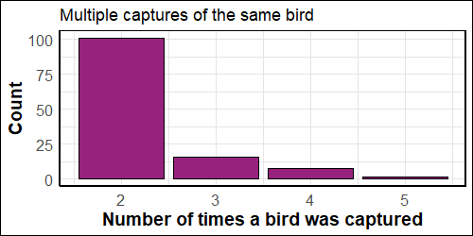
Data pre-processing
Season has been added as a new variable to the dataset
The dataset contained 140 doublicated rows which were subsequently removed
Roughly 13% of the studied birds have been captured multiples times
Keep the latest observation

Slide 6
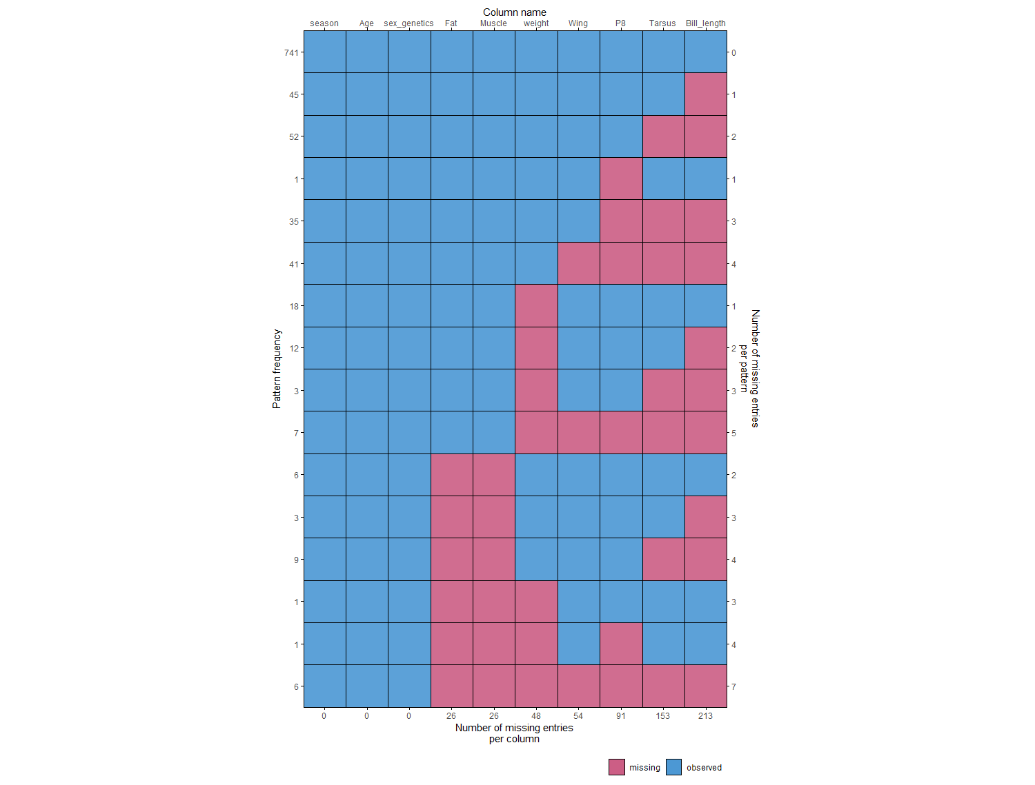

Variable
Overview:
Missing Values
Number of missing entreis per pattern
Pattern Frequency
Number of missing entreis per column

Slide 7
1. Complete cases
Overview:
Missing Values
2. Tightly coupled
4. Many missing values
3. Insufficient data

Slide 8
Model I: Decision Tree
Package: rpart
Can handle missing values
Accuracy: 84.7 %

Slide 9
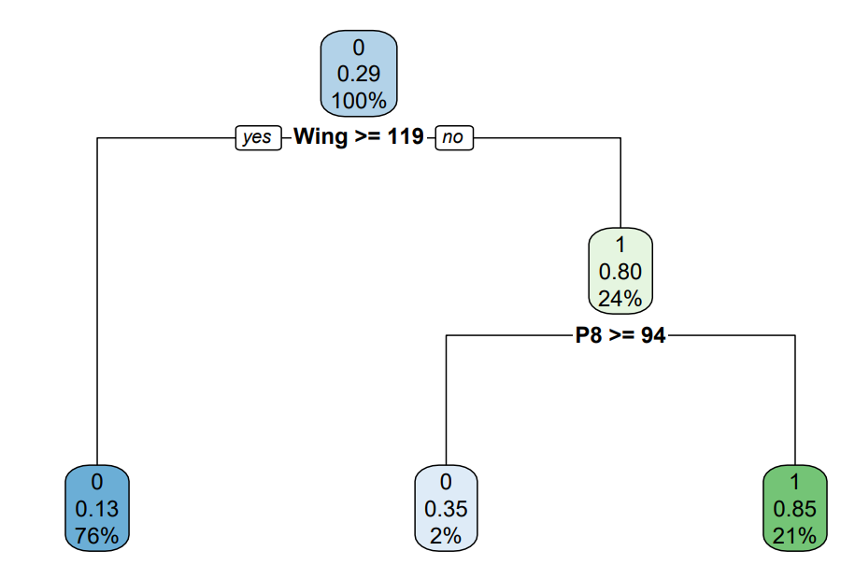
Tree

Slide 10

ModeL II: Random Forest
R package: randomForest
Can handle missing values
Accuracy: 84 %
Number of tress to grow
NA for numeric variables replaced with medians, for factors with most frequent levels

Slide 11
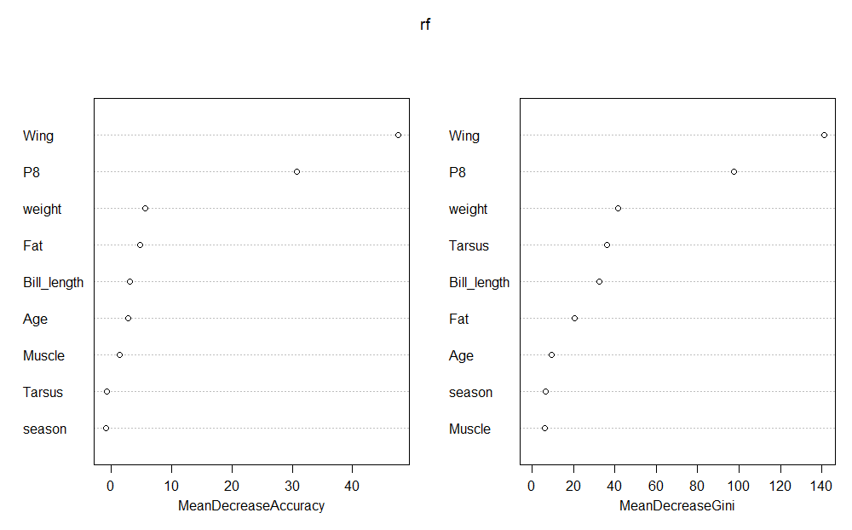
Importance of Variables

Slide 12
Stats Method: MICE

Slide 13
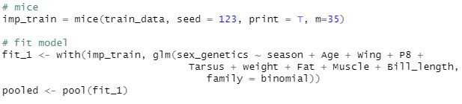
Model III: Logistic regression Model
Imputed data with MICE
Trained glm on every imputed data set
Pooled estimates
Accuracy: 87.2 %
Number of multiple imputations
Pool the imputed data

Slide 14
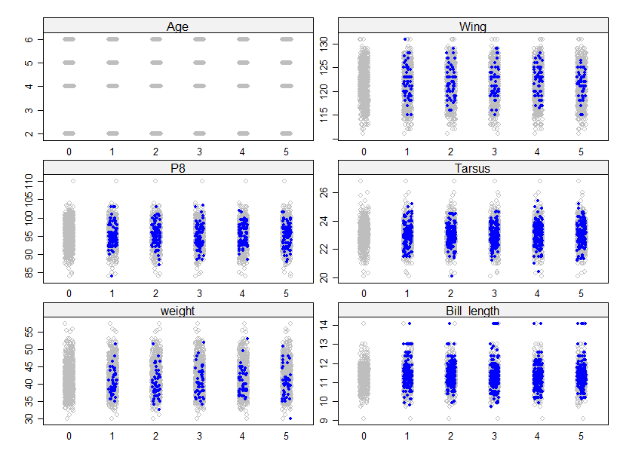
Stripplot of imputed data (m = 5)

Slide 15
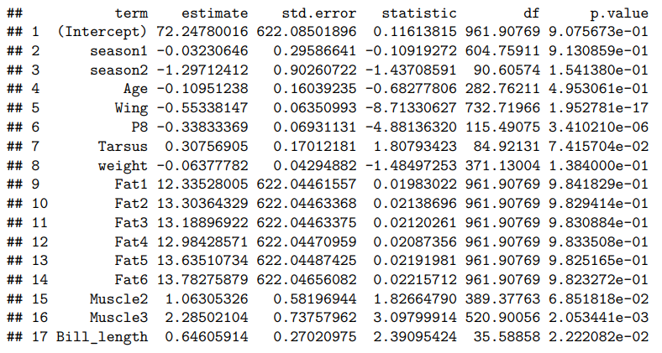
Estimates 1

Slide 16
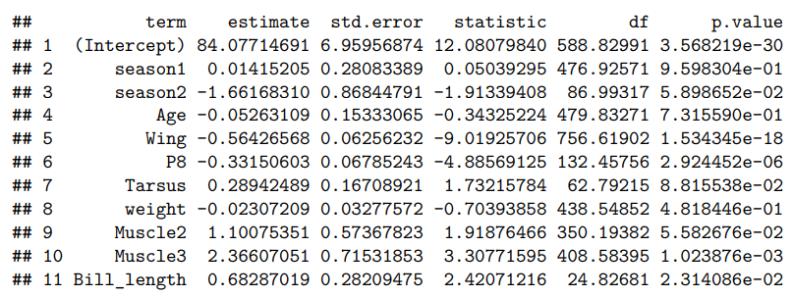
Estimates 2

Slide 17
To dos
Present the result to the client
Distinction between P1 and P8
Weights of the loss functions
Why are there duplicates
Delay the removal of the instances missing sex genetics values

Slide 18
Project review
Develop a systematic approach for cleaning and preparing data before processing
Take a closer look at the data before applying any modeling techniques
Conduct thorough research on Multiple Imputations by Chained Equations (MICE) before applying it
Do not apply the first ideas or finding!
Communicate early with the supervisor the methodology and progress
Studying the missingness pattern before the imputation

Slide 19
summary
Successfully cleaned and prepared the data for the client
Identify the most relevant morphological traits
Suggest a model that gives the probability for the sex via the morphological traits
Accuracy Decision Tree and Random Forest: ~84%
Accuracy Logit Model: 87.2 %
Critical assessment of our result
On a subsample of 415 observations the field expert got an accuracy of 93.2%
Our model for this subsample: DT (91.1%) Logistic Regression (90.1 %)

