Slide 2
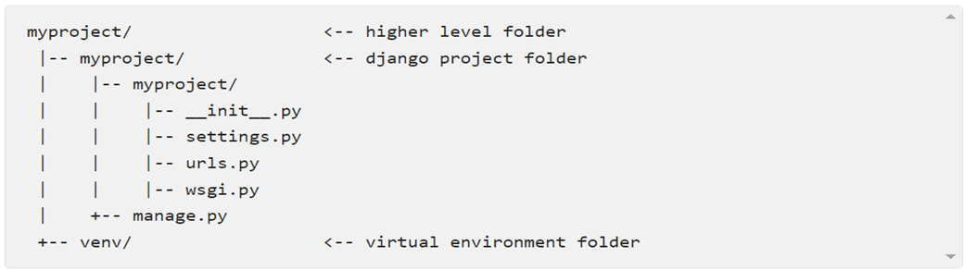
.Start a new project
To start a new Django project, run the command below: django-admin startproject myproject
The command-line utility django-admin is automatically installed with Django.
After we run the command above, it will generate the base folder structure for a Django project. Right now, our myproject directory looks like this:

Slide 3
Our initial project structure is composed of five files:
manage.py: a shortcut to use the django-admin command-line utility. It’s used to run management commands related to our project. We will use it to run the development server, run tests, create migrations and much more.
__init__.py: this empty file tells Python that this folder is a Python package
settings.py: this file contains all the project’s configuration. We will refer to this file all the time!
urls.py: this file is responsible for mapping the routes and paths in our project. For example, if you want to show something in the URL /’about’/ you have to map it here first.
wsgi.py: this file is a simple gateway interface used for deployment. You don’t have to bother about it. Just let it be for now.
Django comes with a simple web server installed. It’s very convenient during the development, so we don’t have to install anything else to run the project locally. We can test it by executing the command:
python manage.py runserver

Slide 4
Django Apps
app: is a Web application that does something. An app usually is composed of a set of models (database tables), views, templates, tests.
project: is a collection of configurations and apps. One project can be composed of multiple apps, or a single app.
It’s important to note that you can’t run a Django app without a project. Simple websites like a blog can be written entirely inside a single app, which could be named blog or weblog for example.
It’s a way to organize the source code. In the beginning, it’s not very trivial to determine what is an app or what is not. How to organize the code and so on. But don’t worry much about that right now! Let’s first get comfortable with Django’s API and the fundamentals.
Alright! So, to illustrate let’s create a simple Web Forum or Discussion Board. To create our first app, go to the directory where the manage.py file is and executes the following command:
django-admin startapp boards

Slide 5
Notice that we used the command startapp this time. This will give us the following directory structure:
migrations/: here Django store some files to keep track of the changes you create in the models.py file, so to keep the database and the models.py synchronized.
admin.py: this is a configuration file for a built-in Django app called Django Admin.
apps.py: this is a configuration file of the app itself.
models.py: here is where we define the entities of our Web application. The models are translated automatically by Django into database tables.
tests.py: this file is used to write unit tests for the app.
views.py: this is the file where we handle the request/response cycle of our Web application.
Now that we created our first app, let’s configure our project to use it.
To do that, open the settings.py and try to find the INSTALLED_APPS variable:

Slide 6
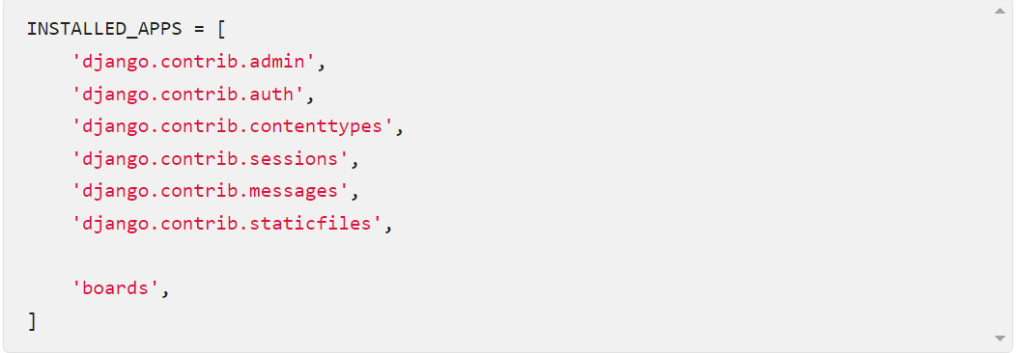
settings.py

Slide 7
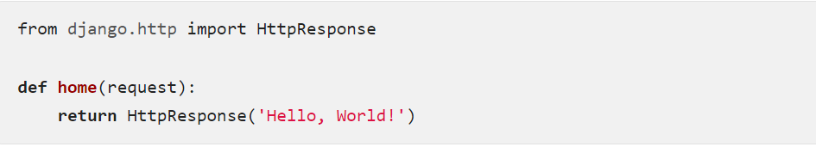
Hello, World!
Let’s write our first view. We will explore it in great detail in the next tutorial. But for now, let’s just experiment how it looks like to create a new page with Django.
Open the views.py file inside the boards app, and add the following code: views.py

Slide 8
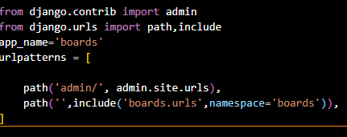
urls.py
Views are Python functions that receive an HttpRequest object and returns an HttpResponse Receive a request as a parameter and returns a response as a result. That’s the flow you have to keep in mind!
Now we have to tell Django when to serve this view. It’s done inside the urls.py file:
urls.py
Let’s see what happen: python manage.py runserver

Slide 9
Use Case Diagram

