Slide 1
Meeting – July 7, 2026

Slide 2
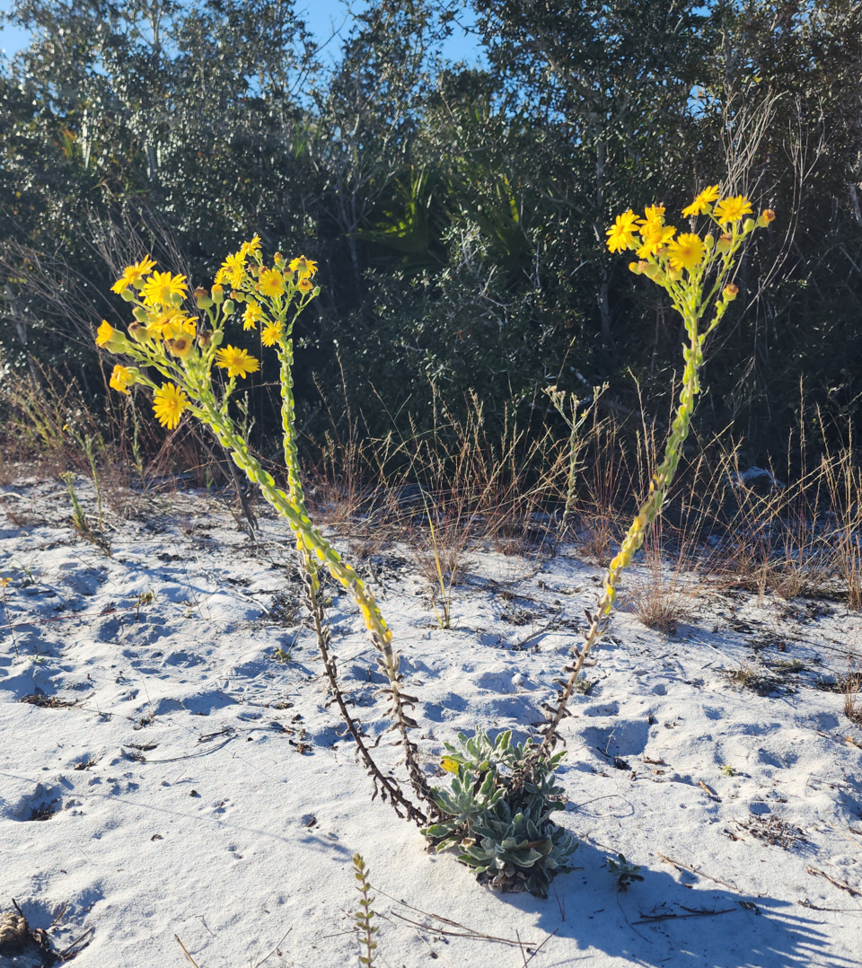
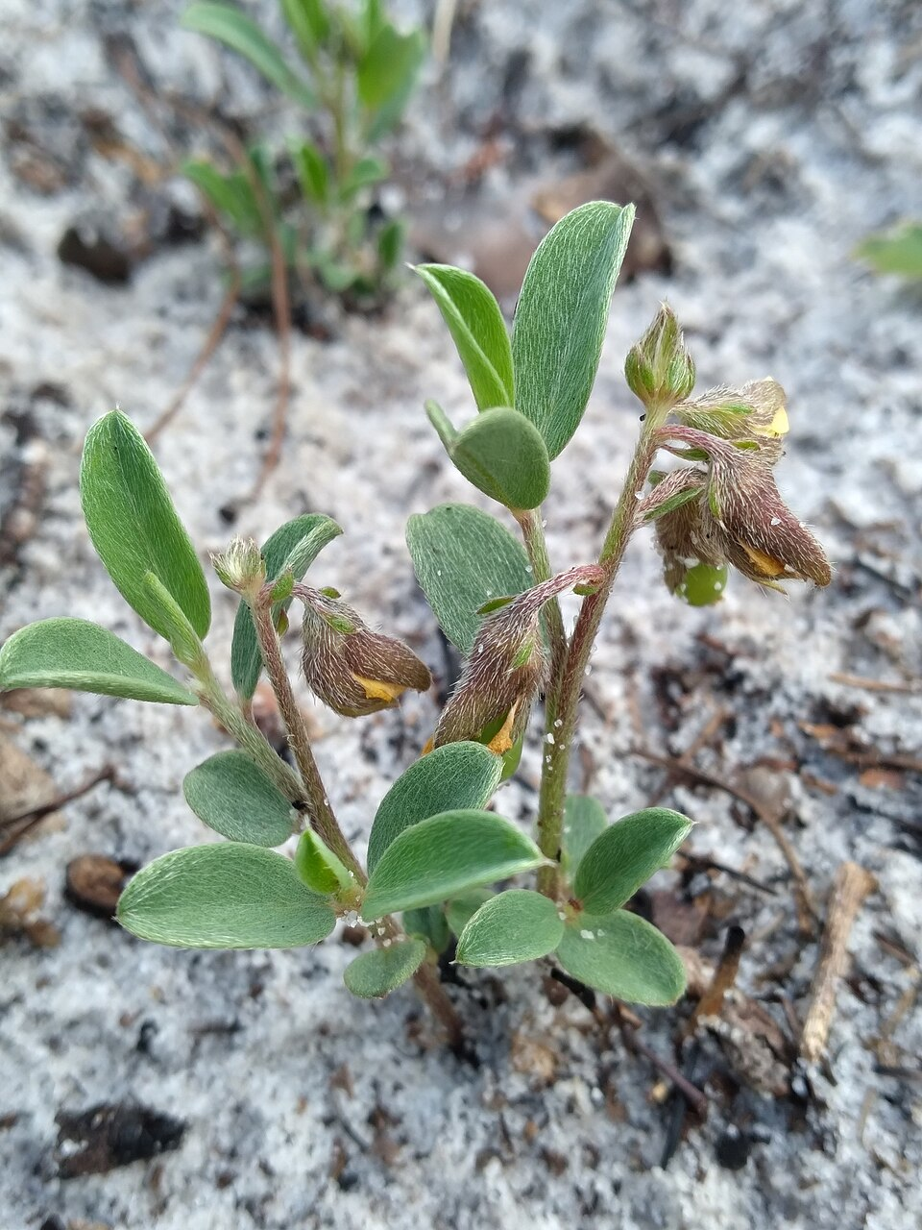
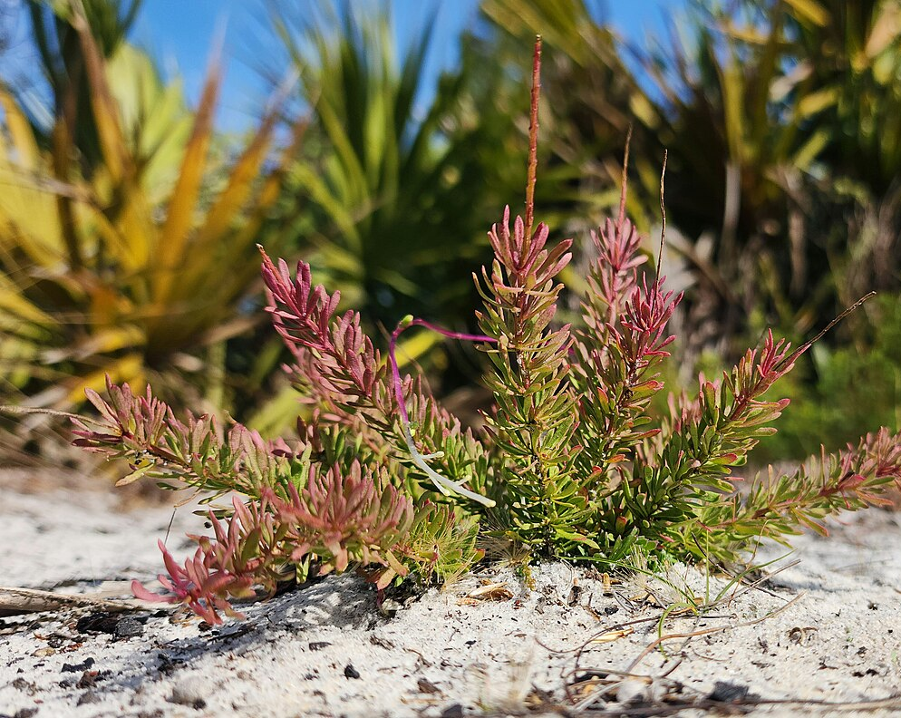
The three Archbold datasets
Chrysopsis highlandsensis | Crotalaria avonensis | Polygala lewtonii
Asteraceae New dataset 1999-2025 11 subpopulations (‘sites’) | Fabaceae Extended dataset 1998-2025 12 subpopulations (‘sites’) | Fabales Polygalaceae Extended dataset 2001 – 2025 220 quadrats
https://en.wikipedia.org/wiki/Chrysopsis_highlandsensis#/media/File:Chrysopsis_highlandsensis_in_bloom_-_Arbuckle_(LWR_SF),_FL_-_November_2025.png
https://en.wikipedia.org/wiki/Crotalaria_avonensis#/media/File:Avon_Park_Rattlebox_imported_from_iNaturalist_photo_118466635_on_3_July_2024.jpg
https://en.wikipedia.org/wiki/Senega_lewtonii#/media/File:Senega_lewtonii_(upclose)_-_Babson_Tract_-_January_2026.jpg

Slide 3
Chrysopsis highlandsensis
Special features: Plant size log rosette diameter, Disturbance
Vital-rate models: Survival, Growth, Flowering probability, Flowerhead production
Fertility pathway: Flowering probability → Number of flowerheads (Flowering | X) → Flowers to recruits (Site level)

Slide 4
Crotalaria avonensis
Special features:
Vital-rate models: Survival, Growth, Flowering probability, Number of flowers, Fruiting probability, Numbers of Fruits
Fertility pathway: Flowering probability → Fruiting probability (Flowering | X) → Number of Fruits (Flowers & Fruiting | X) → Fruit to recruit (Site level)

Slide 5
Polygala lewtonii
Special features:
Vital-rate models:
Fertility pathway:

