Slide 1
FM Tuner Evaluation Board - Si4703
By: Aldo Ndreu

Slide 2
Introduction
The project which I decided to undertake this semester was working with the si4703 FM Tuner Evaluation board.
This small evaluation board enables the user to tune into different FM radio stations and also does a great job of filter and carrier detection.
The antenna of this sensor can either be headphones which go into the 3.5mm audio jack or even speakers which I will be using in order to demonstrate my project.

Slide 3
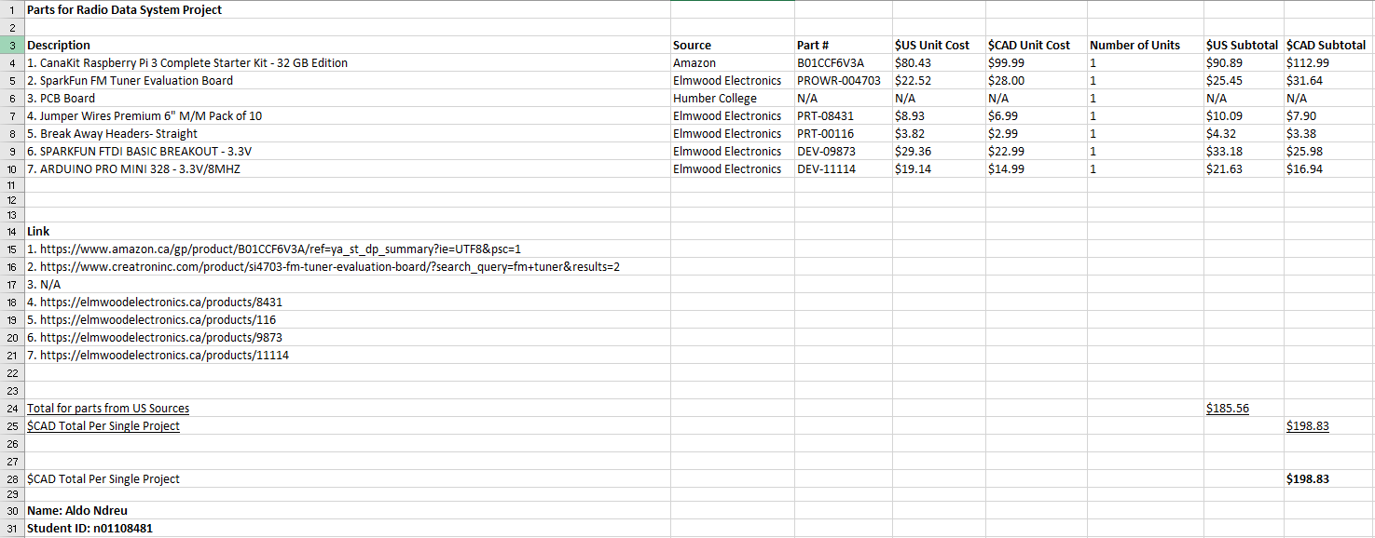
Budget

Slide 4
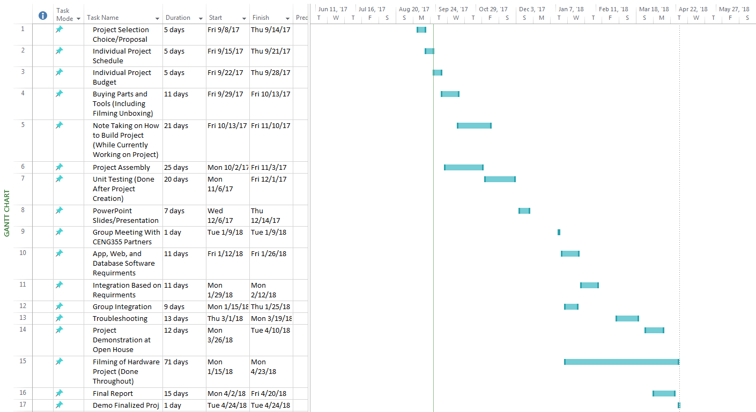
Schedule

Slide 5
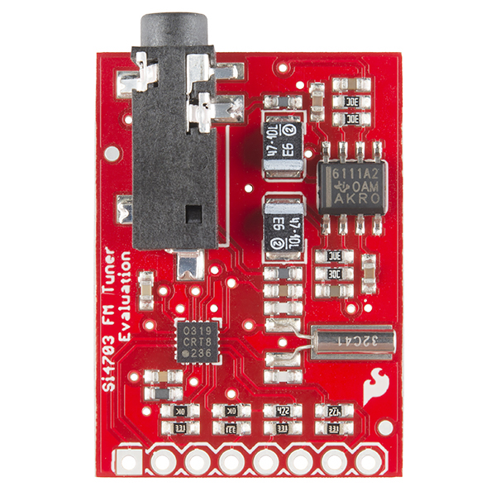
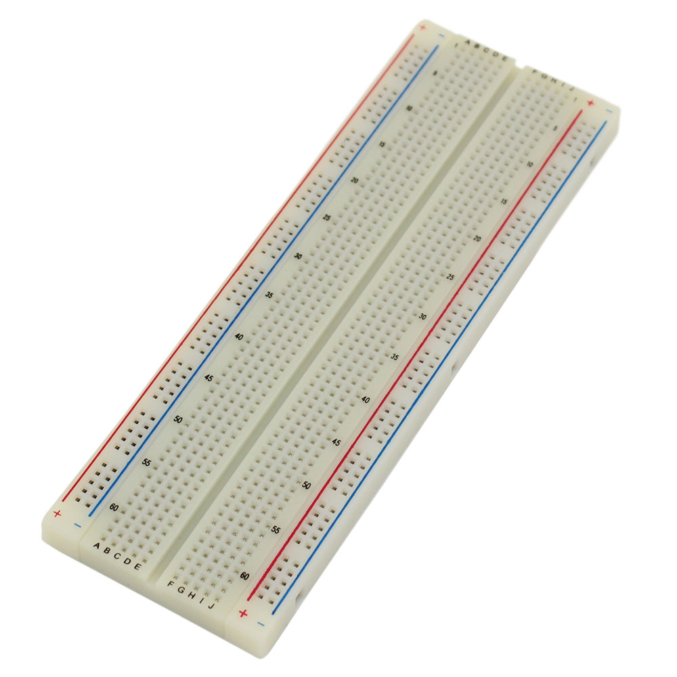
Project Demonstration
I will now demonstrate my project to the class!
ENJOY!

Slide 6
Previous/Current Course Knowledge Utilized
While working on this project I learned a few things such as:
Learning how to use a Raspberry Pi
Learning how to use an Arduino Pro Mini for testing purposes
Soldering
Properly connecting wires to appropriate pins on breadboard
Using previous knowledge of Electric Circuits for troubleshooting
CENG 250, CENG 251, CENG 256 (Other mixtures of electrical and programming courses)

Slide 7
THANK-YOU

