Slide 1
Optimal Transition-to-turbulence scenario
ONERA, Meudon (Paris)
Author:
Aldo Schioppa

Slide 2
Mesh

Slide 3
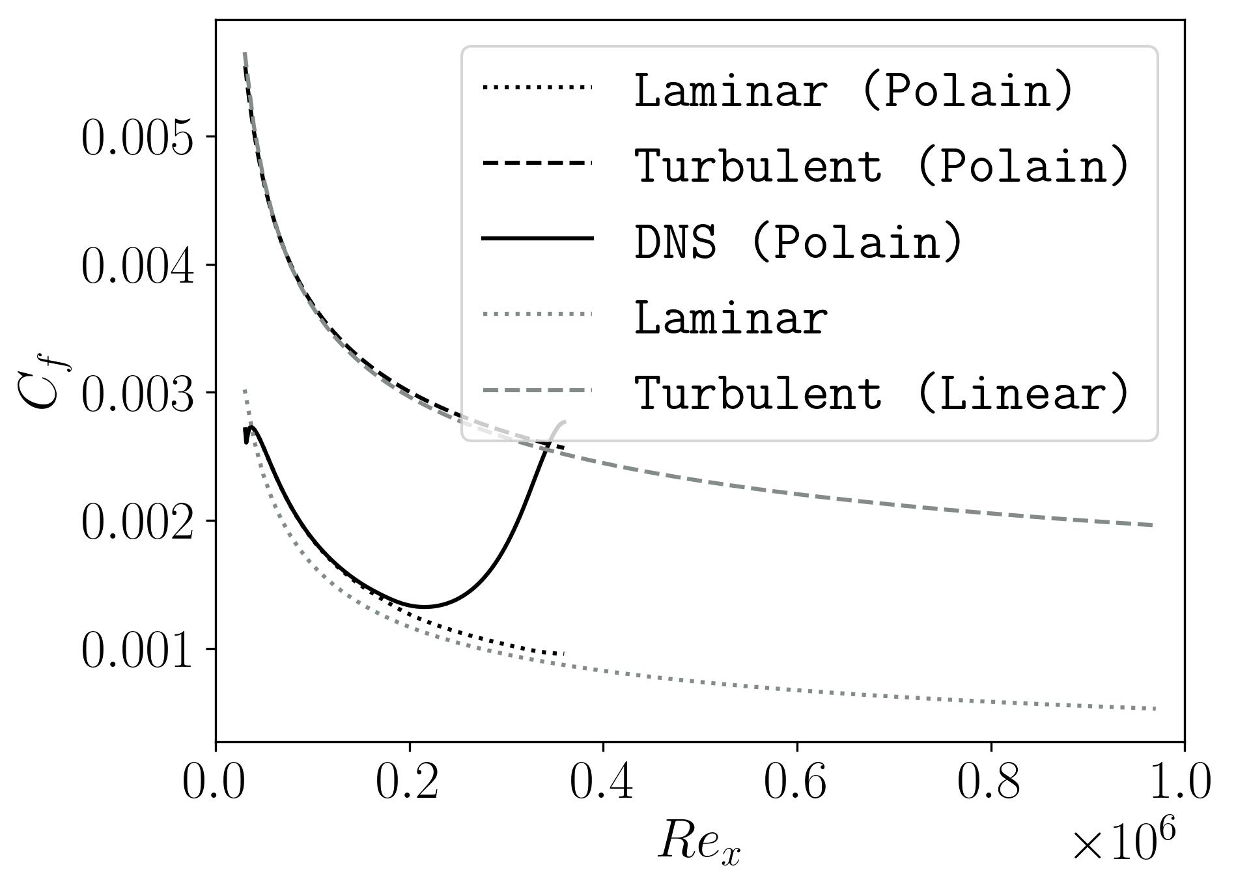
Mesh Inputs
Re_{x} = 4.6e6 → Re_{in} = 29’900, Re_{out} = 10⁶
M = 4.5
Pr = 0.925
T = 288 K
L = x_{out} – x_{in} = (0.2174 – 0.0065) m = 0.2109 m
ρ_{w} = 0.01084219 Kg/m³
ν_{w} = 5.46413 * 10⁻⁵ m²/s
u_{τ}= 126.6427 m/s
Dy : y+ = 0.23
τ_{w} = 173.891335 Pa
T_{w} = T_{aw}

Slide 4
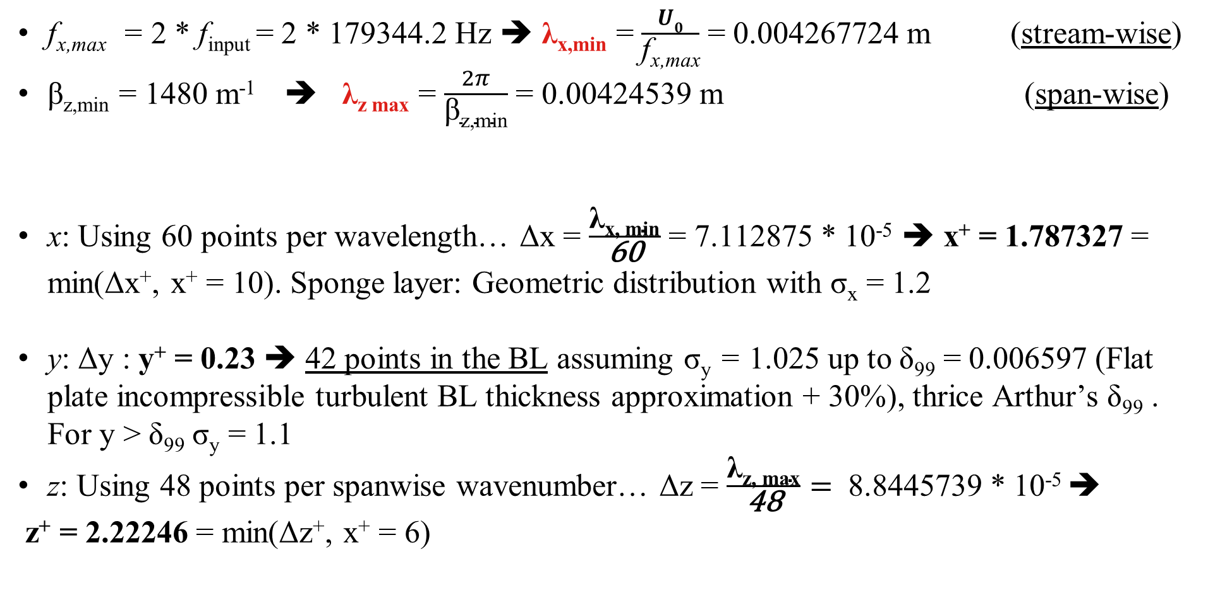
Mesh characteristics
f_{x,max} = 2 * f_{input} = 2 * 179344.2 Hz ➔ λ_{x,min} = $\frac{U0}{\text{f}\text{x}\text{,}\text{max}}$ = 0.004267724 m (stream-wise)
β_{z,min} = 1480 m⁻¹ ➔ λ_{z max} = $\frac{2π}{\text{β}\text{z}\text{,}\text{min}}$ = 0.00424539 m (span-wise)
x: Using 60 points per wavelength… Δx = $\frac{\text{λ}\text{x}\text{, }\text{min}}{\text{60}}$ = 7.112875 * 10⁻⁵ ➔ x⁺ = 1.787327 = min(Δx⁺, x⁺ = 10). Sponge layer: Geometric distribution with σ_{x} = 1.2
y: Δy : y⁺ = 0.23 ➔ 42 points in the BL assuming σ_{y} = 1.025 up to δ₉₉ = 0.006597 (Flat plate incompressible turbulent BL thickness approximation + 30%), thrice Arthur’s δ₉₉ . For y > δ₉₉ σ_{y} = 1.1
z: Using 48 points per spanwise wavenumber… Δz = $\frac{\text{λ}\text{z}\text{, }\text{max}}{\text{48}}=$ 8.8445739 * 10⁻⁵ ➔
z⁺ = 2.22246 = min(Δz⁺, x⁺ = 6)
Results

Slide 5
BCs
N_{x} = 2897, N_{y} = 157, N_{z} = 96 →→ N_{tot} = 43’663’584 cells →→ 6 nodes
L_{x} = L = 0.2109 m, L_{y} = 9*δ₉₉, L_{z} = 2*λ_{z, max}
Supersonic Inlet
$$U0$$
0.1L_{x}
Supersonic Freestream
$$U0$$
L_{y}
$$U0$$
x_{out}
δ₉₉
x_{out}
L_{z}
Adiabatic Wall
y
y
L_{x}
z
x
x
x_{in}
Sponge Layer
Extrapolation

Slide 6
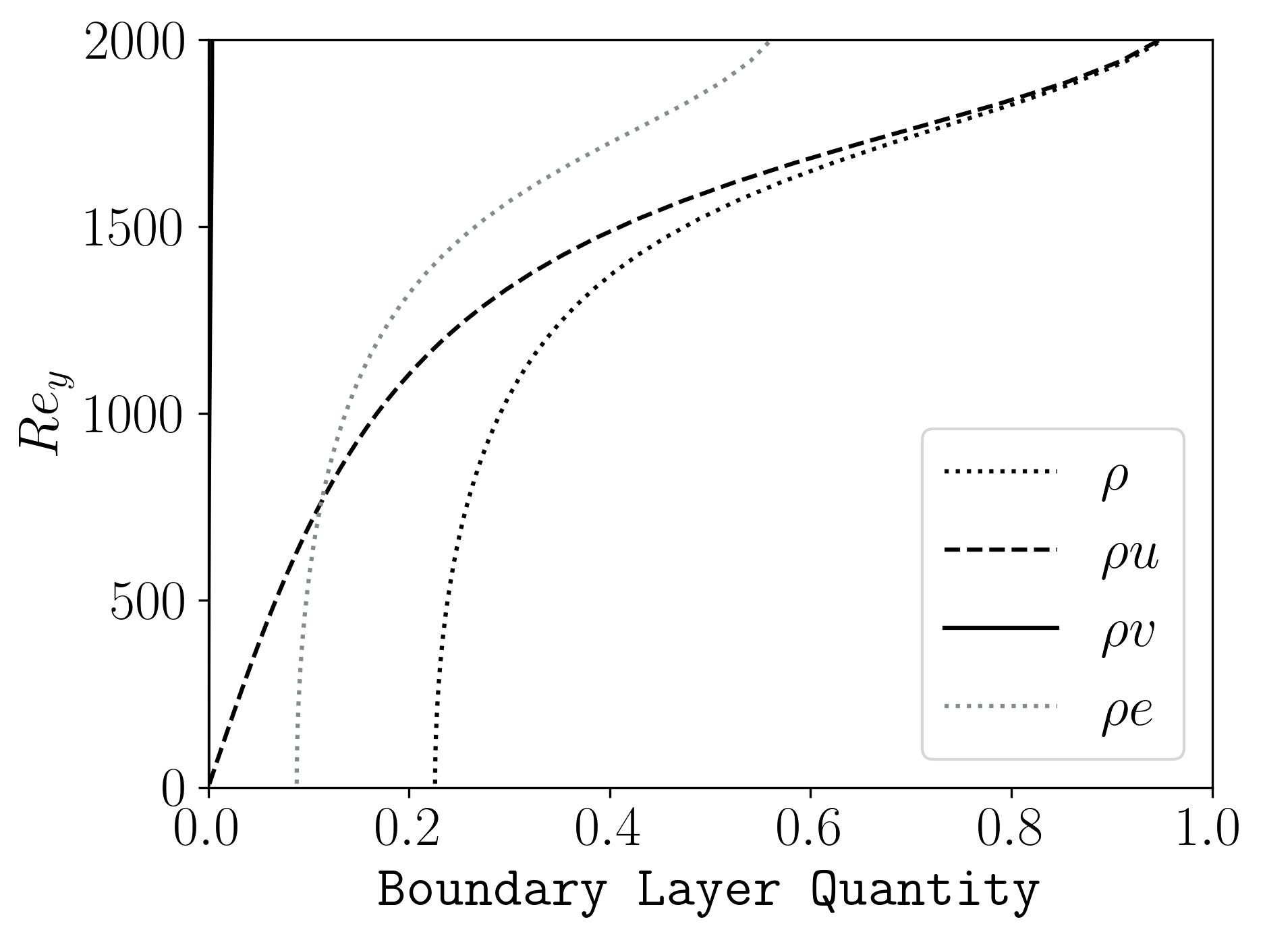
BCs
$$U0$$
$$U0$$
L_{y}
L_{y}
$$U0$$
x_{out}
L_{z}
y
L_{x}
z
x
x_{in}

