Slide 1
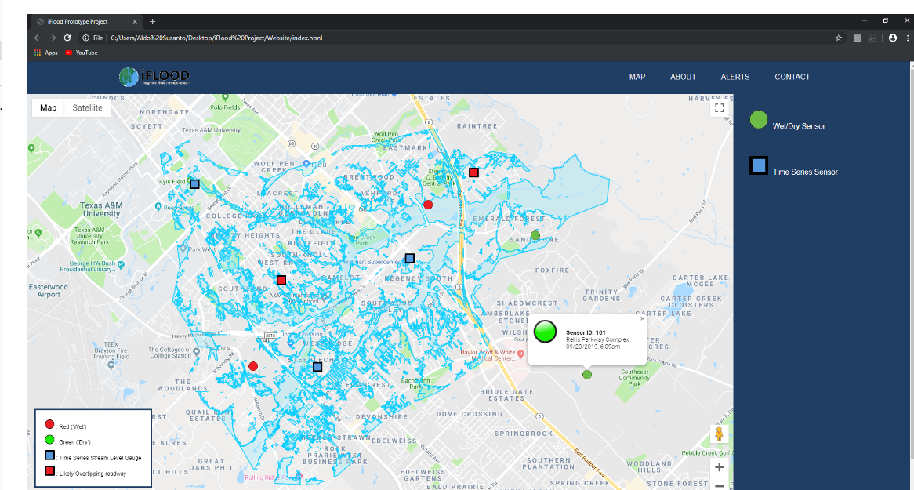

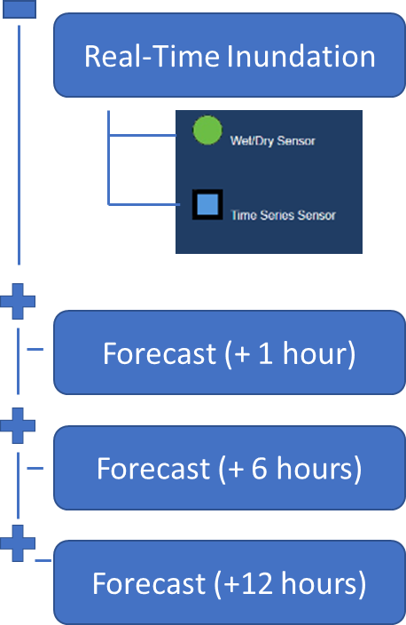


Slide 2

iStorm

Slide 3
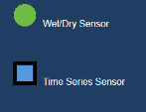

Real-Time Inundation
Forecast (+ 1 hour)
Forecast (+ 6 hours)
Forecast (+12 hours)

