Slide 1
Kalman Filter
Solved example 1D

Slide 2
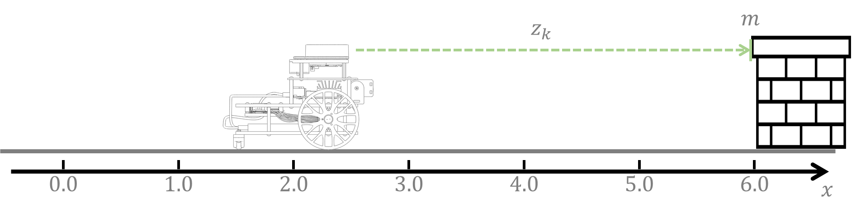
Problem Statement
Using the Kalman filter, estimate the position of a 1D linear robot for two timesteps, i.e., $μ_{1}$, $μ_{2}$, and $Σ_{1}$, $Σ_{2}.$

Slide 3
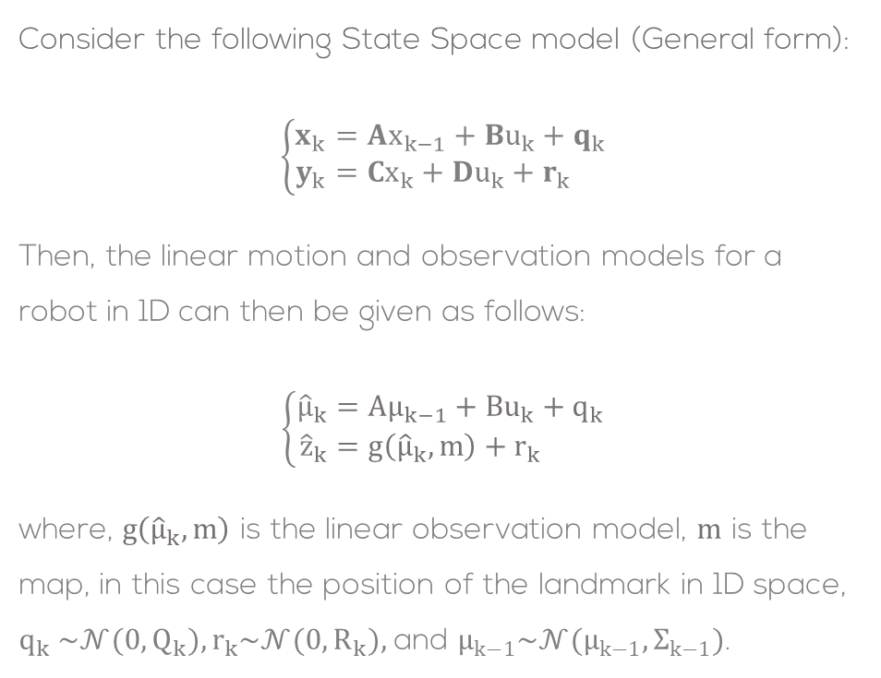
Problem Statement
Consider the following State Space model (General form):
$$\left\{\begin{aligned}x_{k}&=Ax_{k−1}+Bu_{k}+q_{k} \\ y_{k}&=Cx_{k}+Du_{k}+r_{k}\end{aligned}\right.$$
Then, the linear motion and observation models for a robot in 1D can then be given as follows:
$$\left\{\begin{aligned}{\hat{μ}}_{k}&=Aμ_{k−1}+Bu_{k}+q_{k} \\ {\hat{z}}_{k}&=g\left({\hat{μ}}_{k},m\right)+r_{k}\end{aligned}\right.$$
where, $g\left({\hat{μ}}_{k},m\right)$ is the linear observation model, $m$ is the map, in this case the position of the landmark in 1D space, $q_{k} \sim 𝒩(0,Q_{k}), r_{k}\sim 𝒩(0,R_{k}),$and $μ_{k−1}\sim 𝒩(μ_{k−1},Σ_{k−1})$.

Slide 4

Problem Statement
For the following 1D robot, let the linear estimation model to be given by
$${\hat{μ}}_{k}=Aμ_{k−1}+Bu_{k}$$
For this case let
$$A=1$$
$$B=1$$
and the initial conditions to be:
$μ_{0}=2$ robot initial position
$Σ_{0}=0$ initial prediction variance

Slide 5

Problem Statement
The observation model ${\hat{z}}_{k}=g\left({\hat{μ}}_{k},m\right)$, can be given by:
$${\hat{z}}_{k}=m−{\hat{μ}}_{k}$$
The observation model is given by
$$C=−1$$
For this example:
$$m=6 \text{landmark} \text{position}$$

Slide 6
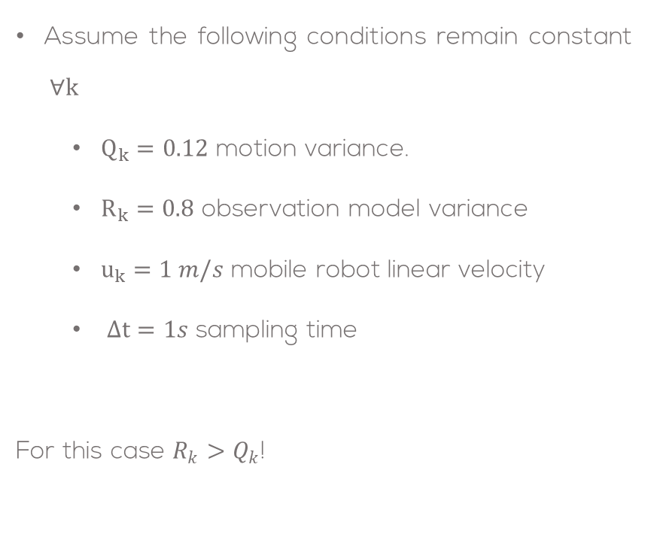
Problem Statement
Assume the following conditions remain constant $∀k$
$Q_{k}=0.12$ motion variance.
$R_{k}=0.8$ observation model variance
$u_{k}=1 m/s$ mobile robot linear velocity
$Δt=1s$ sampling time
For this case $R_{k}>Q_{k}$!

Slide 7

Problem Statement
The Kalman Filter with known data association is given by:
Prediction step:
$${\hat{μ}}_{k}=Aμ_{k−1}+Bu_{k} \\ {\hat{Σ}}_{k}=AΣ_{k−1}A^{T}+Q_{k}$$
Correction step:
$${\hat{z}}_{k}=g({\hat{μ}}_{k},m) \\ Z_{k}=C{\hat{Σ}}_{k}C^{T}+R_{k} \\ K_{k}={\hat{Σ}}_{k}C^{T}Z_{k}^{−1} \\ μ_{k}={\hat{μ}}_{k}+K_{k}\left(z_{k}−{\hat{z}}_{k}\right) \\ Σ_{k}=(I−K_{k}C) {\hat{Σ}}_{k}$$

Slide 8

Problem Statement
Considering the previous given model characteristics, $A=1, B=1,$and $\hat{z}=m−μ_{k}$, the KF becomes:
Prediction step:
$${\hat{μ}}_{k}=μ_{k−1}+u_{k} \\ {\hat{Σ}}_{k}=A Σ_{k−1}A+Q_{k}$$
Correction step:
$${\hat{z}}_{k}=m−{\hat{μ}}_{k} \\ Z_{k}=C{\hat{Σ}}_{k}C+R_{k} \\ K_{k}=\frac{{\hat{Σ}}_{k}C}{Z_{k}} \\ μ_{k}={\hat{μ}}_{k}+K_{k}\left(z_{k}−{\hat{z}}_{k}\right) \\ Σ_{k}=(1−K_{k}C) {\hat{Σ}}_{k}$$

Slide 9
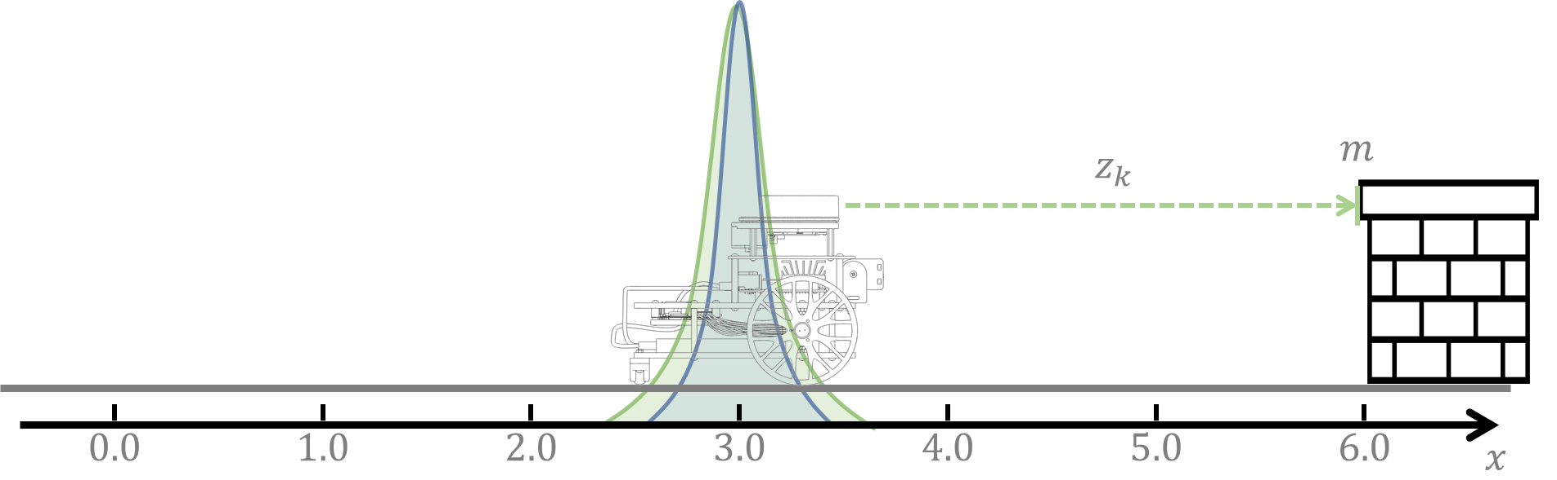
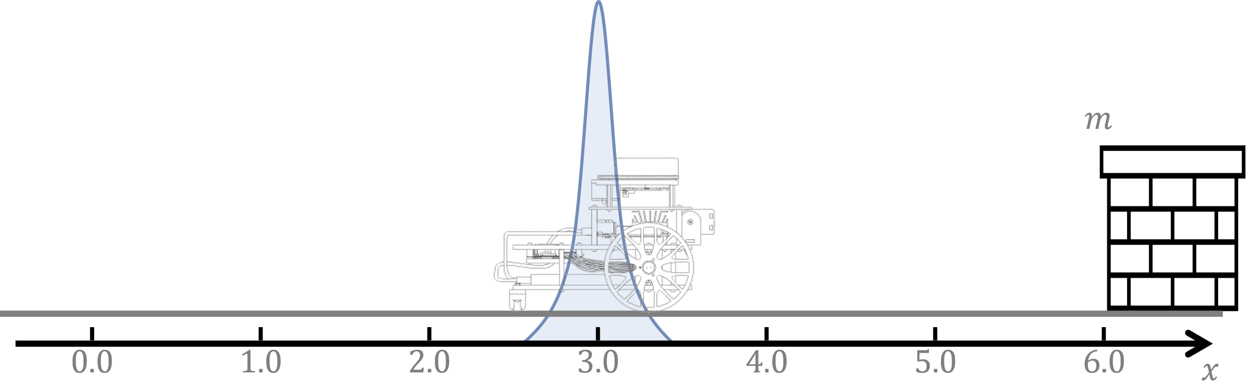
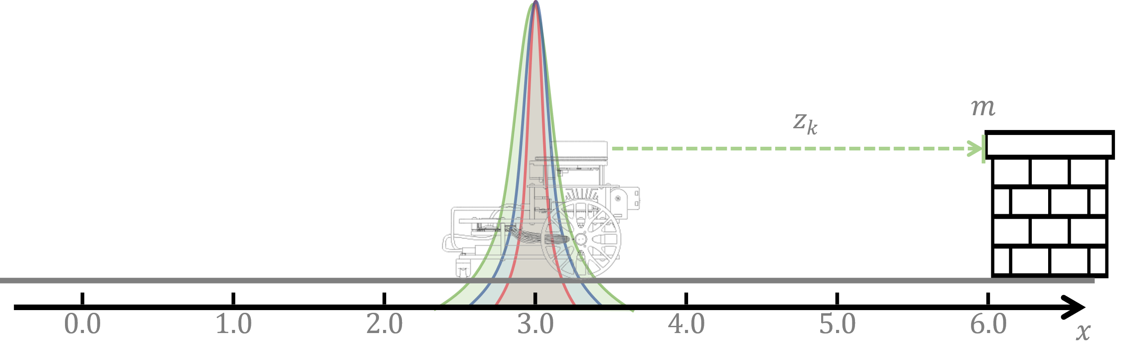
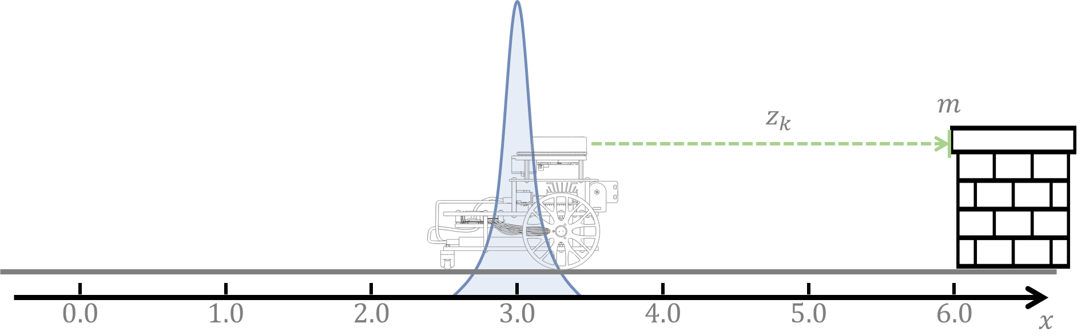
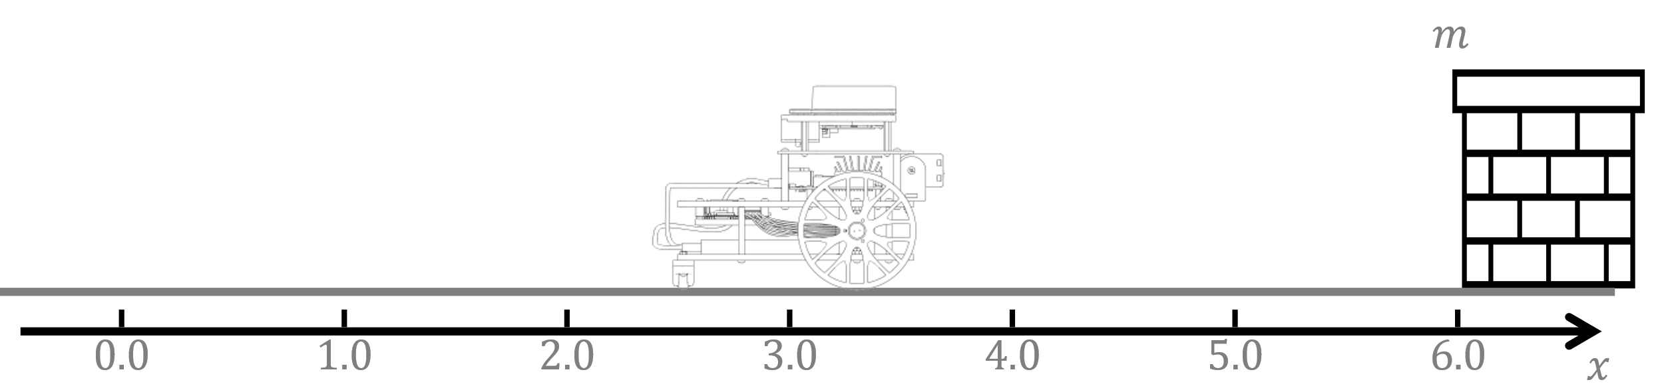
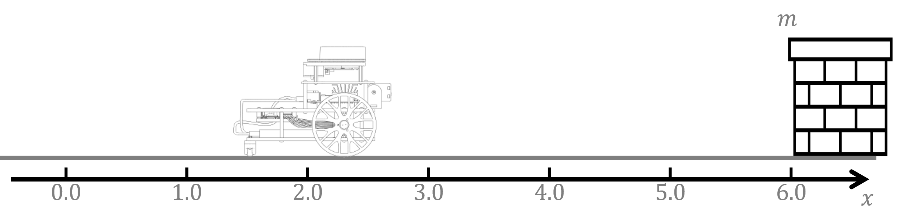











Solution: Iteration 1
Measurement:
$z_{1}=2.2$
For the first iteration $k=1$:
Prediction step:
$${\hat{μ}}_{k}=μ_{k−1}+u_{k} \\ {\hat{Σ}}_{k}=Σ_{k−1}+Q_{k}$$
For the first iteration $k=1$:
Prediction step:
$${\hat{μ}}_{1}=μ_{0}+u_{1} \\ {\hat{Σ}}_{1}=Σ_{0}+Q_{1}$$
For the first iteration $k=1$:
Prediction step:
$${\hat{μ}}_{1}=2+1 \\ {\hat{Σ}}_{1}=0+0.12$$
For the first iteration $k=1$:
Prediction step:
$${\hat{μ}}_{1}=3 \\ {\hat{Σ}}_{1}=0.12$$
Correction step:
$${\hat{z}}_{1}=6−3 \\ Z_{1}=\left(−1\right)0.12 (−1)+0.8 \\ K_{1}=\frac{0.12 ∗(−1)}{0.12+0.8} \\ μ_{k}={\hat{μ}}_{k}+K_{k}\left(z_{k}−{\hat{z}}_{k}\right) \\ Σ_{k}=(1−K_{k}) {\hat{Σ}}_{k}$$
Correction step:
$${\hat{z}}_{1}=3 \\ Z_{1}=0.92 \\ K_{1}=−0.1304 \\ μ_{k}={\hat{μ}}_{k}+K_{k}\left(z_{k}−{\hat{z}}_{k}\right) \\ Σ_{k}=(1−K_{k}) {\hat{Σ}}_{k}$$
Correction step:
$${\hat{z}}_{1}=3 \\ Z_{1}=0.92 \\ K_{1}=−0.1304 \\ μ_{1}={\hat{μ}}_{1}+K_{1}\left(z_{1}−{\hat{z}}_{1}\right) \\ Σ_{1}=(1−K_{1}C) {\hat{Σ}}_{1}$$
Correction step:
$${\hat{z}}_{1}=3 \\ Z_{1}=0.92 \\ K_{1}=−0.1304 \\ μ_{1}=3+(−0.1304)\left(2.2−3\right) \\ Σ_{1}=\left(1−(−0.1304)(−1)\right)0.12$$
Correction step:
$${\hat{z}}_{1}=3 \\ Z_{1}=0.92 \\ K_{1}=−0.1304 \\ μ_{1}=3.104 \\ Σ_{1}=0.1043$$
Correction step:
$${\hat{z}}_{1}=m−{\hat{μ}}_{1} \\ Z_{1}=C{\hat{Σ}}_{1}C+R_{1} \\ K_{1}=\frac{{\hat{Σ}}_{1}C}{Z_{1}} \\ μ_{k}={\hat{μ}}_{k}+K_{k}\left(z_{k}−{\hat{z}}_{k}\right) \\ Σ_{k}=(1−K_{k}) {\hat{Σ}}_{k}$$

Slide 10
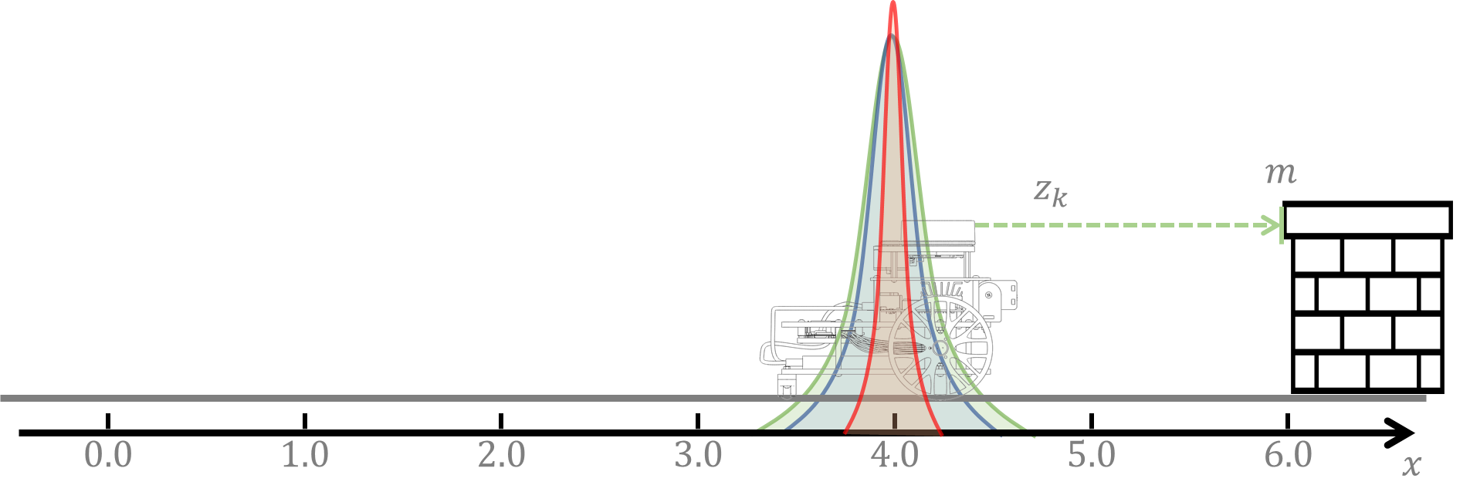
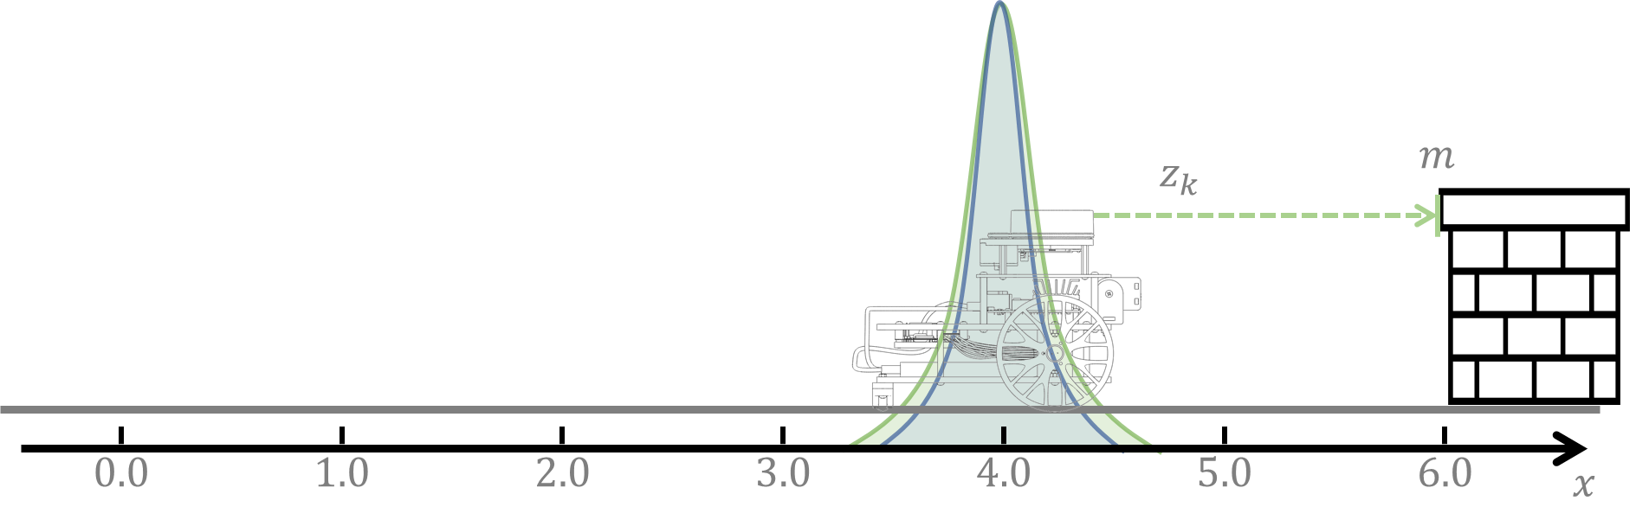
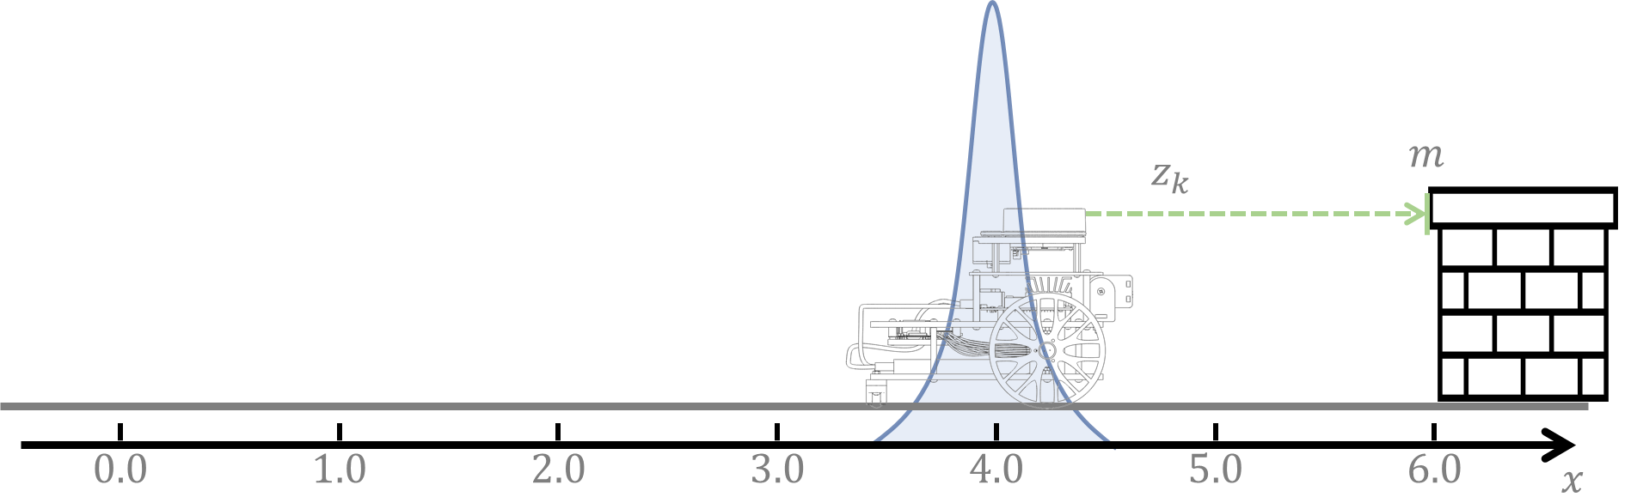
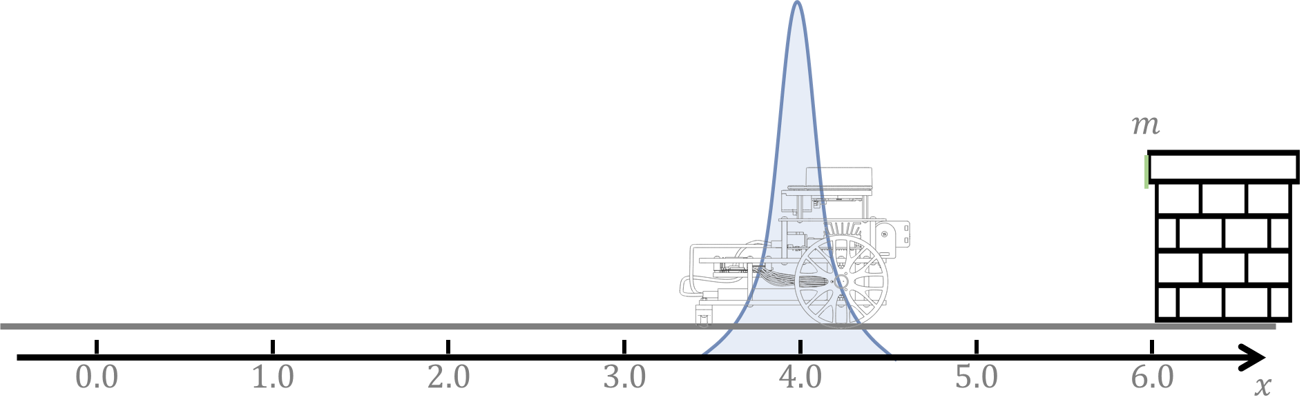
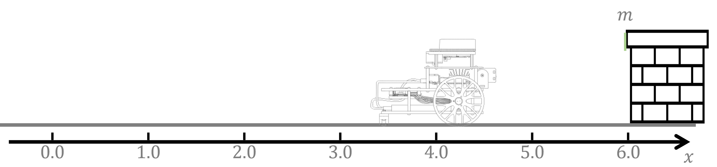






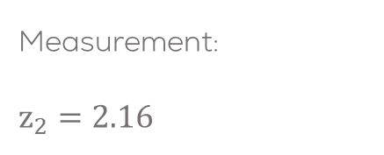



Solution: Iteration 2
Measurement:
$z_{2}=2.$16
For the first iteration $k=2$:
Prediction step:
$${\hat{μ}}_{2}=μ_{1}+u_{2} \\ {\hat{Σ}}_{2}=Σ_{1}+Q_{2}$$
For the first iteration $k=2$:
Prediction step:
$${\hat{μ}}_{2}=3.014+1 \\ {\hat{Σ}}_{2}=0.1043+0.12$$
For the first iteration $k=2$:
Prediction step:
$${\hat{μ}}_{3}=4.1043 \\ {\hat{Σ}}_{2}=0.2243$$
Correction step:
$${\hat{z}}_{2}=6−4.104 \\ Z_{2}=(−1)0.2243(−1)+0.8 \\ K_{2}=\frac{0.2243(−1)}{0.2243+0.8} \\ μ_{k}={\hat{μ}}_{k}+K_{k}\left(z_{k}−{\hat{z}}_{k}\right) \\ Σ_{k}=(1−K_{k}) {\hat{Σ}}_{k}$$
Correction step:
$${\hat{z}}_{2}=1.896 \\ Z_{2}=1.0243 \\ K_{2}=−0.2189 \\ μ_{k}={\hat{μ}}_{k}+K_{k}\left(z_{k}−{\hat{z}}_{k}\right) \\ Σ_{k}=(1−K_{k}) {\hat{Σ}}_{k}$$
Correction step:
$${\hat{z}}_{2}=1.896 \\ Z_{2}=1.0243 \\ K_{2}=−0.2189 \\ μ_{2}={\hat{μ}}_{2}+K_{2}\left(z_{2}−{\hat{z}}_{2}\right) \\ Σ_{2}=(1−K_{2}) {\hat{Σ}}_{2}$$
Correction step:
$${\hat{z}}_{2}=1.896 \\ Z_{2}=1.0243 \\ K_{2}=−0.2189 \\ μ_{2}=4.104+(−0.2189)\left(2.16−1.896\right) \\ Σ_{2}=\left(1−(−0.2189)(−1)\right)0.2243$$
Correction step:
$${\hat{z}}_{2}=1.896 \\ Z_{2}=1.0243 \\ K_{2}=−0.2189 \\ μ_{2}=4.046 \\ Σ_{2}=0.1752$$
Correction step:
$${\hat{z}}_{2}=m−{\hat{μ}}_{2} \\ Z_{2}=C{\hat{Σ}}_{2}C+R_{2} \\ K_{2}=\frac{{\hat{Σ}}_{2}C}{{\hat{Σ}}_{2}+R_{2}} \\ μ_{k}={\hat{μ}}_{k}+K_{k}\left(z_{k}−{\hat{z}}_{k}\right) \\ Σ_{k}=(1−K_{k}) {\hat{Σ}}_{k}$$

Slide 11
Kalman Filter
Solved Example 1D - 2

Slide 12
Problem Statement
For the following 1D robot, let the linear estimation model to be given by
$${\hat{μ}}_{k}=Aμ_{k−1}+Bu_{k}$$
For this case let
$$A=1$$
$$B=1$$
and the initial conditions to be:
$μ_{0}=2$ robot initial position
$Σ_{0}=0$ initial prediction variance

Slide 13

Problem Statement
The observation model ${\hat{z}}_{k}=g\left({\hat{μ}}_{k},m\right)$, can be given by:
$${\hat{z}}_{k}=m−{\hat{μ}}_{k}$$
Therefore, the observation model is given by
$$C=−1$$
For this example:
$$m=6 \text{landmark} \text{position}$$

Slide 14
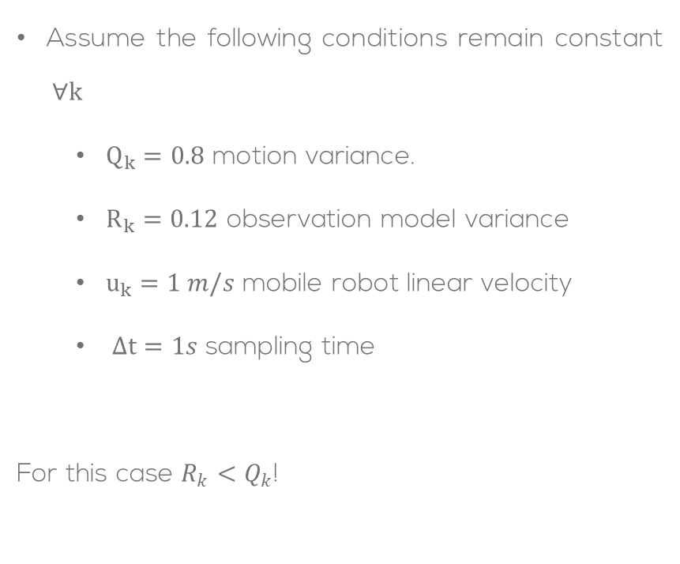
Problem Statement
Assume the following conditions remain constant $∀k$
$Q_{k}=0.8$ motion variance.
$R_{k}=0.12$ observation model variance
$u_{k}=1 m/s$ mobile robot linear velocity
$Δt=1s$ sampling time
For this case $R_{k}<Q_{k}$!

Slide 15
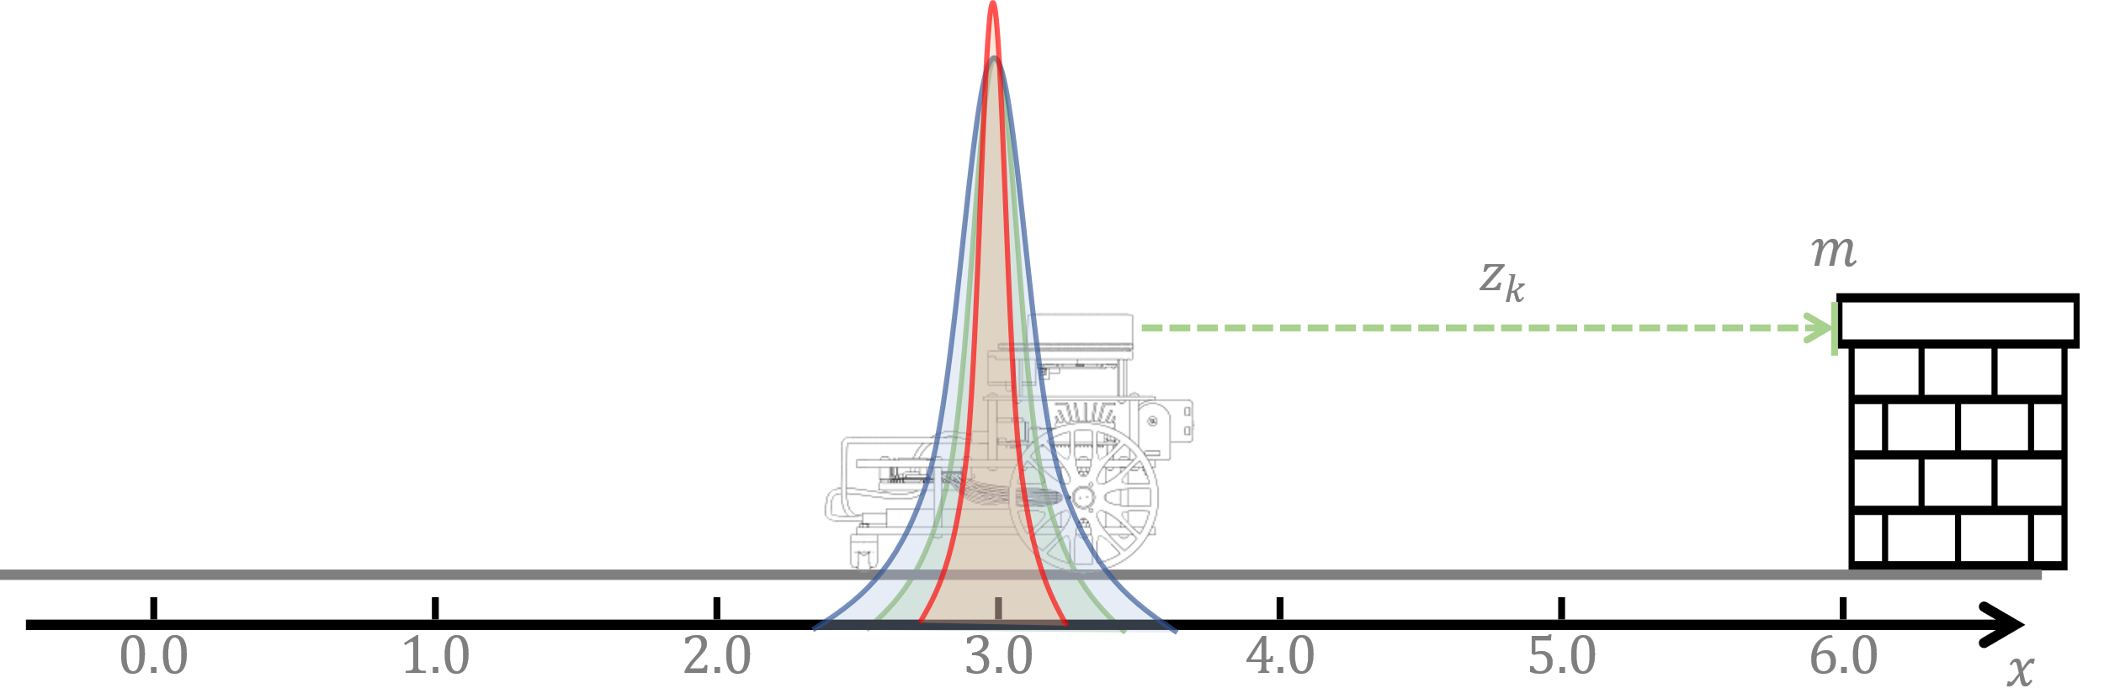
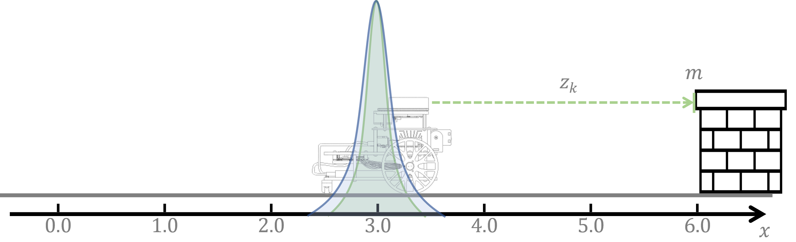
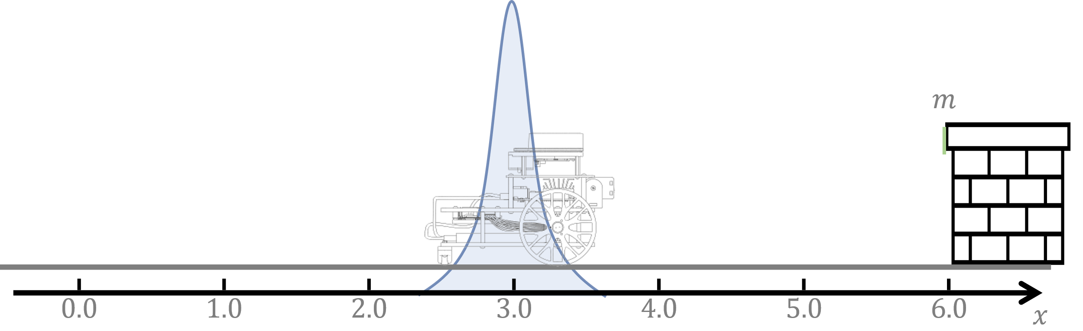
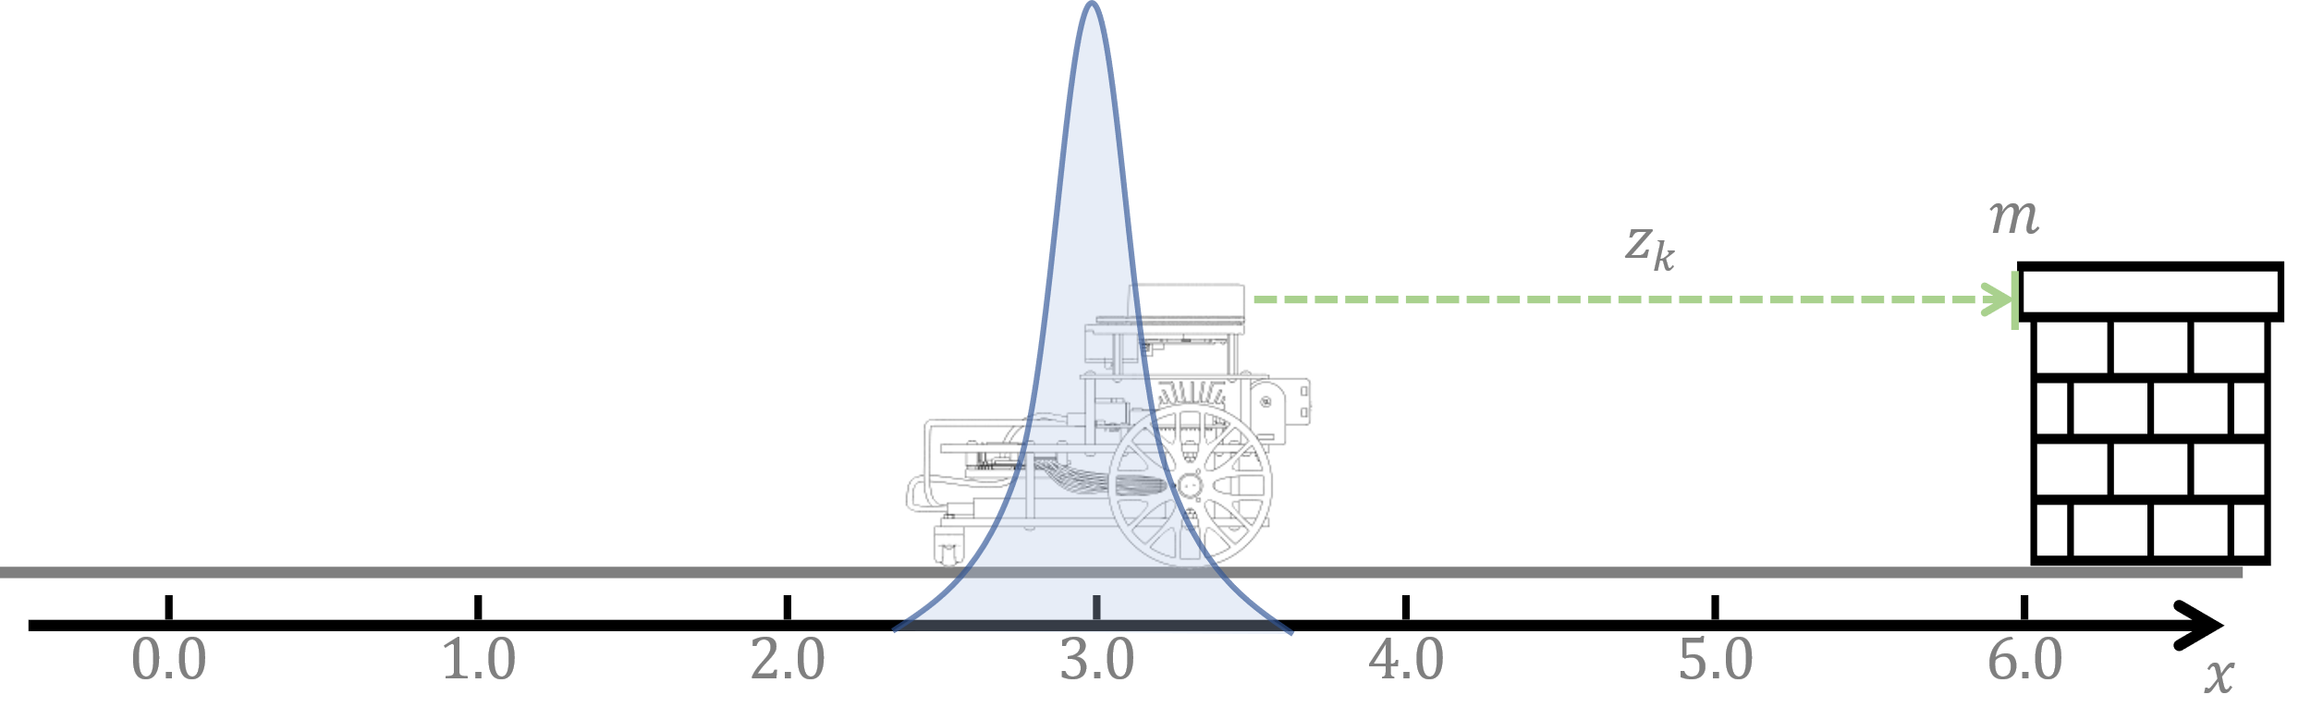










Solution: Iteration 1
Measurement:
$z_{1}=2.88$
For the first iteration $k=1$:
Prediction step:
$${\hat{μ}}_{k}=μ_{k−1}+u_{k} \\ {\hat{Σ}}_{k}=Σ_{k−1}+Q_{k}$$
For the first iteration $k=1$:
Prediction step:
$${\hat{μ}}_{1}=μ_{0}+u_{1} \\ {\hat{Σ}}_{1}=Σ_{0}+Q_{1}$$
For the first iteration $k=1$:
Prediction step:
$${\hat{μ}}_{1}=2+1 \\ {\hat{Σ}}_{1}=0+0.8$$
For the first iteration $k=1$:
Prediction step:
$${\hat{μ}}_{1}=3 \\ {\hat{Σ}}_{1}=0.8$$
Correction step:
$${\hat{z}}_{1}=6−3 \\ Z_{1}=(−1)0.8(−1)+0.12 \\ K_{1}=\frac{0.8(−1)}{0.8+0.12} \\ μ_{k}={\hat{μ}}_{k}+K_{k}\left(z_{k}−{\hat{z}}_{k}\right) \\ Σ_{k}=(1−K_{k}) {\hat{Σ}}_{k}$$
Correction step:
$${\hat{z}}_{k}=3 \\ Z_{1}=0.92 \\ K_{k}=−0.8695 \\ μ_{k}={\hat{μ}}_{k}+K_{k}\left(z_{k}−{\hat{z}}_{k}\right) \\ Σ_{k}=(1−K_{k}) {\hat{Σ}}_{k}$$
Correction step:
$${\hat{z}}_{1}=3 \\ Z_{1}=0.92 \\ K_{1}=−0.8695 \\ μ_{1}={\hat{μ}}_{1}+K_{1}\left(z_{1}−{\hat{z}}_{1}\right) \\ Σ_{1}=(1−K_{1}C) {\hat{Σ}}_{1}$$
Correction step:
$${\hat{z}}_{1}=3 \\ Z_{1}=0.92 \\ K_{1}=−0.8695 \\ μ_{1}=3+(−0.8695)\left(2.88−3\right) \\ Σ_{1}=\left(1−(−0.8695)(−1)\right)0.8$$
Correction step:
$${\hat{z}}_{1}=3 \\ Z_{1}=0.92 \\ K_{1}=−0.8695 \\ μ_{1}=3.104 \\ Σ_{1}=0.1044$$
Correction step:
$${\hat{z}}_{1}=m−{\hat{μ}}_{1} \\ Z_{1}=C{\hat{Σ}}_{1}C+R_{1} \\ K_{1}=\frac{{\hat{Σ}}_{1}C}{{\hat{Σ}}_{1}+R_{1}} \\ μ_{k}={\hat{μ}}_{k}+K_{k}\left(z_{k}−{\hat{z}}_{k}\right) \\ Σ_{k}=(1−K_{k}) {\hat{Σ}}_{k}$$

Slide 16













Solution: Iteration 2
Measurement:
$z_{2}=2.024$
For the first iteration $k=2$:
Prediction step:
$${\hat{μ}}_{2}=μ_{1}+u_{2} \\ {\hat{Σ}}_{2}=Σ_{1}+Q_{2}$$
For the first iteration $k=2$:
Prediction step:
$${\hat{μ}}_{2}=3.104+1 \\ {\hat{Σ}}_{2}=0.1044+0.8$$
For the first iteration $k=2$:
Prediction step:
$${\hat{μ}}_{3}=4.104 \\ {\hat{Σ}}_{2}=0.9044$$
Correction step:
$${\hat{z}}_{2}=6−4.104 \\ Z_{2}=(−1)0.9044(−1)+0.12 \\ K_{2}=\frac{0.9044(−1)}{0.9044+0.12} \\ μ_{k}={\hat{μ}}_{k}+K_{k}\left(z_{k}−{\hat{z}}_{k}\right) \\ Σ_{k}=(1−K_{k}) {\hat{Σ}}_{k}$$
Correction step:
$${\hat{z}}_{2}=1.8956 \\ Z_{2}=1.0244 \\ K_{2}=−0.8828 \\ μ_{k}={\hat{μ}}_{k}+K_{k}\left(z_{k}−{\hat{z}}_{k}\right) \\ Σ_{k}=(1−K_{k}) {\hat{Σ}}_{k}$$
Correction step:
$${\hat{z}}_{2}=1.8956 \\ Z_{2}=1.0244 \\ K_{2}=−0.8828 \\ μ_{2}={\hat{μ}}_{2}+K_{2}\left(z_{2}−{\hat{z}}_{2}\right) \\ Σ_{2}=(1−K_{2}C) {\hat{Σ}}_{2}$$
Correction step:
$${\hat{z}}_{2}=1.8956 \\ Z_{2}=1.0244 \\ K_{2}=−0.8828 \\ μ_{2}=4.104+(−0.8828)\left(2.024−1.8956\right) \\ Σ_{2}=\left(1−(−0.8828)(−1)\right)0.9044$$
Correction step:
$${\hat{z}}_{2}=1.8956 \\ Z_{2}=1.0244 \\ K_{2}=−0.8828 \\ μ_{2}=3.99103 \\ Σ_{2}=0.10599$$
Correction step:
$${\hat{z}}_{2}=m−{\hat{μ}}_{2} \\ Z_{2}=C{\hat{Σ}}_{2}C+R_{2} \\ K_{2}=\frac{{\hat{Σ}}_{2}C}{{\hat{Σ}}_{2}+R_{2}} \\ μ_{k}={\hat{μ}}_{k}+K_{k}\left(z_{k}−{\hat{z}}_{k}\right) \\ Σ_{k}=(1−K_{k}) {\hat{Σ}}_{k}$$

