Slide 1

Puzzlebot NVIDIA Jetson® / Jetson Lidar Edition.
Introduction

Slide 2
Puzzlebot: NVIDIA Jetson Edition
Introduction
The Puzzlebot NVIDIA JETSON® Edition is an extension of the Puzzlebot Hacker Edition encompassing an NVIDIA Jetson® CPU and a Raspberry Pi® Camera.
Combining the power of the Hacker Board and the NVIDIA JETSON Nano® allows users to implement research-level, real-time algorithms such as AI & Computer Vision, SLAM and autonomous driving algorithms using ROS.
The Puzzlebot NVIDIA JETSON® Edition works by communicating the Hacker Board (Plug and play) with the NVIDIA Jetson Nano®.

Slide 3
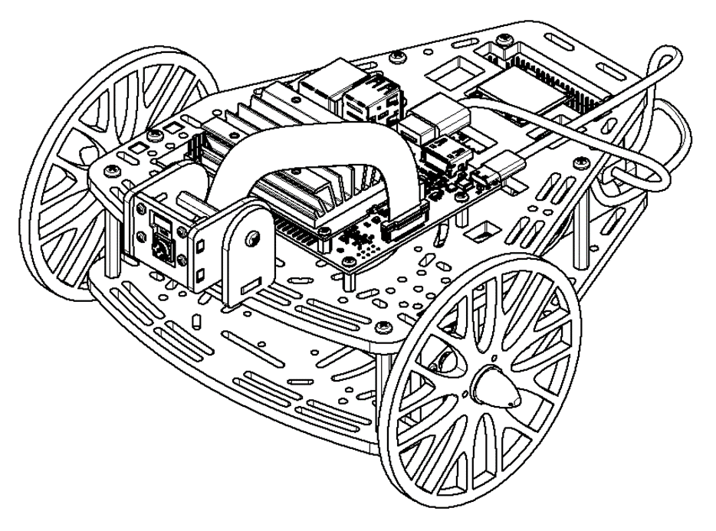
Puzzlebot: NVIDIA Jetson ® Edition
The following slides will guide the user through the basic usage of the Puzzlebot Jetson ® Edition.
The initial configuration will take place in two steps
The Hackeboard configuration: In this configuration, the user will learn how to
The NVIDIA Jetson® configuration.

Slide 4
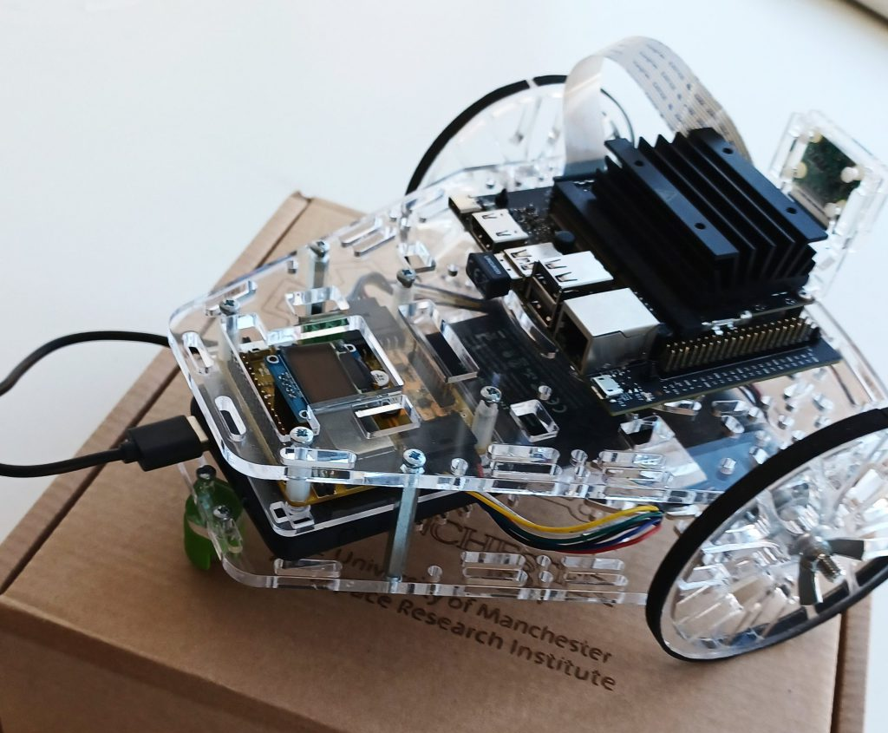
System Overview
NVIDIA Jetson Nano
For AI and computer vision
Raspberry Pi Camera
Higher processing power
Time-sharing operating system
Good for more complex, slower tasks
Specifically designed by NVIDIA for AI applications
GPIO Arrays
Expansion is possible via the
Jetson or the Hacker Board.
Hackerboard
For low-level control algorithms
Low processing power
Real-time operating system
Good for simple, fast, time-sensitive tasks
Puzzlebot Hacker Edition

Slide 5
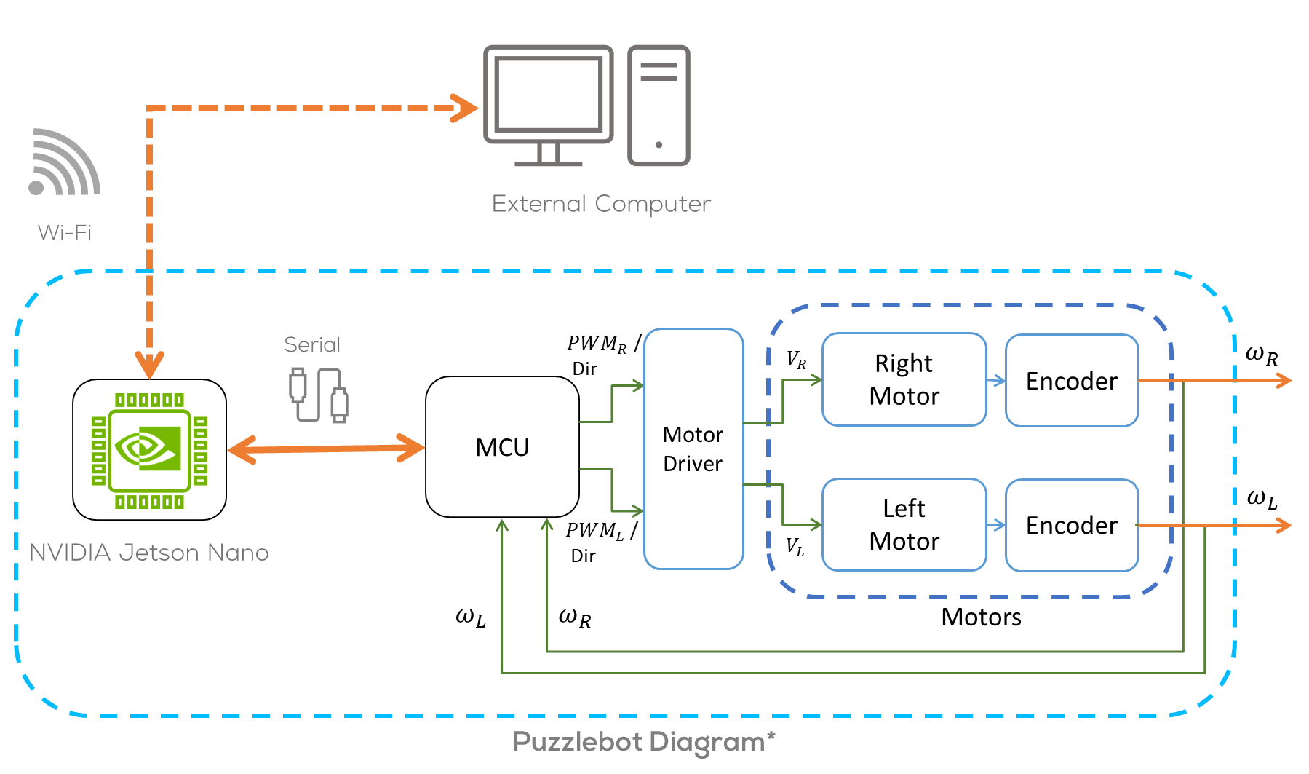
Puzzlebot Diagram

Slide 6
Hackerboard
Introduction

Slide 7
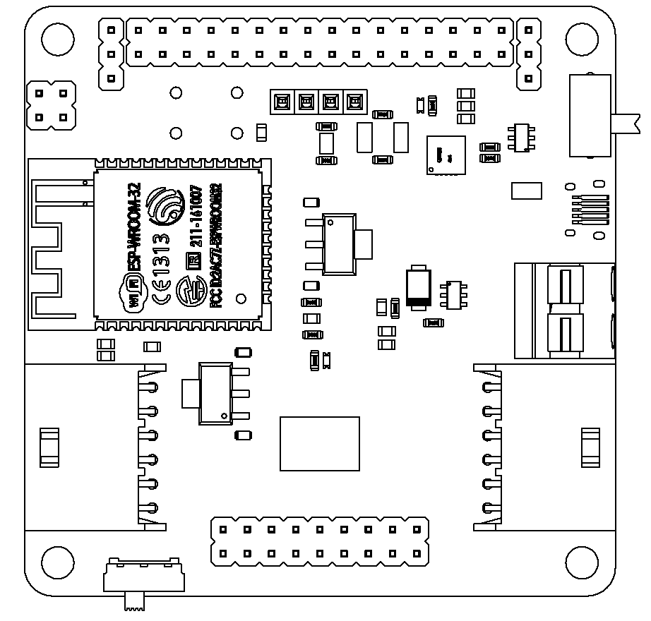
The Hacker Board
General characteristics
ESP32-based Microcontroller
Xtensa dual-core 32-bit LX6 microprocessor
520 KB of SRAM
Wi-Fi & Bluetooth
DC-DC Converter
Motor Driver
0.96” I2C LCD Display
Notes:
Note: Mexico course has V1, but the new robots will be V2
For control of low level, low power components such as motors and encoders
DC-DC convertor provides the voltages necessary for all onboard components
Screen by default displays information such as motor speeds, sonar distance, and connection details

Slide 8
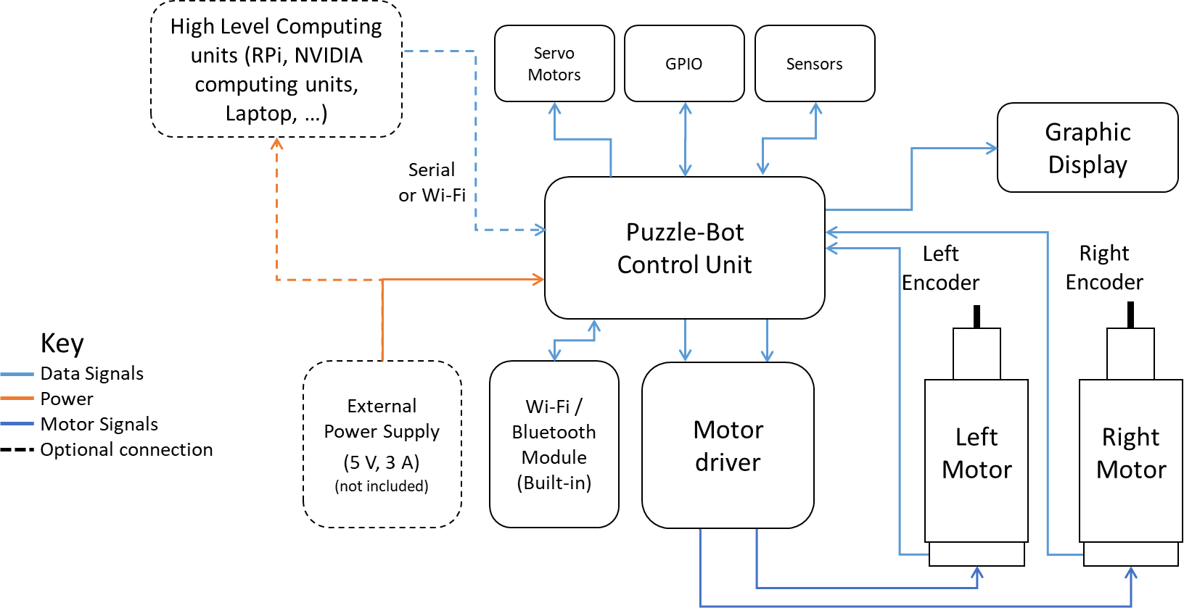
System Architecture

Slide 9
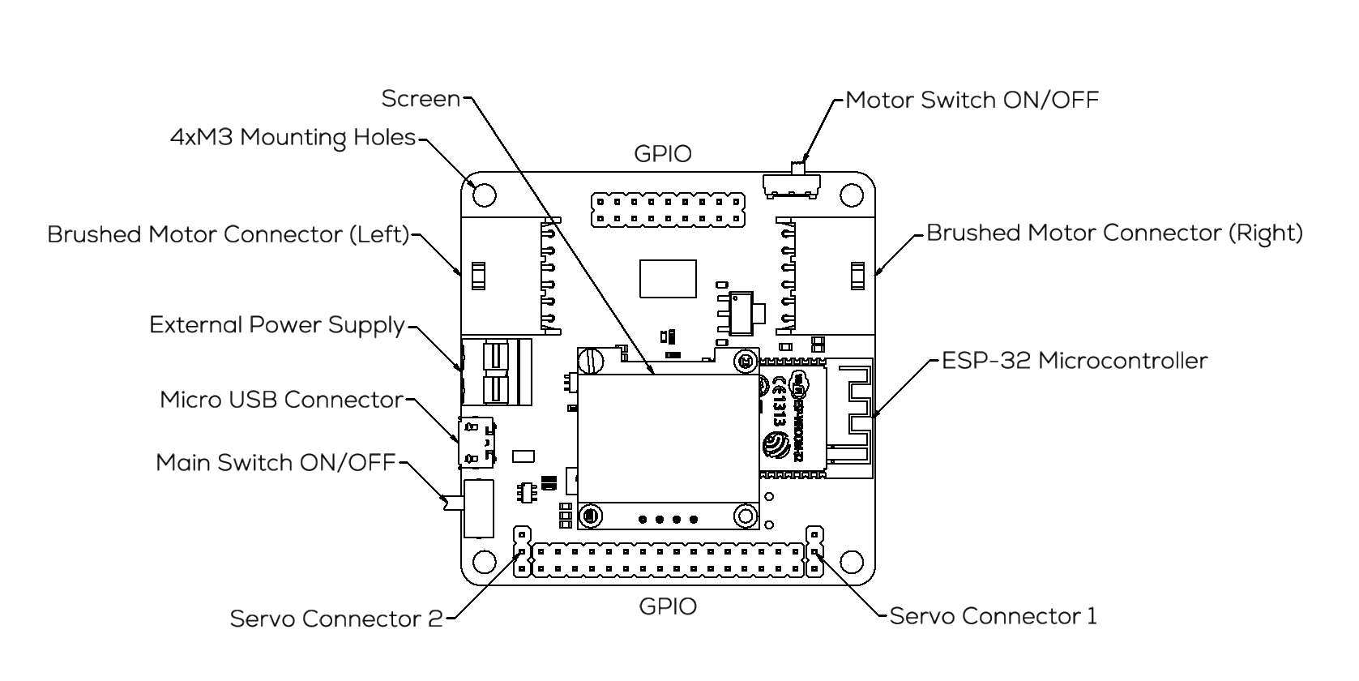
The Hacker Board
For additional details, please refer to the pinout diagram.

Slide 10
Hackerboard
Control Modes
The Hackerboard has two different control modes depending on the user’s requirements.
The two programming configurations:
Standalone Configuration
External-Control Configuration
Control Mode: Standalone Configuration (Information purpose only)
The user directly programs the Hacker Board, using the Arduino IDE.
Libraries for control and communication with computing units, sensors, and actuators are provided by MCR2.
3rd Party peripherals can be attached.
This configuration will not be used for this Puzzlebot version.
For additional examples and a more in-depth understanding, please consult the "Puzzlebot Hacker Edition" manual.

Slide 11
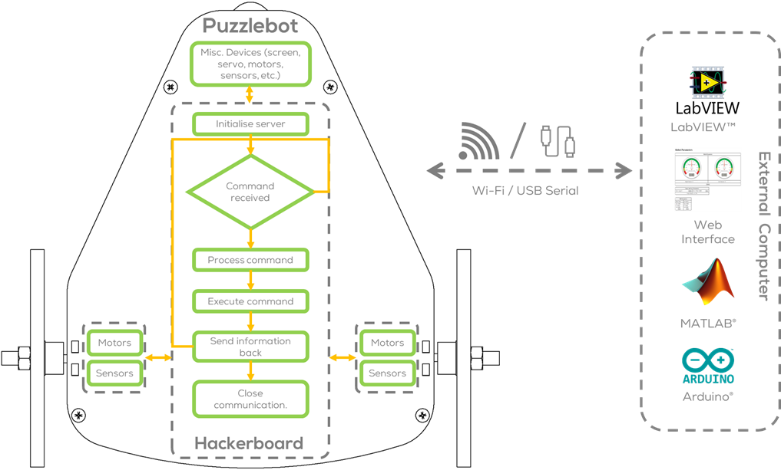
Hackerboard
Control Mode: External Control Configuration
The robot is controlled from an external computer via Wi-Fi or Serial Communication.
The internal firmware and libraries for communicating with the robot’s sensors and actuators are provided by MCR2.
Basic web interface for configuring and testing provided.
MCR2 provides MATLAB , ROS and LabVIEW libraries for communicating with the robot.
This configuration will be used for this Puzzlebot version.
For additional examples and a more in-depth understanding, on how to use MATLAB or LabVIEW communications and simulators, contact us.

Slide 12
Hackerboard
Flashing the Hackerboard

Slide 13
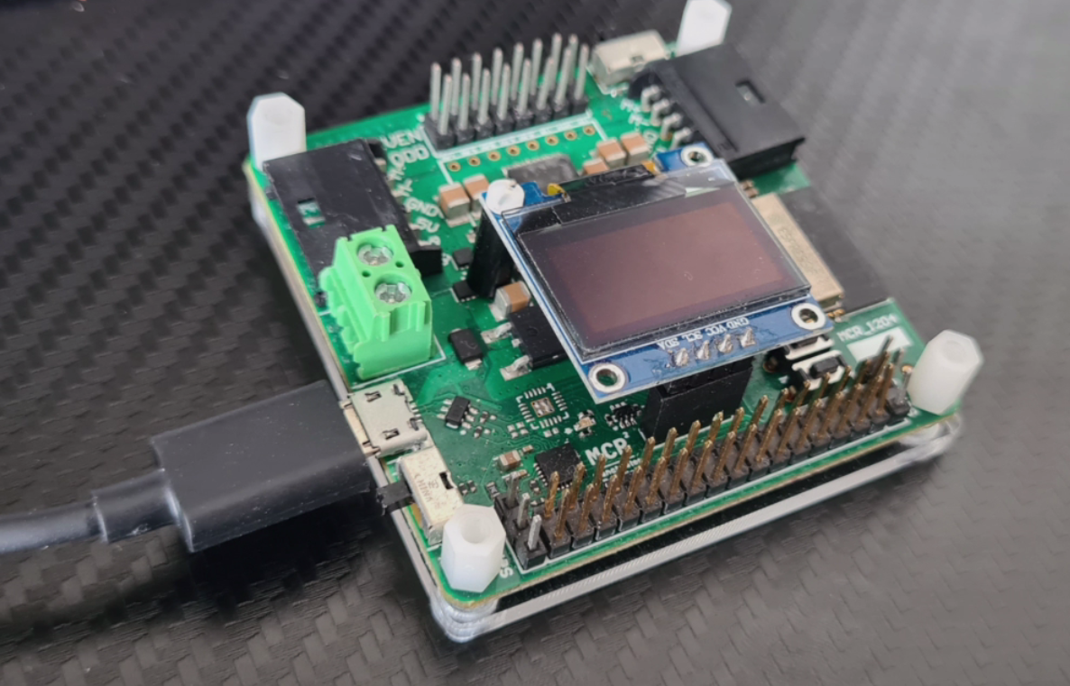
Hackerboard: Flashing the Binaries
Flashing Hackerboard
MCR2 provides the firmware binaries for the External Computing Unit Control Mode.
This section will guide the user on how to flash such binaries.
All the robots come preprogrammed with such binaries unless the user modifies the program (On Board Configuration).
The original binaries can be flashed anytime by following the steps in this section.

Slide 14
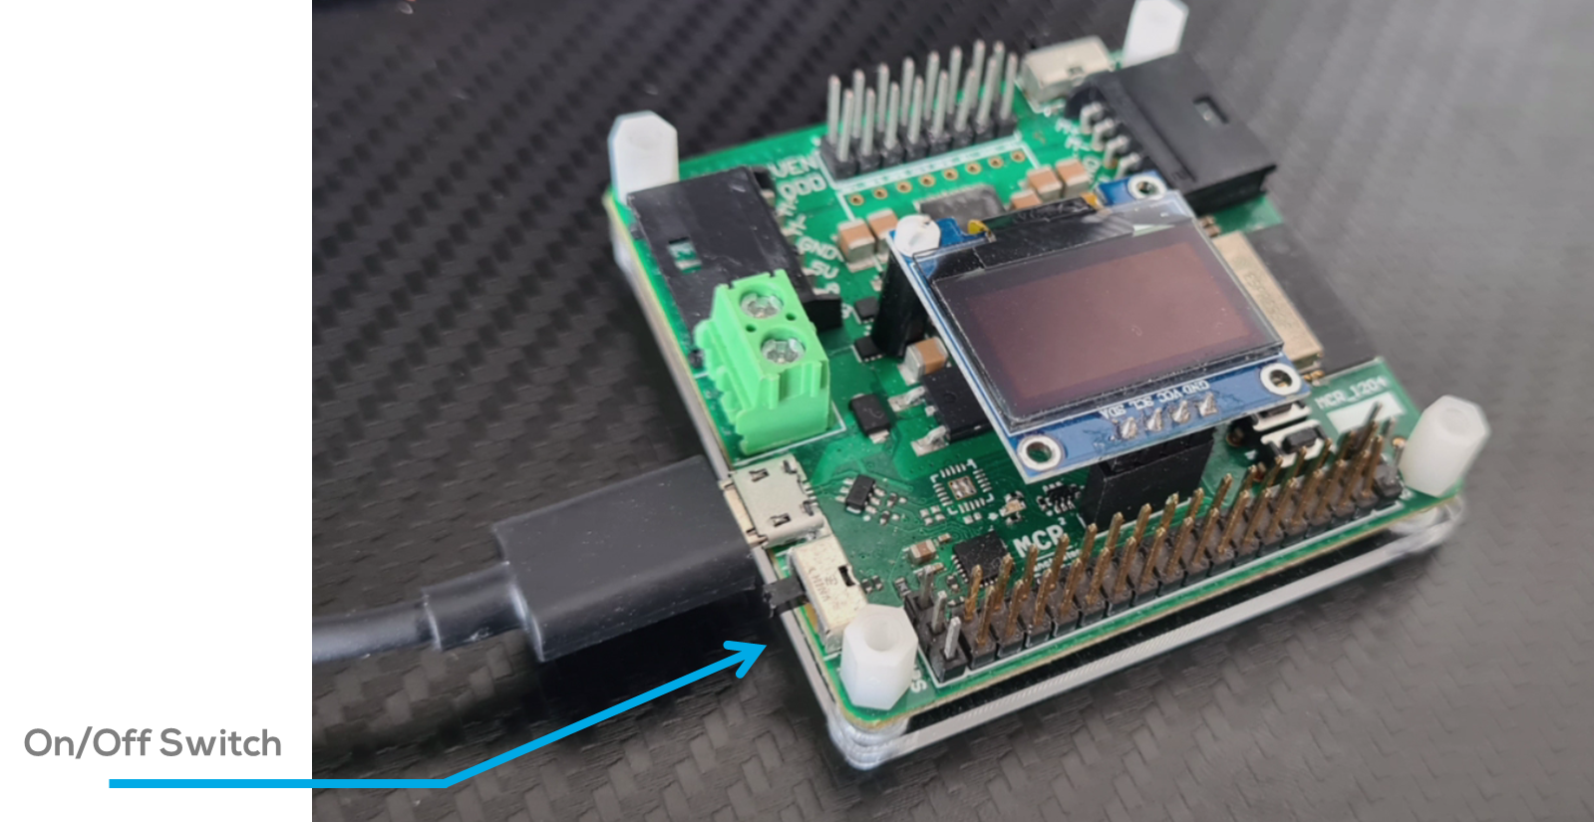
Hackerboard: Flashing the Binaries.
Steps
Attach the micro-USB cable to the Puzzle-Bot Control Module. Note the image is just for explanation purposes, detachment of the Puzzle-Bot Control module from the robot is not necessary.
Make sure the Hackerboard power switch is turned on.
Connect the USB to any free USB port in the computer
Download the firmware from the MCR2 GitHub and extract it.
Select the OS of the computer that will perform the flash.
Run the file “FirmwareFlash”
For Linux and MacOS users, it may be necessary to set execution permissions in properties.

Slide 15
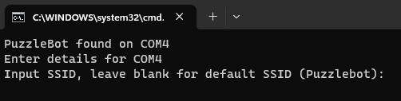

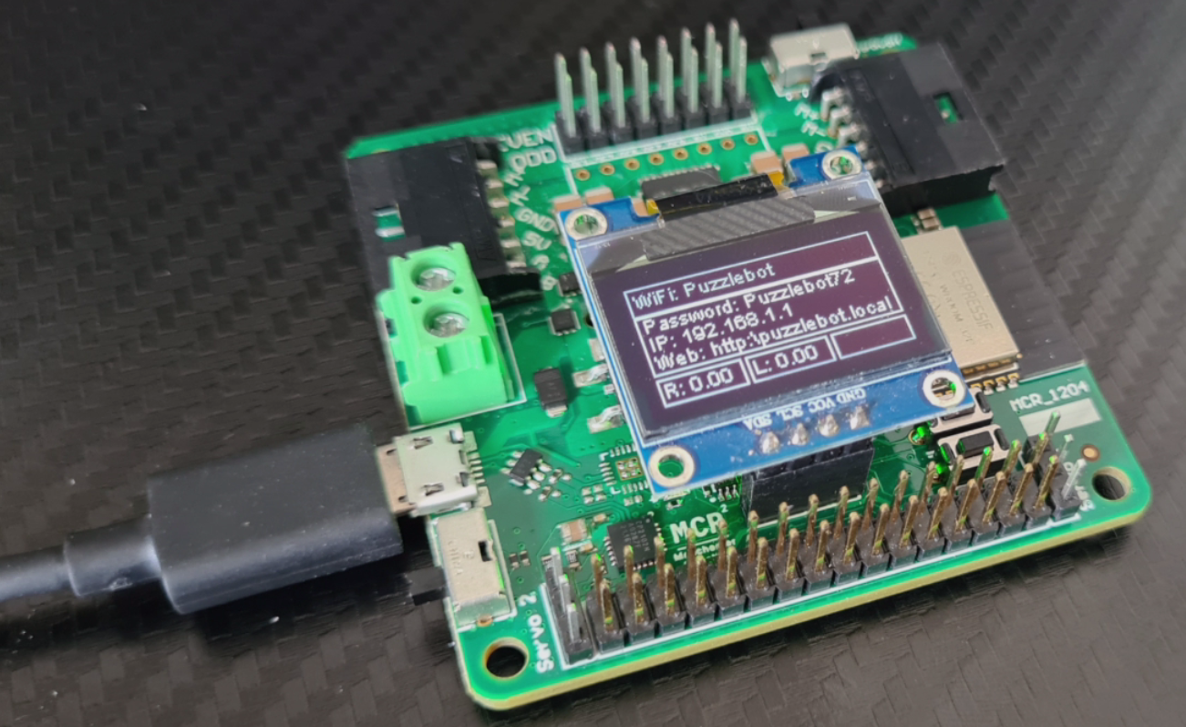
Hackerboard: Flashing the Binaries.
Steps
Select the SSID identification for the Hackerboard and press Enter (recommended to use a different one if several Puzzlebots are being used simultaneously).
Select the password for the Hackerboard's Wi-Fi Network and press Enter (recommended to use a different one if several Puzzlebots are being used simultaneously).
Wait until the program finish flashing.
The screen must turn on.

Slide 16
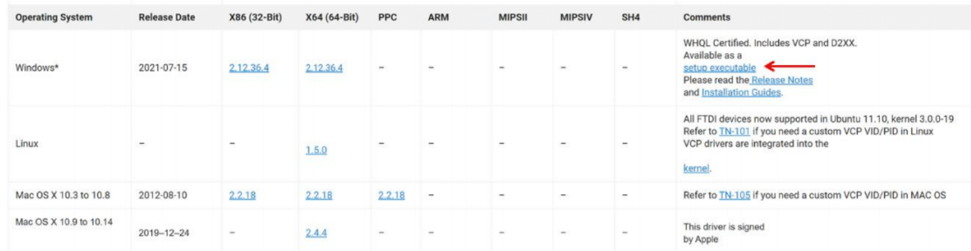

Troubleshoot
Troubleshoot (Drivers)
Drivers are usually installed automatically by Windows and Ubuntu even for the Virtual Machines.
How do I know if the drivers are properly installed (Windows)?
Plug the Puzzle-Bot into the USB port.
Go to Start > Device Manager
The Serial port should appear as shown in the following figure (The COM port may vary).
If the computer cannot find the drivers, download the drivers from the following link
https://ftdichip.com/drivers/vcp-drivers/
Verify that the USB cable is a data cable and not only a power cable!
Scroll down and download the executable setup as shown in the following figure
Before Installing the drivers!!
Unplug the Puzzlebot from the computer.
Unzip the drivers and run the setup (some computers must be restarted after the installation).
Plug the Puzzlebot back into the computer.

Slide 17
Troubleshoot
Troubleshoot (Drivers)
Some Hackerboard have a different USB-UART chip the CP210x.
Drivers are usually installed automatically by Windows and Ubuntu even for the Virtual Machines.
Verify if they are installed by following the steps in the previous slide.
Verify that the USB cable is a data cable and not only a power cable!.
If the computer cannot find the drivers, download the drivers from the following link
https://www.silabs.com/developers/usb-to-uart-bridge-vcp-drivers?tab=downloads
Before Installing the drivers!!
Unplug the Puzzle-Bot from the computer.
Unzip the drivers and run the setup (some computers are required to be restarted after the installation).
Plug the Puzzle-Bot back into the computer.
A troubleshoot guide can be found here.

Slide 18
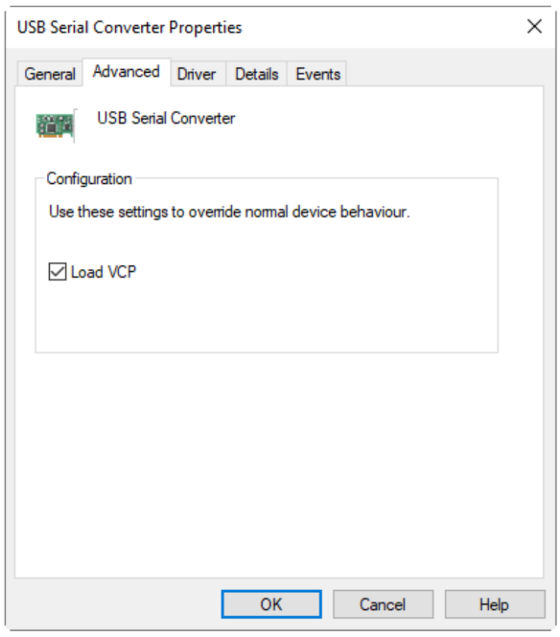
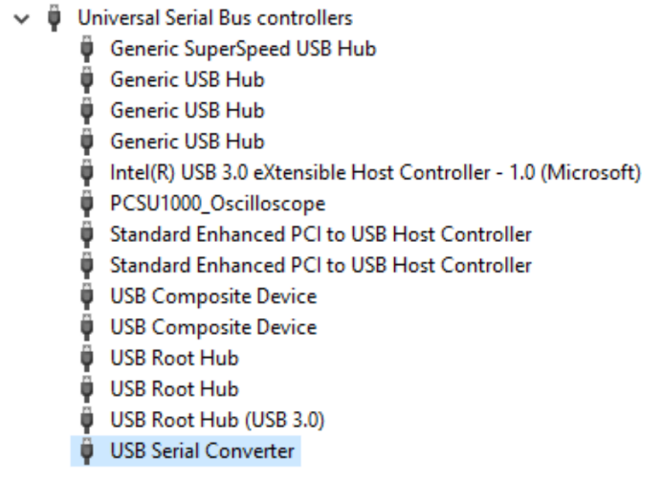
Troubleshoot
Troubleshoot (Drivers)
My computer still not recognize the drivers even after the installation
Plug the Puzzle-Bot into the USB port.
Go to Start > Device Manager.
Look for the USB Serial Converter as shown in the following picture.
Right Click to Properties > Advanced Tab.
Make sure the Load VCP box is checked.
Reconnect the Puzzle-Bot to the computer.
FIGURE: USB SERIAL CONVERTER
FIGURE: VCP PORT

Slide 19
Hackerboard
Connections and configurations for the Jetson Nano

Slide 20
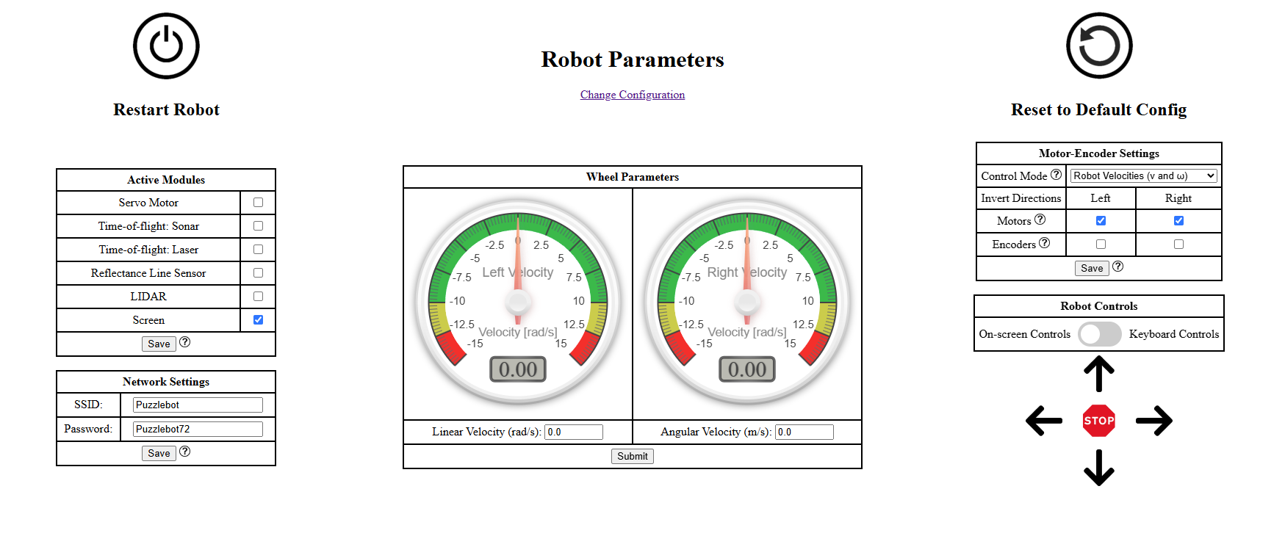
Connecting to the Hackerboard
Puzzlebot Web Interface
The Puzzlebot has a web interface allowing it to configure and test the different sensors and actuators equipped in the robot.
The website offers a visual interface that enables the user to configure and test various internal settings of the robot, including motor controllers, sensor activation, actuator activation (if applicable), and communication with external computing units.

Slide 21
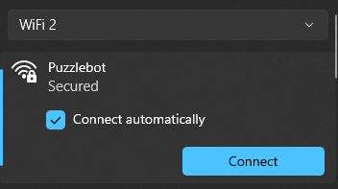
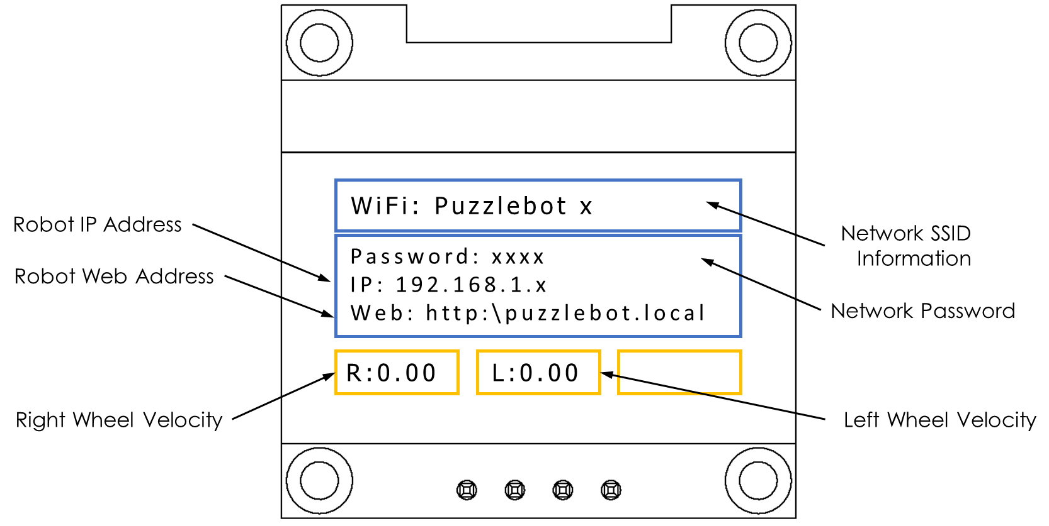
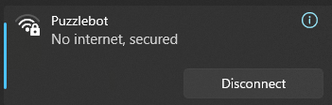
Connecting to the Hackerboard
Go to the Wi-Fi Network connections.
Connect to the Wi-Fi network created by the Puzzlebot by choosing the Puzzlebot Wi-Fi network of the robot you want (Puzzlebot x), then select Connect.
Type the network password that you selected when flashing (shown on the LCD Display), and then select Next.
Once Connected the network should say “No internet, secured” (Windows only).

Slide 22


Connecting to the Hackerboard
Connecting to the Puzzlebot Web Interface
Open a web browser
Type the following IP address on the search bar
The Puzzlebot Robot Parameters interface should load.
http:\\192.168.1.x

Slide 23
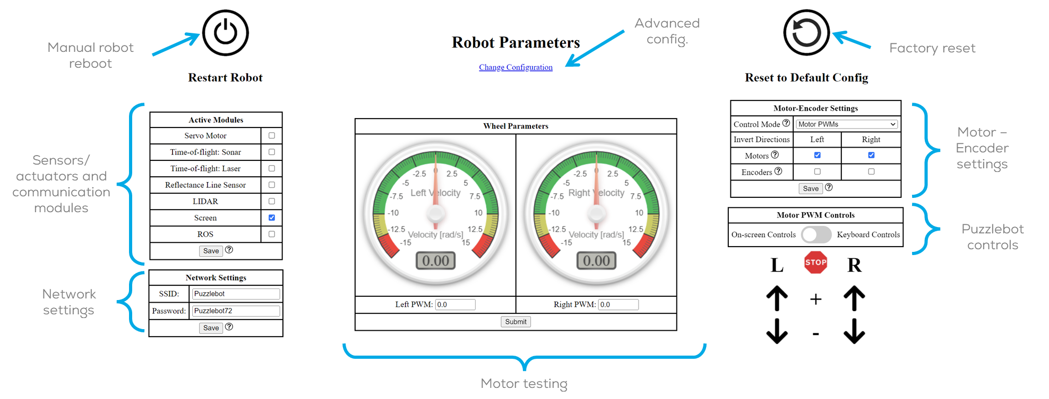
Configuring the Hackerboard
**This slide is only for informative purposes and is not required for basic Jetson connection.
Manual robot reboot: Manually reboots the Hackerboard.
Factory Reset: Reset all the configurations to factory configurations.
Network settings: Configuration of the SSID and password of the Puzzlebot. Useful when multiple Puzzlebots are being used.
Puzzlebot controls: Simple Puzzlebot controls for the user to move the robot forward, backwards or turning.
Sensor/actuators and comms. modules: Activation of the sensors/actuators if included connected to the Hackerboard. The sensors and actuators in this section can connect to ROS. More information on the Puzzlebot Manual.
*Moving the cursor over the question marks (?) displays more information about each configuration parameter.

Slide 24
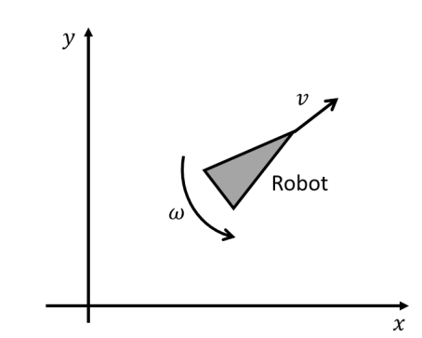
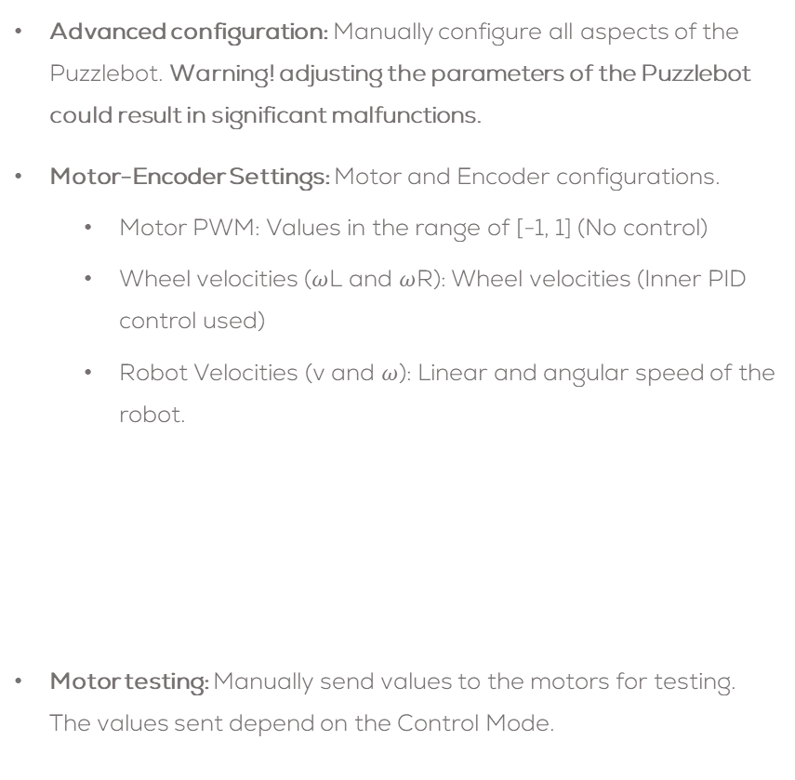
Configuring the Hackerboard
Advanced configuration: Manually configure all aspects of the Puzzlebot. Warning! adjusting the parameters of the Puzzlebot could result in significant malfunctions.
Motor-Encoder Settings: Motor and Encoder configurations.
Motor PWM: Values in the range of [-1, 1] (No control)
Wheel velocities ($ω$L and $ω$R): Wheel velocities (Inner PID control used)
Robot Velocities (v and $ω$): Linear and angular speed of the robot.
Motor testing: Manually send values to the motors for testing. The values sent depend on the Control Mode.

Slide 25
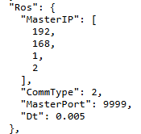
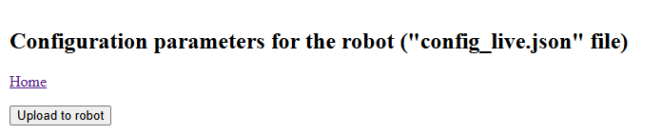
Connecting to the Hackerboard
Configuring ROS Serial communication
Click on the “Change Configuration” link on the top. This will take you to another website were all the internal configurations of the robot can be seen.
In the section “Ros” Change the value of “CommType” to “2”.
Upload to the robot by pressing the button “Upload to the robot” at the top of the webpage.
The Hackerboard will restart
Click Here
Click Here

Slide 26
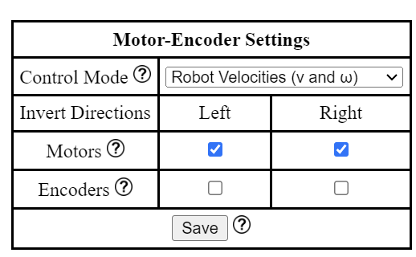
Connecting to the Hackerboard
Configuring the Hackerboard
The ROS topics to be published by the Puzzlebot depend on the “Control Mode” Selected.
See table in next slide.
Having selected the Control Mode and activated the ROS Module, press Save and disconnect from the robot.

Slide 27
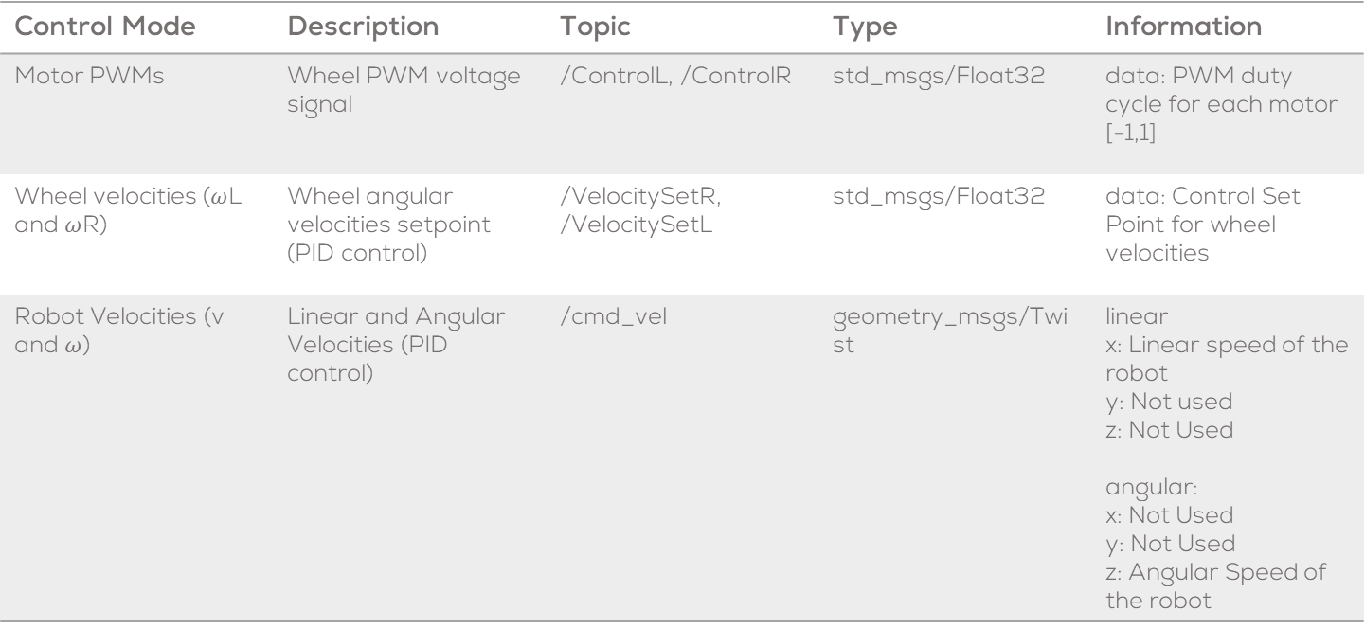
Connecting to the Hackerboard
Control Mode | Description | Topic | Type | Information
Motor PWMs | Wheel PWM voltage signal | /ControlL, /ControlR | std_msgs/Float32 | data: PWM duty cycle for each motor [-1,1]
Wheel velocities ($ω$L and $ω$R) | Wheel angular velocities setpoint (PID control) | /VelocitySetR, /VelocitySetL | std_msgs/Float32 | data: Control Set Point for wheel velocities
Robot Velocities (v and $ω$) | Linear and Angular Velocities (PID control) | /cmd_vel | geometry_msgs/Twist | linear x: Linear speed of the robot y: Not used z: Not Used angular: x: Not Used y: Not Used z: Angular Speed of the robot

Slide 28
NVIDIA Jetson Nano®
Connections and configurations

Slide 29
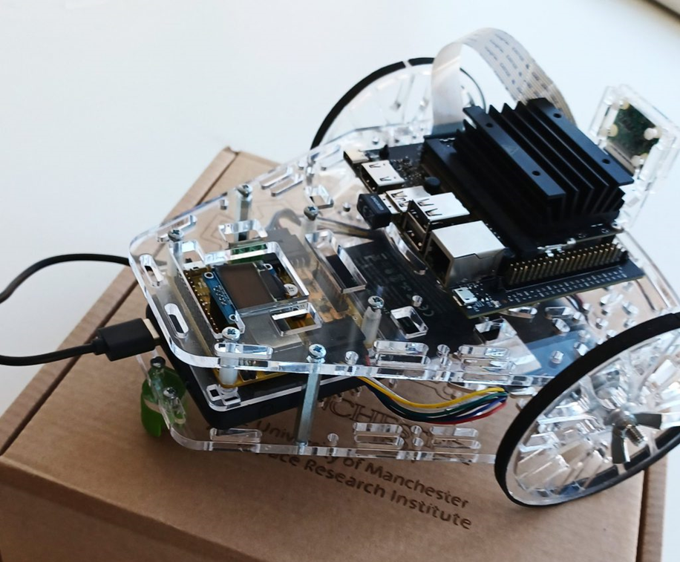
NVIDIA Jetson Nano®, 2 GB
Overview
MCR2 provides a modified version of the Jetson Image, with some preloaded packages, that connects with the Hackerboard (plug and play).
This section will guide the user on how to flash such image.
The original image can be flashed anytime by following the steps in this section.
This guide will help you start using the Jetson board on the Puzzlebot.

Slide 30
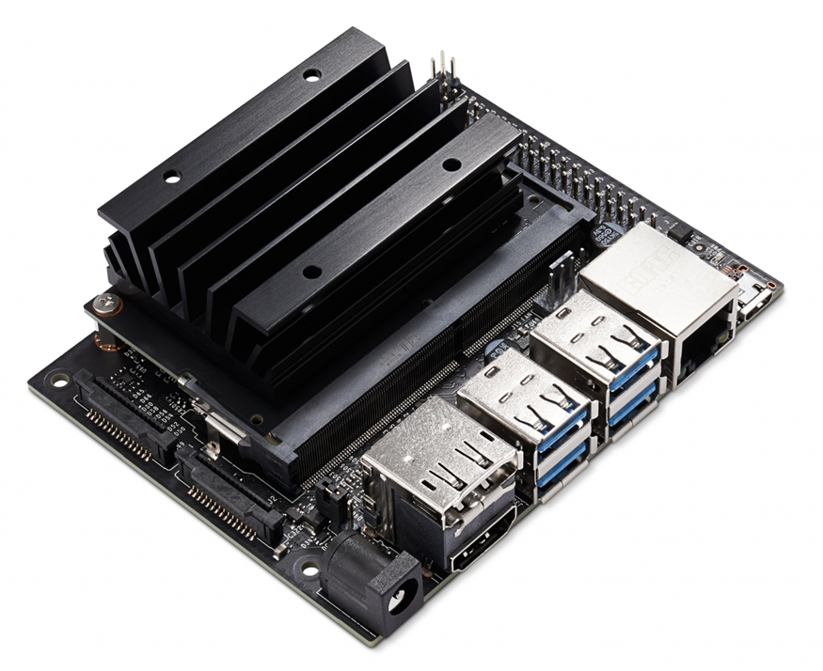
NVIDIA Jetson Nano®, 2 GB
General characteristics
128-core NVIDIA Maxwell GPU
1.43 GHz Quad-core ARM A57 CPU
2 GB of 64-bit LPDDR4 Memory
SD card for storage
Ethernet & Wi-Fi
CSI-2 Connector for Camera
Runs a modified version of Ubuntu 18.04, with the following preinstalled software:
ROS2
OpenCV
Nvidia Camera nodes

Slide 31
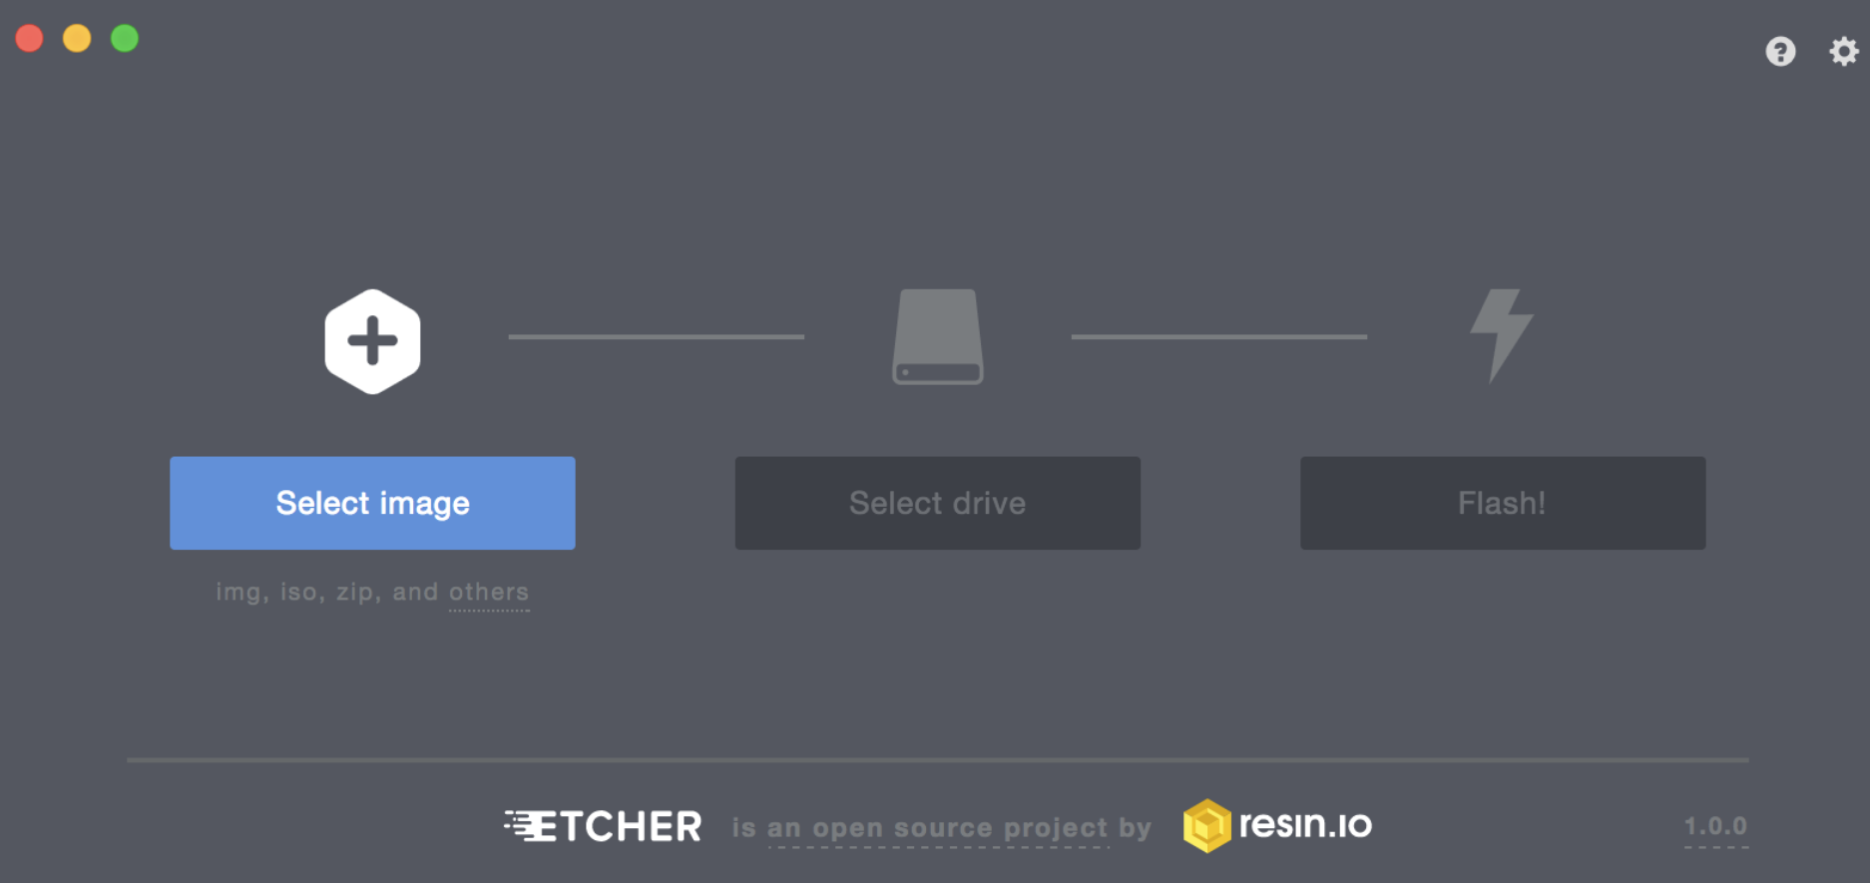
MCR2 Image Installation
General characteristics
The OS for the Jetson is stored on an SD card
An image must be flashed to the SD card; download it from here
This is flashed from an image using the Balena Etcher tool
To flash the SD card:
Insert the SD into your PC
Launch the etcher software
Select the image downloaded from the link above in the “Flash from file” section
Select the SD card in the “Select target” section
Click “Flash” and wait.
Once Flashed insert the SD Card into the Puzzlebot

Slide 32
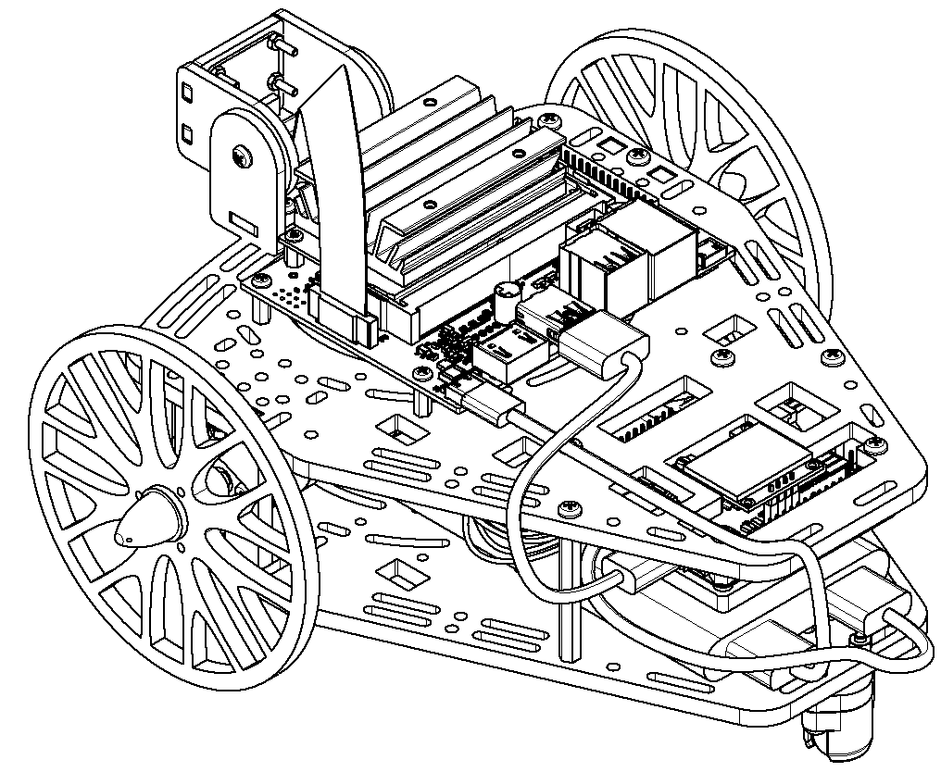
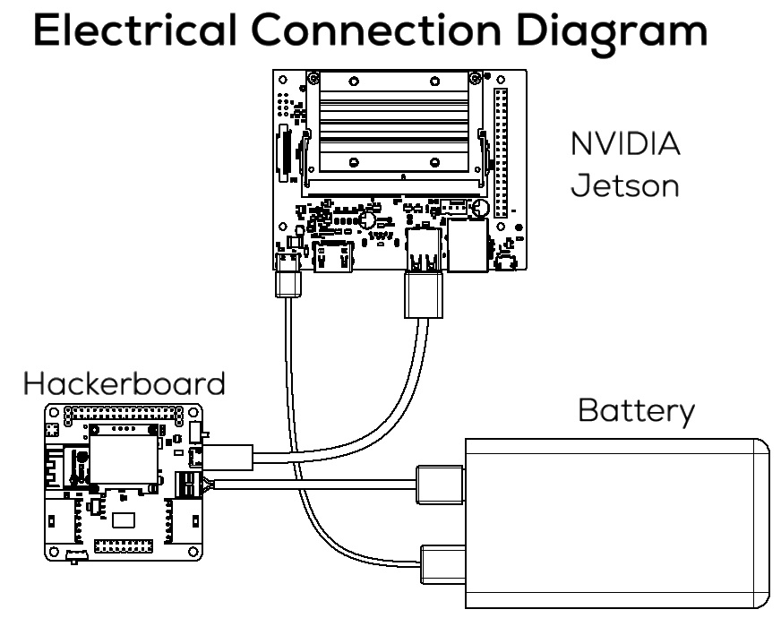
Electrical Connections
*The battery must be able to provide 5V, 3A per port independently.

Slide 33
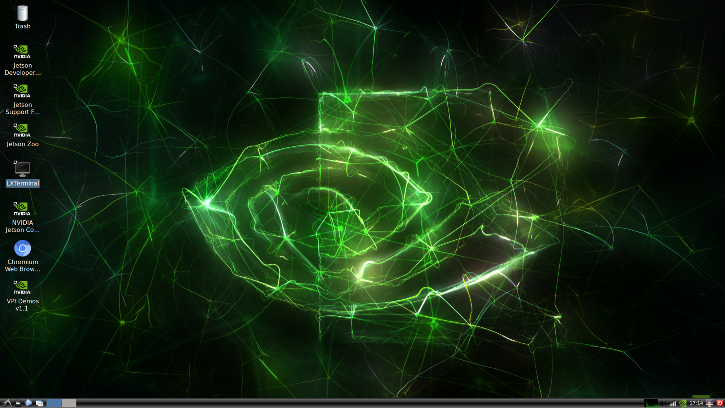

NVIDIA Jetson Nano®, 2 GB
Initial Setup
Connect the Hackerboard to the Jetson.
Connect the Jetson Nano to a screen
Connect the Jetson to the battery
Open a terminal “LXTerminal”
Type “ros2 topic list”, you should see the following:

Slide 34
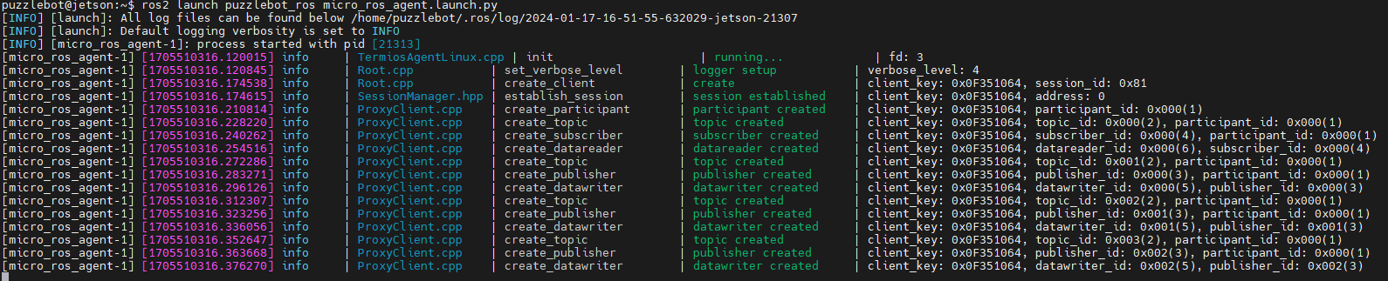
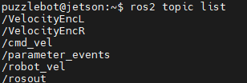
NVIDIA Jetson Nano®, 2 GB
Testing the robot
Open a terminal “LXTerminal” and type the following
Open another terminal and the following topics should be shown (according to the Hackerboard configuration)
Publish the following command if the /cmd_vel topic is active. The wheels should rotate.
ros2 launch puzzlebot_ros micro_ros_agent.launch.py
ros2 topic list
$ ros2 topic pub /cmd_vel geometry_msgs/msg/Twist 'linear:
x: 0.0
y: 0.0
z: 0.0
angular:
x: 0.0
y: 0.0
z: 0.7'
*Make sure the Hackerboard is turned On, and the Motor Switch is turned On.

Slide 35
Raspberry Pi Camera (simple access)
NVIDIA provides a package for interfacing with a CSI camera.
To access the camera and test the connection type on a terminal (must be connected to a screen)
nvgstcapture-1.0
To interface the camera with ROS, NVIDIA provides a ROS package that comes pre-installed on the Puzzlebot image
For this package, several launch files are available. Only 2 are of interest to us:
ros_deep_learning video_viewer.ros2.launch
ros_deep_learning video_source.ros2.launch
On your Jetson, run the command:
ros2 launch ros_deep_learning video_viewer.ros2.launch
The camera view should be displayed on the screen.
To only publish the image to a topic without any viewer, run the following command and ther run “ros2 topic list” command on another terminal. This node does not publish the camera calibration information, please see the next slide!
ros2 launch ros_deep_learning video_source.ros2.launch
Notes:
These resources are available from this repository, featuring full installation instructions, however the necessary packages are pre-installed on the Puzzzlebot-002 image
Mini-task – preview the camera – The camera feed should appear on their screen

Slide 36
MCR2 Camera Node
MCR2 provides a package for interfacing with a CSI camera (RPi camera).
The package provides the user with the “image_raw” and the “camera_info” topics.
MCR2 provides the pre-calibrated camera parameters.
To launch the camera node, the following command must be used
ros2 launch puzzlebot_ros camera_jetson.launch.py
The following topics will be published
camera_info – Contains the camera calibration parameters and the frame information (camera).
video_source/raw – contains the raw image from the camera.
The user can see the camera image using rqt
ros2 run rqt_image_view rqt_image_view
Notes:
These resources are available from this repository, featuring full installation instructions, however the necessary packages are pre-installed on the Puzzzlebot-002 image
Mini-task – preview the camera – The camera feed should appear on their screen

Slide 37
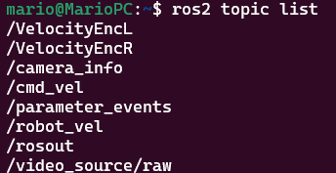
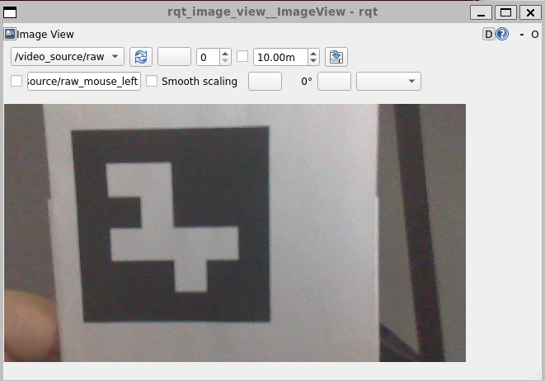
Raspberry Pi Camera
MCR2 provides a launch file that contains the previous node and also publishes the camera information, required for different algorithms such as localisation.
$ ros2 launch puzzlebot_ros camera_jetson.launch.py
Notes:
These resources are available from this repository, featuring full installation instructions, however the necessary packages are pre-installed on the Puzzzlebot-002 image
Mini-task – preview the camera – The camera feed should appear on their screen

Slide 38
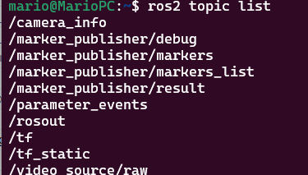
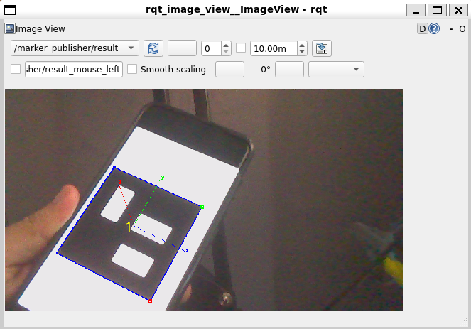
Raspberry Pi Camera
MCR2 also provides April Tag marker detection
$ ros2 launch puzzlebot_ros aruco_jetson.launch.py
Notes:
These resources are available from this repository, featuring full installation instructions, however the necessary packages are pre-installed on the Puzzzlebot-002 image
Mini-task – preview the camera – The camera feed should appear on their screen

Slide 39
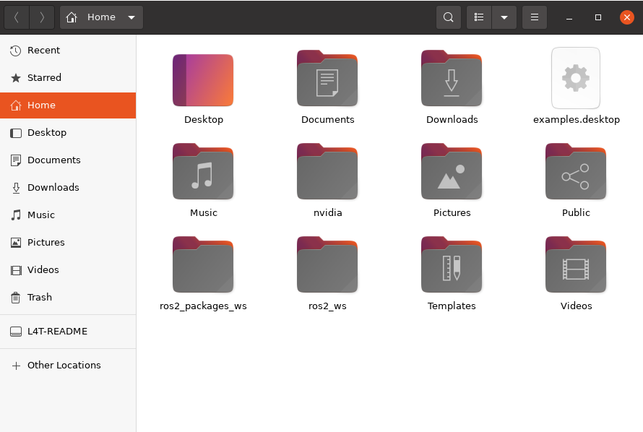
MCR2 Jetson Image
General Information
ROS is always running on Jetson nano.
No nodes are running at boot, the user must run its own nodes or the ones pre-loaded by MCR2.
There is a pre-setup workspace with some nodes on the Jetson called ros2_ws where the users can deploy their nodes.
The “ros2_packages_ws” are some MCR2 nodes and libraries necessary for the Puzzlebot and camera communication and should not be changed in any way.

Slide 40
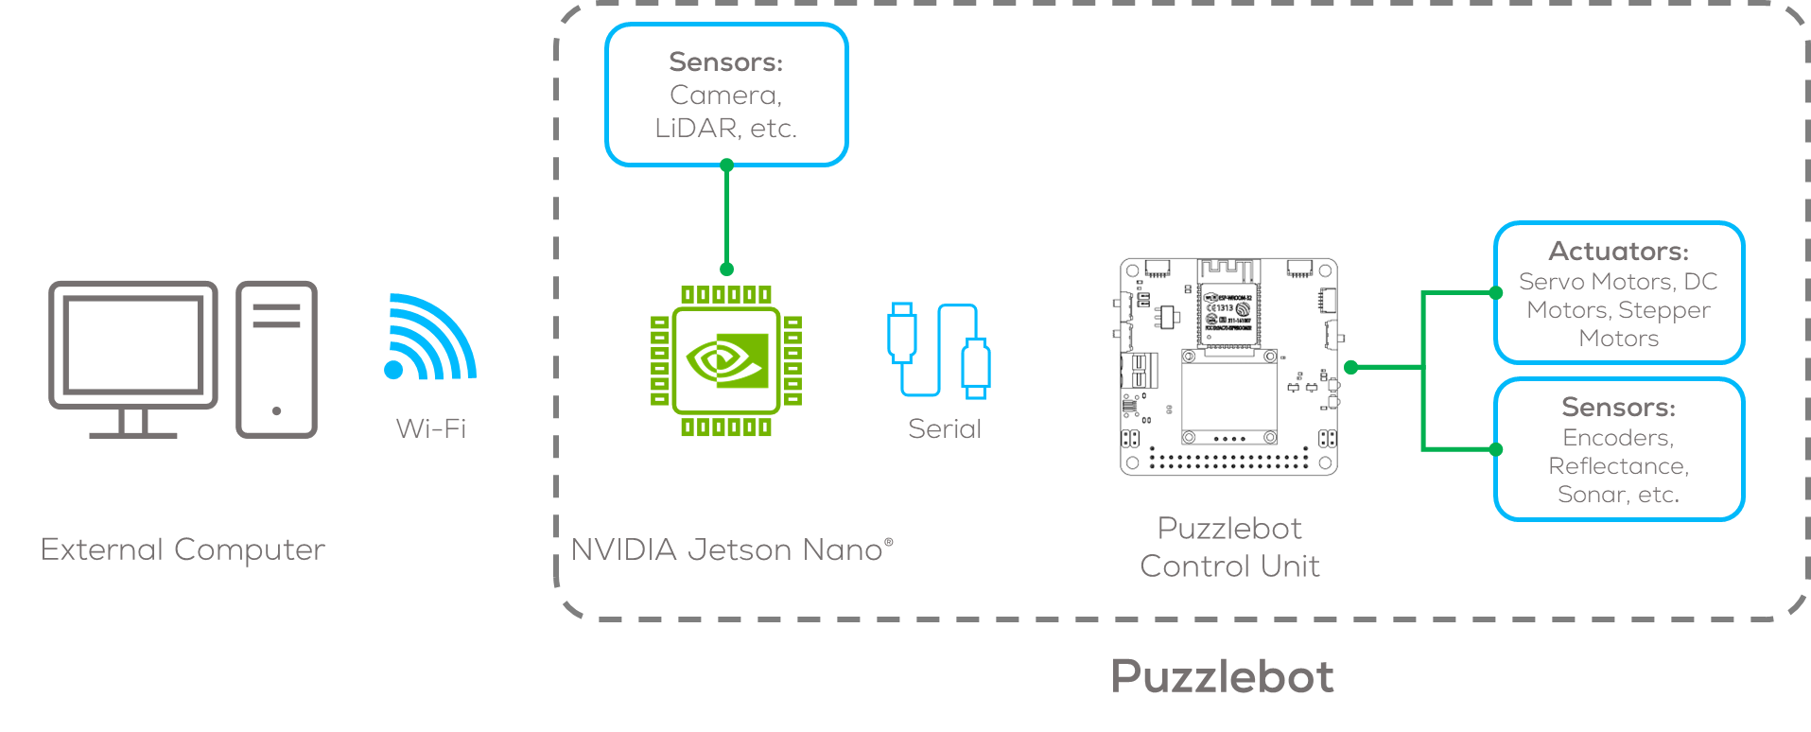
Remote Access
It can be useful to control the Jetson from a remote PC, as the robot cannot be in motion and hooked up to a monitor
To do this, two ways of communication are available SSH or ROS Network. Both uses Wi-Fi to give your computer access to the Jetson.
For both connection in this tutorial, the Jetson needs to be configured as a Hotspot to generate its own access point.
To prevent conflicts when many Jetsons are used, change the Network Name to something unique (if applicable)

Slide 41
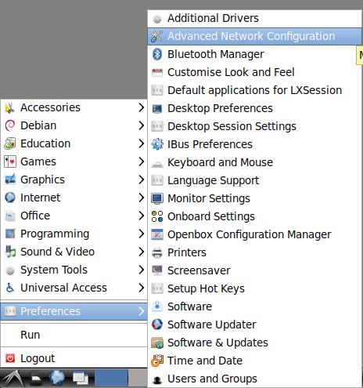
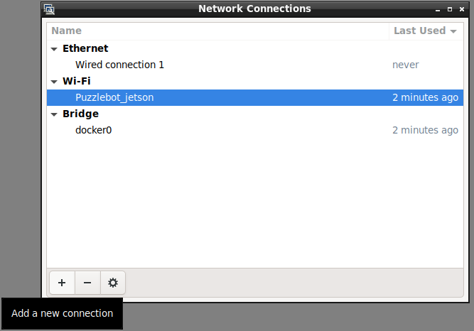
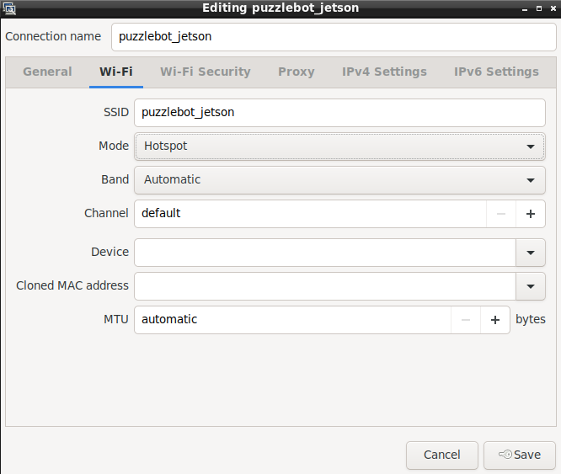
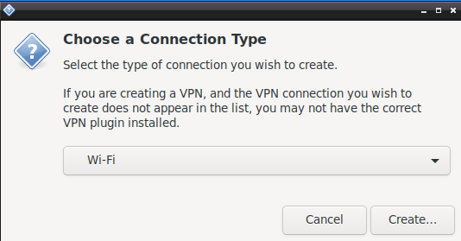
Making a Hotspot
Hotspot Setup
Set up a hotspot by going to the Start Menu>> Preferences >> Advanced Network Configuration
In the pop-up window click on the “+” signal to add a new connection.
Select on the pop-up window to Wi-Fi
Configure the name of the connection (you can use any name).
Configure the SSID (the name that you will see in other computers)
Change the mode to “Hotspot”

Slide 42
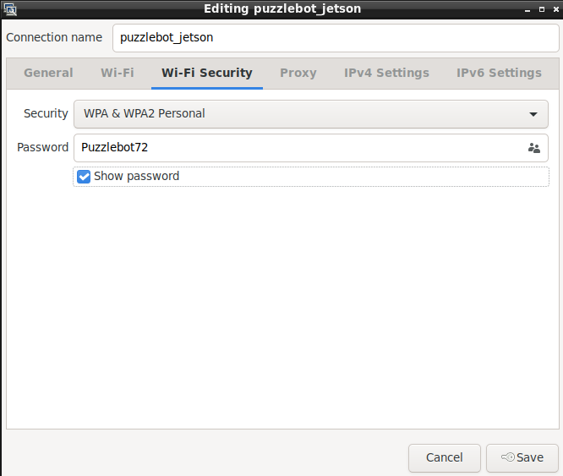
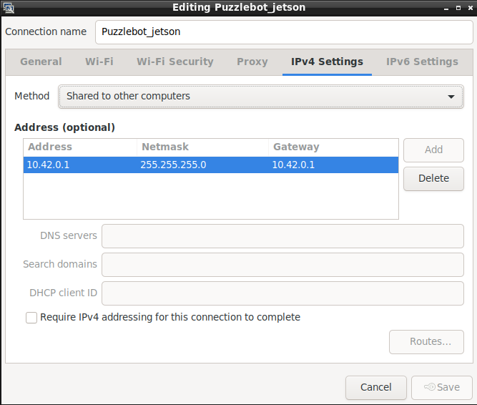
Making a Hotspot
Hotspot Setup
In the “Wi-Fi” security tab establish a password for your own robot.
On the tab IPv4 setting configure an static IP address to connect to the robot.
In the example the addresses selected are the following
Address: 10.42.0.1
Netmask: 255.255.255.0
Gateway: 10.42.0.1
Save the configuration by clicking the “Save” button.

Slide 43
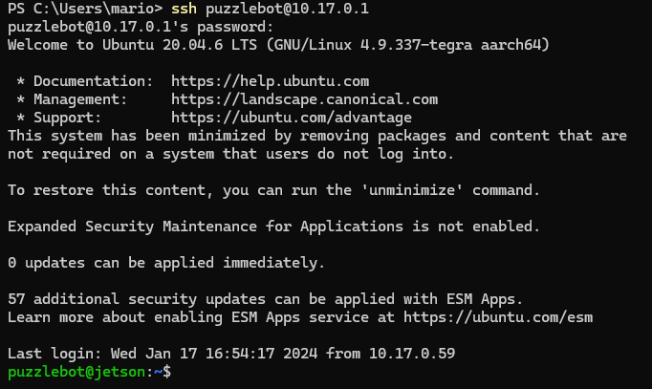
Remote Access
On the external PC (Windows or Ubuntu), open a Terminal window and type:
ssh puzzlebot@10.42.0.1 (Configured IP Address)
Password: Puzzlebot72 (Configured Password)
If prompted, type yes and then press enter.
This command window is now equivalent to one running on the Jetson.
Once any control code is written on the Jetson, it can be tested and debugged remotely via SSH, enabling the PuzzleBot to move around

Slide 44
Testing
Test the ROS communication, run the following command (if not already running on the Jetson)
Echo the different topics using ros2 topic echo
Echo the topics /VelocityEncR, and /VelocityEncR, and rotate the wheels
The speed of the wheels should be displayed
Publish to the command topics, the wheels should turn
If control mode 1 is used, publish to /cmd_vel
If control mode 2 is used, publish to /VelocitySetR and /VelocitySetL
If control mode 3 is used, publish to /ControlL and /ControlL
The control mode is changed on the Hackerboard webpage
ros2 launch puzzlebot_ros micro_ros_agent.launch.py

Slide 45
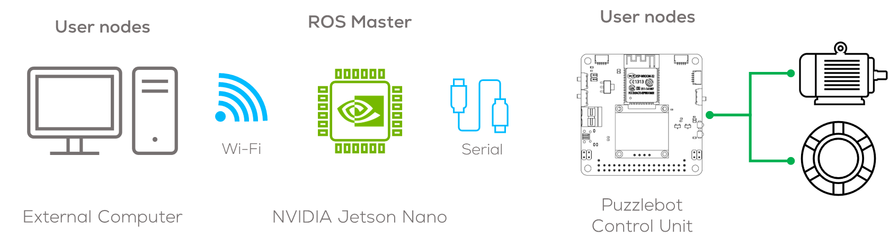
Multi-device Communication with ROS (ROS network)
Introduction
ROS facilitates communication between various devices, with ROS2 installed, on a shared network (No SSH).
The Jetson Nano acts as an Access Point (AP) to provide this network.
In the context of the Puzzlebot, by connecting to the Jetson's AP, other devices can communicate via ROS topics and publishers.
Notes:
With Puzzlebot, the ROS Master runs on the puzzlebot, so the external PC must be directed to that master.
This enables remote control of the puzzlebot and debugging of the Jetson code, without needing to connect the jetson to a monitor/keyboard
Mention ROS_Hostname – with more devices, referring to each by IP can be confusing, so ROS hostname provides a way to give each device a name

Slide 46
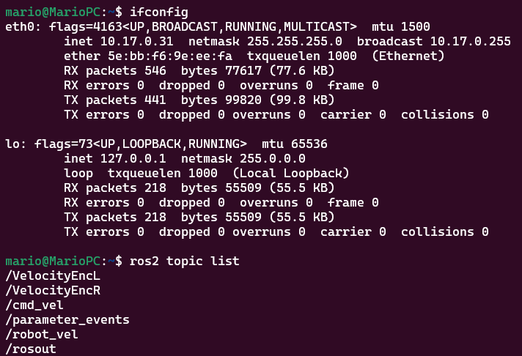
Multi-device Communication with ROS (ROS Network)
From the host computer in Ubuntu with ROS2 Installed, connect to the “Hotspot” of the Jetson.
Make sure the IP address is correct using the command “ifconfig” on the terminal.
ROS Should be able to detect the nodes, topics and subscribers.
This connection is not a remote access into the Jetson like SSH, we cannot start nodes or run other commands
However, it can be more useful, as we cannot easily display visualisations via SSH.
Notes:
With Puzzlebot, the ROS Master runs on the puzzlebot, so the external PC must be directed to that master.
This enables remote control of the puzzlebot and debugging of the Jetson code, without needing to connect the jetson to a monitor/keyboard
Mention ROS_Hostname – with more devices, referring to each by IP can be confusing, so ROS hostname provides a way to give each device a name

Slide 47
Troubleshooting
The Hacker Board communication will only work correctly if the Jetson is connected to its own Wi-Fi network (AP)
Go to Network -> Connect to Hidden Wi-Fi network and select “Hotspot” from the dropdown.
The PuzzlebotJetson Network should now be visible in the networks; connect to it, to activate the hotspot.
Sometimes, the Jetson Wi-Fi Network takes a couple of minutes to appear on other devices after a reboot. If it does not, make sure no other connections are saved. It is only guaranteed to connect to PuzzlebotJetson on boot if there are no other connections saved
Always consider checking the Hackerboard if these don’t work: is ROS turned on?

Slide 48
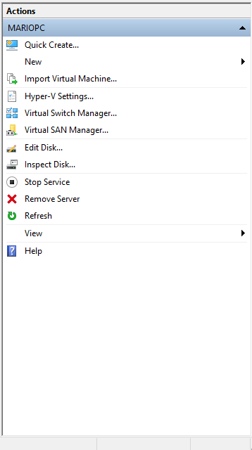
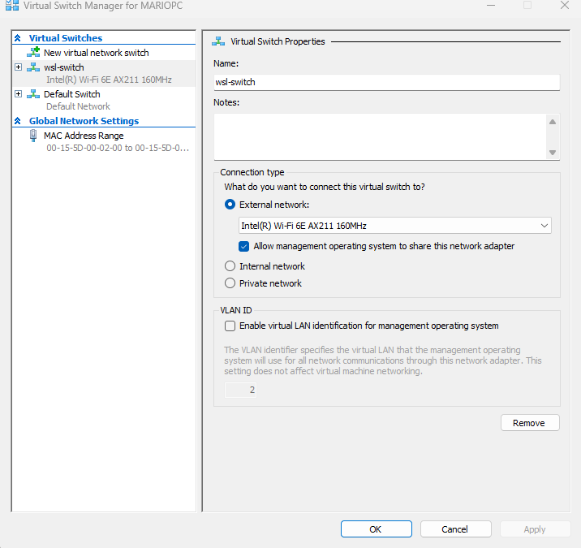
WSL2 IP Configuration
WSL requires the user to configure the IP address to mirror the one in the host computer and connect to the Puzzlebot.
Open Hyper-V manager and press “Virtual Switch Manager”
Press the button “Create a Virtual Switch”
Give a name to the switch “wsl-switch” and select the WiFi adapter to use (in case you have different) to create the Switch.
Press “Apply” and “OK”

Slide 49


WSL2 IP Configuration
Create a new file called “.wslconfig” on the “User” folder e.g., “C:\Users\mario”
You can use a terminal to create the file
Add the following inside the file, save it and close it.
Start the WSL2,
If you have previously started it shutdown the WSL as follows: wsl --shutdown
Then start the WSL.
The IP address should be one given by the switch.
Now you can connect to ROS Network “ros2 topic list”

Slide 50
Thank you

Slide 51
T&C
Terms and conditions

Slide 52
Terms and conditions
THE PIECES, IMAGES, VIDEOS, DOCUMENTATION, ETC. SHOWN HERE ARE FOR INFORMATIVE PURPOSES ONLY. THE DESIGN IS PROPRIETARY AND CONFIDENTIAL TO MANCHESTER ROBOTICS LTD. (MCR2). THE INFORMATION, CODE, SIMULATORS, DRAWINGS, VIDEOS PRESENTATIONS ETC. CONTAINED IN THIS PRESENTATION IS THE SOLE PROPERTY OF MANCHESTER ROBOTICS LTD. ANY REPRODUCTION, RESELL, REDISTRIBUTION OR USAGE IN PART OR AS A WHOLE WITHOUT THE WRITTEN PERMISSION OF MANCHESTER ROBOTICS LTD. IS STRICTLY PROHIBITED.
THIS PRESENTATION MAY CONTAIN LINKS TO OTHER WEBSITES OR CONTENT BELONGING TO OR ORIGINATING FROM THIRD PARTIES OR LINKS TO WEBSITES AND FEATURES IN BANNERS OR OTHER ADVERTISING. SUCH EXTERNAL LINKS ARE NOT INVESTIGATED, MONITORED, OR CHECKED FOR ACCURACY, ADEQUACY, VALIDITY, RELIABILITY, AVAILABILITY OR COMPLETENESS BY US.
WE DO NOT WARRANT, ENDORSE, GUARANTEE, OR ASSUME RESPONSIBILITY FOR THE ACCURACY OR RELIABILITY OF ANY INFORMATION OFFERED BY THIRD-PARTY WEBSITES LINKED THROUGH THE SITE OR ANY WEBSITE OR FEATURE LINKED IN ANY BANNER OR OTHER ADVERTISING.

