Slide 1
Coding interview university (7/4)
Hardy Wu

Slide 2
Agenda
Data Structures
Arrays
Linked lists
Hash table

Slide 3
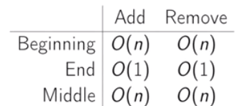
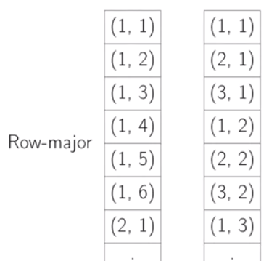
Array
Basic array
Contiguous memory
Equal size
Contiguous index

Slide 4
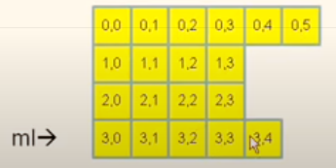
Array
Dynamic array
An array with resized functionality.
Jagged array

Slide 5
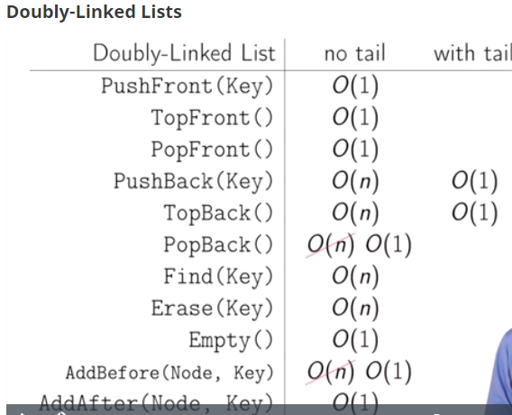
Linked list
Different implementation of Linked List
1. With and without tail.
2. Single or doubly Linked List.
3. Dummy node may help implementation.
4. Traverse of Linked List may cause cache miss.

Slide 7
Target
Search data in constant time.

Slide 8
Applications & usage
Database
Compilers & interpreters
Network router
Substring searching (grep)
File synchronization (rsync)

Slide 9
Dictionary in python
dic = {}
dic[“Hardy”] = “Smart and hardworking”
dic[“Louis”] = “Rich but lazy”
print(dic[“Hardy”])
Console:
Smart and hardworking

Slide 10
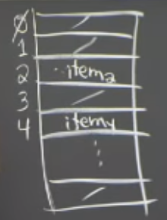
Simple approach
Direct-access table
Assumption
Index is the key
Store items in array indexed by key
Badness
Key may not be non-negative integer
Gigantic memory usage

Slide 11
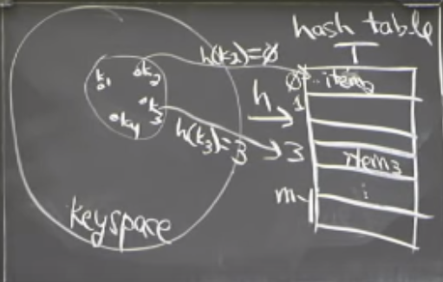
Solution
Prehashing
Maps keys to non-negative integers
In theory, keys are finite & discrete (e.g. string of bits)
Ideally hash(x) = hash(y) ⬄ x = y
Hashing
Reduce universe U of all keys down to reasonable size m for table.
May cause collision

Slide 12
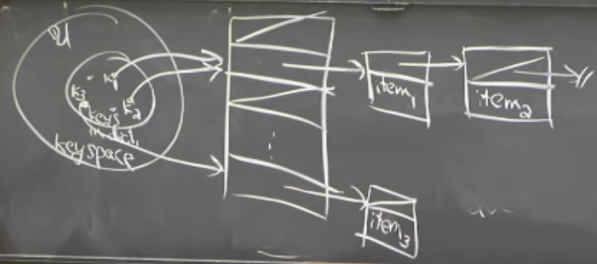
Collision
Solution
Chaining

Slide 13
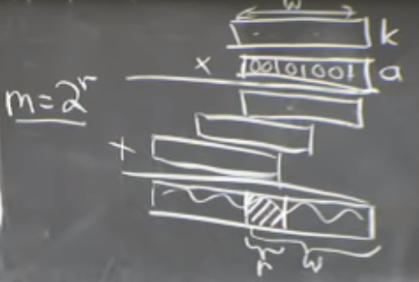
Hashing method
Division method:
H(k) = k mod m
Multiplication method:
H(k) = [(a*k) mod 2^{w}] >>
(w-r)
Universal hashing
H(k) = [(a*k+b) mod p] mod m (a and b is rand(0, p-1), p is prime > |u|)

Slide 14
Table doubling
How to choose m?
Want m = Ɵ(n)
Idea
Start small: e.g. m = 8
Grow/shrink as necessary

Slide 15
Grow table
Size m -> m’
Make table of size m’
Build new hash f’
Rehash:
for item in T: T’.insert(item)
If n > m: grow table
m’ = m+1: cost of n inserts
Ɵ(1+2+3+4+5+…+n) = Ɵ(n²)
m’ = 2m: cost of n inserts
Ɵ(1+2+4+8+…+n) = Ɵ(n) => Ɵ(1) per operation (Amortized insertion)

Slide 16
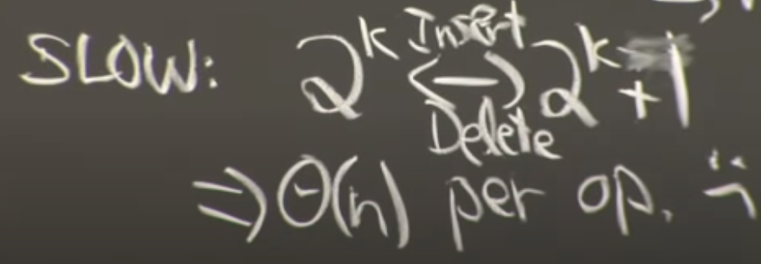
Deletion
If m = n/2 then shrink -> m/2
If m = n/4 then shrink -> m/2
Amortized time -> Ɵ(1)

Slide 17
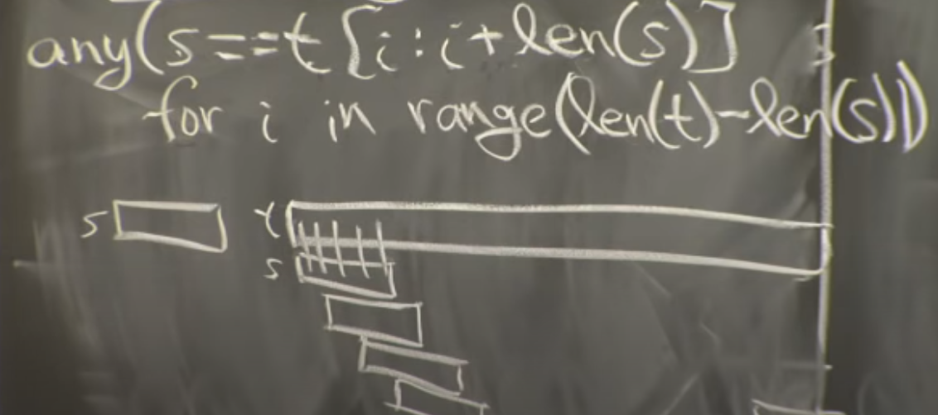
String matching
Simple algorithm
Running time: Ɵ(|s| * (|t| - |s|)) = O(|s|*|t|)

Slide 18
Rabin-Karp algorithm
http://www.tastones.com/zh-tw/stackoverflow/algorithm/substring-search/introduction_to_rabin-karp_algorithm/

