Slide 1
Cloud-Connected OEE Monitoring for a Simulated SMT PCB Assembly Line
Shao-Chi Cheng · Aldrick Peter Thomas Peter · Yi-Hung Ting · Jatin
Notes:
Good [morning/afternoon]. We are presenting our IIoT project: cloud-connected OEE monitoring for a simulated surface-mount PCB assembly line. I’ll walk through the project in five parts: the title and scope, our objectives, why this problem matters, the architecture across the five IIoT layers, and finally where our data comes from and how we plan to build it.

Slide 2
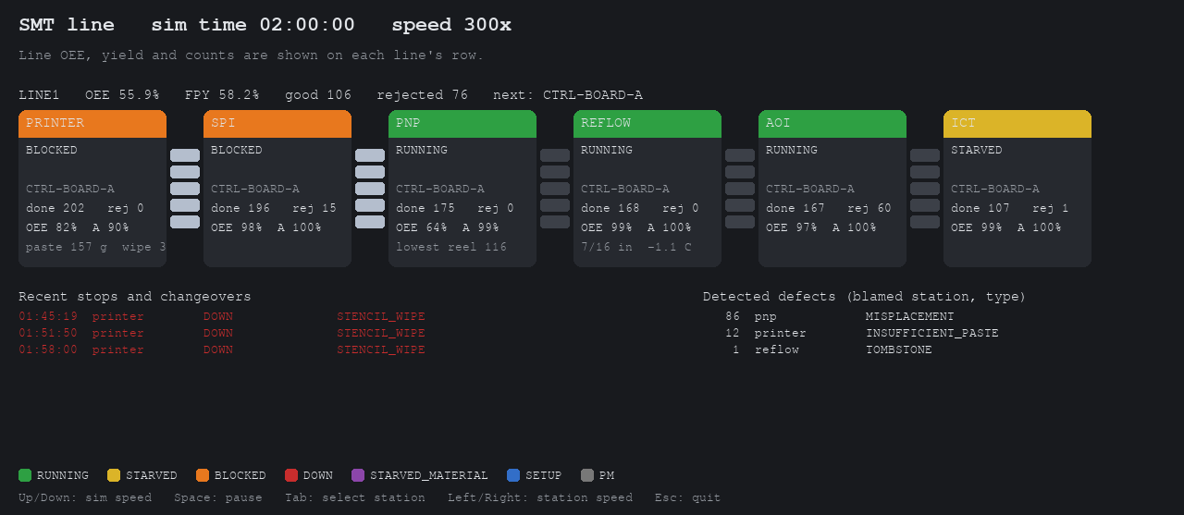
Project title
Cloud-Connected OEE Monitoring for a Simulated SMT PCB Assembly Line
A working IIoT prototype that measures OEE across a six-station PCB line and shows where the losses come from.
6
stations, printer to in-circuit test
5
IIoT layers, device to dashboard
3
scripted faults to validate it
Simulated line at 300× speed with an injected nozzle fault (click to play)
Notes:
Our project is cloud-connected OEE monitoring for a simulated SMT, or surface-mount, PCB assembly line. OEE is Overall Equipment Effectiveness: availability times performance times quality.
The clip on screen is our simulated line running at 300 times real speed. You can see the six stations — stencil printer, solder paste inspection, pick-and-place, reflow oven, optical inspection and in-circuit test — with the buffers between them. Each station is coloured by its state: green running, yellow starved, orange blocked, red down. In this run we injected a clogged nozzle on the pick-and-place, and you can see misplacement defects piling up on the right, blamed on the pick-and-place.
So in one sentence: we are building a working IIoT prototype that measures OEE across six stations, through five IIoT layers, and we will validate it with three scripted faults.

Slide 3
Objectives
1
Measure OEE live
Availability × performance × quality, per station, per shift and for the whole line, computed in the cloud.
2
Explain downtime
Convert raw state changes into downtime events with reason codes, ranked by lost time.
3
Trace every reject
Serialized boards, so a reject found at SPI, AOI or test is blamed on the station that created it; report first-pass yield.
4
Find the bottleneck
Separate starved and blocked time from true faults to show which station limits the line.
5
Prove it works
Scripted faults must lead an operator on the dashboard to the correct root cause.
Notes:
We have five objectives, and they all serve one goal: turning a single OEE number into a root cause.
First, measure OEE live — availability, performance and quality — per station, per shift and for the whole line, computed in the cloud.
Second, explain downtime. Raw state changes become downtime events with reason codes, so we can rank causes by how much time they cost.
Third, trace every reject. Each board carries a serial number and a defect record, so a defect found later at solder paste inspection, optical inspection or in-circuit test is blamed on the station that actually caused it. Quality is reported as first-pass yield.
Fourth, find the bottleneck, by separating time a station spends starved or blocked by its neighbours from its own true faults.
And fifth, prove it works: scripted faults must lead an operator to the correct root cause on the dashboard.

Slide 4
Background, motivation and significance
59%
Background
An SMT line chains six machines with small buffers between them. One stop at the pick-and-place starves every station after it and blocks every station before it.
Line OEE in our 24-hour baseline run. Same number, four possible causes, four different fixes.
Motivation
Output is lost to short stops, slow cycles and solder defects. A defect is often found two or three stations after the machine that caused it.
Significance
Cause per station turns OEE from a score into a to-do list. The simulator knows the true cause of every loss, so we can prove the dashboard is right.
Notes:
A little background. An SMT line chains six machines, with small buffers between them. That coupling matters: if the pick-and-place stops, every station after it runs out of boards and every station before it fills up and stops.
Our motivation is that output is lost in small pieces — short stops, slow cycles and solder defects — and the evidence shows up in the wrong place. A paste defect from the printer may only be caught at inspection, two or three machines later.
On significance: in our 24-hour baseline run, the line OEE was 59 percent. That number alone doesn’t tell you what to do: it could be changeovers, empty feeders, paste defects, or stations waiting on a neighbour, and each one needs a different fix. Knowing the cause per station turns OEE into a to-do list. And because our simulator records the true cause of every loss, we can check that the dashboard points to the right machine — something you can’t do on a real line, where the true cause is rarely known.

Slide 5
Architecture: five IIoT layers
L5
Application
Web dashboard HMI: live line status, OEE trends, ranked downtime causes, target vs actual output.
Web dashboard
L4
Cloud
Time-series database stores events; computes availability, performance and quality per station, shift and line.
Time-series DB
L3
Edge
Gateway turns state changes into downtime events with reason codes, aggregates counts, buffers during outages.
Node-RED
MQTT over TLS
L2
Network
Each station exposes its state, fault code, part count and reject count as tags.
OPC UA tags
L1
Physical device
Six stations as state machines (running, faulted, starved, blocked) with wear-based faults and finite buffers.
Python simulator
built and tested
data up
Notes:
Here is the architecture, following the five-layer IIoT stack. Data flows from the bottom up.
Layer one, the physical device layer, is our Python simulator. Each of the six stations is a state machine — running, faulted, starved or blocked — with fault and defect probabilities that rise as parts wear, and finite buffers so a stoppage spreads along the line. This layer is already built and tested, which is why it is outlined.
Layer two, the network layer: each station exposes its state, fault code, part count and reject count as OPC UA tags.
Layer three is the edge. A gateway running Node-RED converts raw state changes into downtime events with reason codes, aggregates counts, buffers data if the connection drops, and publishes to the cloud over MQTT secured with TLS.
Layer four, the cloud: a time-series database stores the events and computes availability, performance and quality per station, per shift and for the whole line.
And layer five, the application: a web dashboard that acts as the HMI, with live line status, OEE trends, a ranked chart of downtime causes, and target versus actual output for the active order.

Slide 6
Data source and implementation plan
Data source: our tick-based SMT line simulator
Implementation plan
Tag snapshot
State, fault code, part and reject counts per station, mapped to OPC UA tags
1
Simulator and OEE metrics
Done
Event log
Every state change with its reason code, the raw input for downtime events
2
OPC UA server on the simulator tags
Next
Board records
Serial number, true and detected defects, blamed station, for first-pass yield
3
Node-RED gateway: events, buffering, MQTT over TLS
First check: injected faults vs baseline
4
Cloud time-series DB and OEE calculations
Scenario | Diagnosis names | Effect
Stencil wear | Paste defects, printer | FPY 88.8 → 82.7 %
Feeder depletion | Empty feeder, P&P | 7 → 116 min stopped
Nozzle fault | Misplacement, P&P | FPY 89.7 → 66.2 %
5
Web dashboard as the HMI
6
End-to-end validation with the three scripted faults
Notes:
Finally, our data source and plan.
The data source is our own tick-based simulator of the line, and it already exists. It produces three things that map directly onto the stack: a tag snapshot of each station — state, fault code, part and reject counts — which becomes our OPC UA tags; an event log of every state change with a reason code, which the edge turns into downtime events; and a record for every board with its serial number, its true defects, what inspection detected, and which station was blamed. That last one gives us first-pass yield.
We have already run a first check of the three faults we will use for validation. With stencil wear, the diagnosis names paste defects from the printer and first-pass yield drops from 88.8 to 82.7 percent. With feeder depletion, empty-feeder stops go from 7 to 116 minutes at the pick-and-place. With the nozzle fault, misplacement is blamed on the pick-and-place and yield falls to 66 percent.
Our plan builds up the stack in order: the OPC UA server next, then the Node-RED gateway with MQTT over TLS, then the cloud database and OEE calculations, then the dashboard — and finally, we rerun those three faults end to end to confirm the dashboard leads an operator to the right root cause. The architecture can later extend to energy per board and multiple product types with changeovers. Thank you — we’re happy to take questions.

