Slide 1


“NEXT GENERATION NETWORKS” COURSEWORK
DISI, UNIVERSITY OF TRENTO
SDN Based
HoneyPot
De Toffoli Alessandro
https://github.com/Ale-Deto04/SDN-Based_Honeypot

Slide 2
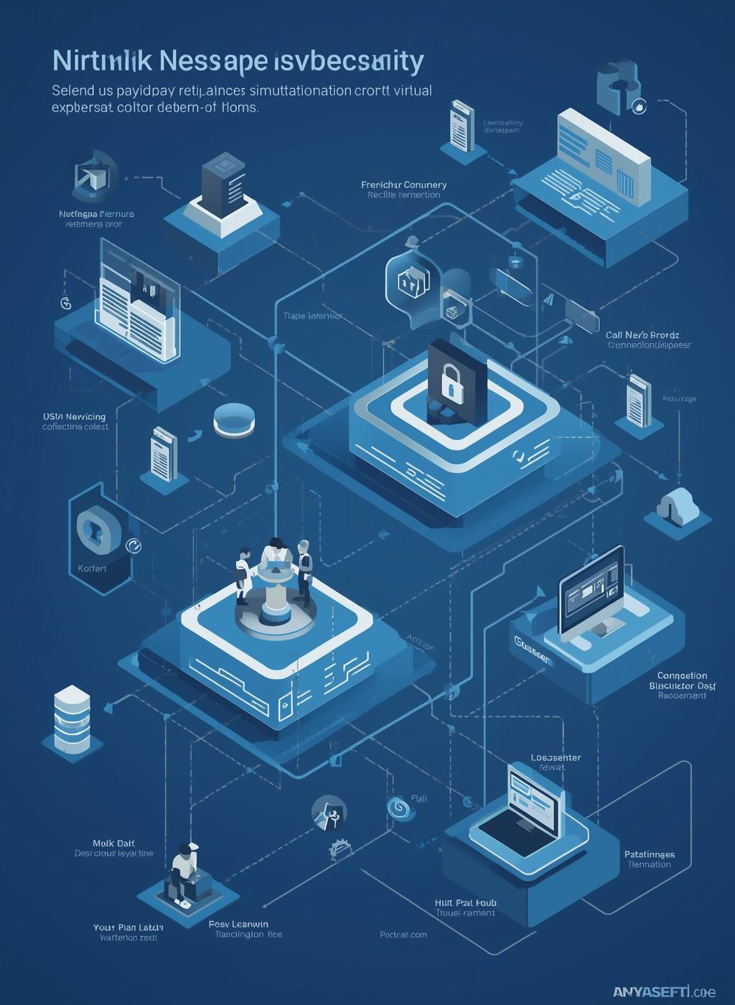
Introduction
Overview
This project focuses on a SDN-based security honeypot architecture implemented on a Kathará-emulated enterprise network.
The scenario models a company environment with a legitimate HTTP server, a honeypot, and both trusted and untrusted hosts.
Using SDN capabilities, the controller dynamically detects untrusted access attempts and transparently redirects malicious traffic to the honeypot, without alerting the attacker.

Slide 3
Introduction
HoneyPot
A honeypot is a decoy system designed to attract malicious users by appearing as a legitimate service, with the goal of observing their behavior without exposing real assets.
In this project, the honeypot is implemented as a dedicated host that closely replicates the behavior of the legitimate server while providing only fake, non-sensitive information.
This approach allows attackers to interact with a realistic environment, enabling safe monitoring and analysis of malicious activity.

Slide 4
Introduction
Network
The network is implemented as a Software-Defined Networking (SDN) environment composed of multiple subnets connected through an Open vSwitch instance, which acts as the central forwarding device.
An SDN controller based on Ryu manages the network behavior, handling routing functionalities, monitoring traffic from suspicious hosts, and performing Deep Packet Inspection to analyze application-layer payloads.

Slide 5
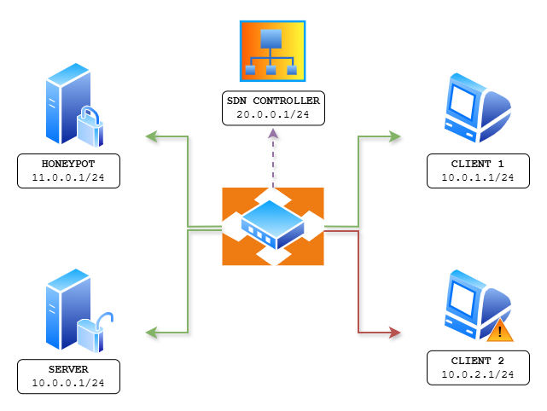
Network Topology
  Four different devices on different subnets
  Open vSwitch linking the collision domains
  SDN Controller administrating the network
  Second client’s LAN is untrusted

Slide 6


SDN Controller
Main features
  Routing functionalities
  Deep Packet Inspection on HTTP packets
  Mostly self learning
  Real-time messages and updates to the dashboard GUI

Slide 7
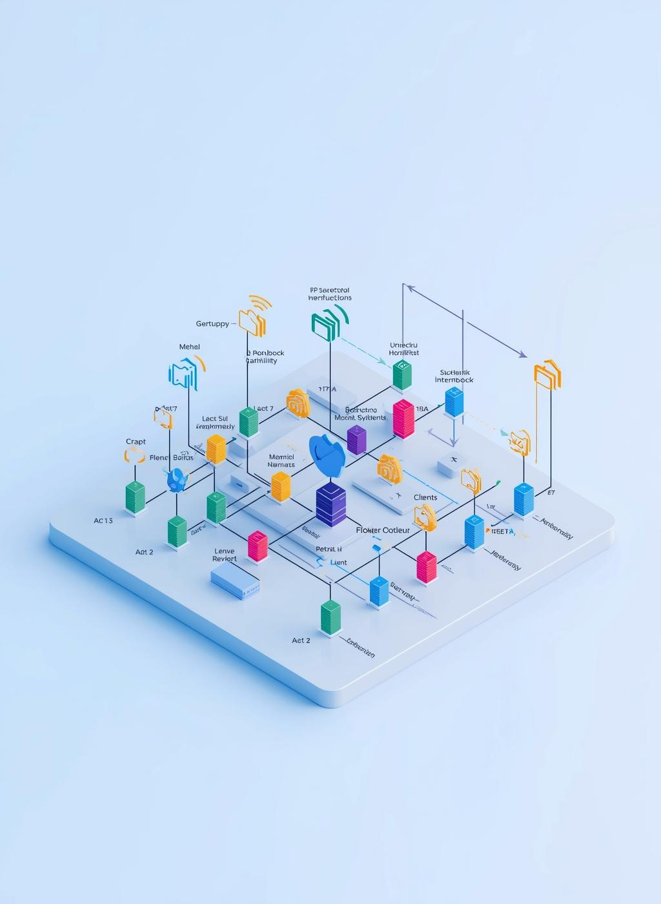
Threat model
Untrusted subnets
Not all company subnets have the same privileges.
The server exposes an HTTP service with an admin-only area containing private information.
Access to these protected resources is allowed only from the trusted subnet, whereas traffic originating from the untrusted subnet is considered suspicious and continuously monitored.

Slide 8
Threat model
Monitoring system
Traffic originating from untrusted networks is continuously monitored by the SDN controller.
For TCP traffic, the controller performs Deep Packet Inspection (DPI) on the application-layer payload, searching for specific patterns that indicate attempts to access unauthorized or protected resources.
This mechanism allows the system to identify suspicious behaviors at runtime and distinguish legitimate traffic from potential attacks.

Slide 9

Redirection
Installing flow rules
When an intrusion attempt is detected, the SDN controller reacts by installing a specific flow rule on the switch.
This rule dynamically modifies the IP headers of the packets, redirecting the traffic generated by the suspicious client toward the honeypot.
The redirection is completely transparent to the attacker: from the client’s perspective, the communication still appears to be established with the legitimate server, while it is actually handled by the honeypot.

Slide 10
Redirection
Connection loss
During traffic redirection, the legitimate server intentionally simulates a connection loss.
This is necessary because the client must establish a new TCP connection with the honeypot, and it is not possible to seamlessly continue the existing TCP session without interruption.
From the client’s perspective, the temporary connection failure appears as a normal network issue, after which communication is re-established with what is believed to be the original server, but is actually the honeypot.

Slide 11
Redirection
Real-world scenario
In fact, in real-world deployments, honeypots are often not implemented as fully separate servers.
Instead, they are commonly integrated as decoy portions of the same service or implemented through proxy-based architectures to overcome TCP-level limitations and TLS-related issues.
.

Slide 12
Tools & Technologies
Main technologies involved
Kathara
Ryu
Flask
Kathará is a network emulation framework used to simulate the enterprise network, enabling realistic testing of the SDN-based architecture.
Ryu is a Python-based SDN framework that provides libraries for building network controllers. The proposed controller is derived from the simple_switch_13.py.
Flask is a lightweight Python web framework used to implement the HTTP services in the project, including both the legitimate server and the honeypot.

Slide 13

Demo
GitHub Repository
https://github.com/Ale-Deto04/SDN-Based_Honeypot

