Slide 1
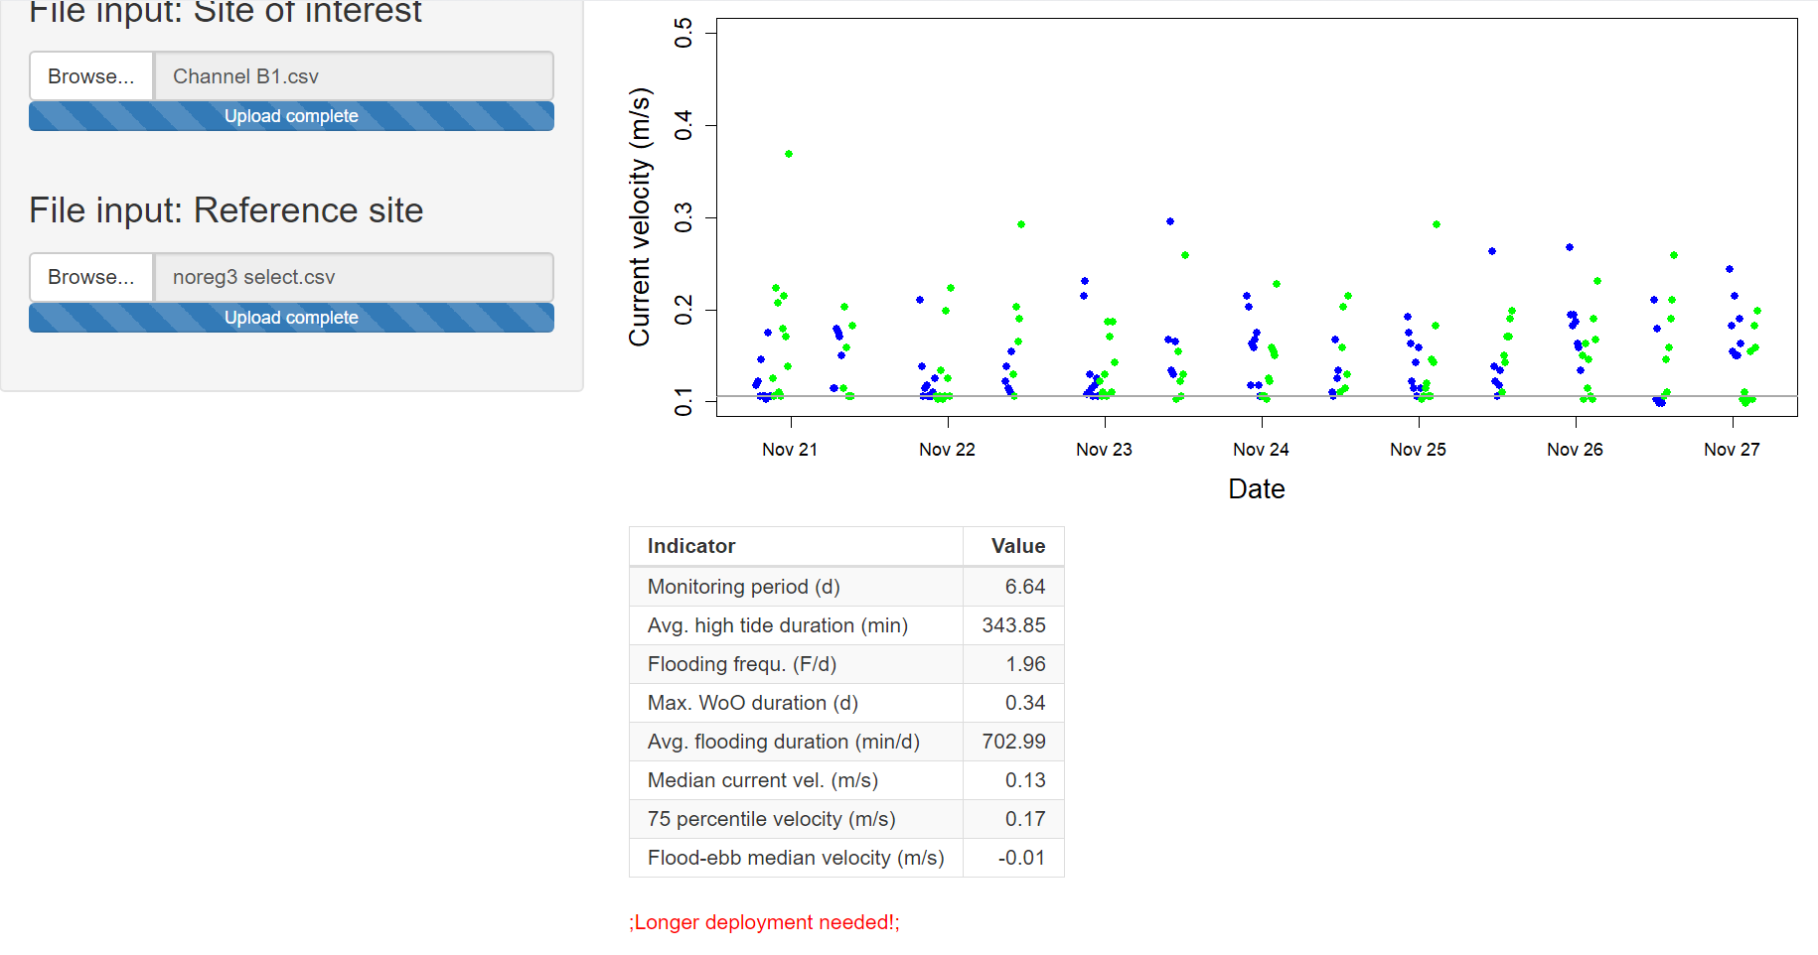
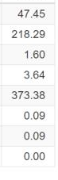
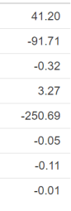
The Mini Buoy App
Results The deployment length was X days, so we consider the results presented here to be robust / which is probably too short to trust the results presented here. We recommend a longer deployment (of at least 15 days) to represent a full spring-neap cycle.
Inundation at the site looks continuous / mixed / like a diurnal tide / like a semi-diurnal tide.
Target
Reference
Difference
Select a plot: daily inundation / current velocity / wave orbital velocity
Disclaimer.

