Slide 1


Calculating the accessible surface area of a protein
By Bel Alexis
2022-2023
Shrake, A; Rupley, JA. (1973). "Environment and exposure to solvent of
protein atoms. Lysozyme and insulin". J Mol Biol 79 (2): 351–71. doi:
10.1016/0022-2836(73)90011-9.
1

Slide 2
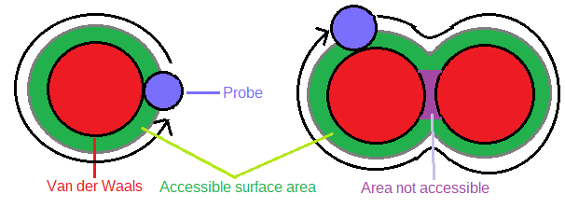
What is ASA?
Picture of the algorithm of Shrake Rupley
2

Slide 3
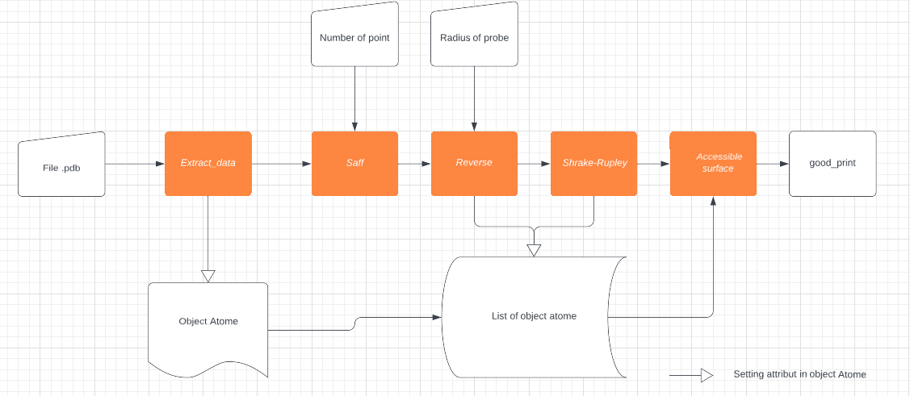
Pipeline
Pipeline of the program
3

Slide 4
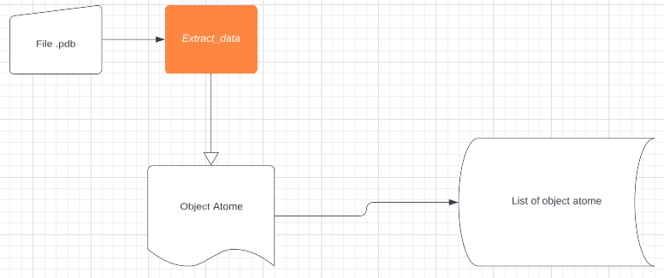
Pipeline extraction
Extract data from a .pdb
For each atom a object atom is creates
A list contain all the object atom
4

Slide 5
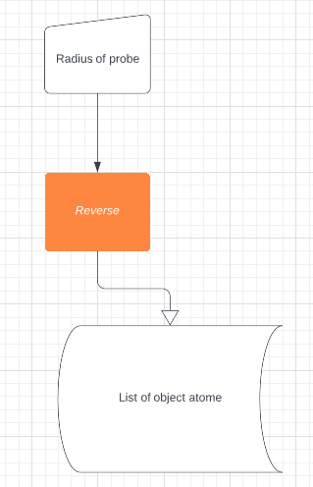
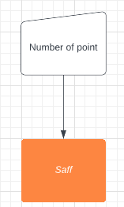
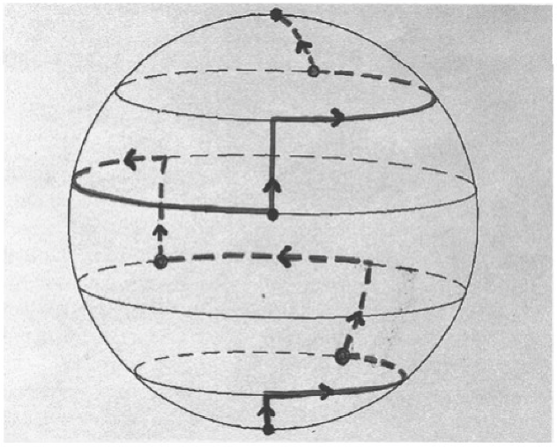
Pipeline: Saff et reverse
Spherical coordinate to 3d coordinates
3d coordinates in object atom
Saff, E.B., Kuijlaars, A.B.J. Distributing many points on a sphere.The Mathematical Intelligencer 19, 5–11 (1997). https://doi.org/10.1007/BF03024331
5

Slide 6
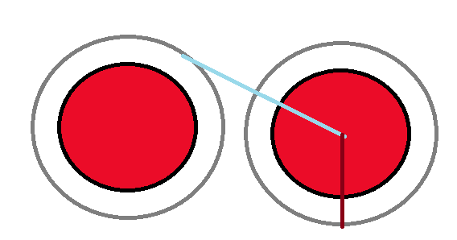
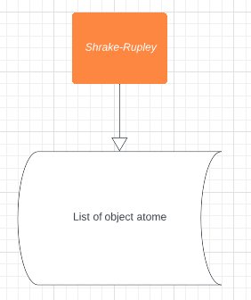
Pipeline: Shrake Rupley
D
R
Compare D and R to determine if a point is buried or not
6

Slide 7
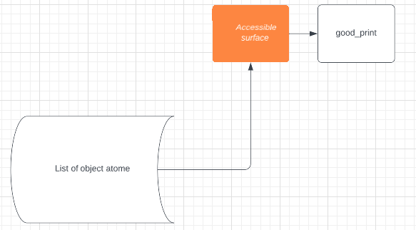
Pipeline: Accessible surface
Add the ASA of atom by residue
Add the ASA of All residue
Add the maxASA of all residue
Ratio of Sum of ASA / Sum MaxASA
7

Slide 8
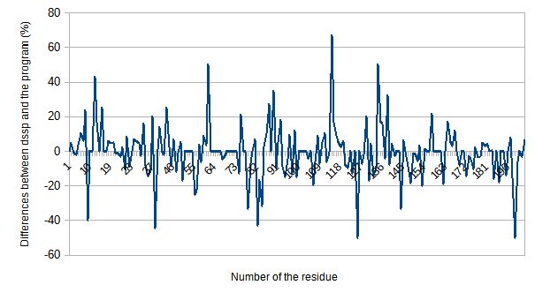
Result:
Mean of the differences : -0.3%
Script = 9730 A^2
DSSP = 9623 A^2
28 % of the protein is accessible
Difference between the results obtain by dssp and by the program
8

Slide 9
Discussion:
Working program
Testing on larger protein
Multiprocessing
9

Slide 10
Thank you for your attention
10

