Slide 1
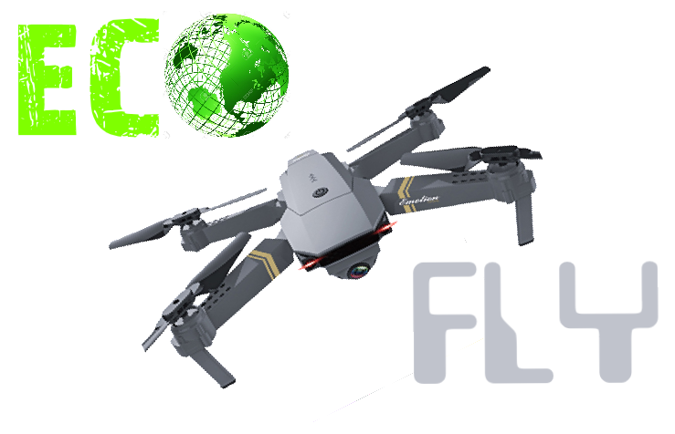

Slide 2
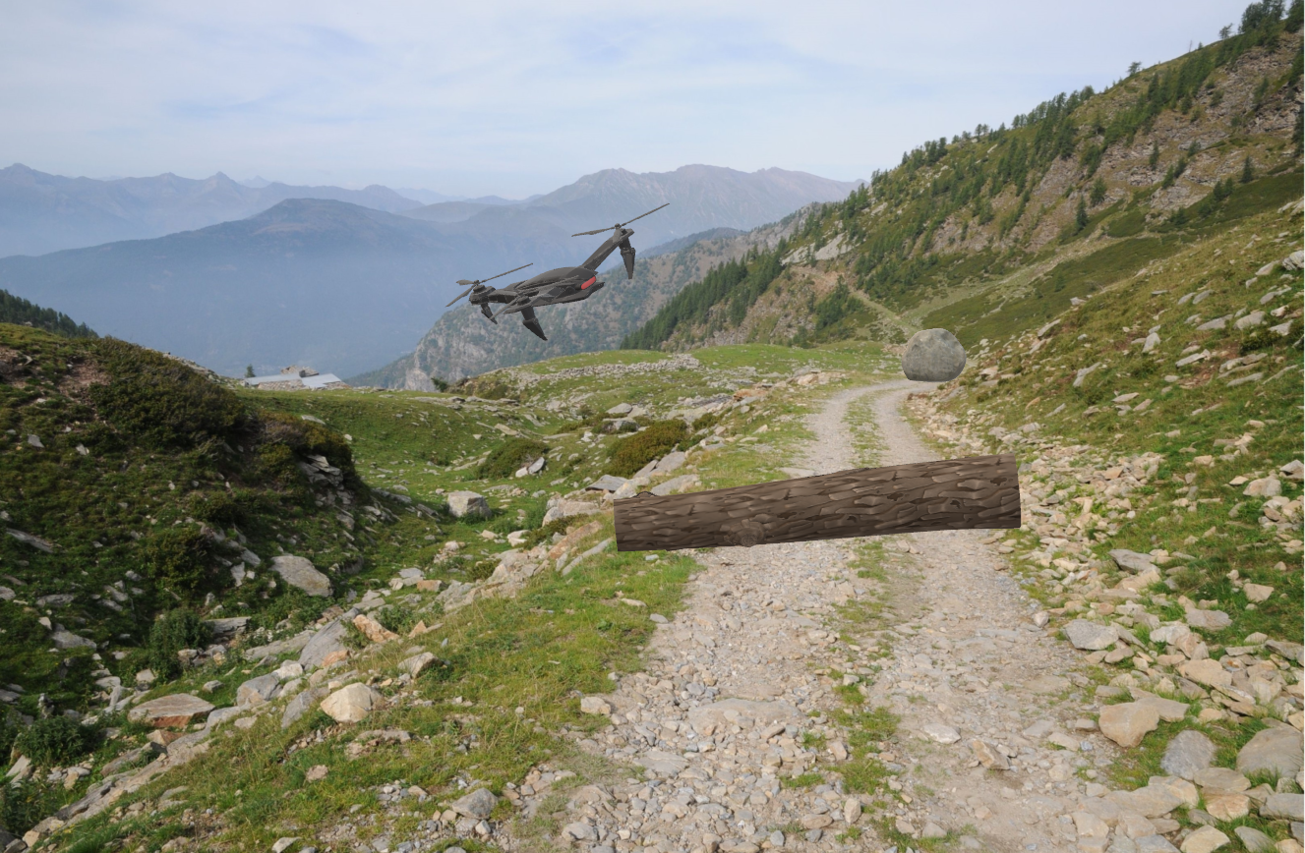

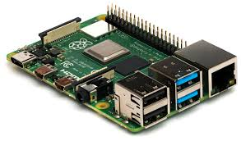
OUR POJECT

Slide 3
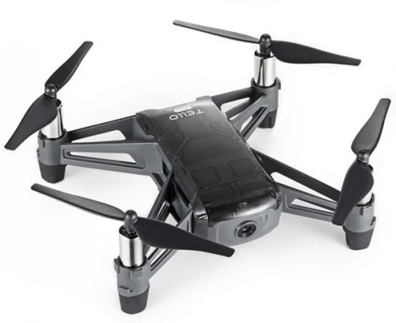
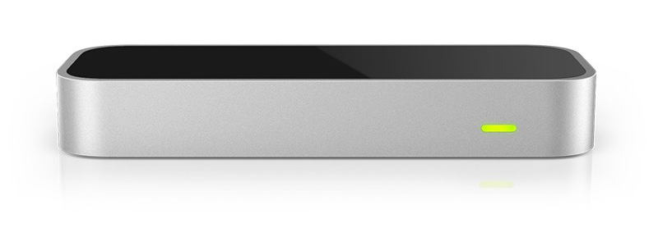
MATERIALS
Tello
Leap Motion

Slide 4
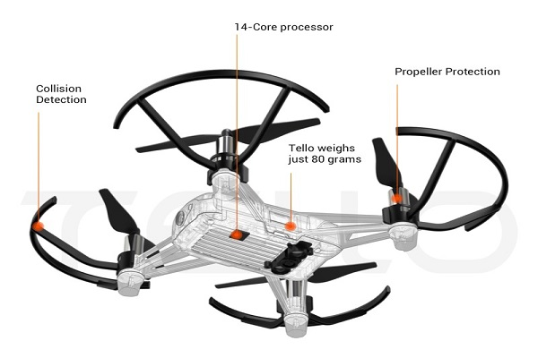


TELLO DRONE
No pilot on board
Taking photos or streaming footage
Light materials
Battery
Control

Slide 5
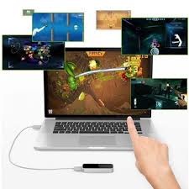
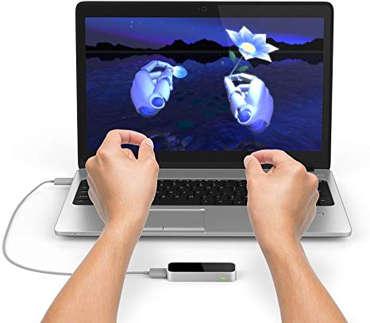
LEAP MOTION

Slide 6
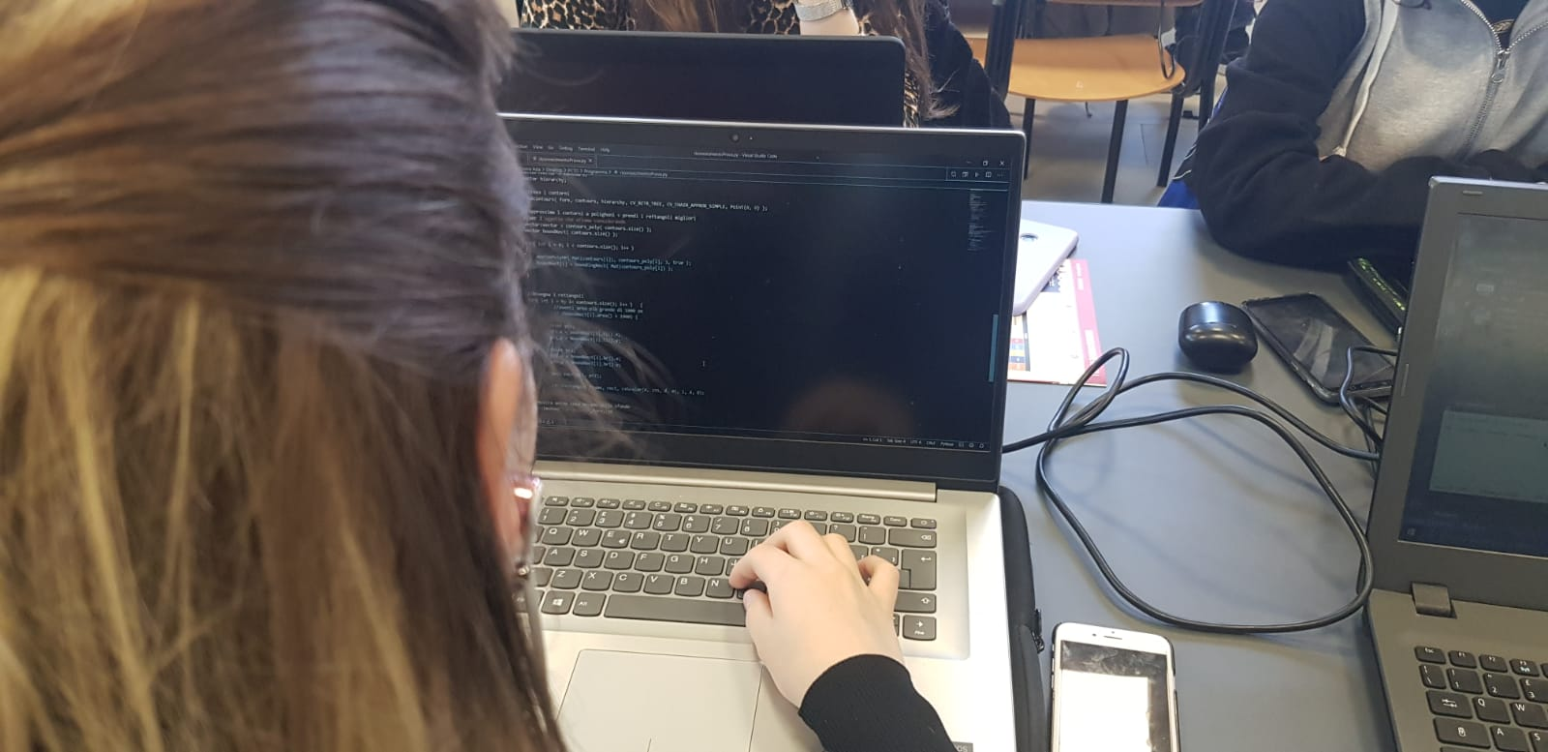
CODE + DIFFICULTIES ENCONTERED
Programming language:
- Python
Difficultes:
- Version
- Libreries

Slide 7

Team and Github page
Github Page - Eco-Fly
Alessia De Giovannini - AleDegio
Irene Gabutti - IreneGabutti
Matteo Giusti - GiustiMatteo
Asia Lovera - asialovera95

