Slide 1
AES_Project_2021_2022
Politecnico di Milano
Automation and Control Engineering
Group’s Members:
Borgnino Michele
Crespi Davide Marco
Firetto Alessandro
Riva Alessandro

Slide 2
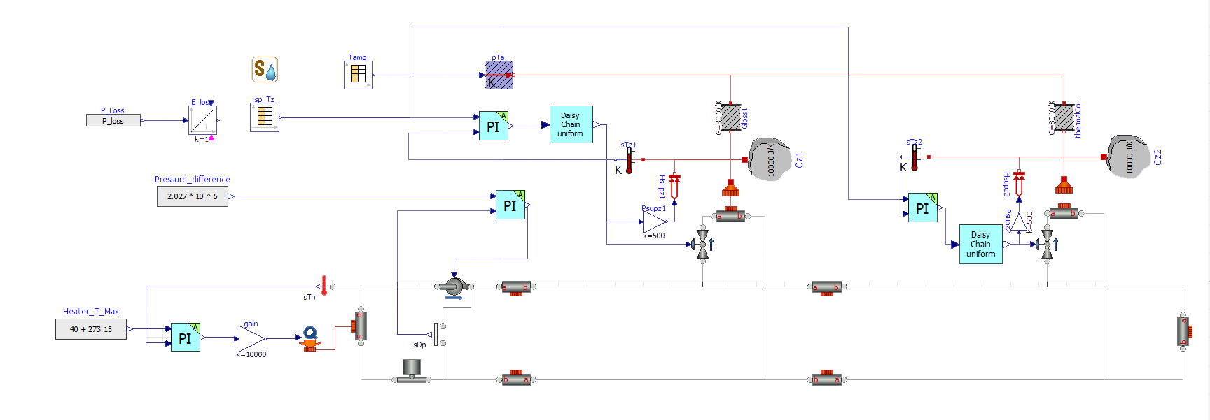
Controlled system

Slide 3
Heater model and tracking
Energy balance $cρV{\dot{T}}_{h}= K_{h}u+wc\left(T_{c}−T_{h}\right)$ → $T_{h}\left(s\right)= \frac{K_{h}/cw}{1+s\frac{ρV}{w}}∙u+\frac{T_{c}}{1+s\frac{ρV}{w}}$
V: total volume of water in the network, wn = 0.5kg/s nominal flow rate
Try impose a Settling time (not exact, since the model is approximated) Ta = 10min
Ti = 1,145*10^3
K = 8,287

Slide 4
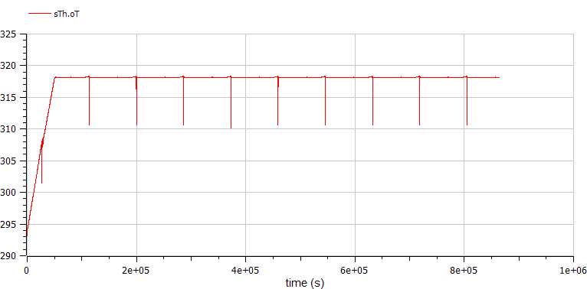
Heater Temperature
Spikes are caused by switch between night and day

Slide 5
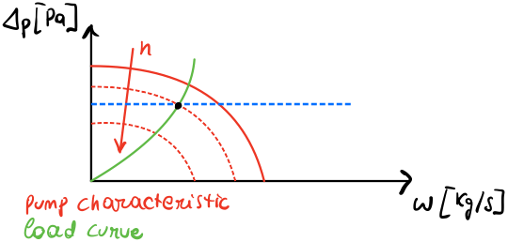
Pump model
Pump: $Δp=H_{0}\left(n\right)−H_{1}\left(n\right)w^{2}$ → $Δp=6∙{10}^{3}n−666,7nw^{2}$
Pipe Network : $Δp=K_{L}ρw^{2}$ →$Δp=4∙{10}^{7}$ $w^{2}$
Flow rate assumed equal in the whole network → Assumption
EQUILIBRIUM
Compute the equilibrium point for n, by imposing $Δp$ = $2,027 ∙{10}^{5 }Pa$ → $\overline{n}=0.338$
Linearization → $δp≅6{∙10}^{5}$ $δn$
«Albegraic model» → Hydraulics dynamics much faster than temperature, can be neglected
(in reality: G$\left(s\right)= \frac{µ}{1+sτ}$ with τ very small)

Slide 6
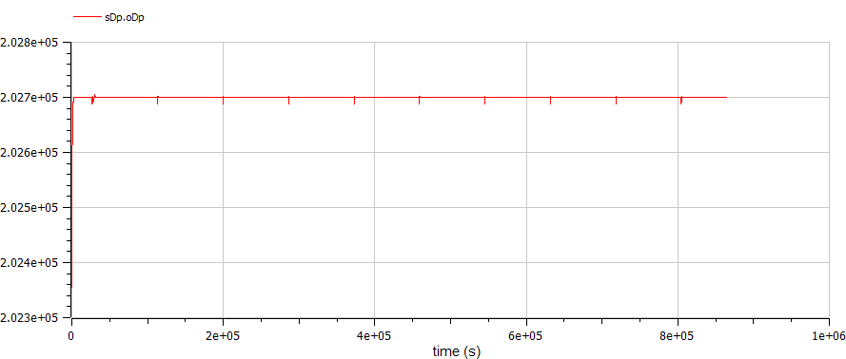
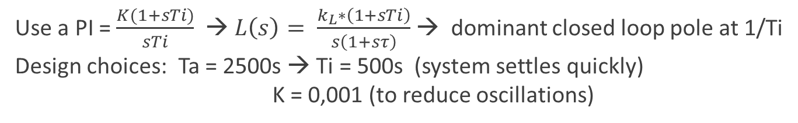
Pump Control
Use a PI = $\frac{K(1+sTi)}{sTi}$ → $L\left(s\right)= \frac{k_{L}∗\left(1+sTi\right)}{s\left(1+sτ\right)}$ → dominant closed loop pole at 1/Ti
Design choices: Ta = 2500s → Ti = 500s (system settles quickly) K = 0,001 (to reduce oscillations)

Slide 7
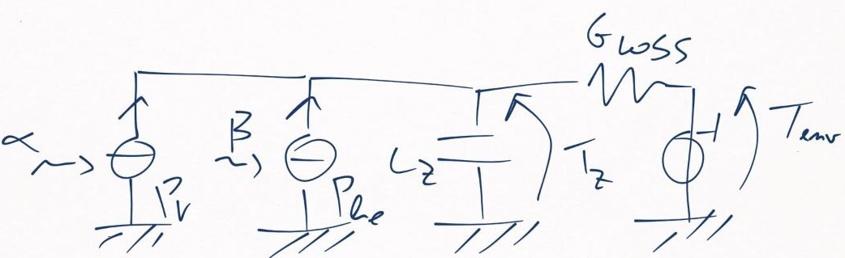
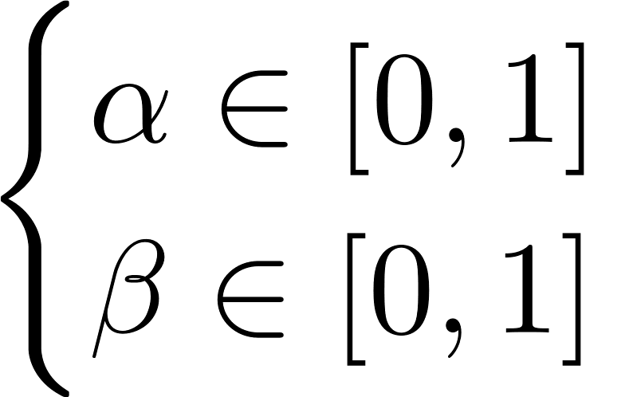
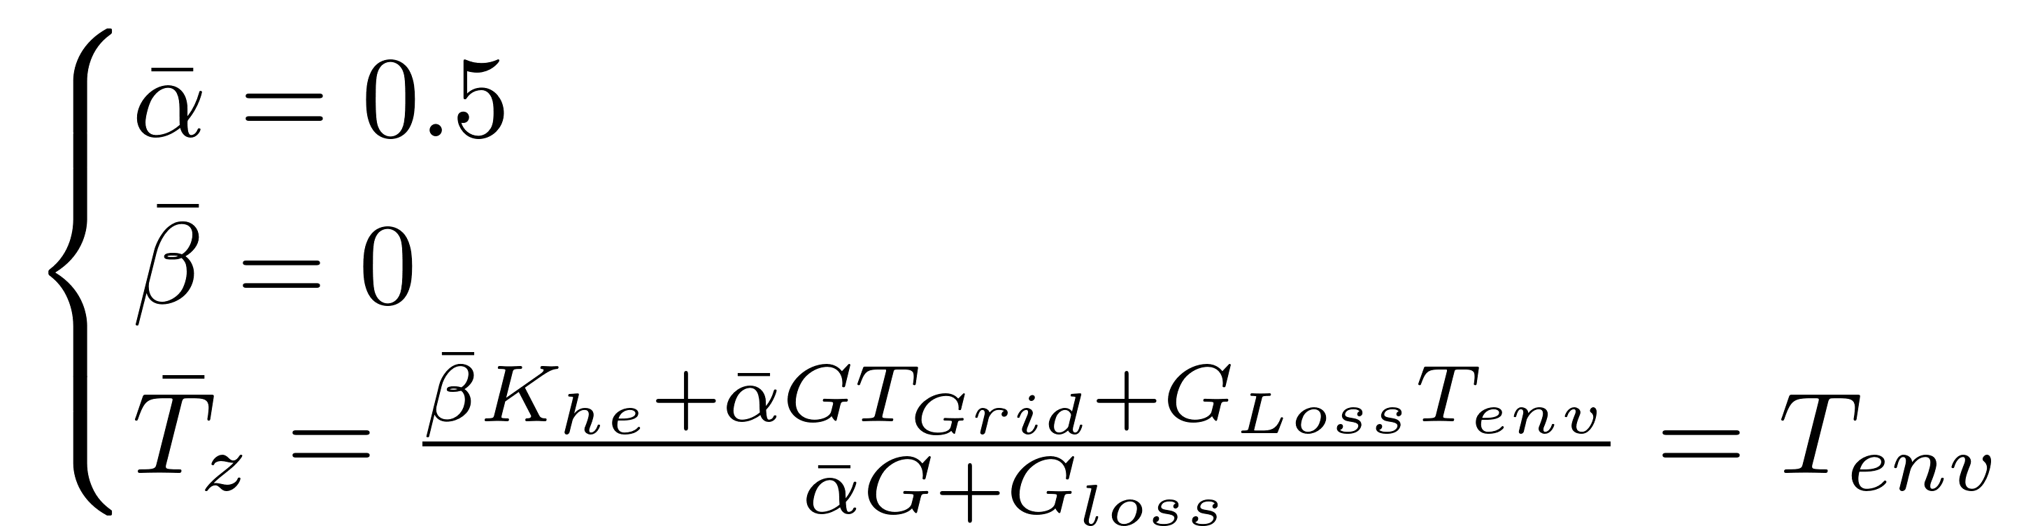
Zones model

Slide 8
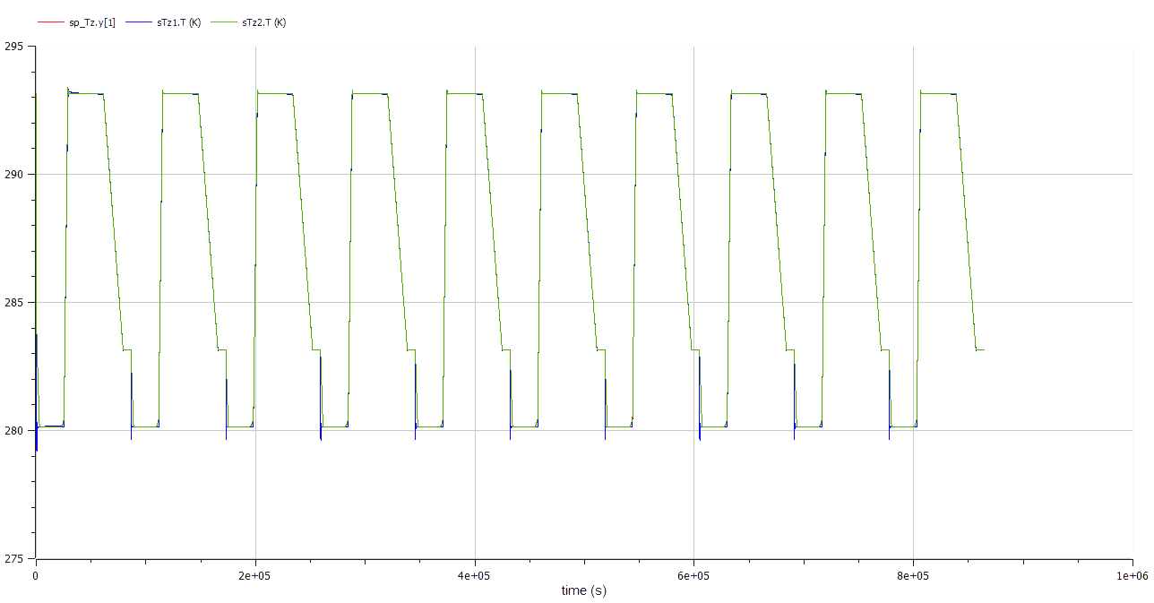

Zones set point tracking

Slide 9
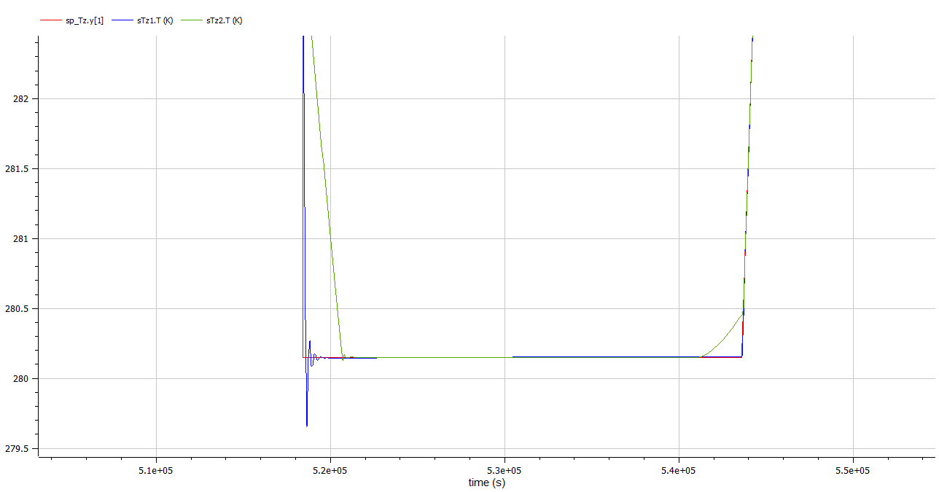


Slide 10
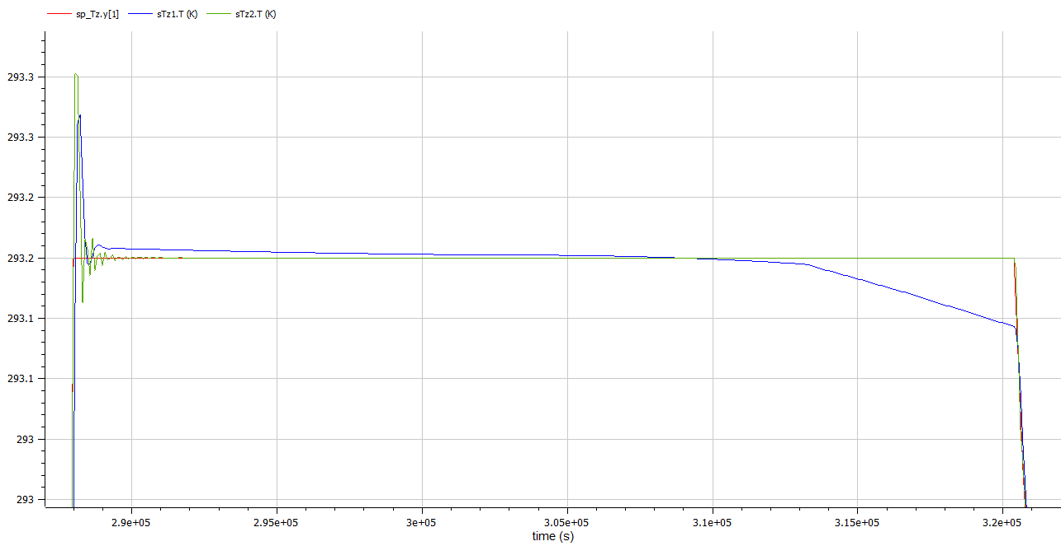





Slide 11
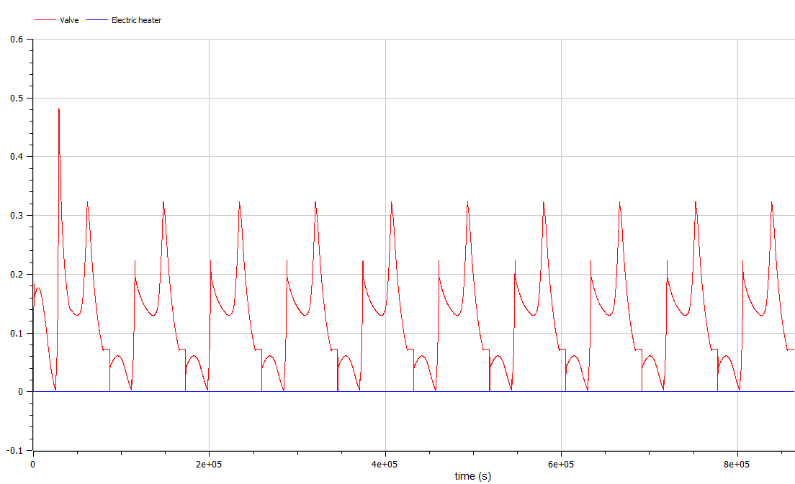
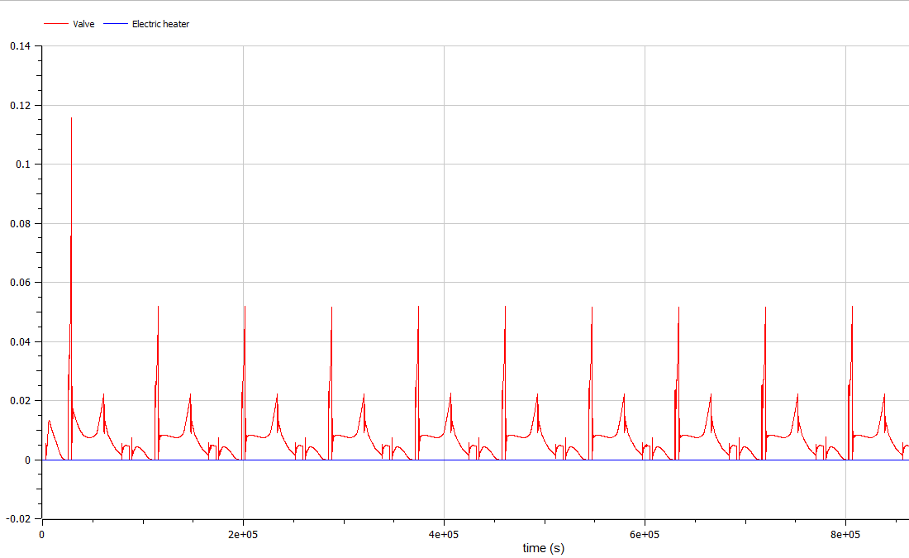
Control signals of each actuator

Slide 12
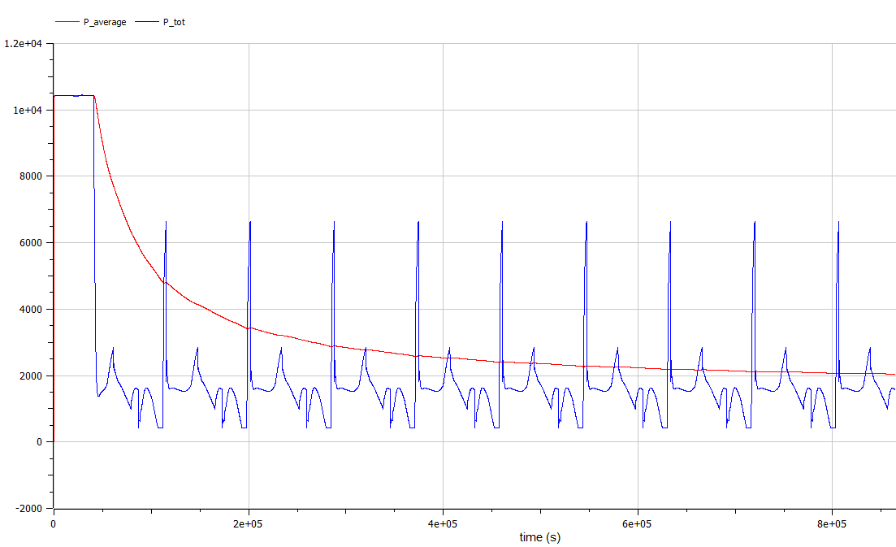
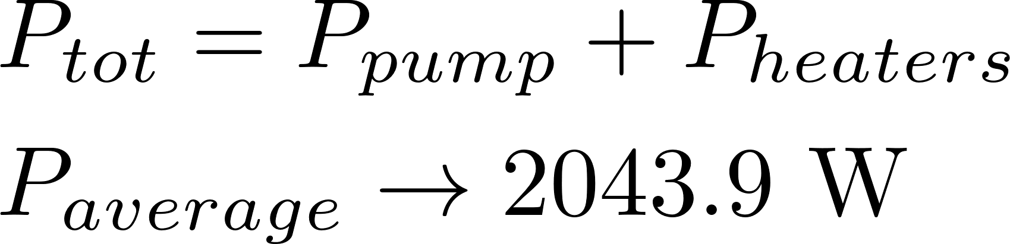
Power consumption

Slide 13
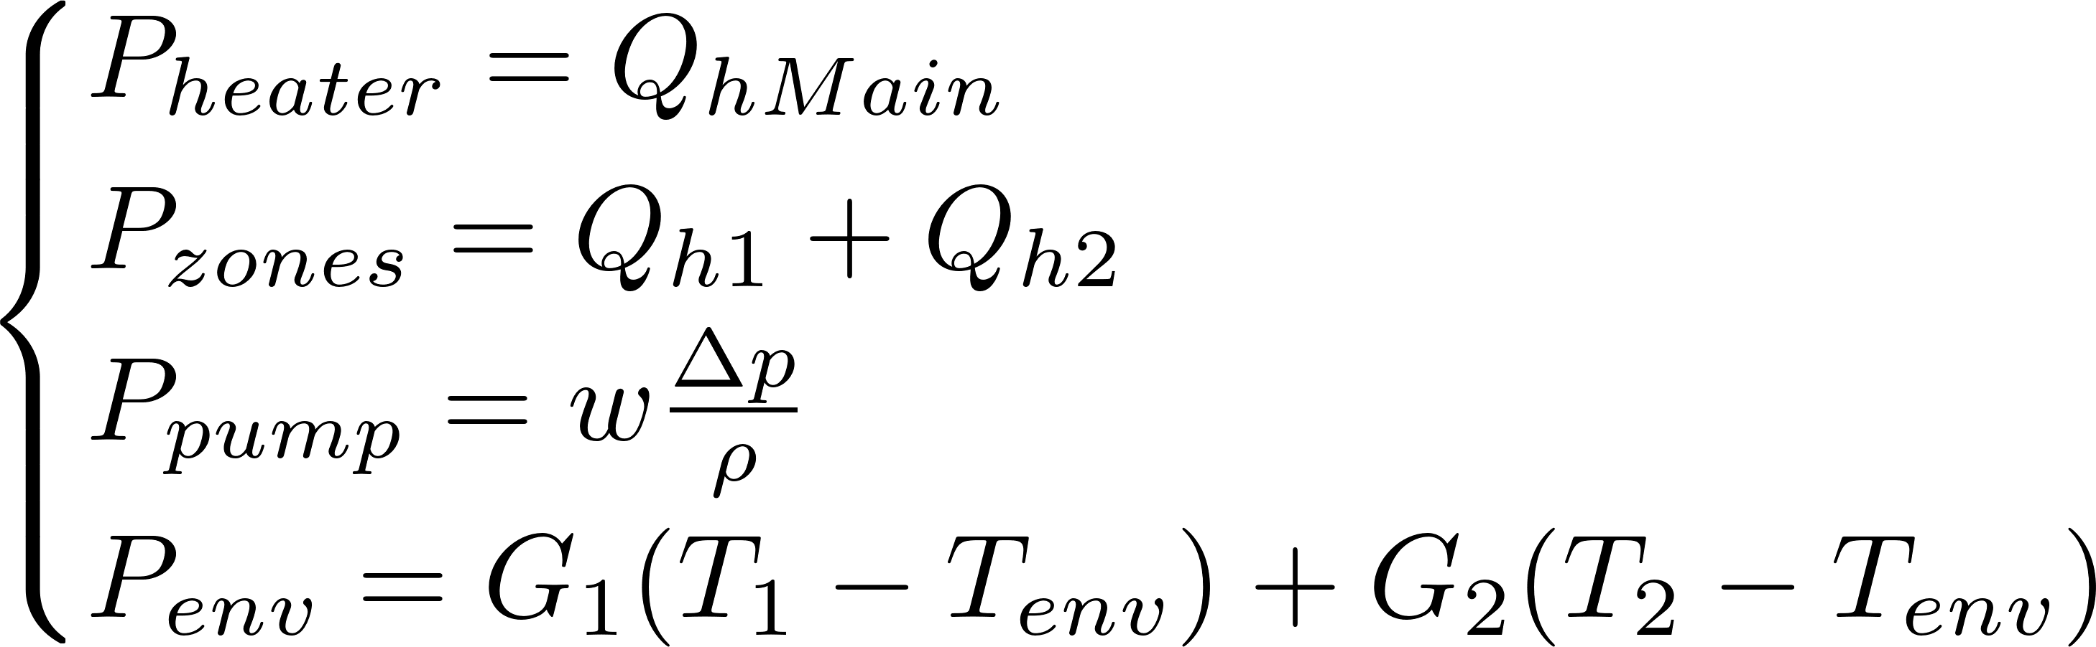
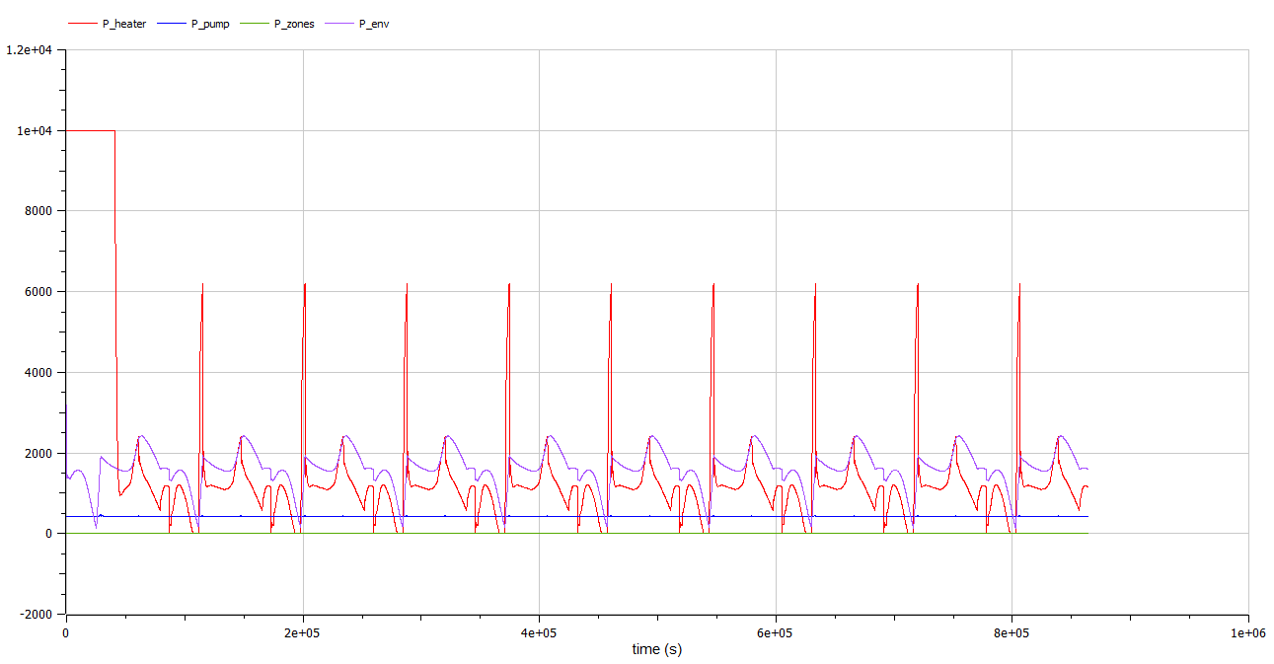
Individual power consumptions

Slide 14
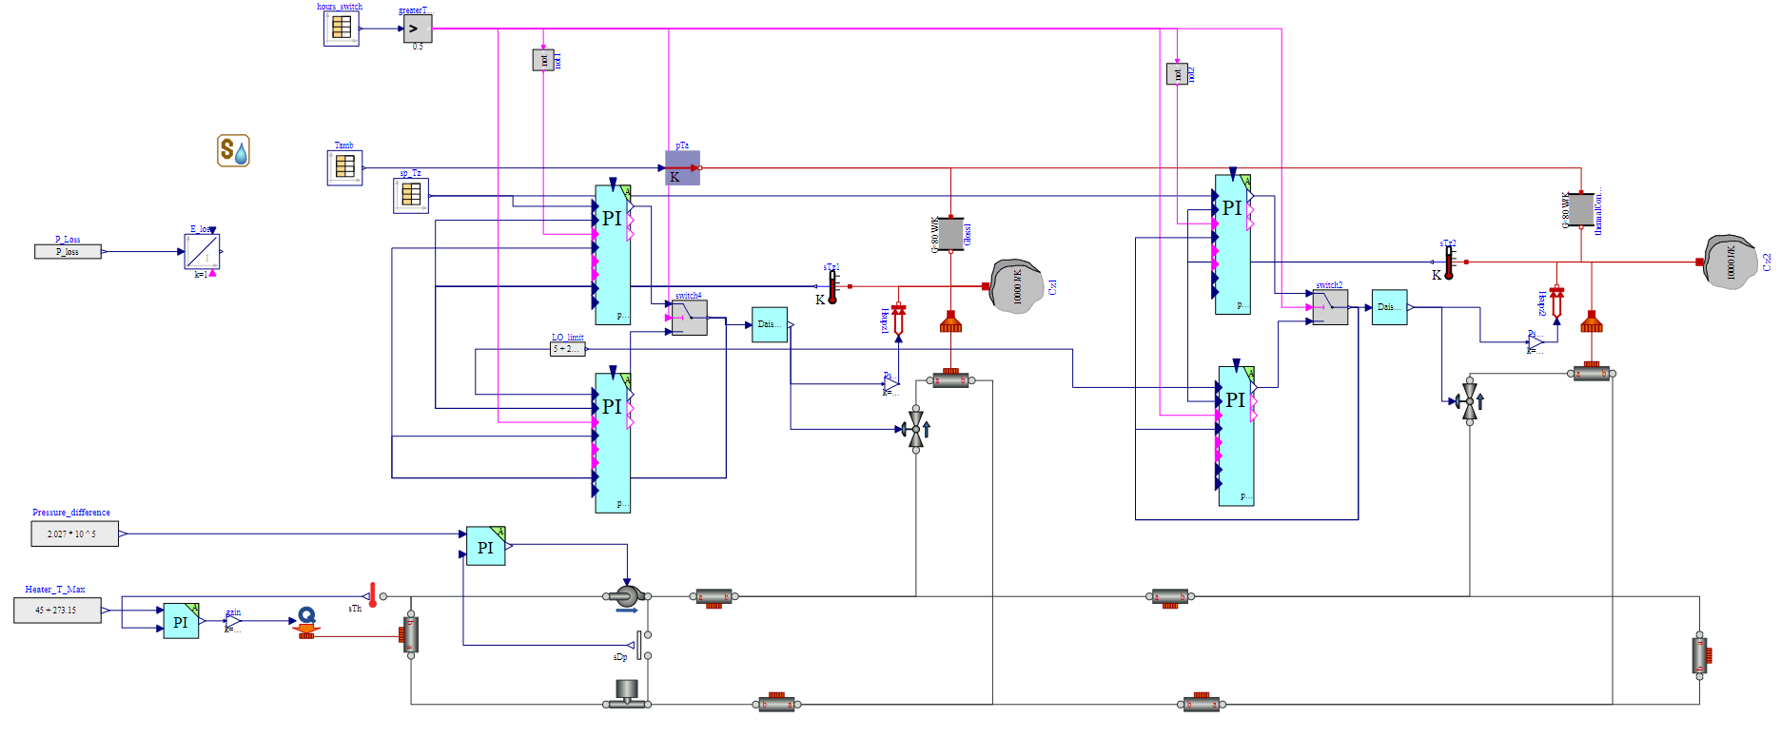
Model with the implementation of Day-Night Control

Slide 15
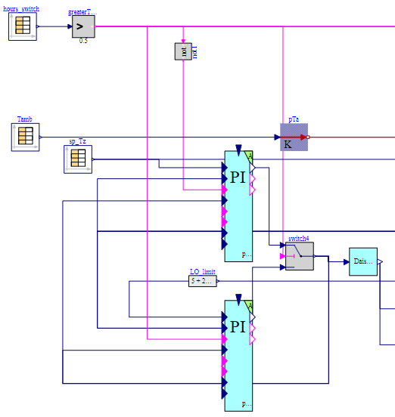
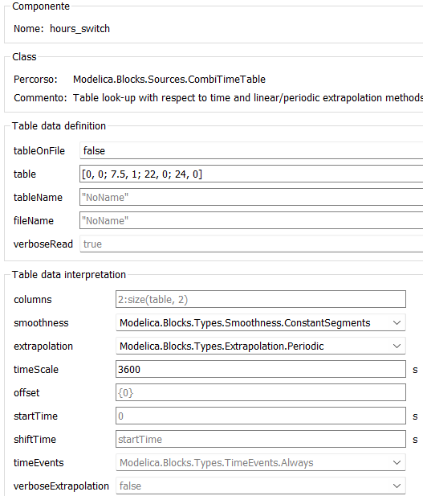
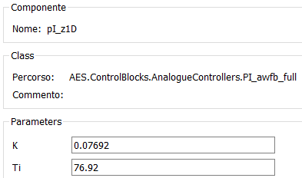
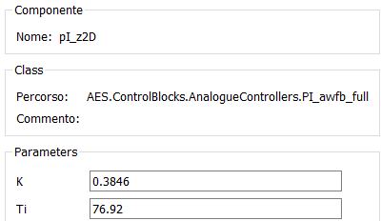
Components of the logic switching system:

Slide 16
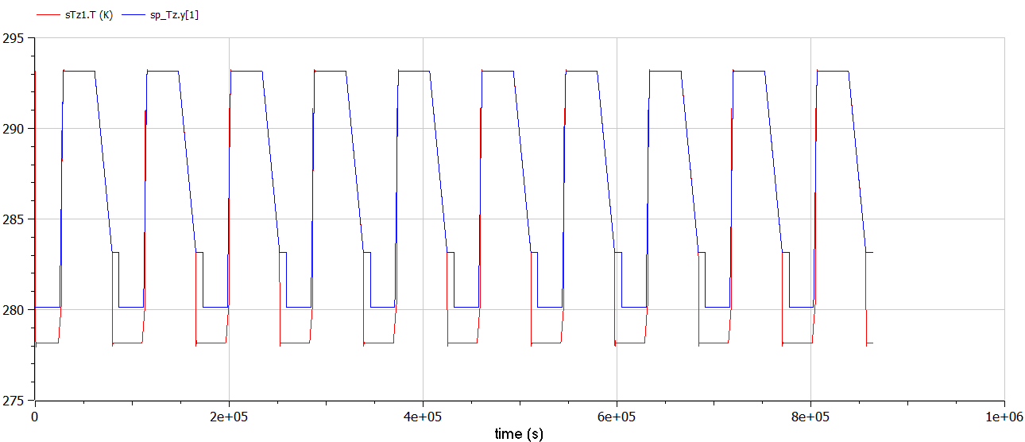
Temperature tracking of zone 1

Slide 17
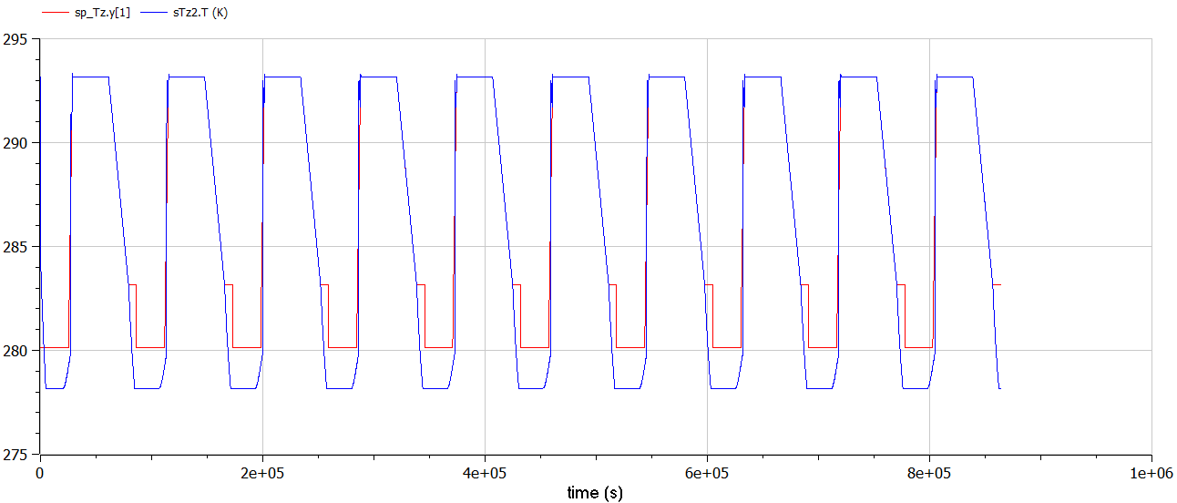
Temperature tracking of zone 2

Slide 18
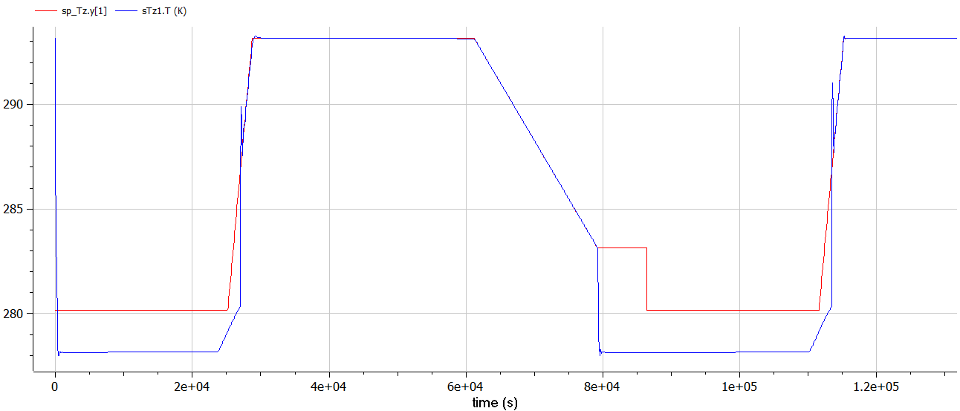
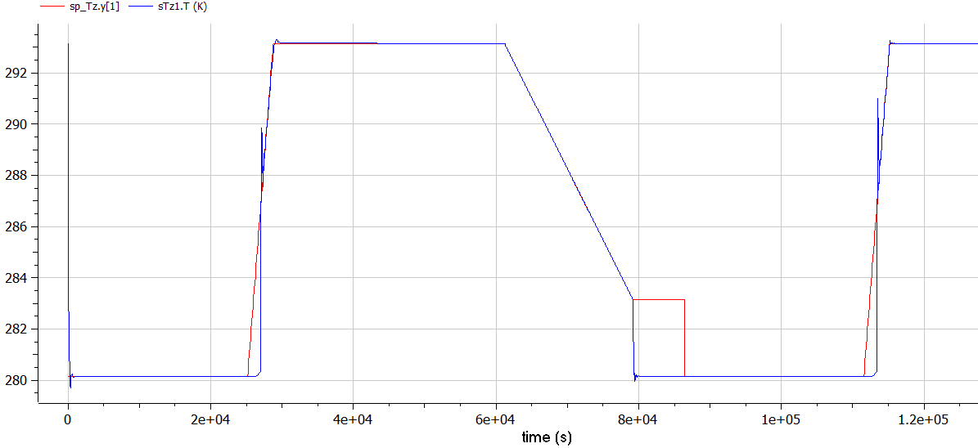
Zone 1 Temperature tracking with different low limits
Low limit= 5+273,15K
Low limit= 7+273,15K

