Slide 1
AES_Project_2021_2022
Politecnico di Milano
Automation and Control Engineering
Group’s Members:
Borgnino Michele
Crespi Davide Marco
Riva Alessandro
Firetto Alessandro

Slide 2
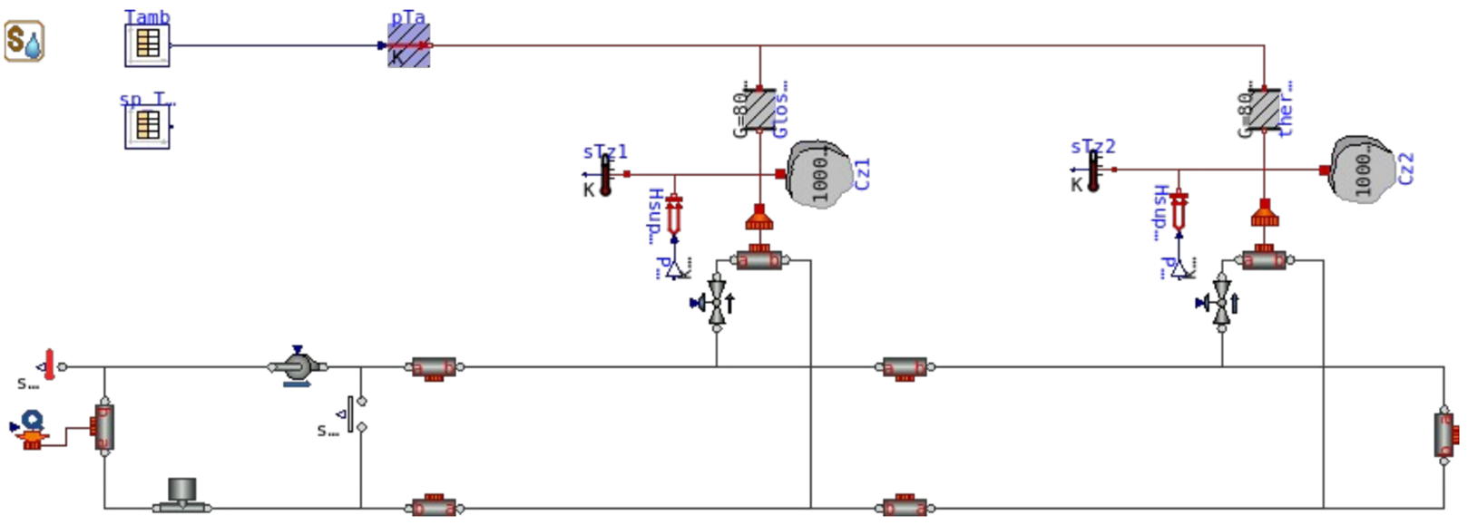

Slide 3
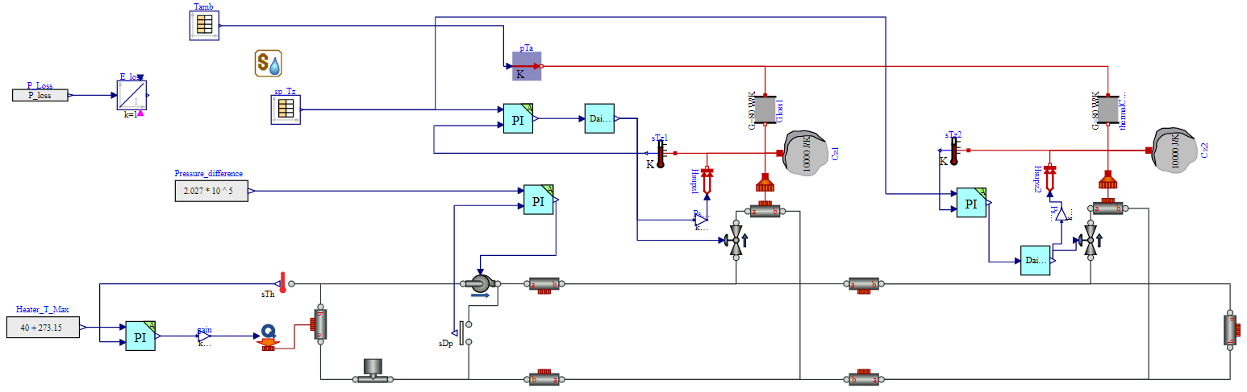

Slide 9
