Slide 1
AES_Project_2021_2022
Politecnico di Milano
Automation and Control Engineering
Group’s Members:
Borgnino Michele
Crespi Davide Marco
Firetto Alessandro
Riva Alessandro

Slide 2
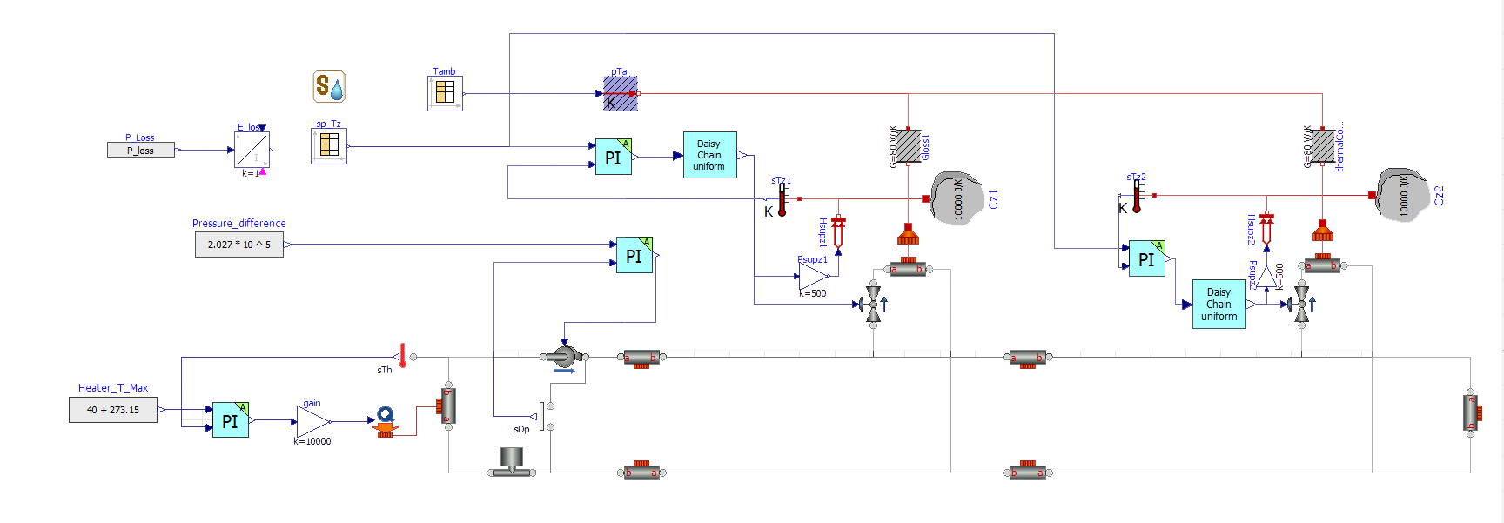
Controlled system

Slide 3

Heater model and tracking
Energy balance $cρV{\dot{T}}_{h}= K_{h}u+wc\left(T_{c}−T_{h}\right)$ → $T_{h}\left(s\right)= \frac{K_{h}/cw}{1+s\frac{ρV}{w}}∙u+\frac{T_{c}}{1+s\frac{ρV}{w}}$
V: total volume of water in the network, $w_{n}= 0.5\frac{kg}{s}$ nominal flow rate
Select experimentally a wc → $wc =0,008 rad/s$ (good tradeoff)
$Ti=4,7517∙{10}^{3}$
$K=\text{8,287}$

Slide 4
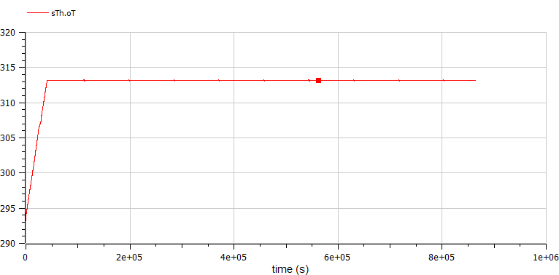
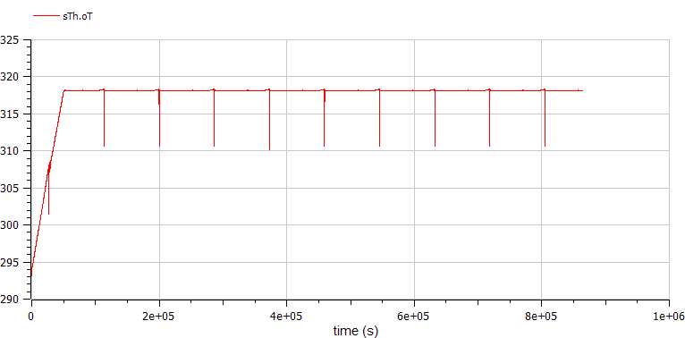
Heater Temperature

Slide 5
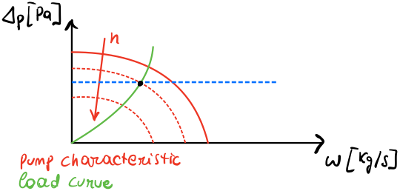
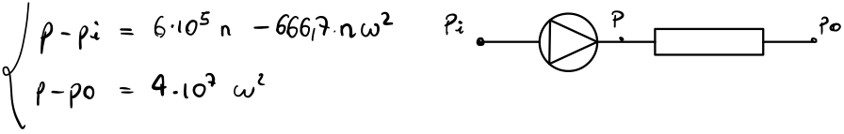
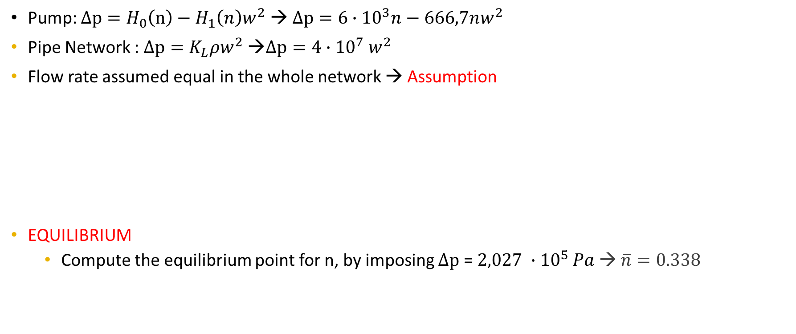
Pump model
Pump: $Δp=H_{0}\left(n\right)−H_{1}\left(n\right)w^{2}$ → $Δp=6∙{10}^{3}n−666,7nw^{2}$
Pipe Network : $Δp=K_{L}ρw^{2}$ →$Δp=4∙{10}^{7}$ $w^{2}$
Flow rate assumed equal in the whole network → Assumption
EQUILIBRIUM
Compute the equilibrium point for n, by imposing $Δp$ = $2,027 ∙{10}^{5 }Pa$ → $\overline{n}=0.338$

Slide 6
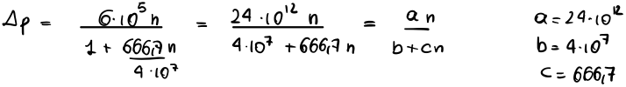
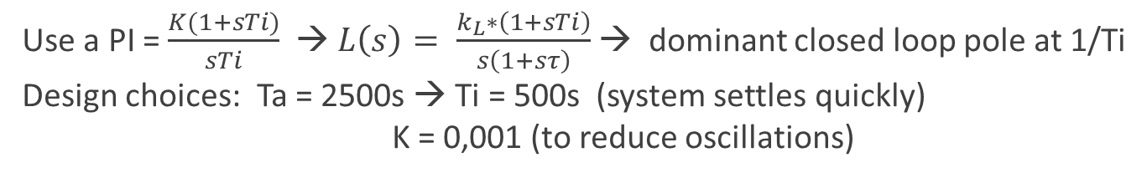
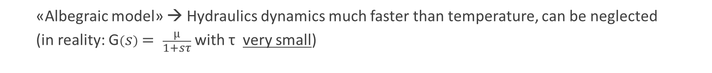
Pump Model
Linearization
«Albegraic model» → Hydraulics dynamics much faster than temperature, can be neglected
(in reality: G$\left(s\right)= \frac{µ}{1+sτ}$ with τ very small)
Use a PI = $\frac{K(1+sTi)}{sTi}$ → $L\left(s\right)= \frac{k_{L}∗\left(1+sTi\right)}{s\left(1+sτ\right)}$ → dominant closed loop pole at 1/Ti
Design choices: Ta = 2500s → Ti = 500s (system settles quickly) K = 0,001 (to reduce oscillations)

Slide 7
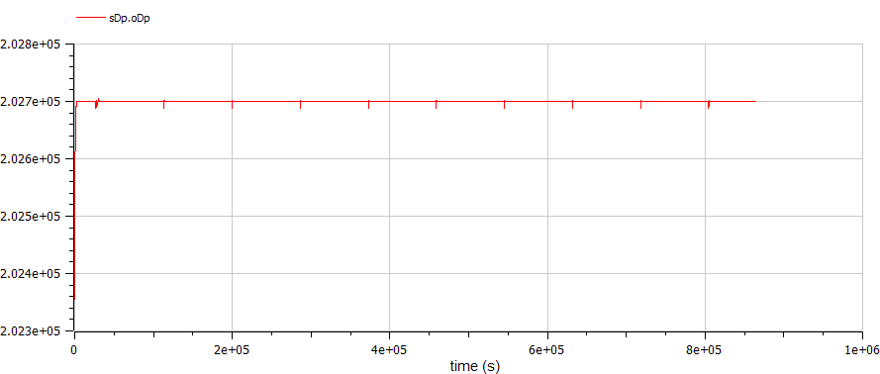
Pump Control

Slide 8
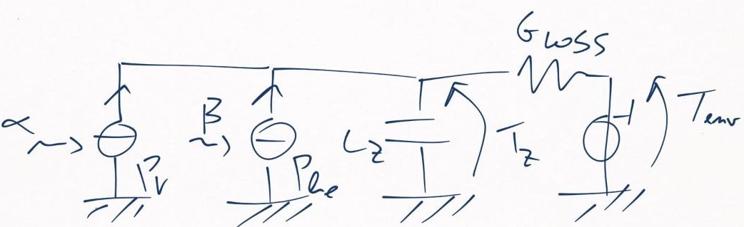
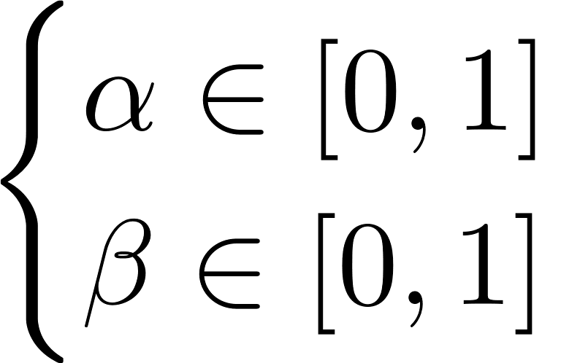
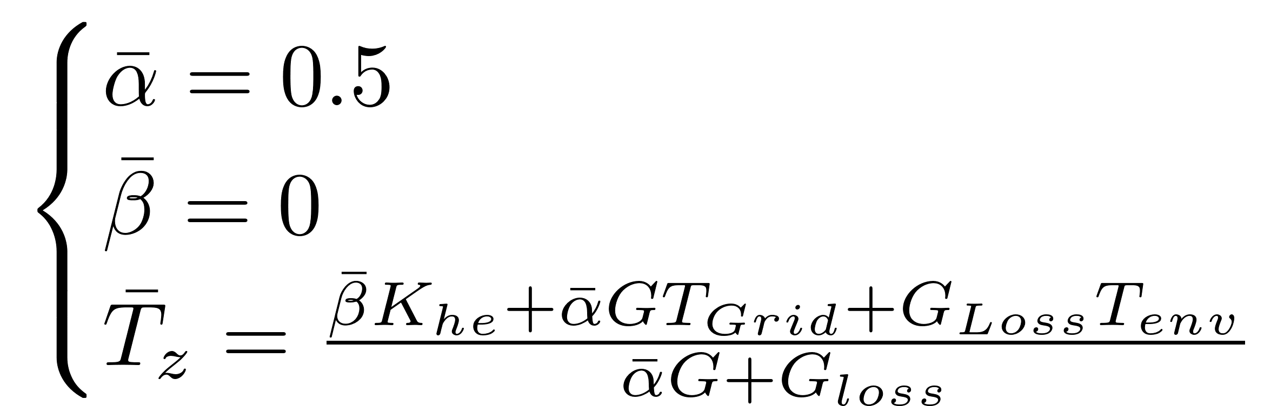
Zones model

Slide 9
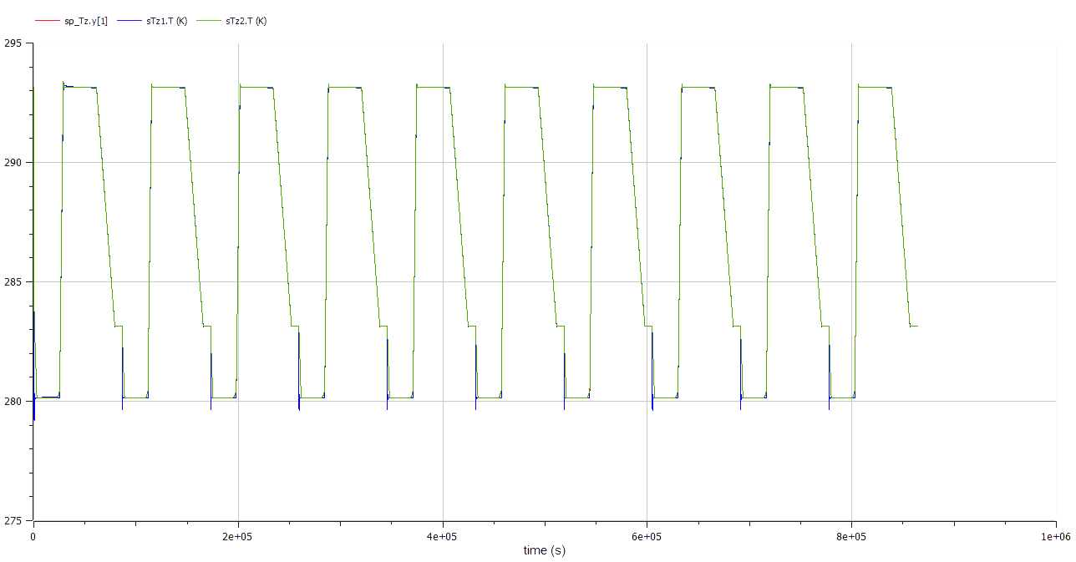

Zones set point tracking

Slide 10
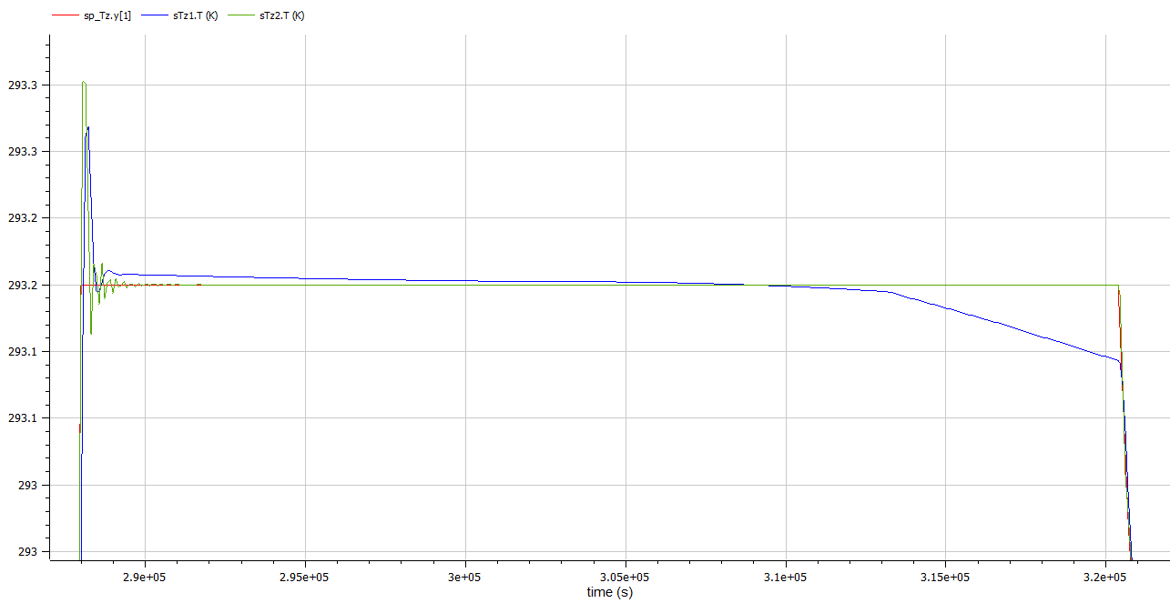





Slide 11
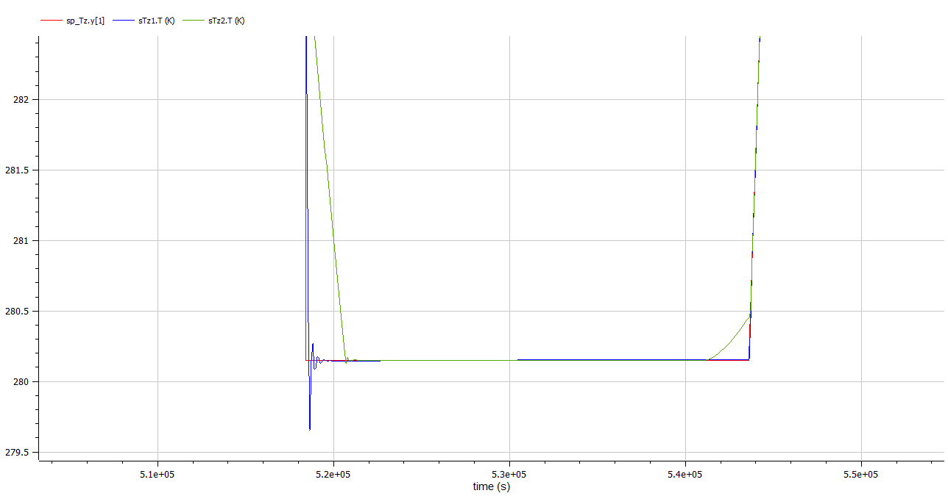


Slide 12
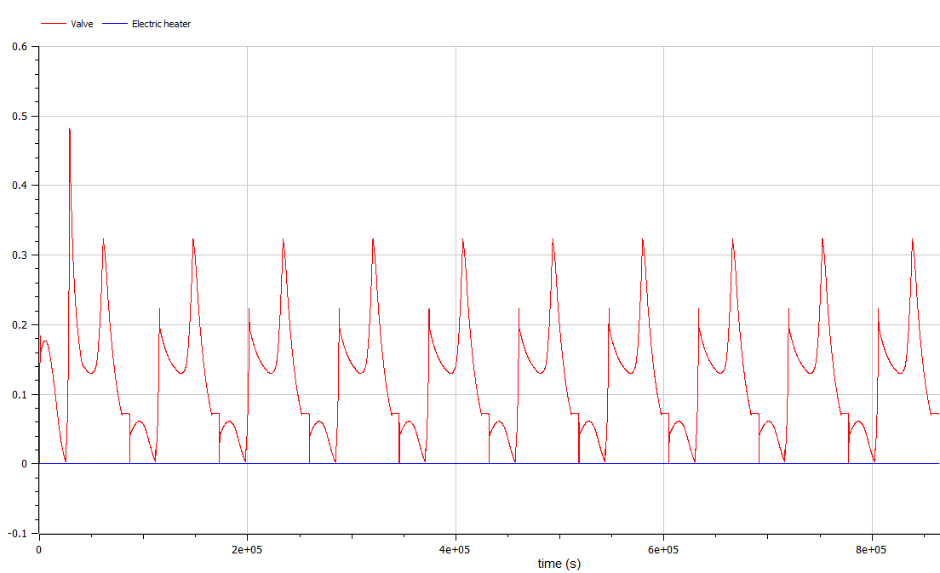
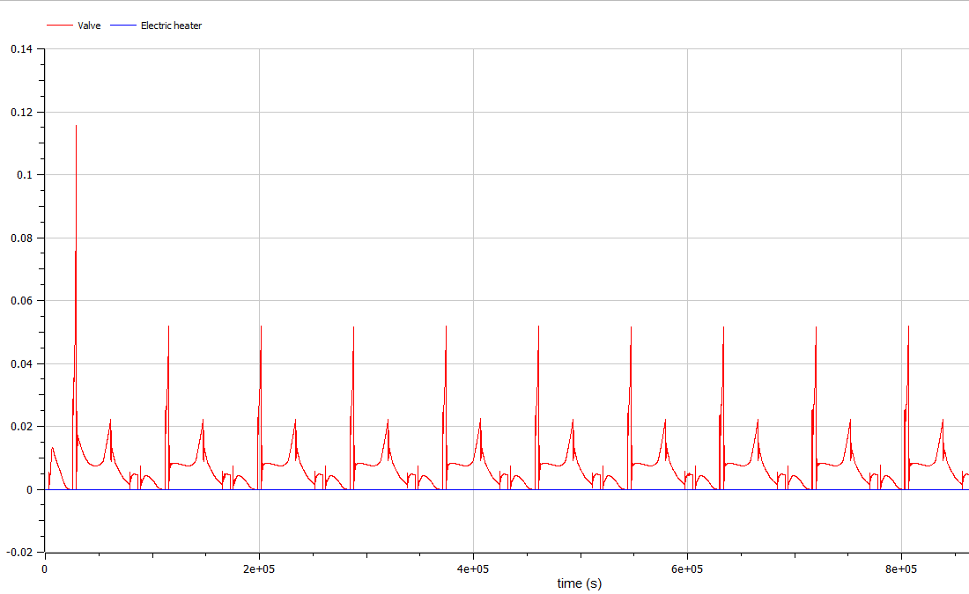
Control signals of each actuator

Slide 13
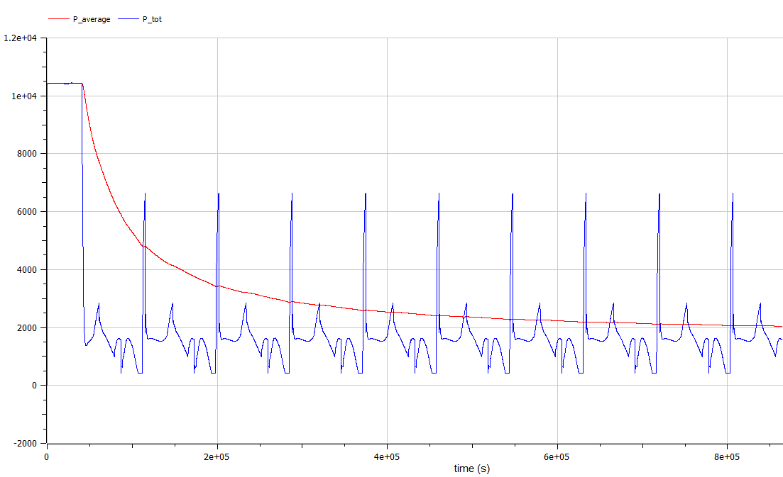
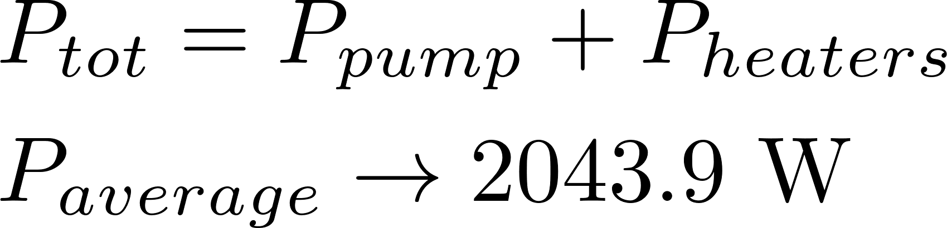
Power consumption

Slide 14
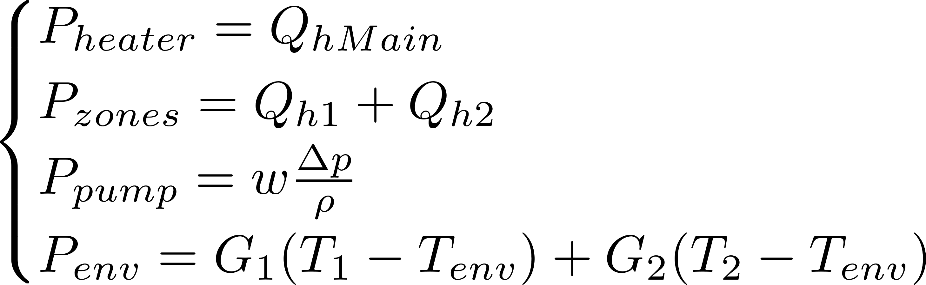
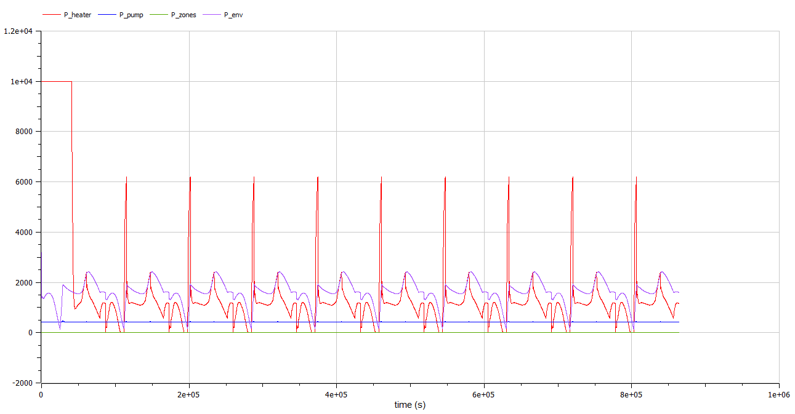
Individual power consumptions

Slide 15
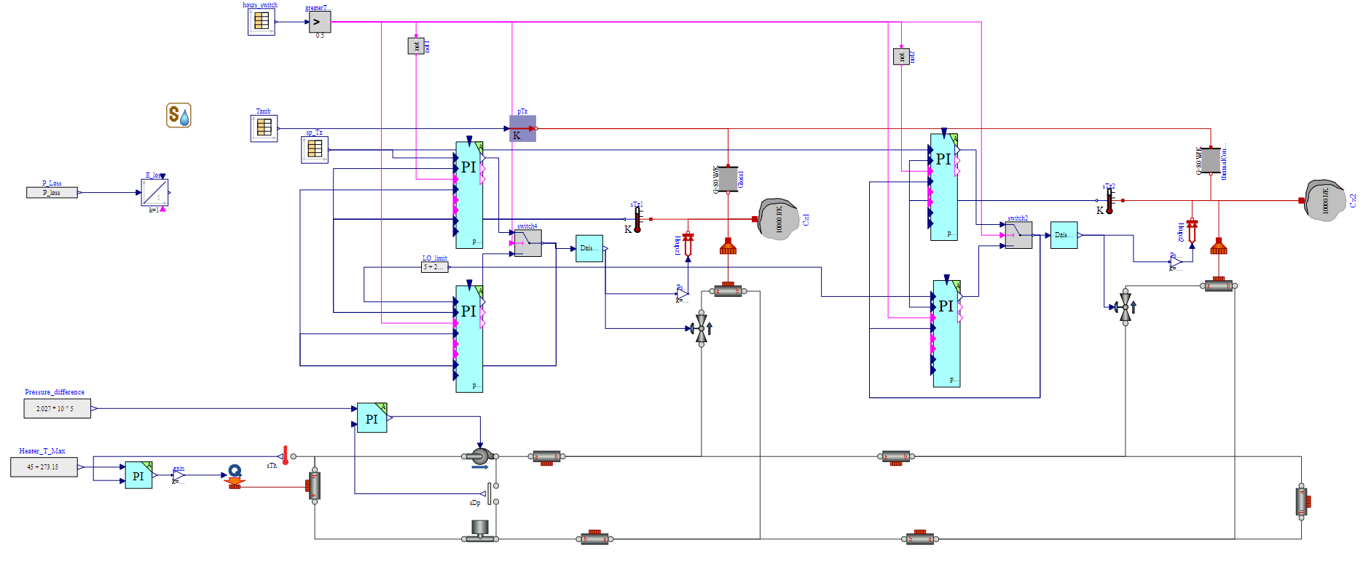
Model with the implementation of Day-Night Control

Slide 16
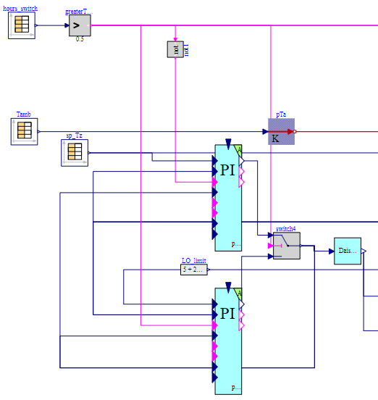
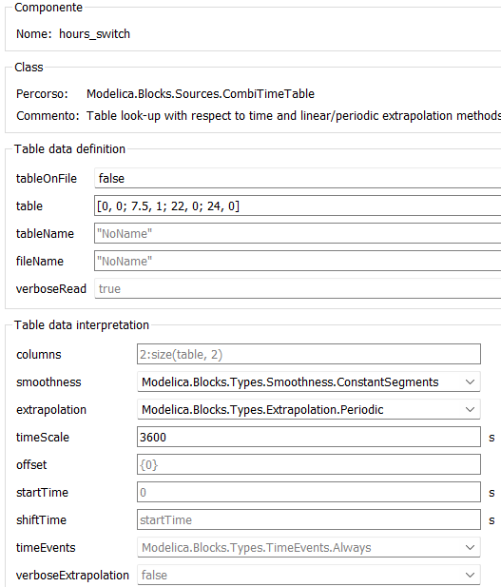
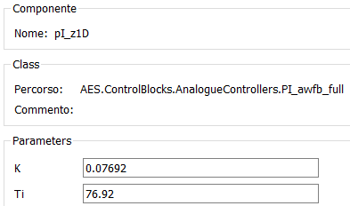
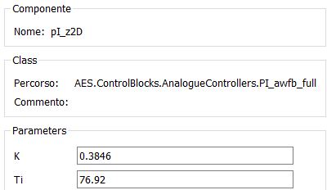
Components of the logic switching system:

Slide 17
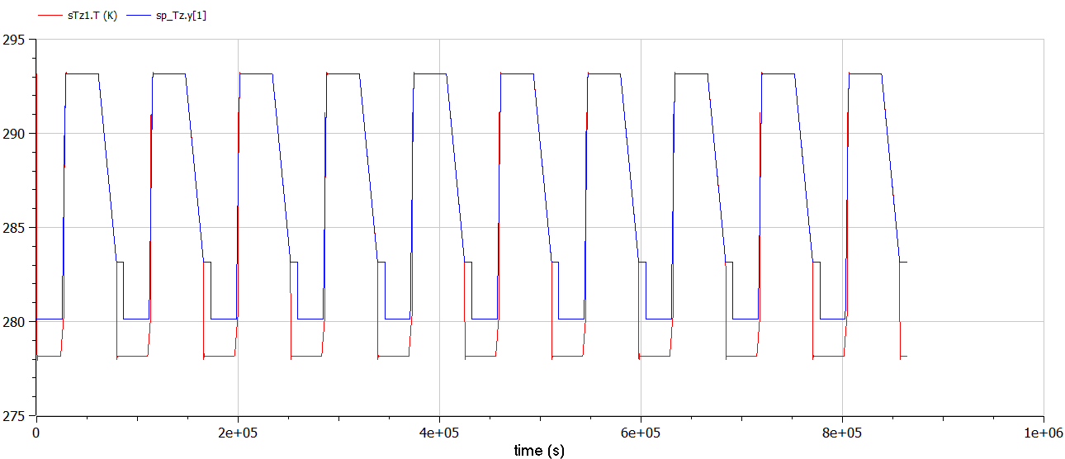
Temperature tracking of zone 1

Slide 18
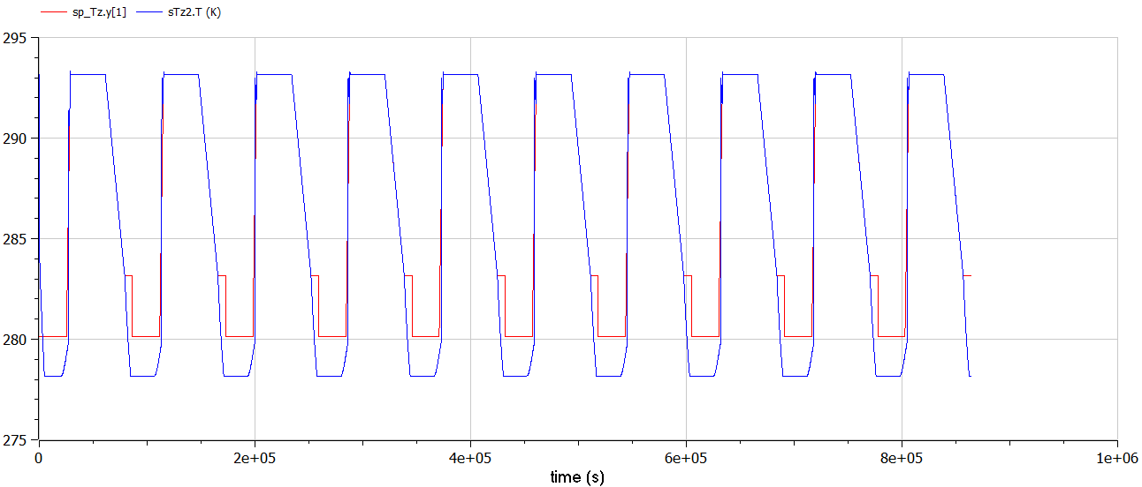
Temperature tracking of zone 2

Slide 19
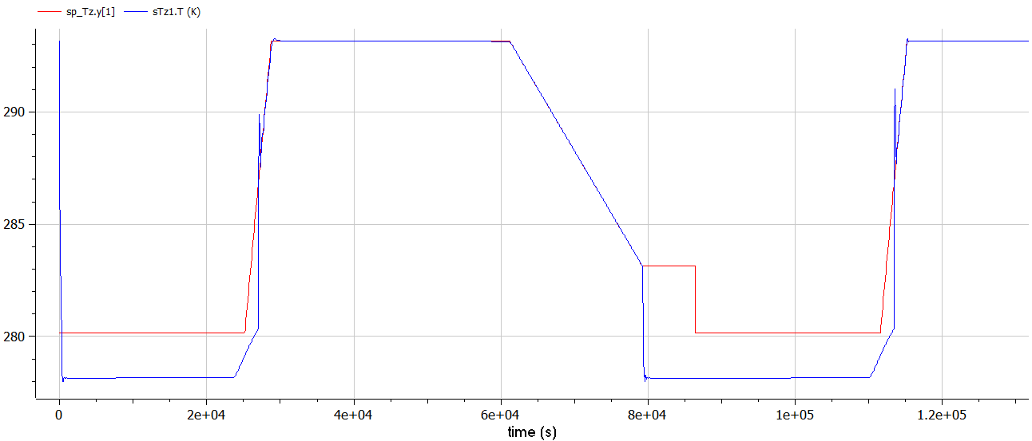
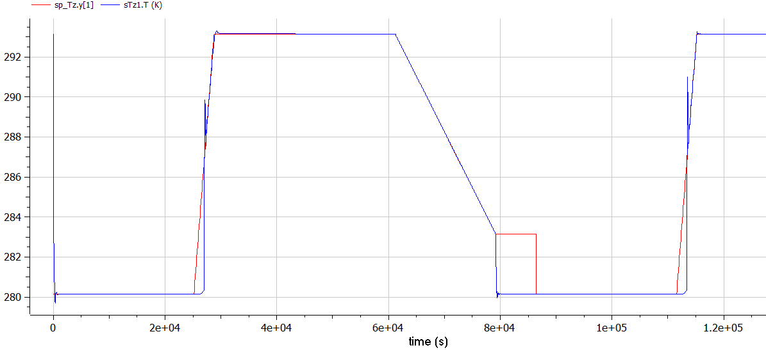
Zone 1 Temperature tracking with different low limits
Low limit= 5+273,15K
Low limit= 7+273,15K

Slide 20
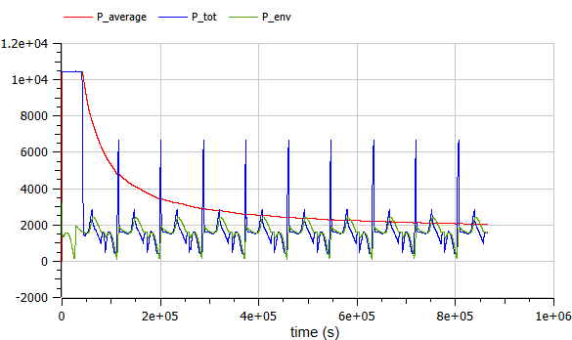
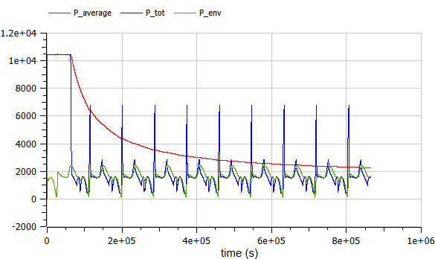



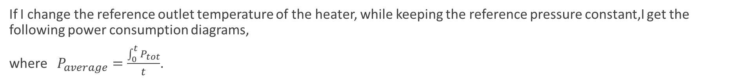
Power consumption with different outlet temperatures in day mode
If I change the reference outlet temperature of the heater, while keeping the reference pressure constant,I get the following power consumption diagrams,
where $P_{average}=\frac{\int_{0}^{t}{P_{tot}}}{t}$.

Slide 21
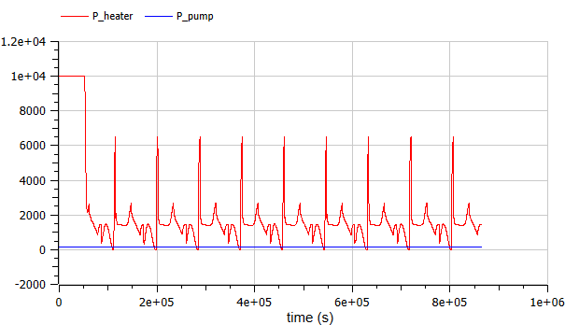
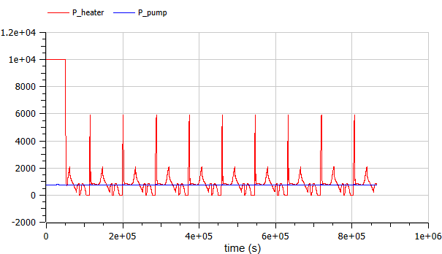


Power consumption with different outlet pressure in day mode
The higher the reference pressure, the more the pump will be used. As the overall consumption remains the same, I can decrease or increase the pressure reference based on the efficiency of the heater and the pump. In this case I change the pressure keeping the temperature at 45$℃$.

Slide 22
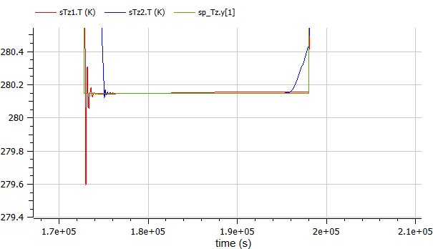
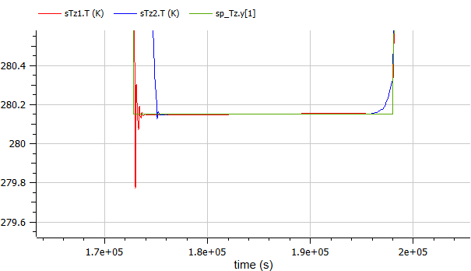
Comparison of different reference values in day mode
Modifying the pressure and outlet temperature references I don’t change the room temperature dynamics. I only have a small reduction of the amplitude of oscillations in the case I operate at higher pressure. It is not advisable therefore to operate at higher fluid temperatures because I don’t have consistent advantages.

Slide 23
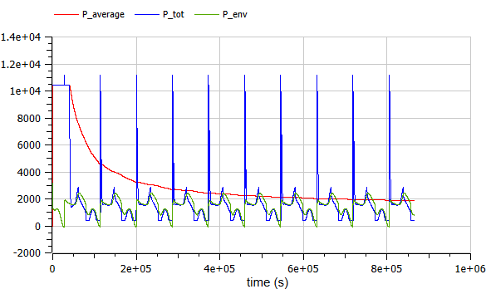
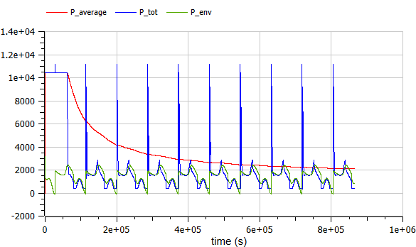
Power consumption with different outlet temperatures in day/night mode
The same behavior can also be observed in the day/night mode. The only difference with the previous case is that the same increment of the fluid temperature produces now a higher average power increase: 12% compared to a 10.7% increase in the day mode.

Slide 24
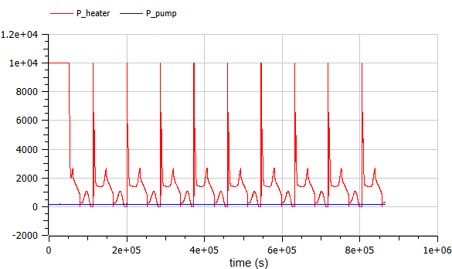
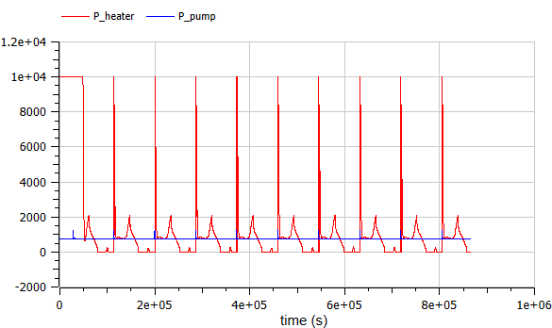
Power consumption with different outlet pressure in day/night mode
As in the other case, higher pressure references mean more utilization of the pump instead of the heater. As during the night one of our objectives is to minimize the heater usage, we are more inclined to consider the second option.

