Slide 1

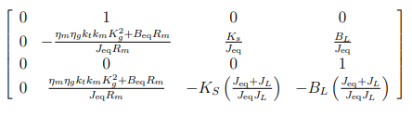
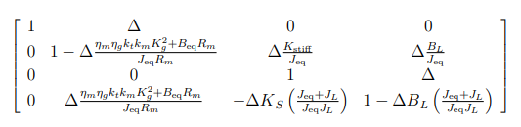
1- dynamic eq
Continuos
Discrete

Slide 2
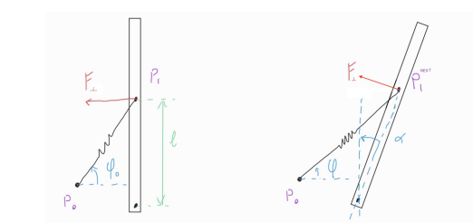
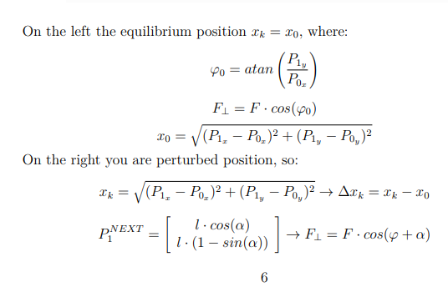
2- linearization
Non lin Bounderies

Slide 3
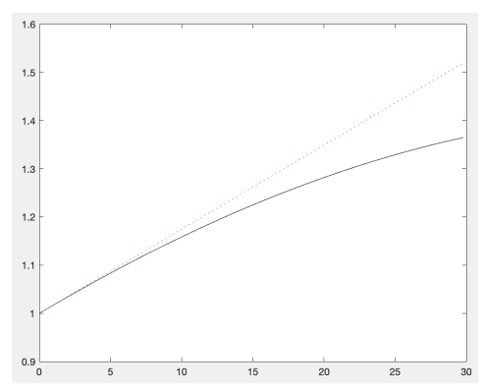
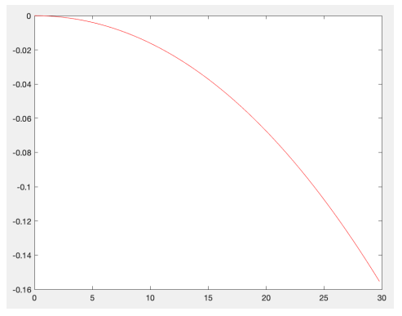
2- linearization

Slide 4
3-optimization

Slide 5
4-comparison between nonlinear behaviour and linear one

Slide 6
5-time and freq validations
PART 1
dynamic eq
Cont and dis time
linearization
Actual nonlinear part vs linear part. Graph of percentage error.
optimization
Jesus calculation of stiffness????
Wn and damping
Numerical values of ss/tf
comparison between nonlinear behaviour and linear one
Plot of nonlinear and linear model. Who has matching the validation data better
time and freq validations
Time and frequency l1 norm comparison (one with text output)
Bode comparison with sine dataset(fire collects dataset)
Hf and low freq model merge (trick)

