Slide 1






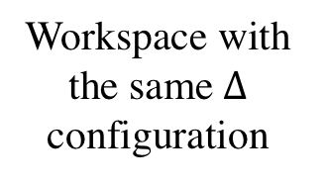
Workspace with the same$∆$ configuration
l₁
$$ψ$$
c
s
$$γ$$
$$d_{⊥}$$
g
l₂
l₄
l₃
$$ψ$$
c
$$γ$$
$$d_{⊥}$$
Workspace with annotations

