Slide 1
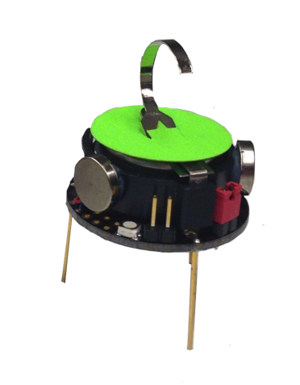
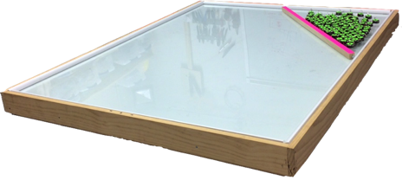
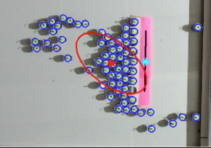
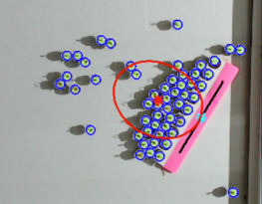
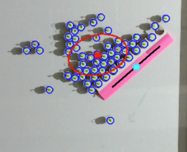
Vision System
30W LED Lights
50W LED Lights
corner lights are further away and thus require more watts
NE
E
N
1.5 m
SE
NW
S
W
SW
1.2 m
1.5 m
Large aspect ratio rectangle
Robots
Workspace
3 cm
𝜃 = 22.5°
𝜃 = 45°
𝜃 = 0°
α ~ 43°
α ~ 42°
α ‍~ 62°

