Slide 1
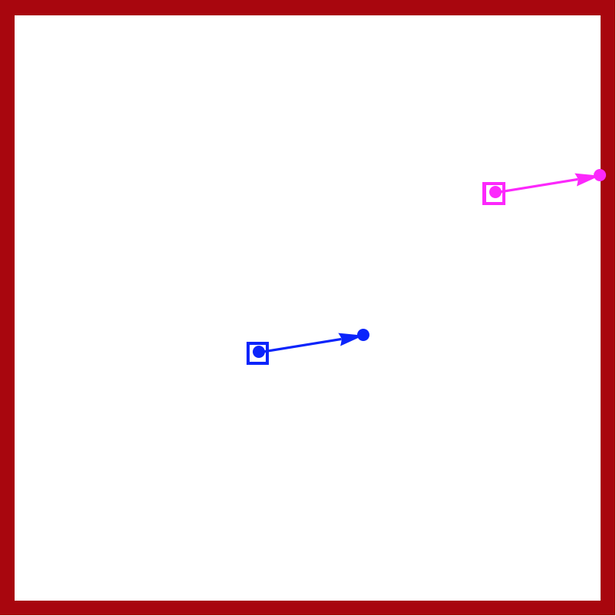
s2
s1
Reachable set for s1
s1.y
s1.y

