Slide 1
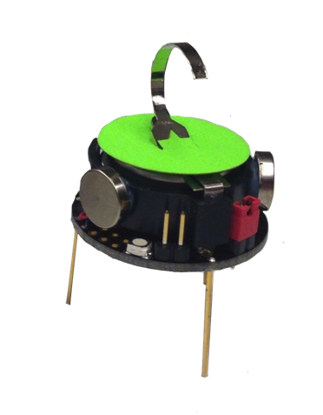
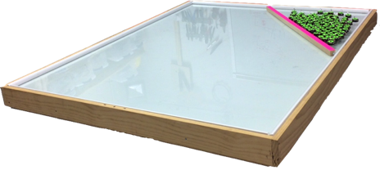
Vision System
30W LED Lights
50W LED Lights
NE
E
N
1.5 m
SE
NW
S
W
SW
1.2 m
1.5 m
Robots
3 cm
Large aspect ratio rectangle
Workspace

