Slide 1

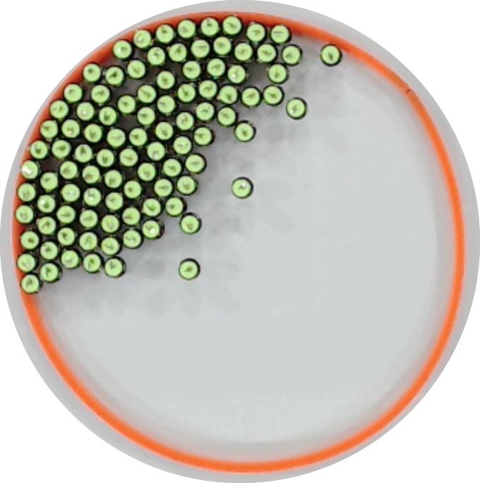
Light direction
β
h=1/8
h=1/2
h=1
h=3/2

