Slide 1
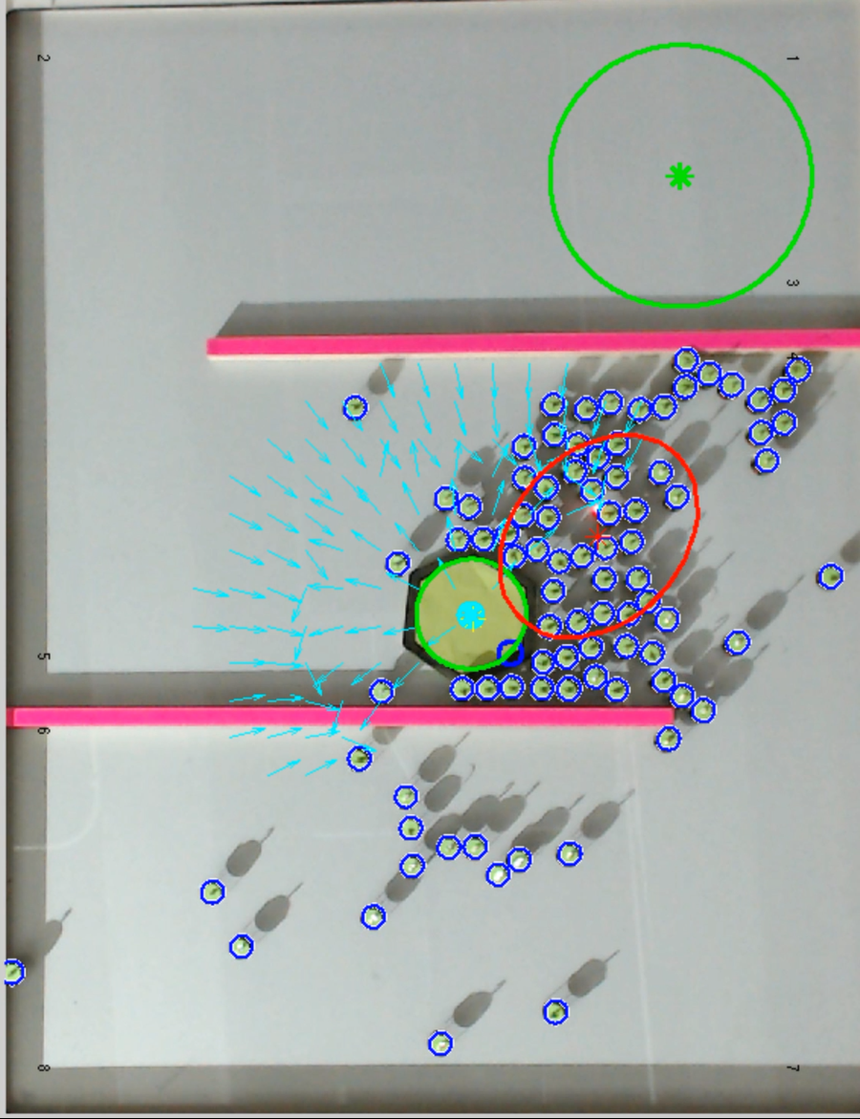
Goal
Robot Mean
Object Centroid / Repulsive Point
Object
95% Confidence Ellipse
Force Vectors
Attractive Point
Robots

