Slide 1
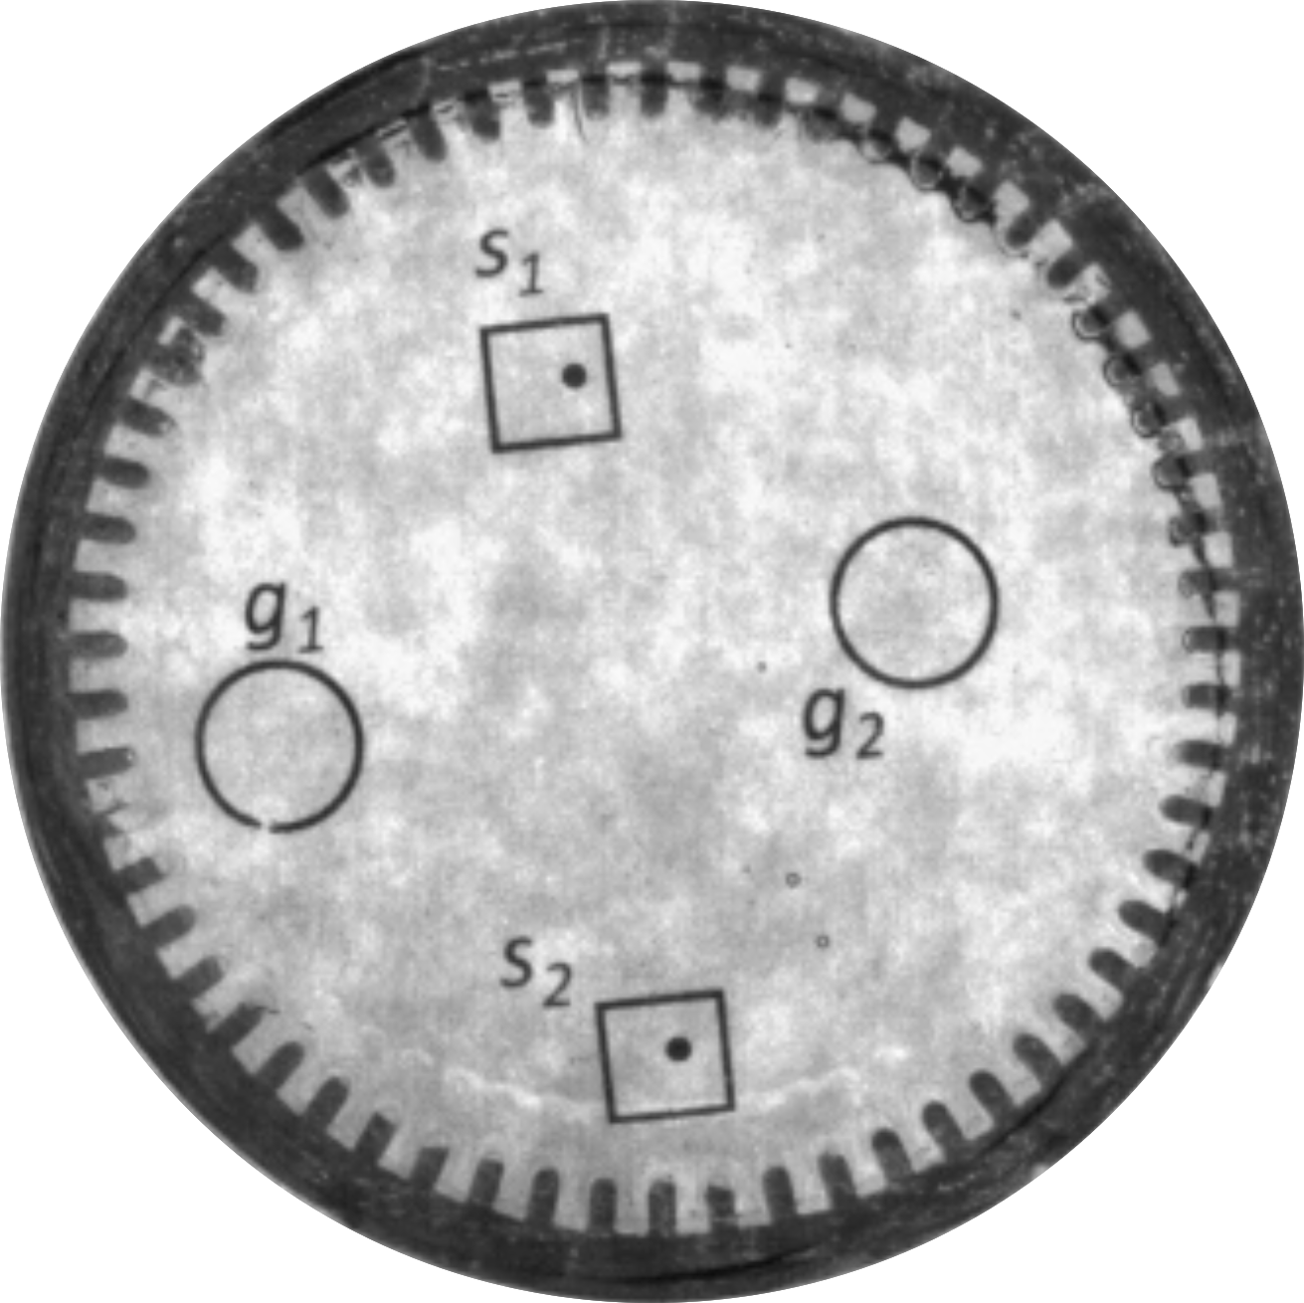
5 mm
0.5 mm
magnets

