Slide 1
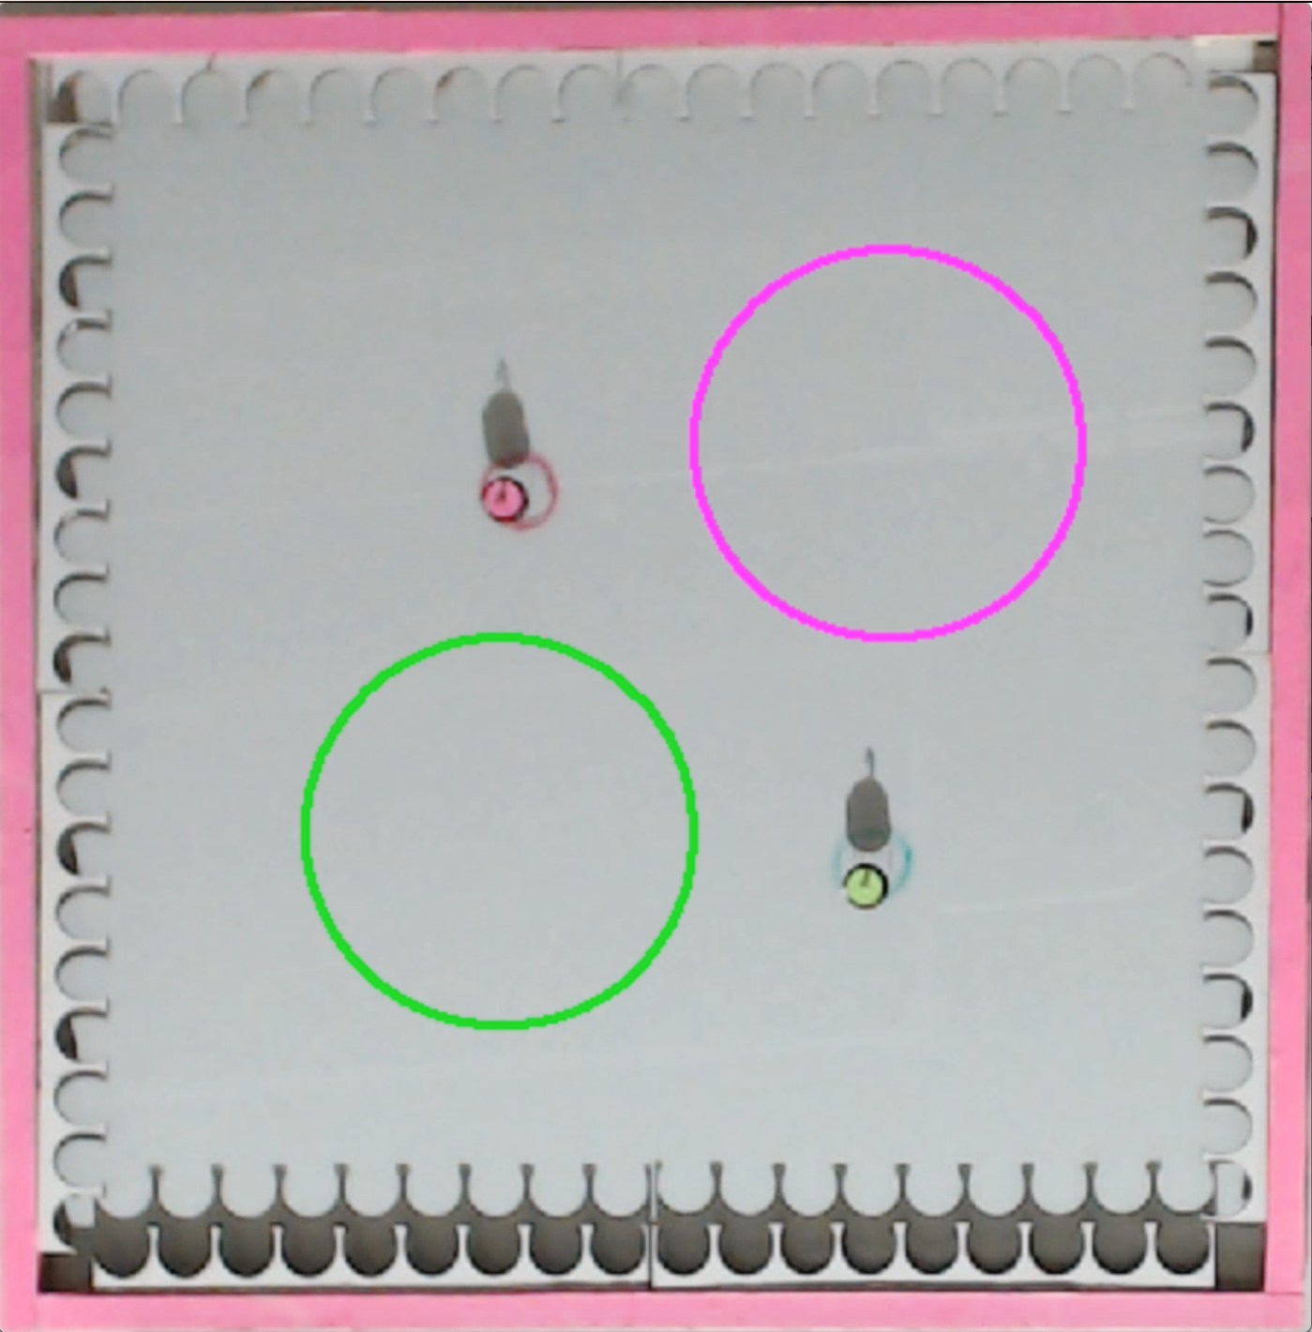
Goal Region: pink robot
Starting position: pink robot
Starting position:
green robot
Goal Region: green robot

