Slide 1
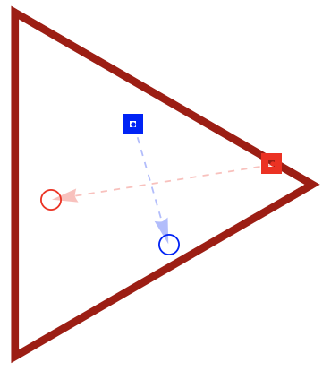
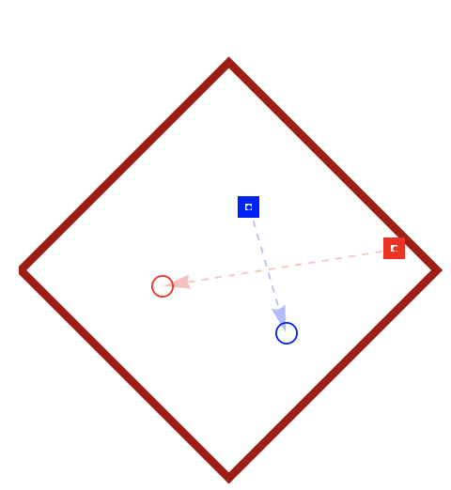
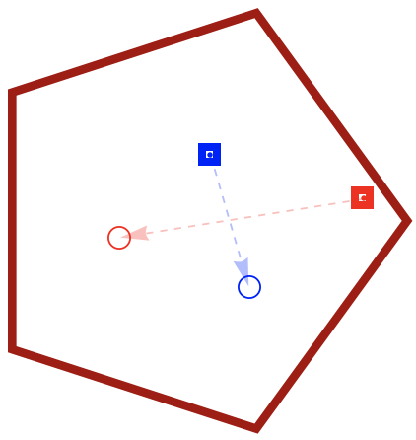
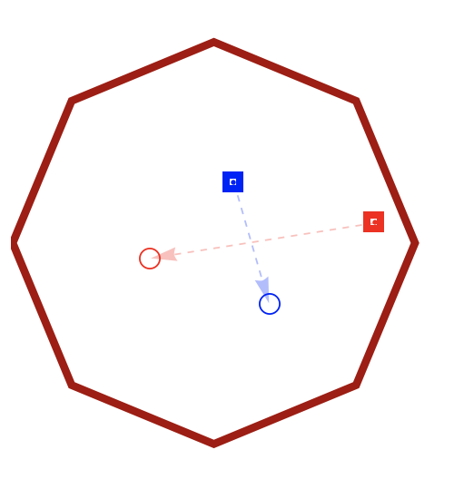
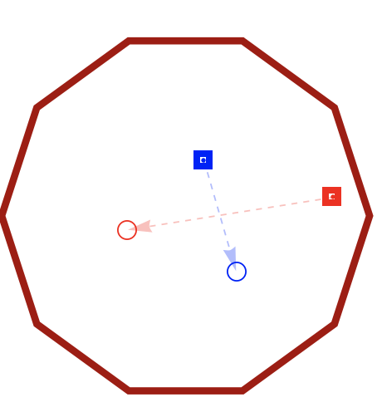
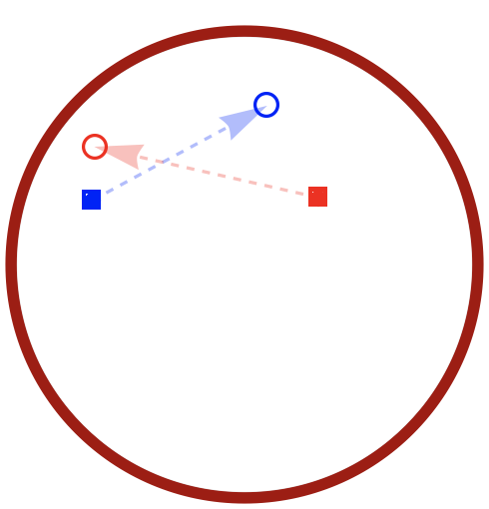


n = 3
Δs = −
2-move reachable set
4-move reachable set
n = 4
6-move reachable set
n = 5
△g_{c}
n = 8
△g_{c}
n = $10$
8-move reachable set
n = $∞$
10-move reachable set

