Slide 1
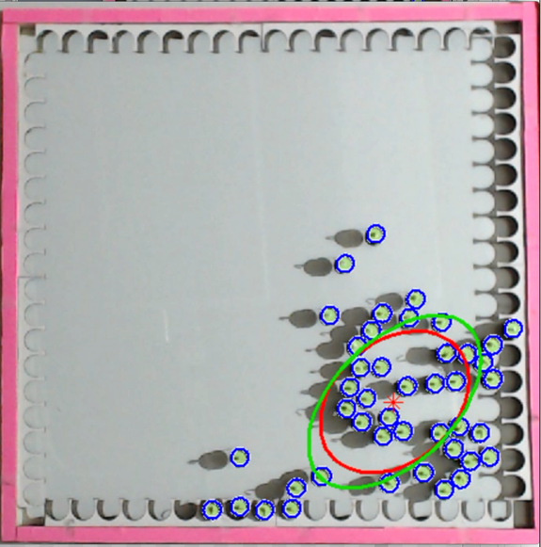
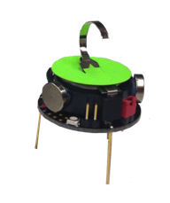
Kilobots with photophile behavior
(global control input)
Distant light
sources
3 cm
3 cm

