Slide 1
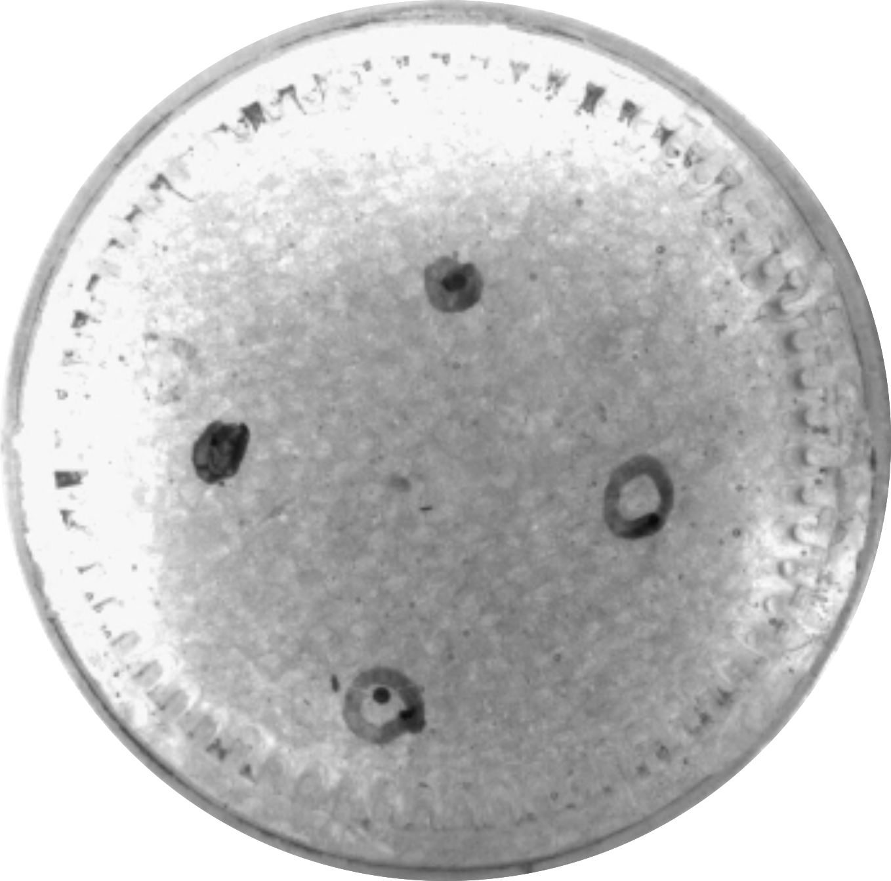
5 mm
P₁ Start
0.5 mm
magnets
P₂ Goal
P₁ Goal
P₂ Start

